Slide 1

The Use of Respirators in the United States
NRT Worker Safety and Health Conference
Jeffrey Peterson, Conformity Verification & Standards Development Branch Chief
National Personal Protective Technology Laboratory
National Institute for Occupational Safety and Health
June 2026
Photo credit: NIOSH

Slide 2
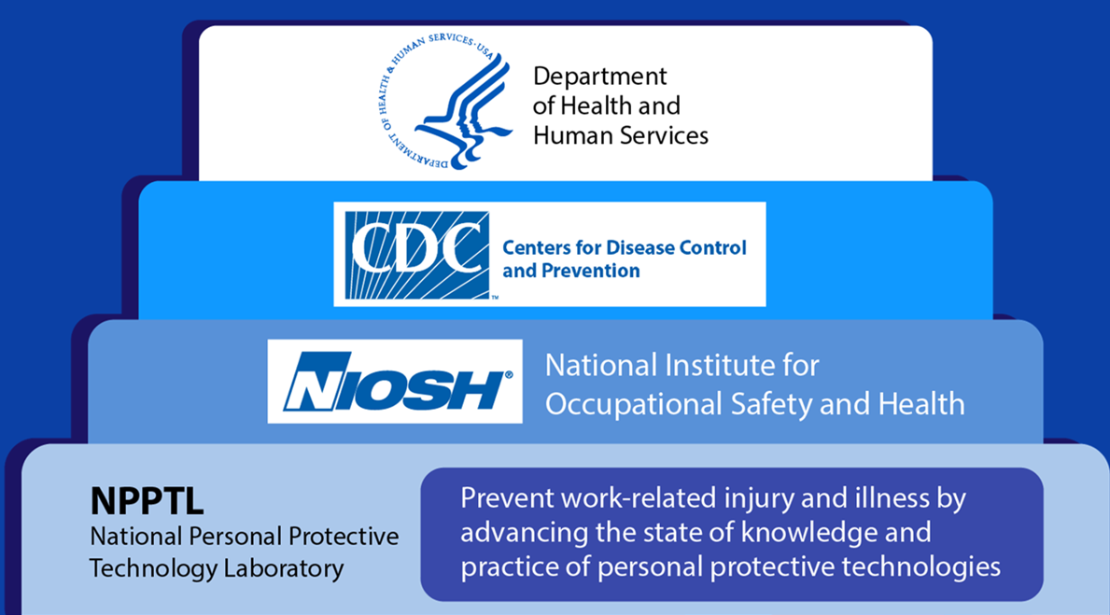
National Institute for Occupational Safety and Health (NIOSH)
CDC/DHHS
NIOSH is the federal institute responsible for conducting research and making recommendations for the prevention of work-related injury and illness.

Slide 3
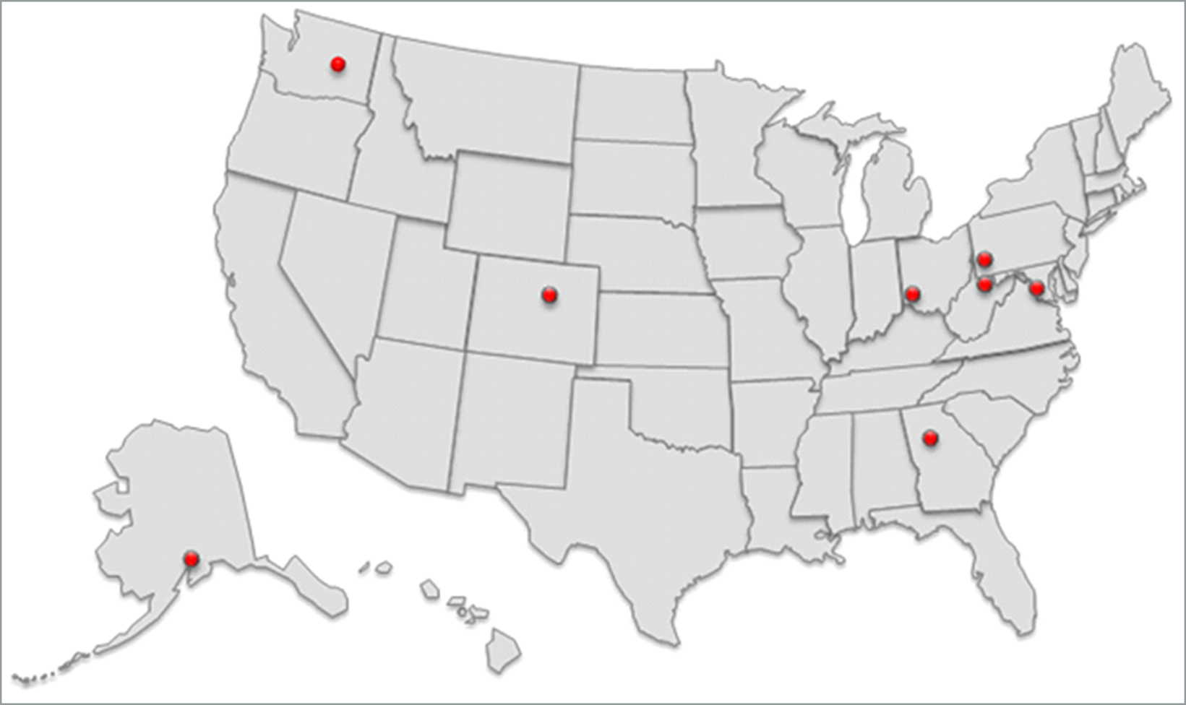
Simple Text Content Slide with Blue Tint Background
NIOSH has 11 research divisions across the U.S.
Spokane, WA
Western States Division
Spokane Mining Research Division
Pittsburgh, PA
Pittsburgh Mining Research Division
National Personal Protective Technology Laboratory
Cincinnati, OH
Division of Field Studies and Engineering
Division of Science Integration
Washington DC
NIOSH OD
World Trade Center Health Program
Denver, CO
Anchorage, AK
Western States Division
Morgantown, WV
Division of Safety Research
National Personal Protective Technology Laboratory
Respiratory Health Division
Health Effects Laboratory Division
Atlanta, GA
Office of Extramural Programs
NIOSH Office of the Director

Slide 4
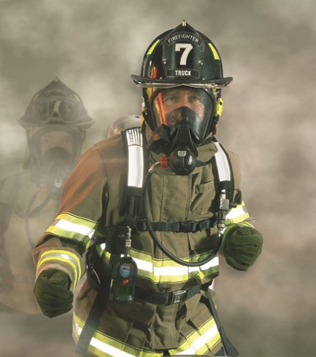
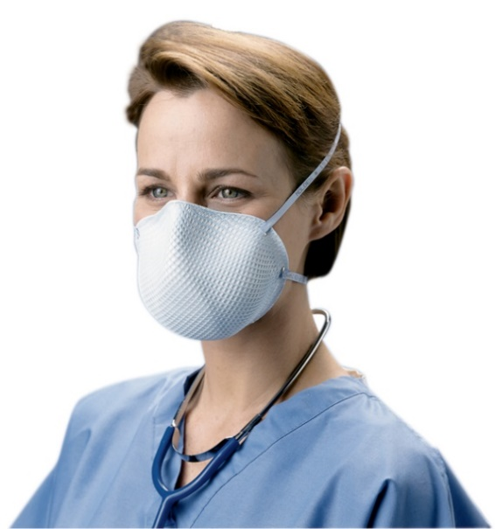
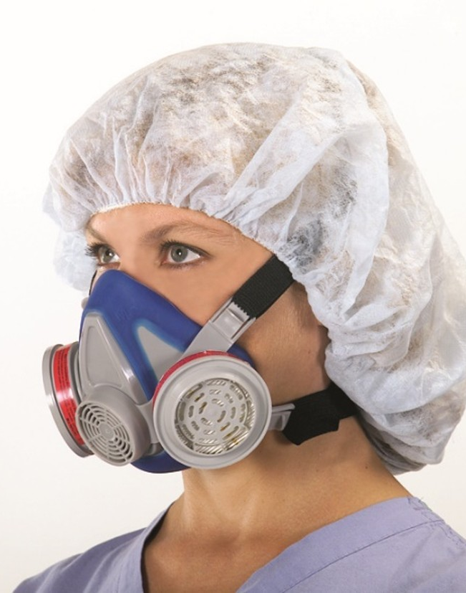
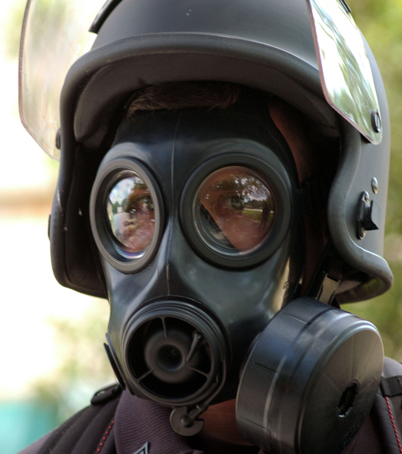
The Respirator Conformity Assessment Program is the NPPTL cornerstone and global “gold standard”
Respirator Approval Program (RAP)
Post Market Evaluations
Brand Protection
Standards Development
Technical Assistance
Share Information
Photos courtesy of Moldex, MSA, Avon

Slide 5





NIOSH approves all types of respirators
OSHA and MSHA oversee workplace compliance
An MOU between NIOSH and FDA delegates NIOSH to approve surgical N95 respirators for use in healthcare settings
Did You Know?
NIOSH, OSHA, MSHA, and FDA have regulatory authorities for respirators in U.S. occupational settings

Slide 6
Updated Respirator Approval Program Metrics
Globally
Over 16,500 approvals issued historically
Approximately 9,700 currently active
97 Approval Holders
202 sites in 32 countries

Slide 7
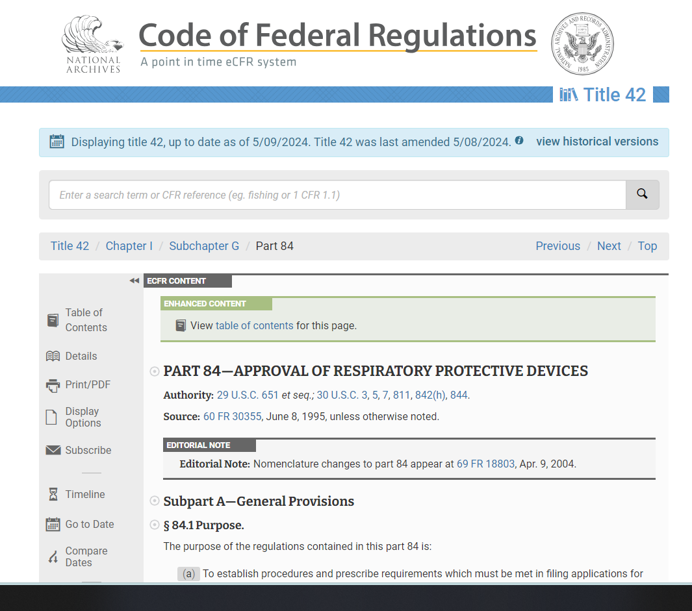
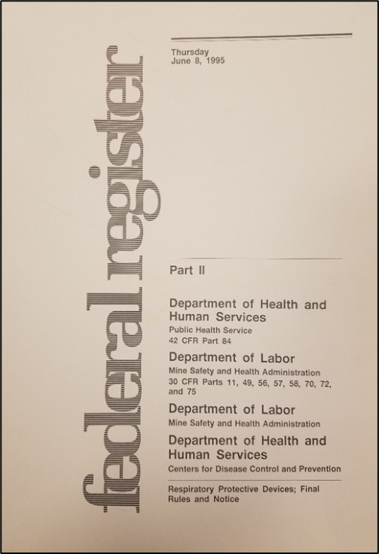
Respiratory Protection and NIOSH Authorities 42 CFR 84
Establishes procedures and requirements for requesting approval
Establishes a schedule of test fees
Describes the criteria for a quality assurance program for manufacturing respirators
Establishes minimum performance requirements
Provides criteria for the issuance of new approvals as well as for modifications of existing approvals

Slide 8
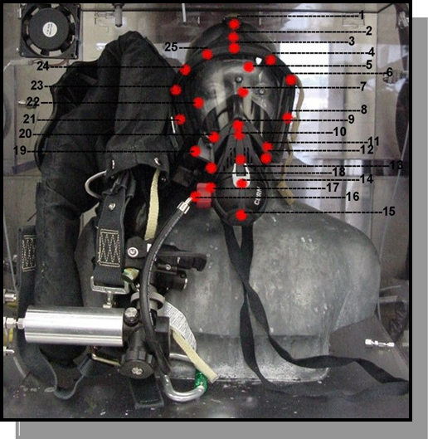
NIOSH Policy Letters: Standards
Statement of Standard: | Date:
CBRN SCBA (13F) (OC, PD, Carbon, 4500-2216 psig) | December 28, 2001
SCBA Upgrade to CBRN Protection | March 11, 2003
CBRN APR (14G) (Full facepiece, tight-fitting) | April 4, 2003
CBRN APER (14G) and SCER (13F) | October 8, 2003
CBRN PAPR (14G) (Full facepiece, tight-fitting) | October 6, 2006
CBRN PAPR (23C) (Loose fitting hood) | October 6, 2006
PAPR Upgrade to CBRN Protection (14G) | October 6, 2006
Notes:
As shown, the existing NIOSH respirator approval process relies on vetted technical performance standards published as federal regulations and adopted consensus standards. CBRN respirator standards were created under the authority of 42 CFR Part 84 and special CBRN respirator policy letters to all respirator manufacturers, A voluntary program, the CBRN respirator statement of standards within the NIOSH approval program are commonly referred to as “being implemented by policy” (letters). Seven actions are shown starting from December 28, 2001 to October 6, 2006. NIOSH developed technical standards that can access the CBRN protection qualities of candidate open circuit, pressure demand SCBA, field deployed SCBA requiring upgrade to NIOSH CBRN protection, full face, tight fitting air-purifying respirator (canister filter media), air-purifying escape respirator – tight fitting air purifying hood and self-contained escape respirator (supplied air), followed by a powered-air purifying respirator standard that addressed full face, tight fitting PAPRs, loose fitting hood PAPRs, and an upgrade capability for full face, tight fitting PAPRs. All of these standards except for the loose fitting PAPR have live agent exposure requirements to liquid blister agent (distilled H series or “HD”) as shown in this image of a live agent test headform with a SCBA test sample mounted and superimposed 25 red dot pattern indicating where HD droplets are to be applied by the toxic agent laboratory technician. It is not an eacy process to submit a commercially available respirator to undergo live agent testing. NIOSH requires a dedicated scientist to conduct initial review actions on the submitted applications from respirator manufacturers. There are six actions the initial reviewer does to ensure a respirator sample is efficiently evaluated.

Slide 9
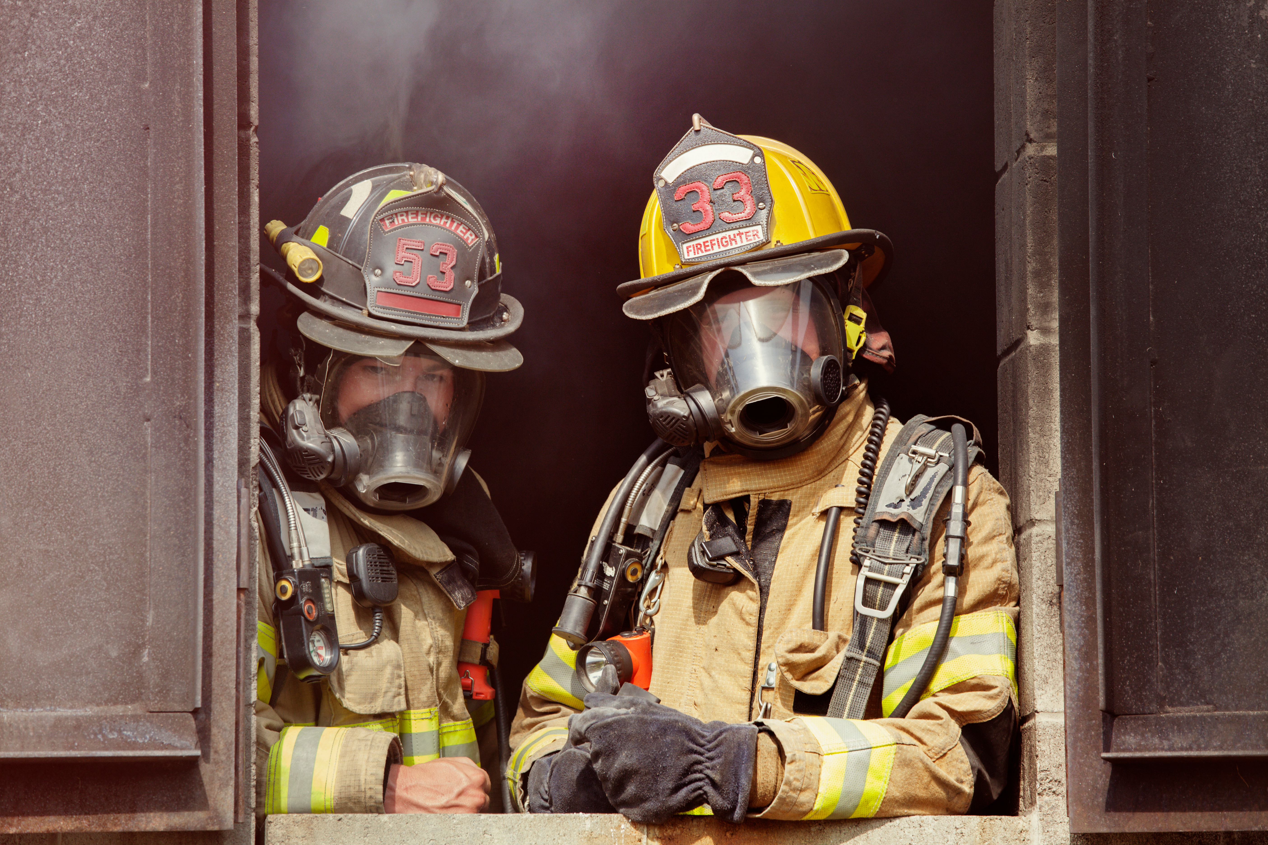
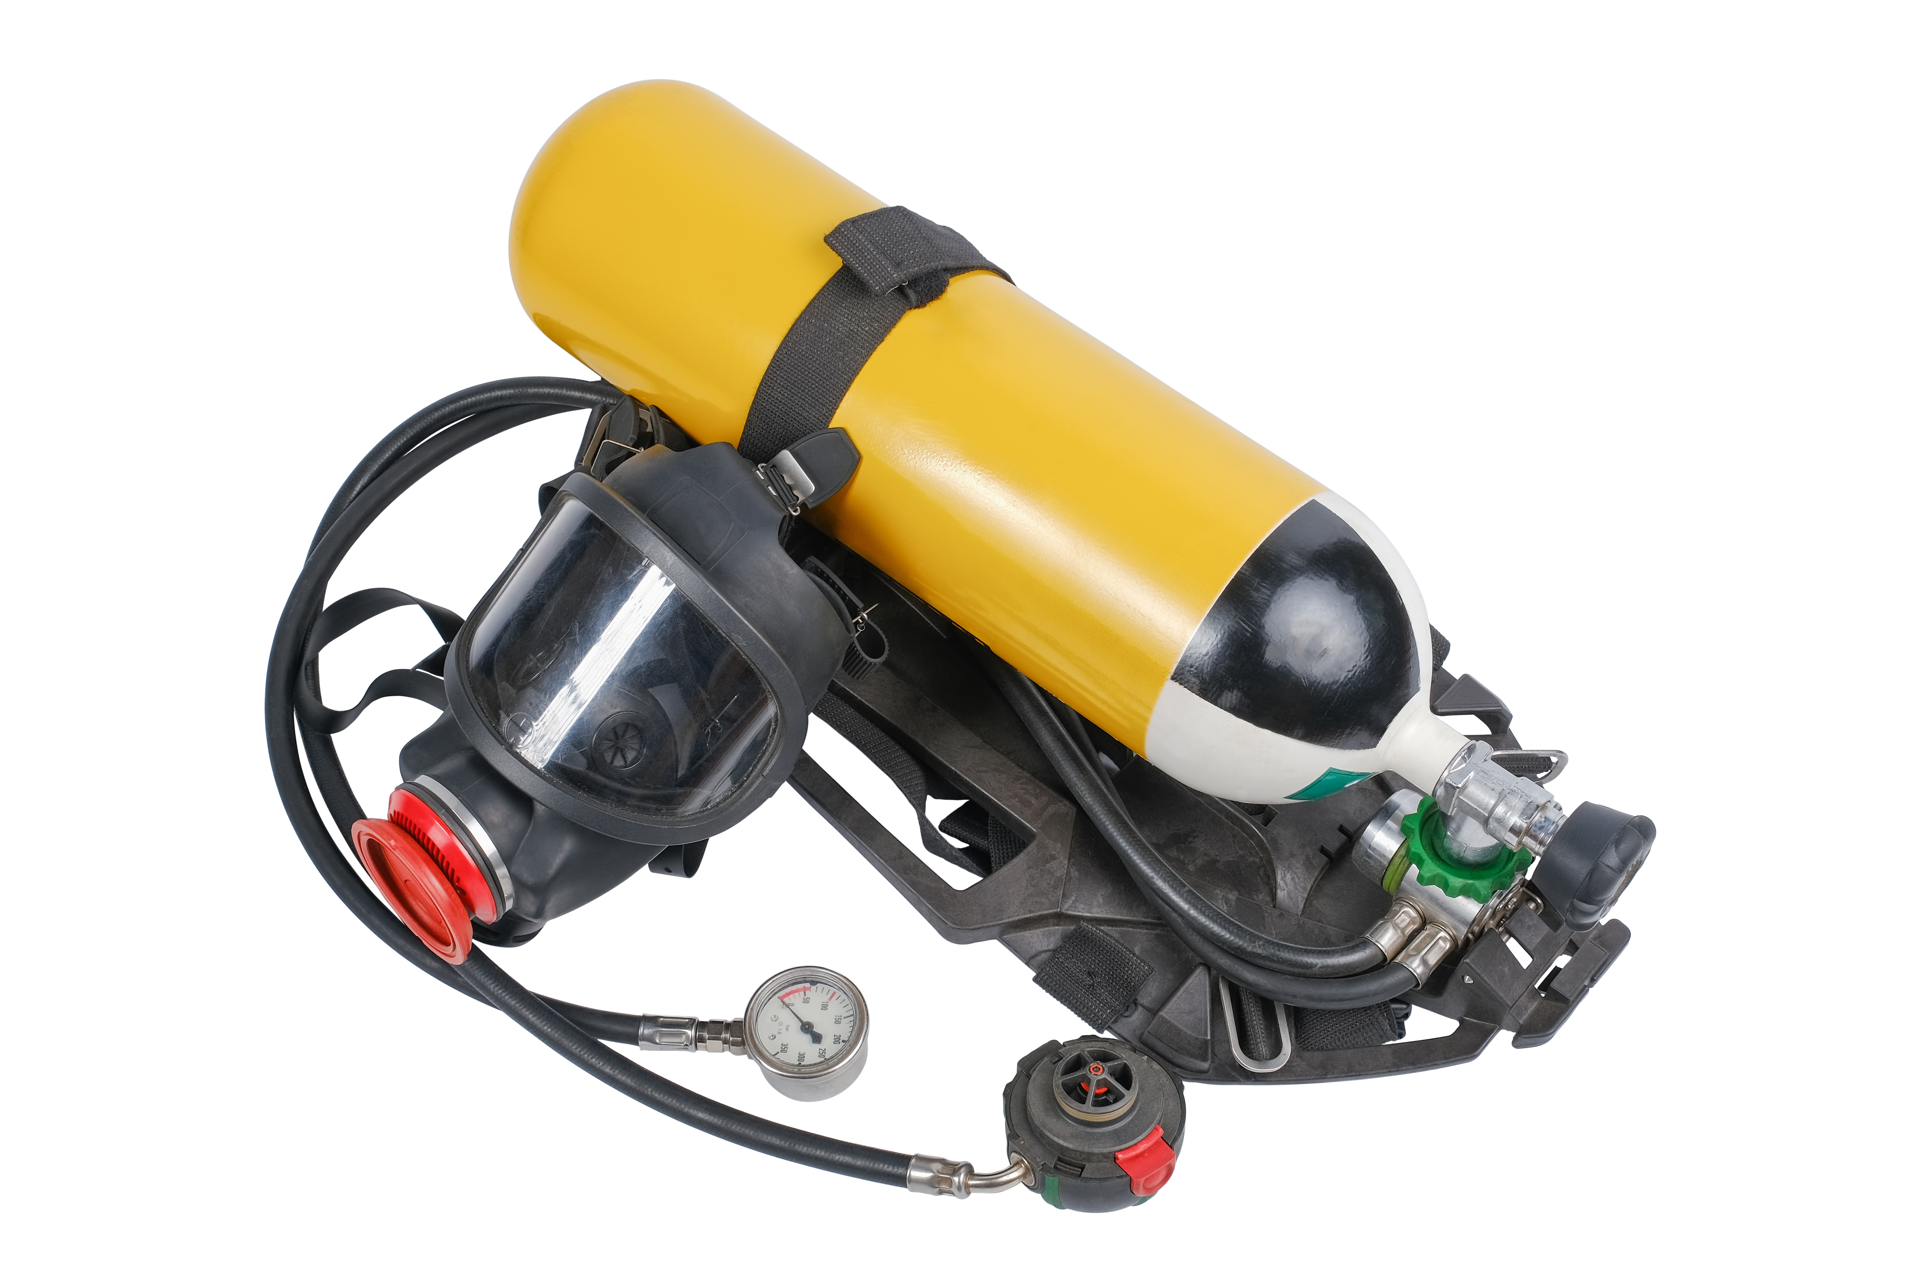
A bit more about NIOSH Authorities
NIOSH approves ‘individual, completely assembled respirators’
  42 CFR 84.30(a)
NIOSH will not issue approval of ‘any respirator component or any respirator subassembly’
  42 CFR 84.30(b)
Concept makes it easy to track actual configurations and identify critical performance characteristics
Photo by Adobe Stock
Photo by Adobe Stock
Notes:
NIOSH approves ‘individual, completely assembled respirators . We don’t approve individual components that make up an approval. An end user can’t mix and match parts and pieces of approved respirators to make their own respirator systems.
We issue new and extensions or modifications to approvals. CA schemes for respiratory protective devices found in other parts of the world do approve components of respirator. NIOSH can only approve complete respirator systems which are not prototypes.

Slide 10
NIOSH Approval Process
Overview
Receiving/Records Room
Initial Engineering, Quality Review and Testing
Issuance of Final Documentation
Site Qualification for New Approval Holder

Slide 11
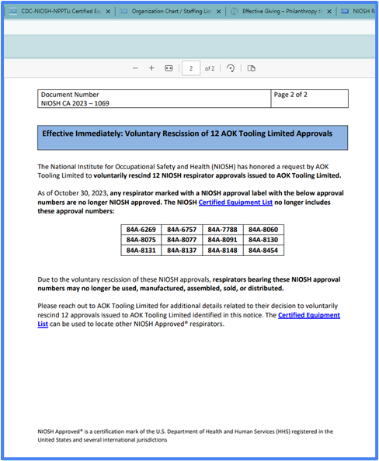
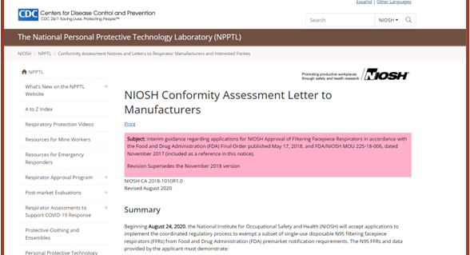
Finding Additional Information
Conformity Assessment Notices inform impacted parties about a variety of topics including processes or procedures used by the RAP, regulatory interpretations or clarifications.
RPD Info Notices inform users about products failures or recalls, rescinded and revoked approvals.
User Notices provided by Approval Holders to inform users of product failures or recalls.

Slide 12
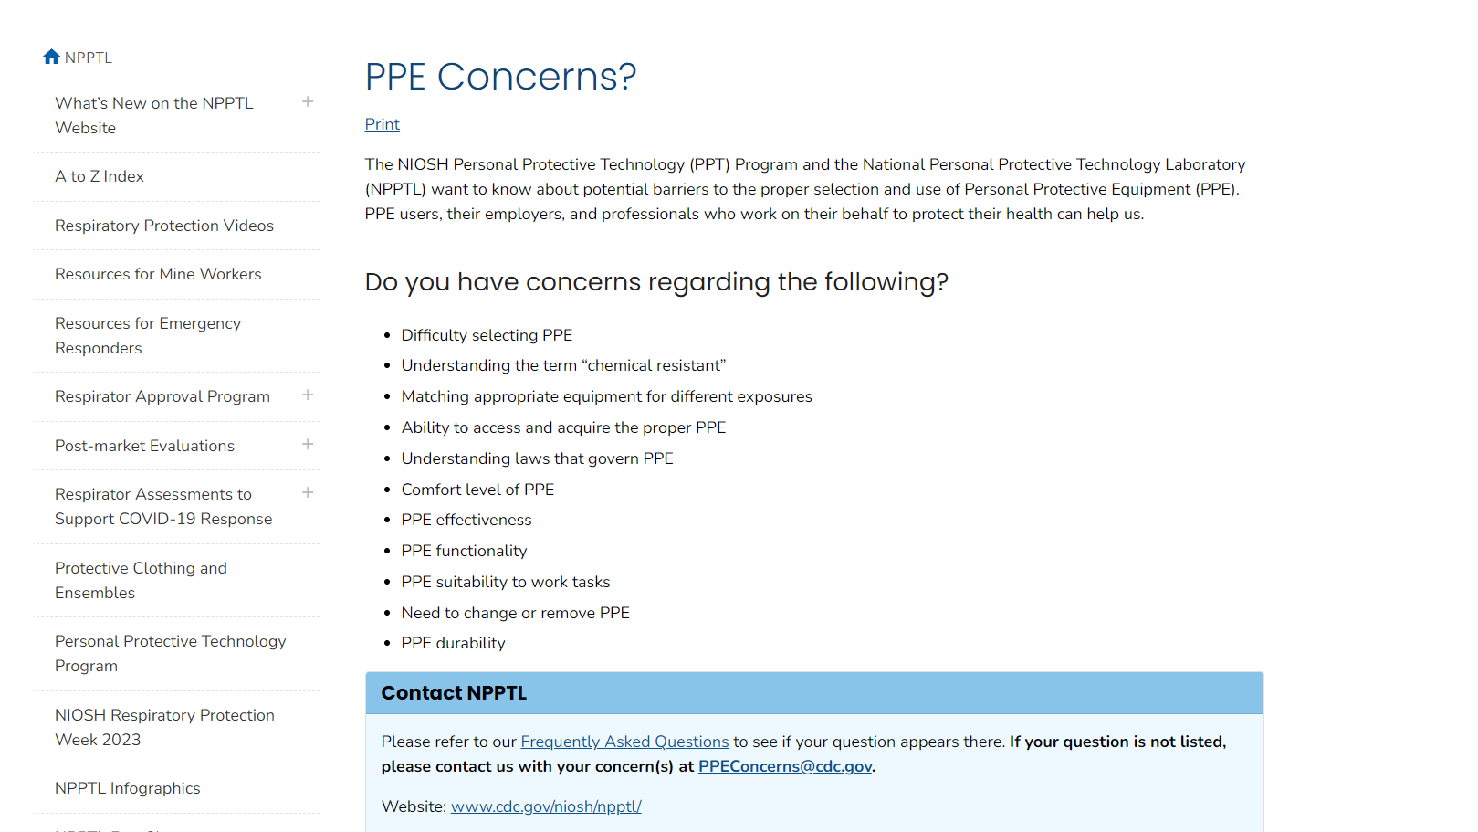

We respond to questions from PPEConcerns@cdc.gov
Notes:
NIOSH also has the PPEconcerns@cdc.gov mailbox. This is an avenue for people to reach out to NIOSH to ask any questions they may have about personal protective equipment. NIOSH will provide the sender with detailed responses provided by subject matter experts.
I will hand over the presentation to Aaron Reeder who will provide you with information about the various testing NIOSH conducts to evaluate respirators. Aaron the floor is yours.

Slide 13
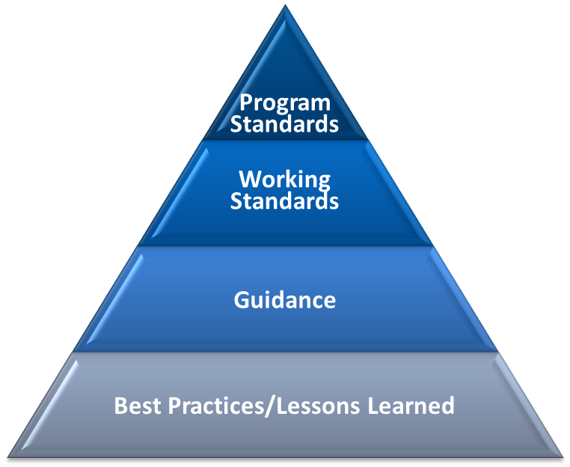
Regulatory and Standard Development Priorities
Specific to 42 CFR 84
  Requirements for Combination Unit Respirators, NFPA 1987
  Requirements for Respirator Fit Capability, Air-Purifying Particulate-only Respirators
  Fee Update
National Fire Protection Association
  NFPA 1984
  NFPA 1970 (formerly NFPA 1981)
  NFPA 1852
ASTM International
  Barrier Face Coverings ASTM 3502
  Respirator Fit Capability ASTM 3407

Slide 14

Post-Market Activities
Ensure NIOSH Approved respirators continue to be manufactured according to the approval holder’s quality system, perform according to NIOSH standards, and protect the respirator user as intended
Photo by Adobe Stock

Slide 15
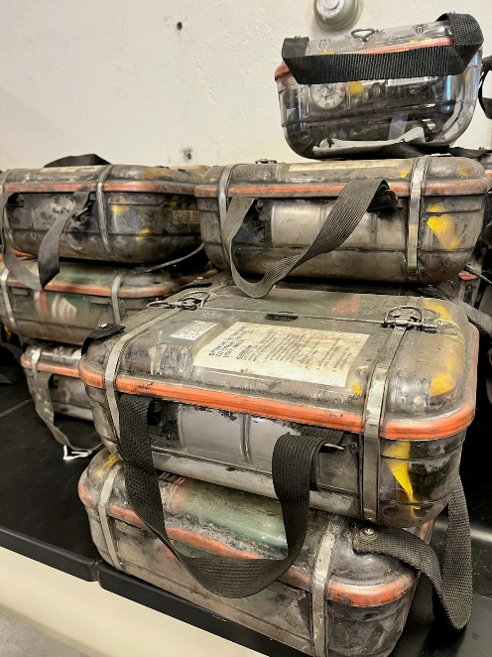
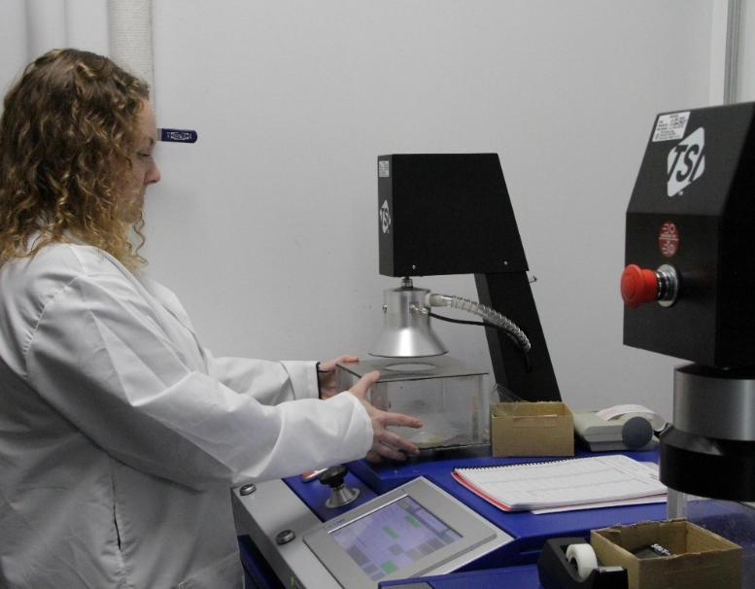


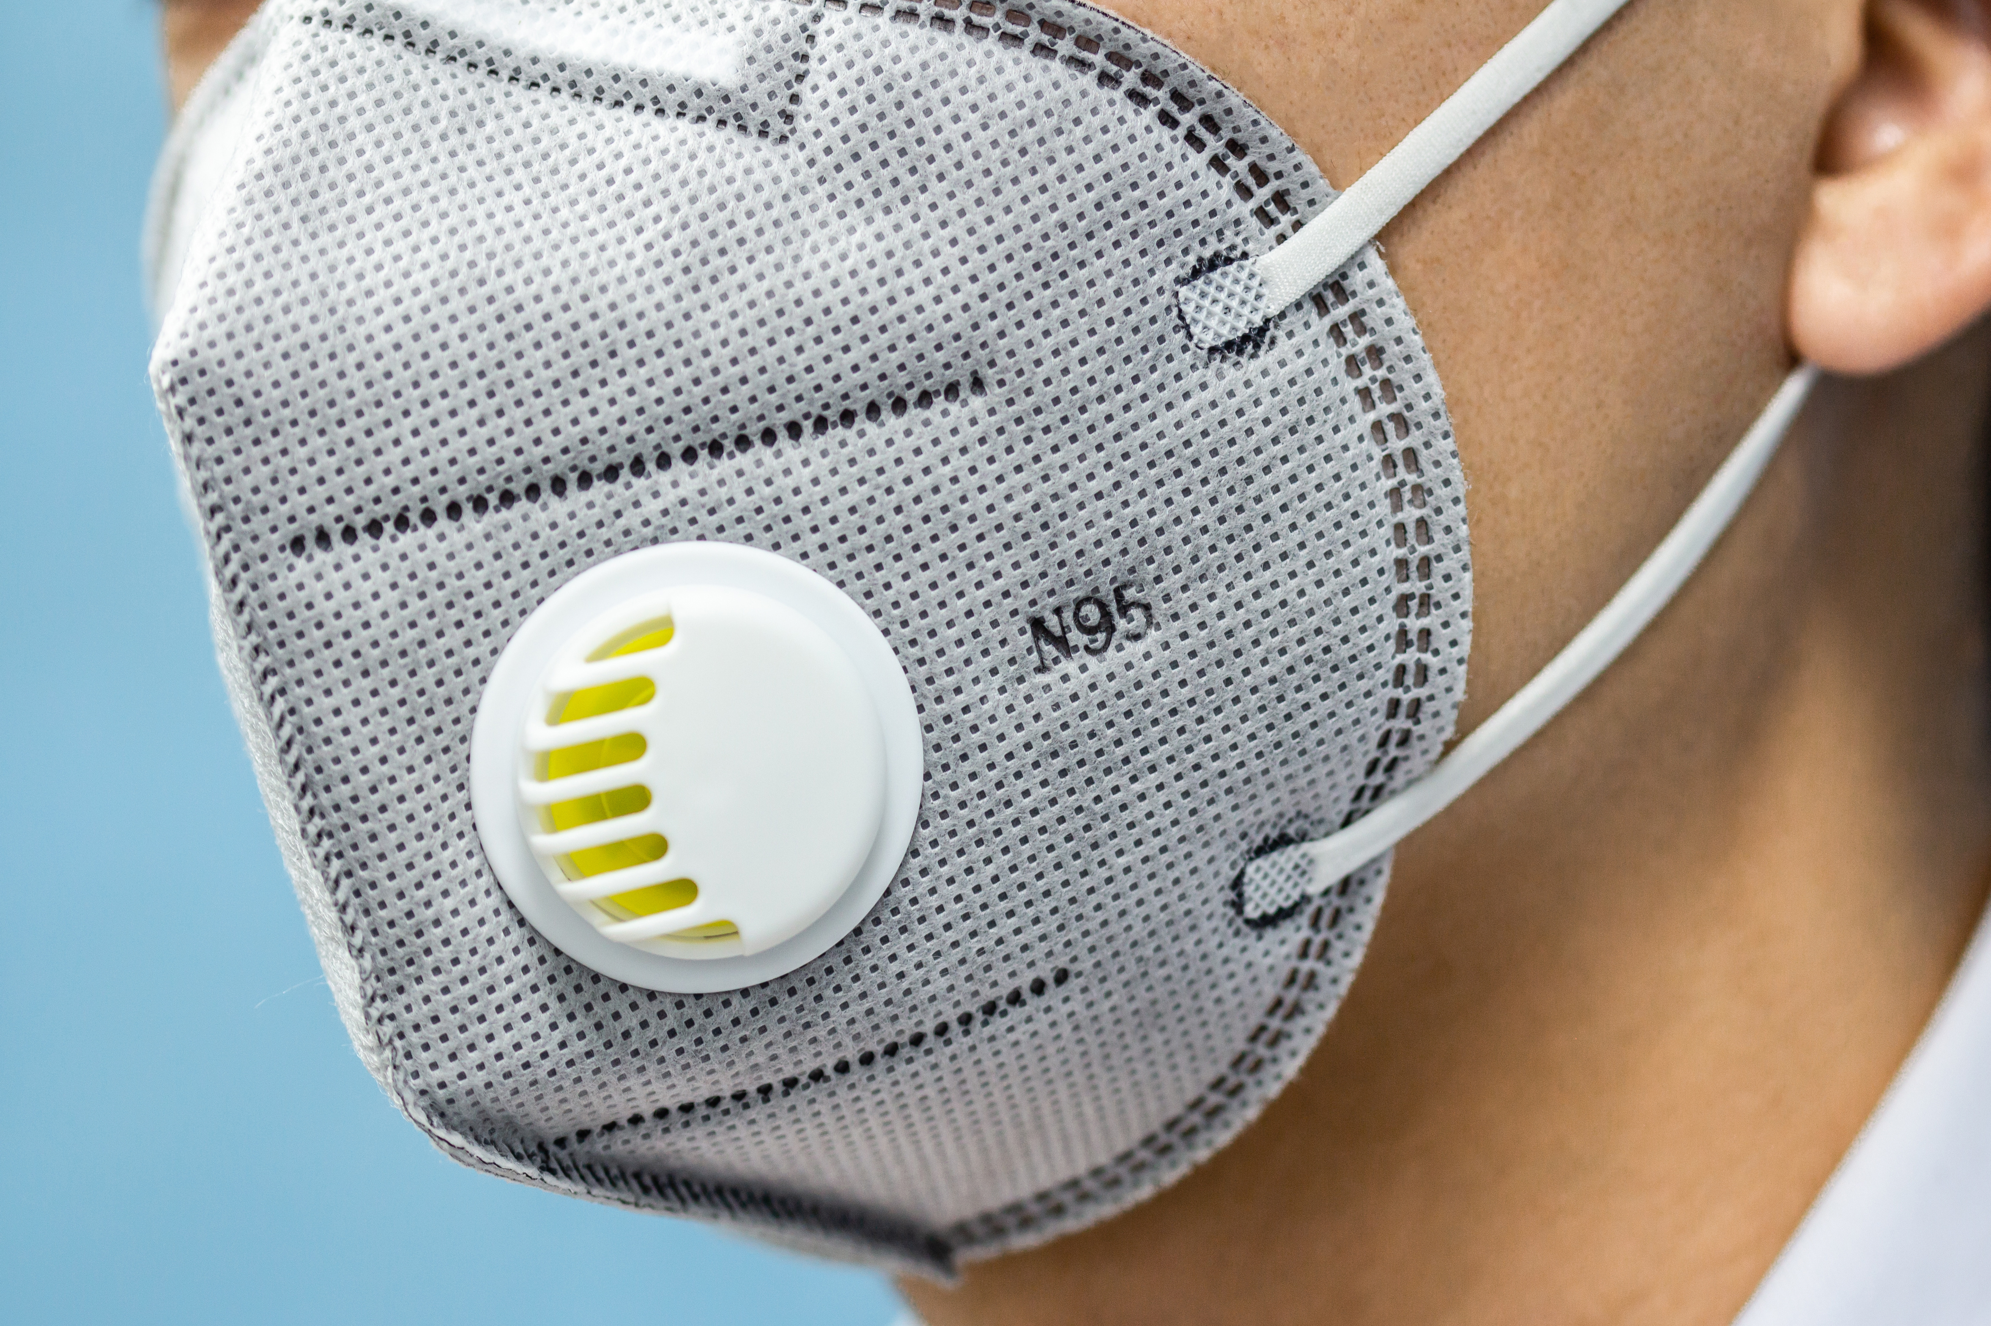
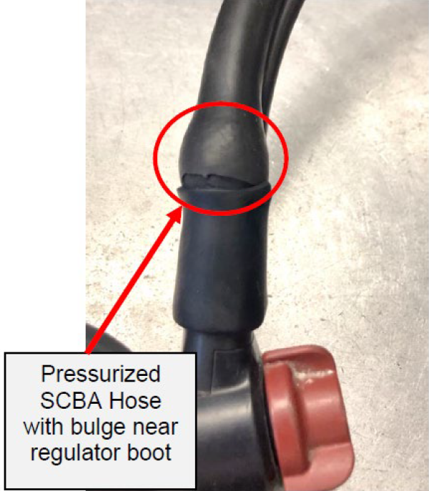

Photo by NIOSH
Photo by NIOSH
Product Audits
Site Audits
Sampling and testing fielded escape respirators from US mines and the US Navy
Photo by NIOSH
Photo by NIOSH
Photo by Adobe Stock
SCBA testing for NIOSH’s Fire Fighter Fatality Investigation and Prevention Program
Nonconforming Respirator Investigations
Brand protection

Slide 16
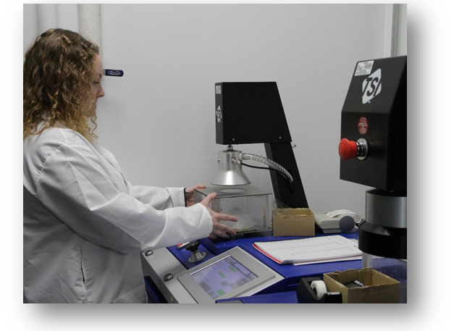

Product Audits and Site Audits
Product Audits
  Conducted for approval holders annually to verify the performance and/or documentation of new (unused) commercially available NIOSH Approved respirators
    Visual inspections (e.g., proper labeling)
    Product performance
    If nonconformances are found→ Nonconforming Respirator Investigation (NRI)
Site Audits (domestic and international)
  Conducted for NIOSH approval holders every ~two years to ensure their quality management systems continues to meet our requirements
    Inspect the facilities and records, and interview employees to evaluate the quality system in place
    Verify that the approval holder’s quality system is acceptable, effective, and operates as described in the documentation on file;
    Safeguard that the manufactured product continues to meet NIOSH performance requirements;
    If nonconformances are found→ corrective actions and other actions up to and including revocation
Photo by NIOSH
Photo by Adobe Stock

Slide 17
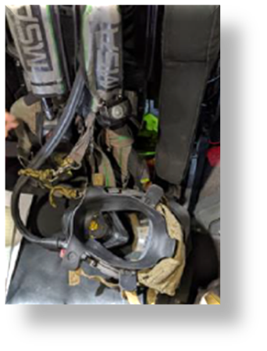
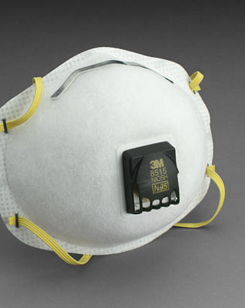
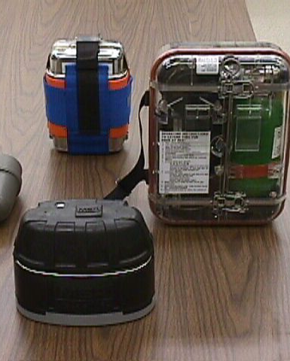
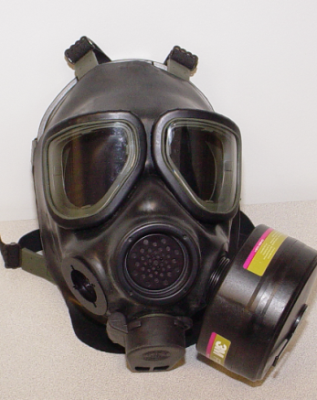
Nonconforming Respirator Investigations (NRI)
Photo by NIOSH
Nonconformance examples
  Performance or test failure identified during any NIOSH evaluation (such as a NIOSH product audit),
  Improper documentation or product labeling, such as products sold with an unapproved private label entity, or
  Misleading advertising by the Approval Holder, such as making false protection claims.
NIOSH Approval Holder Actions (reviewed by NIOSH)
  Investigate to determine root cause
  Determine how widespread the problem is
  Develop corrective actions
Photo by NIOSH
Photo by NIOSH
Photo by NIOSH

Slide 18

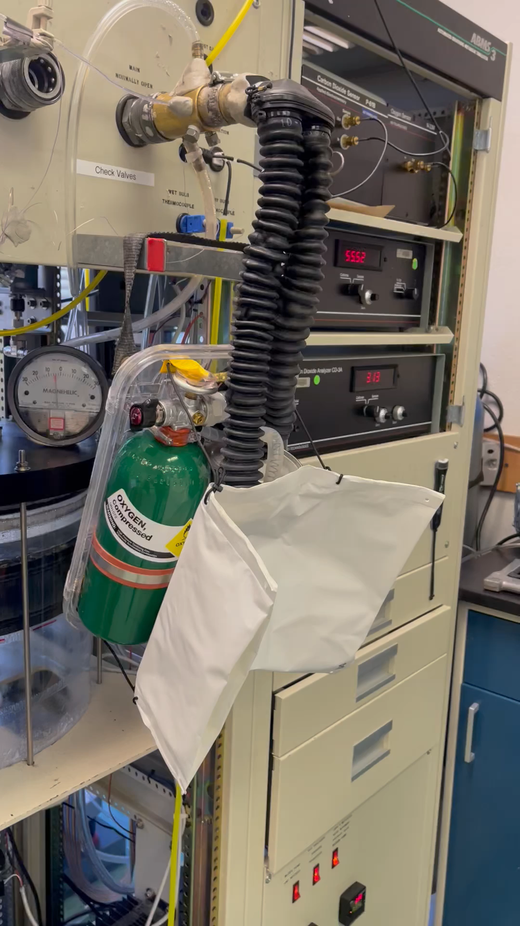
Long-Term Field Evaluation (LTFE) Program
Respirators sampled from mines
  Sample and test NIOSH Approved Subpart O and Subpart H closed-circuit escape respirators that are deployed in underground coal mines around the United States
  Testing confirms if the respirators meet the required performance characteristics and provides information on possible degradation due to the physical stresses of in-mine use
Respirators sampled from ships
  Support the U.S. Navy with point-of-use sampling and testing of emergency escape breathing devices (EEBDs)
  Testing confirms if the respirators meet the required performance requirements and provides information on possible degradation due to the physical stresses of vessel storage
Photos by: NIOSH
  Recent reports can be found on the NIOSH PPE CASE Reports webpage under “Performance of Escape Respirators Used by Mine Workers” and “Performance of Escape Respirators Used by U.S. Navy Personnel”

Slide 19
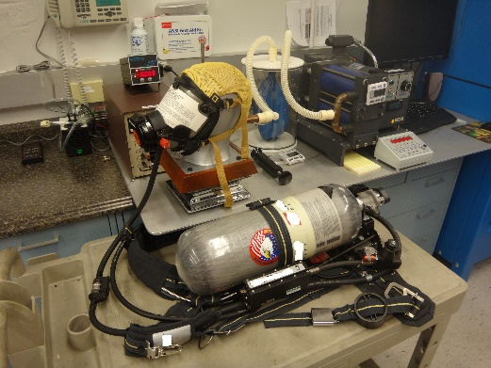
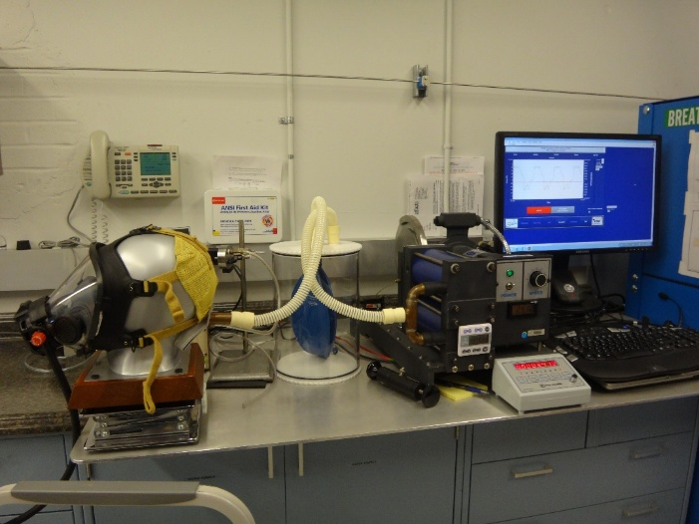

Fire Fighter Fatality Investigation and Prevention Program Support
Support the NIOSH Fire Fighter Fatality Investigation and Prevention Program (FFFIPP) by evaluating NIOSH Approved self-contained breathing apparatus (SCBA) involved in a fire fighter fatal event
Conduct tests to determine if the SCBA meets NIOSH performance requirements and to provide information on whether the SCBA may be a contributing factor to the fatality
Utilize findings to support revisions to industry standards, develop future research, and educate the fire service
FFFIPP SCBA investigation reports can be found on the NIOSH PPE CASE Reports webpage.
Photo Credits: NIOSH

Slide 20
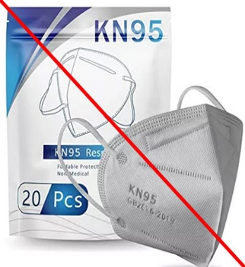
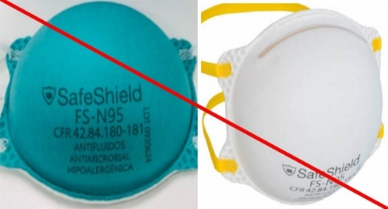
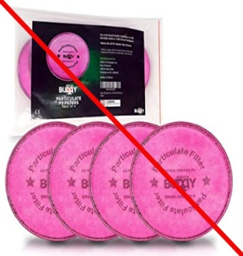
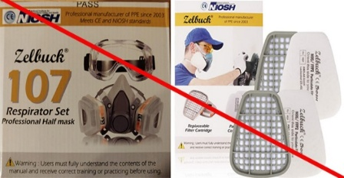
NIOSH Brand Protection Efforts
Registering
Registering certification marks with…
US Customs and Border Protection (CBP)
Monitoring
Monitoring certification marks on…
US marketplace platforms
Enforcing
Enforcing certification marks by…
Requesting listing takedowns
US Patent and Trademark Office (USPTO)
Working with CBP to verify and seize “suspect” respirators at the borders if needed
Photos by NIOSH
Notes:
The BP efforts started in 2020 when NIOSH became aware of fraudulent respirators on the open market. We counteracted this by registering NIOSH certification marks.

Slide 21


Combatting Suspect Respirators
N95®
N99®
N100®
R95®
P95®
P100®
PAPR100-P®
HE®
NIOSH Approved®
NIOSH stylized logo with text:
NIOSH stylized logo without text:
PAPR100-N®
Registered Certification Marks
Only NIOSH approval holders are permitted to use these marks
*N95 and NIOSH Approved are also registered in 13 other countries
Notes:
The first certification mark registered was NIOSH Approved in November 2020. To date, NIOSH has registered 12 respirator certification marks.

Slide 22
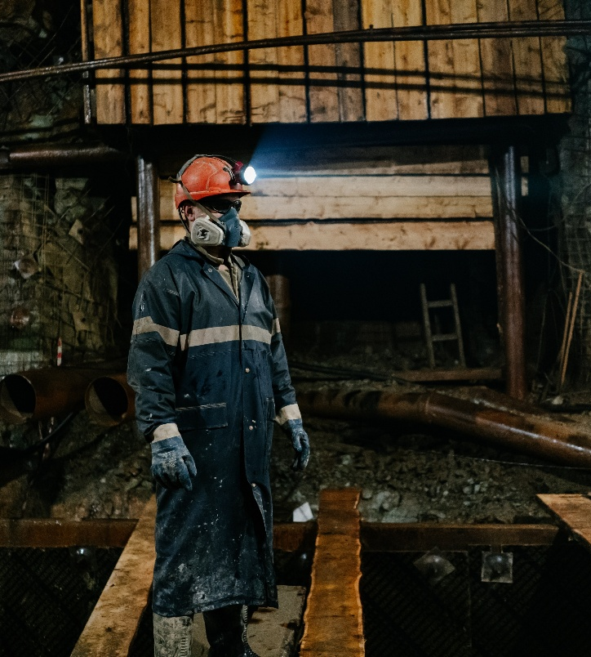

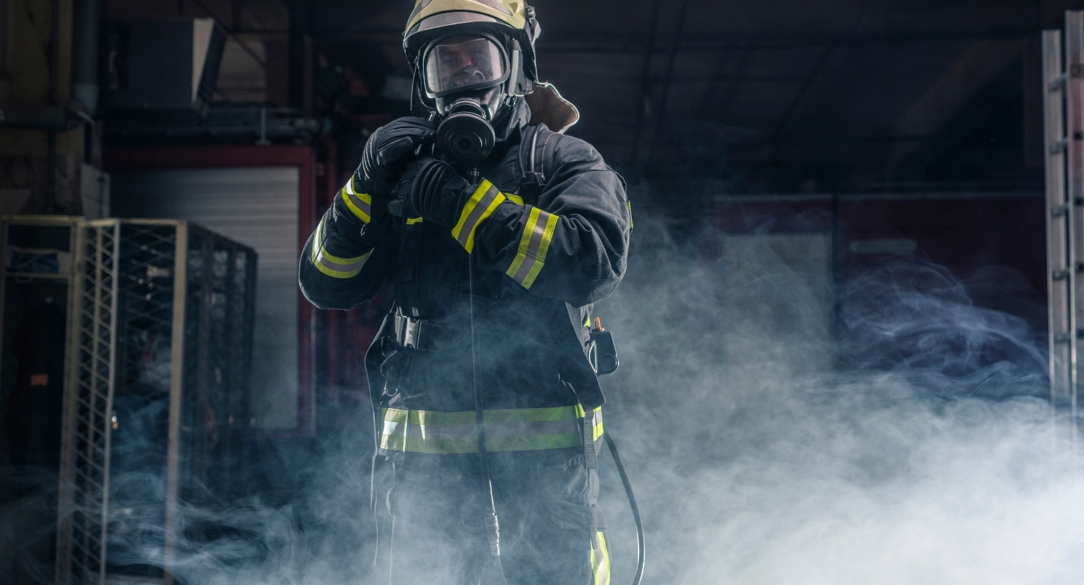
An Introduction to Respirator Basics
Understand the different types of respirators
Develop an understanding of how different types of respirators work
Understand terminology and performance associated with different types of respirators
Photo by Adobe Stock
Photo by Adobe Stock
Photo by Adobe Stock

Slide 23
How the Respirator Provides Clean Air
Air-Purifying Respirators
Purify contaminated air by filtration, absorption or chemical reaction to make it suitable for breathing.
Atmosphere-Supplying Respirators
Provides breathing gas from a source independent of the surrounding atmosphere.

Slide 24

Respirator Types
Air Purifying Respirators – Non-powered and Powered
Particulate Filtering
Gas / Vapor Removing
Combination Gas/Vapor and Particulate Filtering
Approved under Schedule 21C, 23C and 84A
Entry vs Escape
Certain types of respirators with tight fitting facepieces can be utilized for entry into non-IDLH environments as well as escape from IDLH environments
Approved under Schedule 14G

Slide 25
Respirator Inlet Coverings for Air-Purifying Respirators
Non-powered – tight fitting
  Filtering Facepiece Respirator (FFR)
  Mouth-bit
  Quarter Mask
  Half Mask
  Full Facepiece
Powered – tight or loose fitting
  Half Mask
  Full Facepiece
  Hood
  Helmet

Slide 26
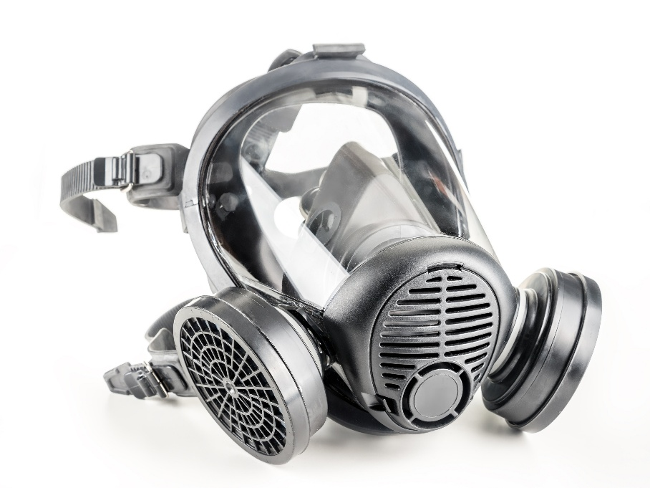

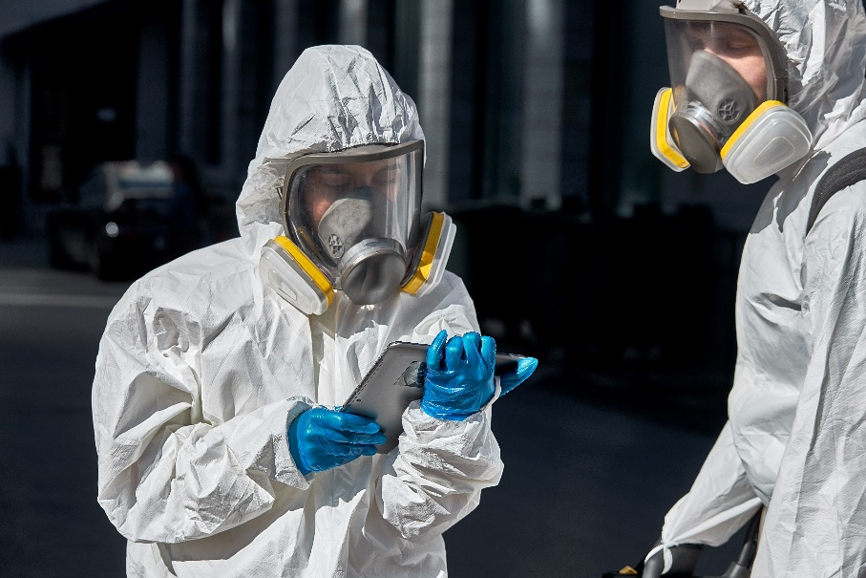
Full Facepiece, Air-Purifying Respirators: APR and PAPR
Examples
Photo by Adobe Stock
Photo by Adobe Stock
Photo by Adobe Stock

Slide 27
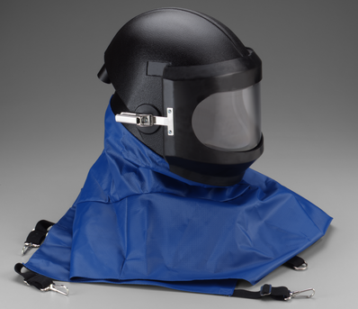
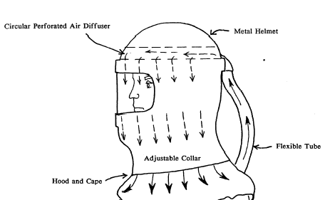
Loose-Fitting Helmet PAPR
Circular Perforated
Air Diffuser
Metal Helmet
Flexible
Tube
Adjustable Collar
Hood and
Cape
Photo by 3M
Illustration by NIOSH

Slide 28
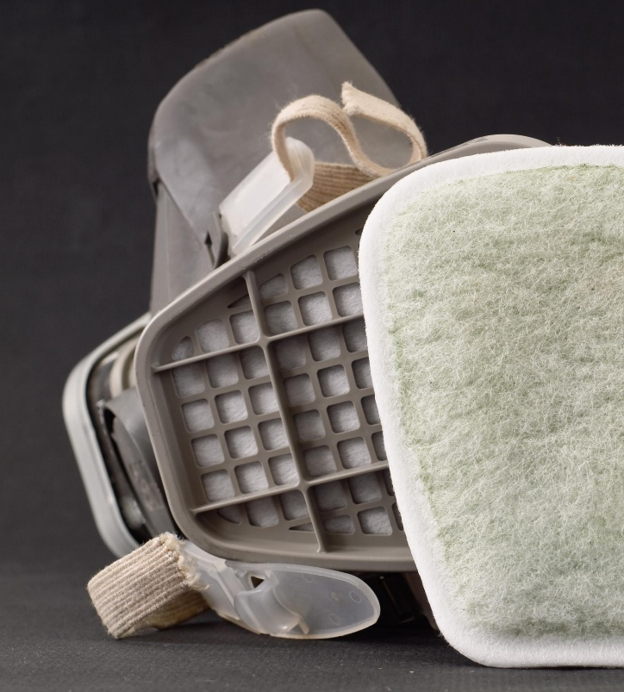
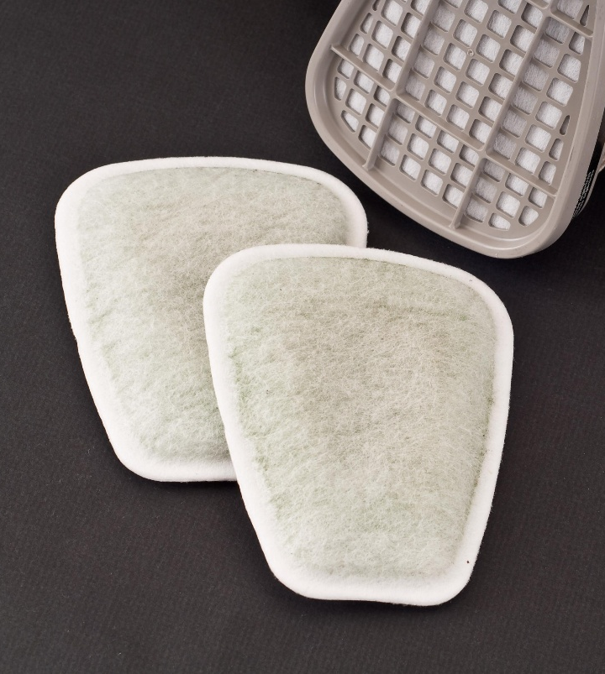

Filters for Particles
Dusts - solid particles usually generated by mechanical stress
Fumes - solid particles generated by condensing a gas or by chemical reaction, usually refers to metals
Mists - suspended liquid droplets
Photo by Adobe Stock
Photo by Adobe Stock
Photo by Adobe Stock
Notes:
Jeff

Slide 29
Filtration Efficiency
Non-powered particulate filters are classed as N, R, or P combined with 95, 99, or 100
N - Not resistant to oil mist
R - Resistant to oil mist
P - Protective against all particulates
95, 99, 100 - approximate filter efficiency against worst case particle size
Powered particulate filters are classed as
HE
PAPR 100P
PAPR 100N
Notes:
Jeff

Slide 30
Gases and Vapors
Cartridges and Canisters
for
NIOSH approval is issued for specific gases:
  Ammonia
  Methylamine
  Chlorine
  Sulfur Dioxide
  Hydrogen Chloride
  Hydrogen Sulfide
  Formaldehyde
  Chlorine Dioxide
  Chloroacetophenone (CN)
  Chlorobenzylidene Malononitril (CS)
  Hydrogen Fluoride
  Methylamine
  Phosphine
  And others

Slide 31
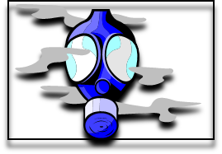
CBRN APR Test Representative Agents (TRA): 7 TRA “Families”
Organic vapor family: 109 compounds with vapor pressures less than cyclohexane. TRA is cyclohexane
Acid gas family: 48 compounds covered by the TRAs of SO2, H2S, CNCL, COCL2 and HCN
Base gas family: 4 compounds covered by TRA of NH3 (ammonia)
Hydride family: 4 compounds covered by the TRA of phosphine
Nitrogen oxide family: 6 compounds covered by the TRA of nitrogen dioxide
Formaldehyde family: 1 compound and it is covered by the TRA of formaldehyde
Particulate family: 56 particulates covered by the TRA of DOP
Notes:
Families, as in “like toxic industrial chemicals (TIC)” that have similar vapor pressures etc….

Slide 32
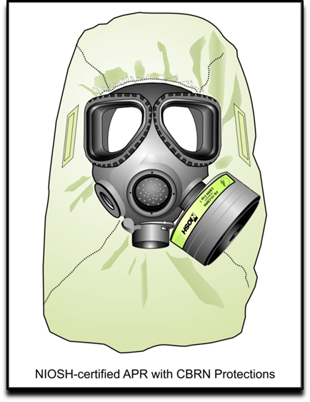
CBRN APR LAT: Full face, tight fitting
8 hours of GB LAT
8 hours of HD vapor LAT
2 hours of HD liquid LAT at six hour mark of 8 hour duration
Laboratory respirator protection level (LRPL) corn-oil QNFT per UI
Durability conditioning & human factors analysis per UI
Plus toxic industrial chemical (TIC) test representative agent (TRA) service life tests on filtration media
.
Notes:
There are no NFPA standards for APR. NIOSH incorporated existing public health 42 CFR Part 84 industrial standards as the baseline requirements for CBRN APR specifications. In addition to those baseline industrial requirements, NIOSH vetted and created special tests that incorporate chemical warfare agent penetration and permeation challenges from GB, (at APR use challenge concentrations), HD, and corn oil particulate as well as special rough handling conditioning, human factors analysis and individual filtration media service life testing against representative industrial chemical compounds that make up seven test representative agent families within NIOSH’s TIC/TIM CBRN APR service life test protocols.

Slide 33
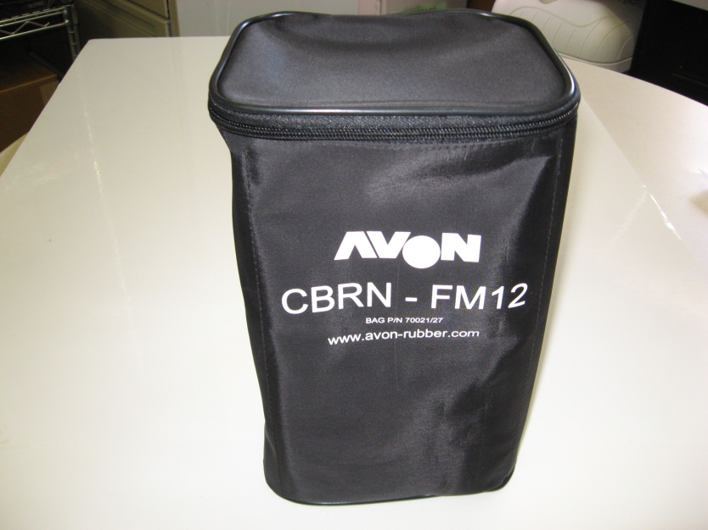
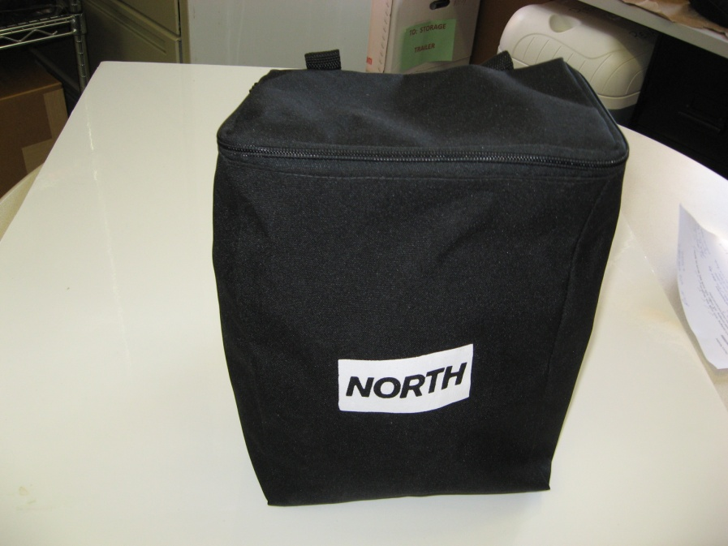
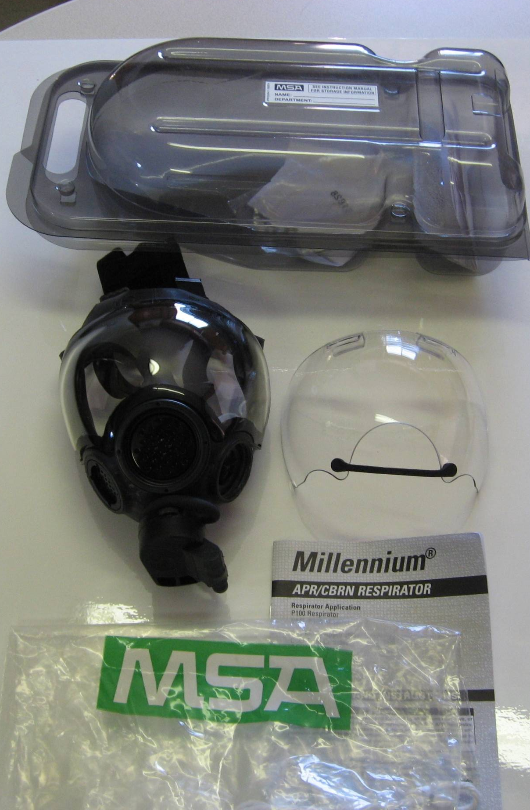
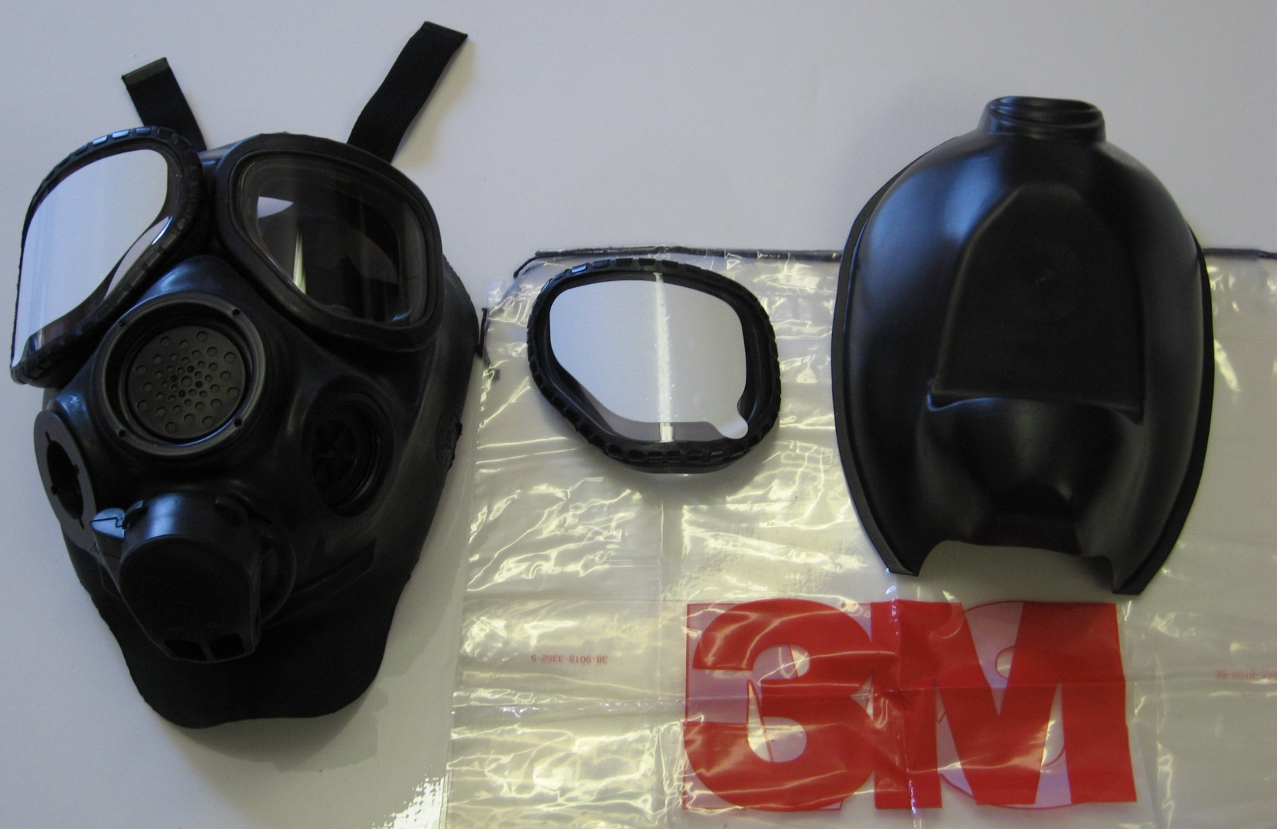
CBRN APR/PAPR are conditioned by NIOSH in manufacturer specified minimum packaging configurations. “MPC” for short…
Photo by NIOSH
Photo by NIOSH
Photo by NIOSH
Photo by NIOSH
Notes:
Examples of current APR devices in manufacturer specified MPC containers.

Slide 34
How do you store a NIOSH approved CBRN respirator?
CBRN APR and PAPR may require special components as part of the “MPC”:
  Breathing tube covers
  Facepiece mask skins
  Facepiece lens out serts
Photo by NIOSH
Failure to use the protective covers, butyl skins, eyepiece lens out-serts or the required carriers configured in the minimum packaging configuration (MPC), as approved by NIOSH, can/may result in permeation or penetration of chemical warfare agents through the CBRN APR or PAPR system assembly.
Photo by NIOSH

Slide 35
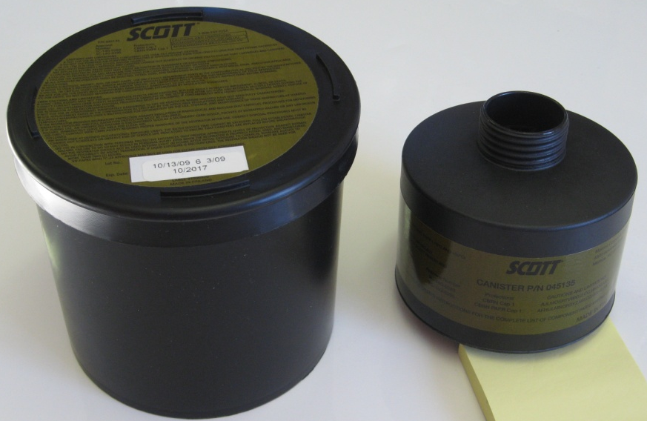
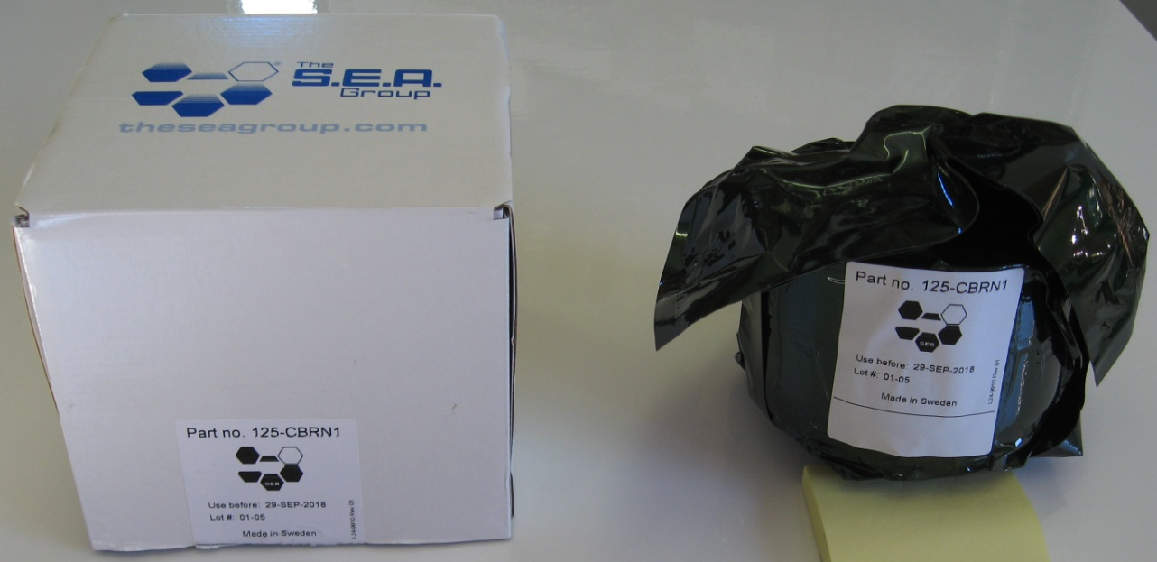
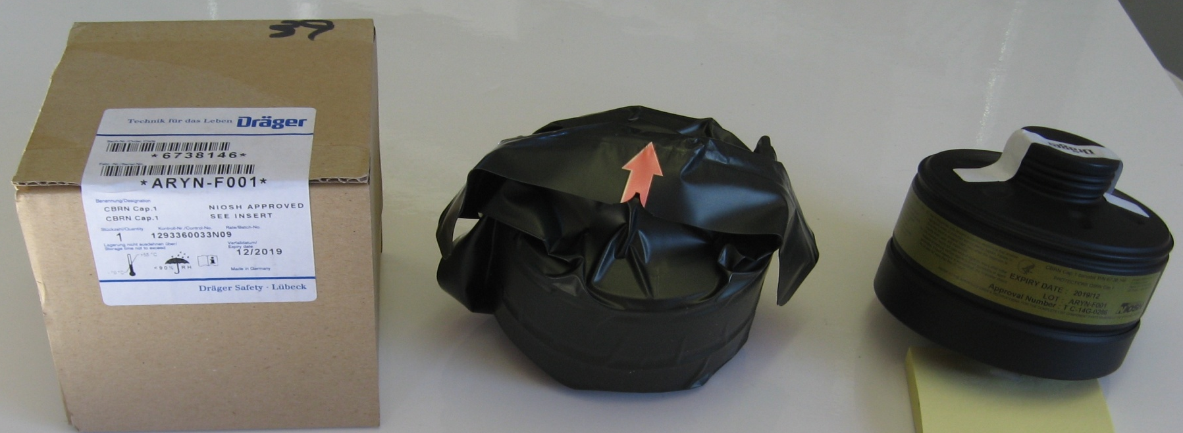
Examples of common CBRN APR filtration media MPC
Photo by NIOSH
Photo by NIOSH
Photo by NIOSH
Notes:
35
What may be in a cardboard box for one approval holder might be in some other type of durability enhancement container for another approval holder. Know your PPE. And all filtration media of this type has a lot number of production and an expiration date on that lot number of production.

Slide 36
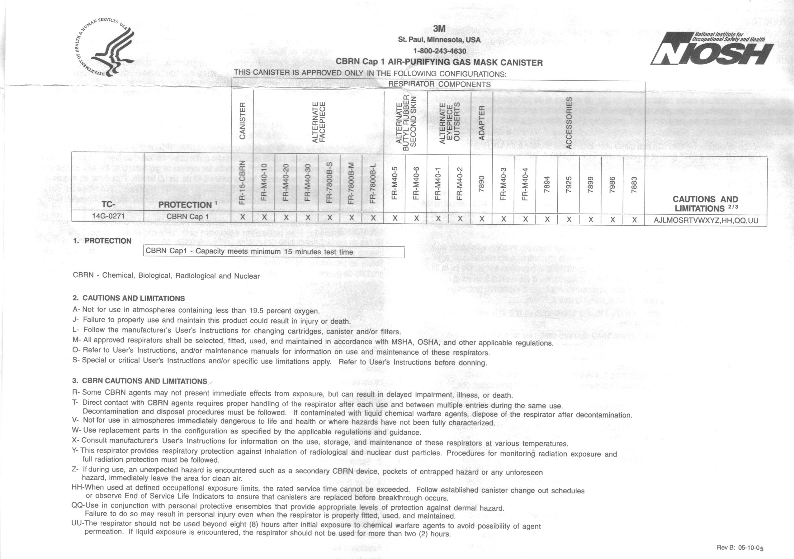
Example of a CBRN APR Canister (Full) Paper Label
Notes:
Canisters have full paper labels and the actual complete respirator has a separate full paper label. This respirator systems full label has the canister, or canisters, that the respirator was successfully live agent tested with. This canister is identified by a unique part number and that part number should be the same part number between the two paper labels.

Slide 37
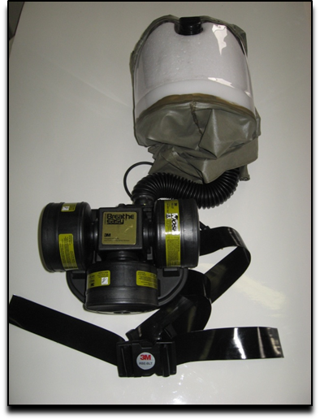
CBRN PAPR LAT
8 hours of GB LAT
8 hours of HD Vapor LAT
2 hours of HD Liquid LAT
LRPL Corn-Oil QNFT and TRAs
Powered-air purifying respirator = PAPR
CBRN PAPR can be tight fitting or loose fitting.
Belt mounted or back packed
Normally 2-3 canisters or cartridges per blower assembly
Photo by NIOSH
.
Notes:
PAPRs are not “positive-pressure” producing respirators. They are air-purifying respirators with motor blower propellers that generate controlled air flow outputs; subject to battery power outage, clogged particulate filtration media, wet/water logged particulate and carbon bed filtration media, and/or dislodged filtration media connections.

Slide 38
“Dual Purpose” Filtration Media
Canister and cartridge components of CBRN PAPR & APR
  NIOSH evaluates CBRN air-purifying filter service life for concentrations of agent/chemical compound penetration at various flow rates, concentrations, and laboratory test durations
    A CBRN filter service life test time is identified in 15-minute intervals (CBRN Cap 1 = 15 minutes, Cap 2 = 30 minutes, etc.)
  Actual field or “in-use” service life is not the CBRN CAP time rating
  Consult the manufacturer and industrial hygienist for additional information
  One style of canister can be rated for both CBRN APR & CBRN PAPR use, per the manufacturer as stated on its NIOSH abbreviated paper label
  A CBRN APR/PAPR canister or cartridge change schedule should be established before use, by the authority having jurisdiction
  Under crisis provisions, CBRN APR canisters are interoperable with different brands of NIOSH-approved CBRN APR, but CBRN PAPR canisters are not.
Notes:
CBRN CAP training perspective, to include interoperability practice and change schedule need.

Slide 39






CBRN APER for the General Working Population
Photo by NIOSH
Photo by ILC Dover
Photo by NIOSH
Photo by Avon Protection
Notes:
Outer photographs are provided courtesy of NIOSH approval holders ILC Dover, MSA, North, and Avon Polymer Protection. Center photograph is provided by Terrence K. Cloonan, HHS, CDC, NIOSH, NPPTL.

Slide 40
Identification of Cartridges and Canisters – Abbreviated Label
Labels are color-coded
Organic vapors – Black
Acid gases – White
Organic vapors and Acid gases – Yellow
Ammonia and Methylamine – Green
Any other gas or vapor not listed - Olive
HE – Magenta
ANSI K13.1
CBRN APR, PAPR and APER -Olive
Notes:
Jeff

Slide 41
Always read the NIOSH Approval Label to verify that the cartridge or filter on your respirator is approved for the contaminant(s) in the workplace!
Notes:
Jeff

Slide 42
APR Required Labels
Abbreviated Labels – on filters and cartridges
Canister Label – on canister
Full respirator Label – typically provided with respirator facepiece
Filter label – typically provided with replacement filters
Full cartridge or canister label – provided with replacement cartridges or canisters
Notes:
Jeff

Slide 43

Example of a NIOSH Approval Label
Notes:
Jeff

Slide 44
Respiratory Inlet Coverings for Continuous Flow Air-Supplied Respirators
Can be tight-fitting or loose fitting
  Quarter Mask
  Half Mask
  Full Facepiece
  Hood
  Helmet
May incorporate a filter for entry and egress
Notes:
Jeff

Slide 45
Respiratory Inlet Coverings for Pressure Demand Air-Supplied Respirators
Must be tight-fitting
Half Mask
Full Facepiece
May incorporate a filter for entry and egress

Slide 46
Respiratory Inlet Coverings for Self-Contained Breathing Apparatus
Must be tight-fitting.
Only Full Facepiece can be approved.

Slide 47


Self-Contained Breathing Apparatus
Photo by Adobe Stock
Photo by Adobe Stock
Notes:
Jeff

Slide 48
Respiratory Inlet Coverings for Closed Circuit Escape Respirators (CCER)
Most, if not all, CCER are mouth-bit respirators
Notes:
Jeff

Slide 49

Closed-Circuit Escape Respirators
Photo by NIOSH
Notes:
Jeff

Slide 50
Atmosphere- Supplying Required Labels
Harness labels – on SCBA harness
Full respirator label – typically provided with respirator facepiece
CCER label – on case of unit
Notes:
Jeff

Slide 51



How to Recognize a CBRN SCBA in the Field: Locate and Read the Labels
5 indicators of compliance:
  Manufacturer operations manual/user instructions (UI) with new respirator
  NIOSH Full Approval Label in UI of new respirator. (paper version)
  Back frame and harness assembly Entire label: NIOSH Respirator Approval 13F Label. (adhesive)
  Back frame and harness assembly decals: NFPA compliance: SEI decals. (adhesive)
  Back frame and harness assembly abbreviated protections label: CDC/ NIOSH “CBRN Agent Approved” label, with and without “Retrofit” term added. (adhesive)
Notes:
Labels on compliant respirators serve one primary purpose – they demonstrate legible standards information to tell the user or the purchaser the respirator, as an individually complete system, has been found compliant to the cited standard listed on the label. When the label is unreadable, the user should consult with the respiratory protection program administrator, the respirator manufacturer or NIOSH/NFPA to assist in determining the field worthiness of an “unlabeled” respirator. .

Slide 52




New CBRN SCBA & retrofitted CBRN SCBA: adhesive labels on backframes, two versions
b
Notes:
If one of these NIOSH CBRN Agent Approved labels is not on the backframe carrier/harness assembly of a SCBA in question, that SCBA should not be used in CBRN environments. The top row of labels (with the blue arrow) will be found on newly issued CBRN SCBA and the bottom row of labels, with the yellow arrows, will be found on SCBA upgraded or retrofitted to NIOSH CBRN protections by authorized field technicians.

Slide 53
Regulatory Requirements
The selection, use, and maintenance of respirators in the US is regulated by:
Mine Safety and Health Administration (MSHA)
Occupational Safety and Health Administration (OSHA)
Environmental Protection Agency (EPA)
Nuclear Regulatory Commission (NRC)
Notes:
Jeff

Slide 54
Usage of Respirators
Respirators must be used when effective engineering controls are not feasible or while they are being instituted.
Notes:
Jeff

Slide 55
Respiratory Protection Program
A complete written program which includes
  Proper selection and use
  Maintenance, inspection, cleaning, storage, and evaluation of the respirator
  Use of the respirator in accordance with the manufacturer’s instructions
  Fit testing
  Regular worker training
  Medical evaluation
  Environmental monitoring
Notes:
Jeff

Slide 56
Respiratory Selection Factors
Use conditions (e.g. grinding, using jackhammer, asbestos or lead abatement, painting)
Contaminant type (known or unknown)
Physical/chemical/toxicological properties of contaminant
Occupational exposure limits (e.g. OSHA, PEL, NIOSH, REL)
Immediately dangerous to life or health concentration
Notes:
Jeff

Slide 57
Respirator Selection Factors
Oxygen deficient atmosphere (<19.5% O₂ by volume) entry or escape
Expected concentration of each respiratory hazard
Eye irritation potential
Environmental factors, such as presence of oil aerosols
Notes:
Jeff

Slide 58
Assigned Protection Factors
Assigned Protection Factors (APFs) are the metric for determining respirator performance on the worker
APFs can be thought of as multiples of the occupational exposure limit (OEL) or fractions of the contaminated atmosphere
APFs assume the worker will have a fit factor 100 times the APF to allow for variations in donning
Notes:
Jeff

Slide 59
Assigned Protection Factors
The APF is determined based on the leakage of the face seal, penetration through the filter, penetration or leakage from other sources, and a statistical determination to protect 95% of users
The leakage from the face seal is additive to penetration from the filter
Notes:
Jeff

Slide 60
“New” OSHA Assigned Protection Factors
OSHA published current assigned protection factors (APFs) for respirators in 2009
  Some APFs have changed and are no longer consistent with NIOSH values.
    https://www.osha.gov/Publications/3352-APF-respirators.pdf
Notes:
Jeff

Slide 61
“New” OSHA Assigned Protection Factors
Table: OSHA 3352-02 2009
Notes:
Jeff

Slide 62
OSHA Assigned Protection Factors
Notes:
1. Employers may select respirators assigned for use in higher workplace concentrations of a hazardous substance for
use at lower concentrations of that substance, or when required respirator use is independent of concentration.
2. The assigned protection factors in Table I are only effective when the employer implements a continuing, effective
respirator program as required by this section (29 CFR 1910.134), including training, fit testing, maintenance, and use
requirements.
3. This APF category includes filtering facepieces, and half masks with elastomeric facepieces.
4. The employer must have evidence provided by the respirator manufacturer that testing of these respirators demonstrates performance at a level of protection of 1,000 or greater to receive an APF of 1,000. This level of performance can best be demonstrated by performing a WPF or SWPF study or equivalent testing. Absent such testing, all other PAPRs and SARs with helmets/hoods are to be treated as loose-fitting facepiece respirators and receive an APF of 25.
5. These APFs do not apply to respirators used solely for escape. For escape respirators used in association with specific
substances covered by 29 CFR 1910 subpart Z, employers must refer to the appropriate substance-specific standards in
that subpart. Escape respirators for other IDLH atmospheres are specified by 29 CFR 1910.134(d)(2)(ii).

Slide 63








Online Resources
Counterfeit/Misrepresented
Respirators Personal Protective Equipment
How the Certified Equipment List Works
Personal Protective Equipment
Identifying NIOSH Approved Respirators Personal Protective Equipment
Registered Certification Marks
Respirator Approval Program
Performance Testing of Fraudulent Respirator P100 Filters, Organic Vapor Chemical Cartridges, and Combination Cartridges
Fraudulent Cartridges Fail to Meet NIOSH Performance Requirements: P100 Filters
Fraudulent Cartridges Fail to Meet NIOSH
Performance Requirements: Combination Cartridges
CBRN Respiratory Protection Handbook
(Revised September 2025)

Slide 64
Contact Info:
Jeff Peterson: jap3@cdc.gov
Mike Shahan: ywn6@cdc.gov
Pat Wiltanger: few0@cdc.gov

Slide 65
Thank You
N99, N100, R95, P100, PAPR100-N, PAPR100-P, HE, and the NIOSH stylized logos are a registered certification trademark of the U.S. Department of Health and Human Services (HHS) in the United States.
N95 and NIOSH Approved are registered certification trademarks of the U.S. Department of Health and Human Services (HHS) in the United States and several other countries.
Mention of any company or product does not constitute endorsement by the National Institute for Occupational Safety and Health, Centers for Disease Control and Prevention.

