Slide 1
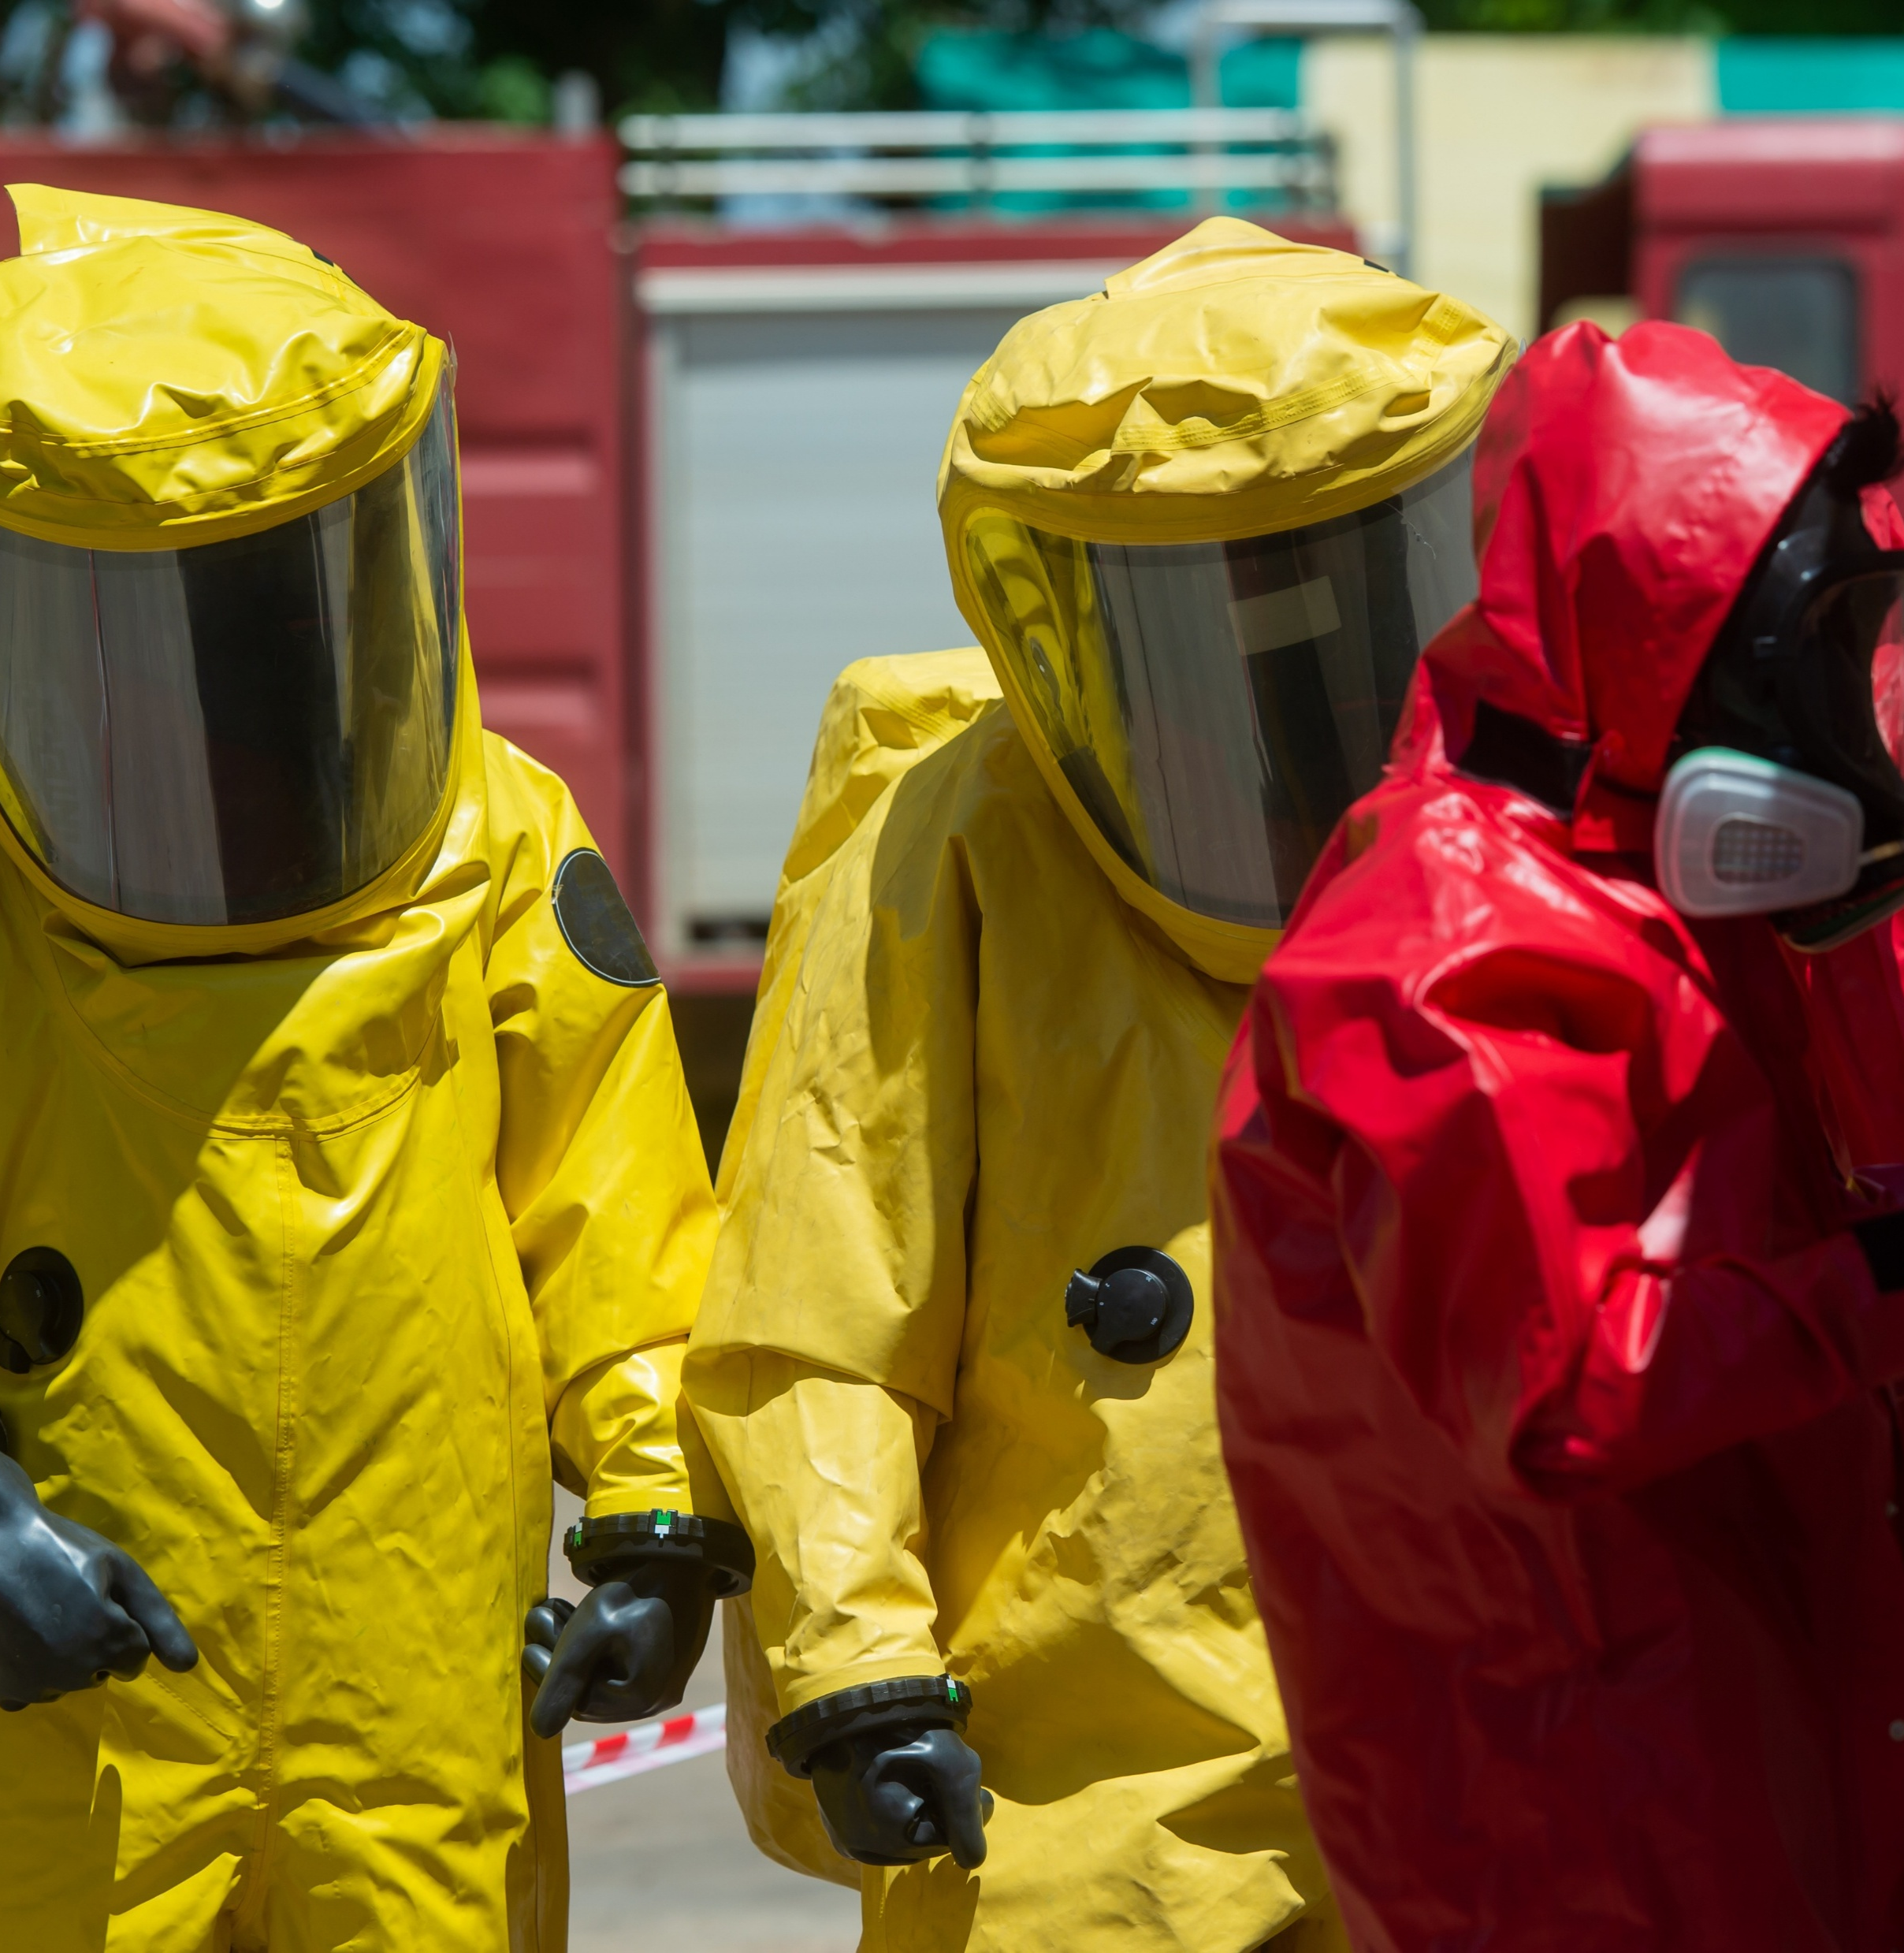

A Risk-Based Approach to Selecting Chemical PPE
Ensuring Responder Safety
Selcen Kilinc-Balci, PhD
Sr. Service Fellow
National Personal Protective Technology Laboratory
National Institute for Occupational Safety and Health
June 23-24, 2026
Photo by stock.adobe.com

Slide 2

National Institute for Occupational Safety and Health (NIOSH)
CDC/DHHS
NIOSH is the federal institute responsible for conducting research and making recommendations for the prevention of work-related injury and illness.

Slide 3
National Personal Protective Technology Laboratory (NPPTL)
NPPTL is the division of NIOSH responsible for advancing the science and effective use of personal protective equipment (PPE) to protect workers.
Core Laboratory Activities
Testing and approving respirators against minimum performance standards for occupational use
Developing science-based national recommendations for respirators and other PPE
Developing new methods to test PPE effectiveness
Creating tools to help employers and workers use PPE as effectively and economically as possible
Developing and evaluating innovative PPE designs and test methods to improve comfort, fit, and usability
DHHS/CDC/NIOSH

Slide 4
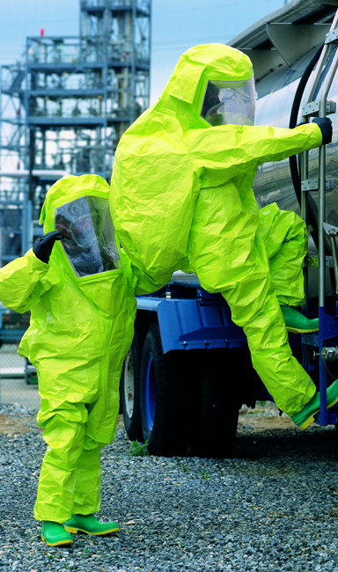
Understanding Emergency Response Environments
Rapidly Evolving Environments
  Emergency scenes are unpredictable, requiring responders to adapt as chemical hazards are initially unknown.
Key Protective Principles
  Identifying hazards, assessing exposure routes, selecting protective equipment, and ongoing risk reassessment are essential.
Role of Chemical Protective Ensembles
  Chemical protective clothing (CPC) and ensembles act as a vital barrier against vapors, aerosols, and liquid chemical exposure to keep responders safe.
Structured Decision-Making
  A clear decision framework helps responders adapt protection choices as new information emerges.
Photo by DuPont

Slide 5

Real Incidents, Real Tragedies Shape Today's Standards
Why this matters: lessons from the field
  Benicia, CA (1983)
  Hazmat response to anhydrous dimethylamine leak.
    Suit material was rated for the threat, but the visor was not.
    The visor cracked, causing severe dermatitis.
KEY LESSON:
Every single component of an ensemble matters.
Unverified manufacturer claims are not enough.
Photo by stock.adobe.com

Slide 6

Understanding Regulatory Framework
OSHA Legal Requirements
  OSHA, including HAZWOPER, sets essential regulatory requirements for hazardous waste and emergency response safety.
NFPA Performance Standards
  NFPA standards specify protective clothing and gloves for vapor, splash, and medical emergency scenarios.
ASTM Testing Procedures
  ASTM standards provide rigorous testing methods for chemical permeation and viral penetration resistance.
Photo by stock.adobe.com

Slide 7
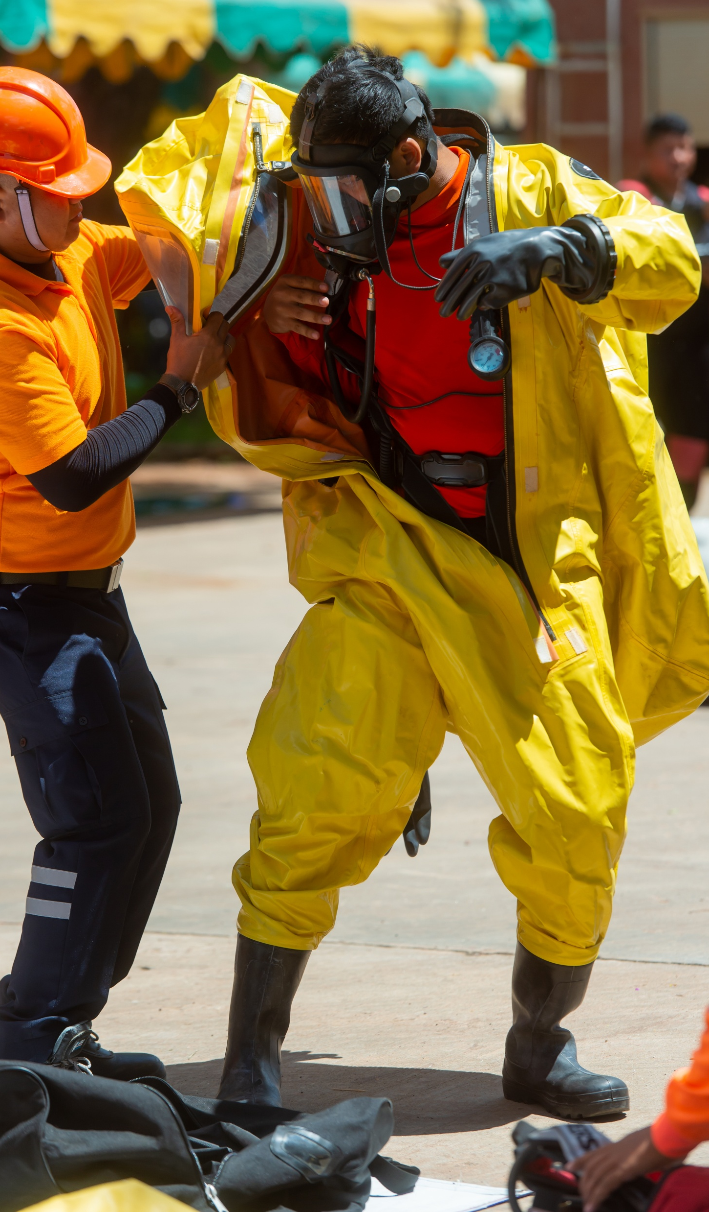

Protection Levels
The foundation
Protection Level | Key Equipment Required | Protection Provided | When to Use | Limiting Criteria
Level A | SCBA (Full Facepiece) Fully Encapsulating Suit Chem-Resistant Gloves & Boots | Highest available for Respiratory, Skin, and Eye | High vapor/splash hazard from skin-absorbing/harmful chemicals; Confined or poorly ventilated spaces. | Suit material must be strictly compatible with the specific substances involved.
Level B | SCBA (Full Facepiece) Chem-Resistant Splash Suit Chem-Resistant Gloves & Boots | Highest Respiratory. Lesser Skin Protection | Minimum for initial site entries; <19.5% Oxygen; Known IDLH lacking severe skin hazards. | Do not use if vapors or splashes contain high concentrations of skin-absorbing/harmful chemicals.
Level C | Air-Purifying Respirator (APR) Chem-Resistant Splash Suit Chem-Resistant Gloves & Boots | Lower Respiratory. Same Skin as Level B | Airborne hazards are strictly identified and measured; Appropriate canister is available; No exposed skin hazard. | Must not exceed IDLH levels; Atmosphere must contain at least 19.5% oxygen.
Level D | Standard Coveralls Safety Boots/Shoes Safety Glasses or Goggles Hard Hat | No Respiratory. Minimal Skin | Atmosphere has no known hazards; Operations preclude any unexpected splashes or inhalation risks. | Do not wear in hot or warm zones; Atmosphere must contain at least 19.5% oxygen.
Source: National Fire Protection Association. (2018, April). Risk-based selection of chemical-protective clothing (White paper). National Fire Protection Association.
Photo by stock.adobe.com

Slide 8
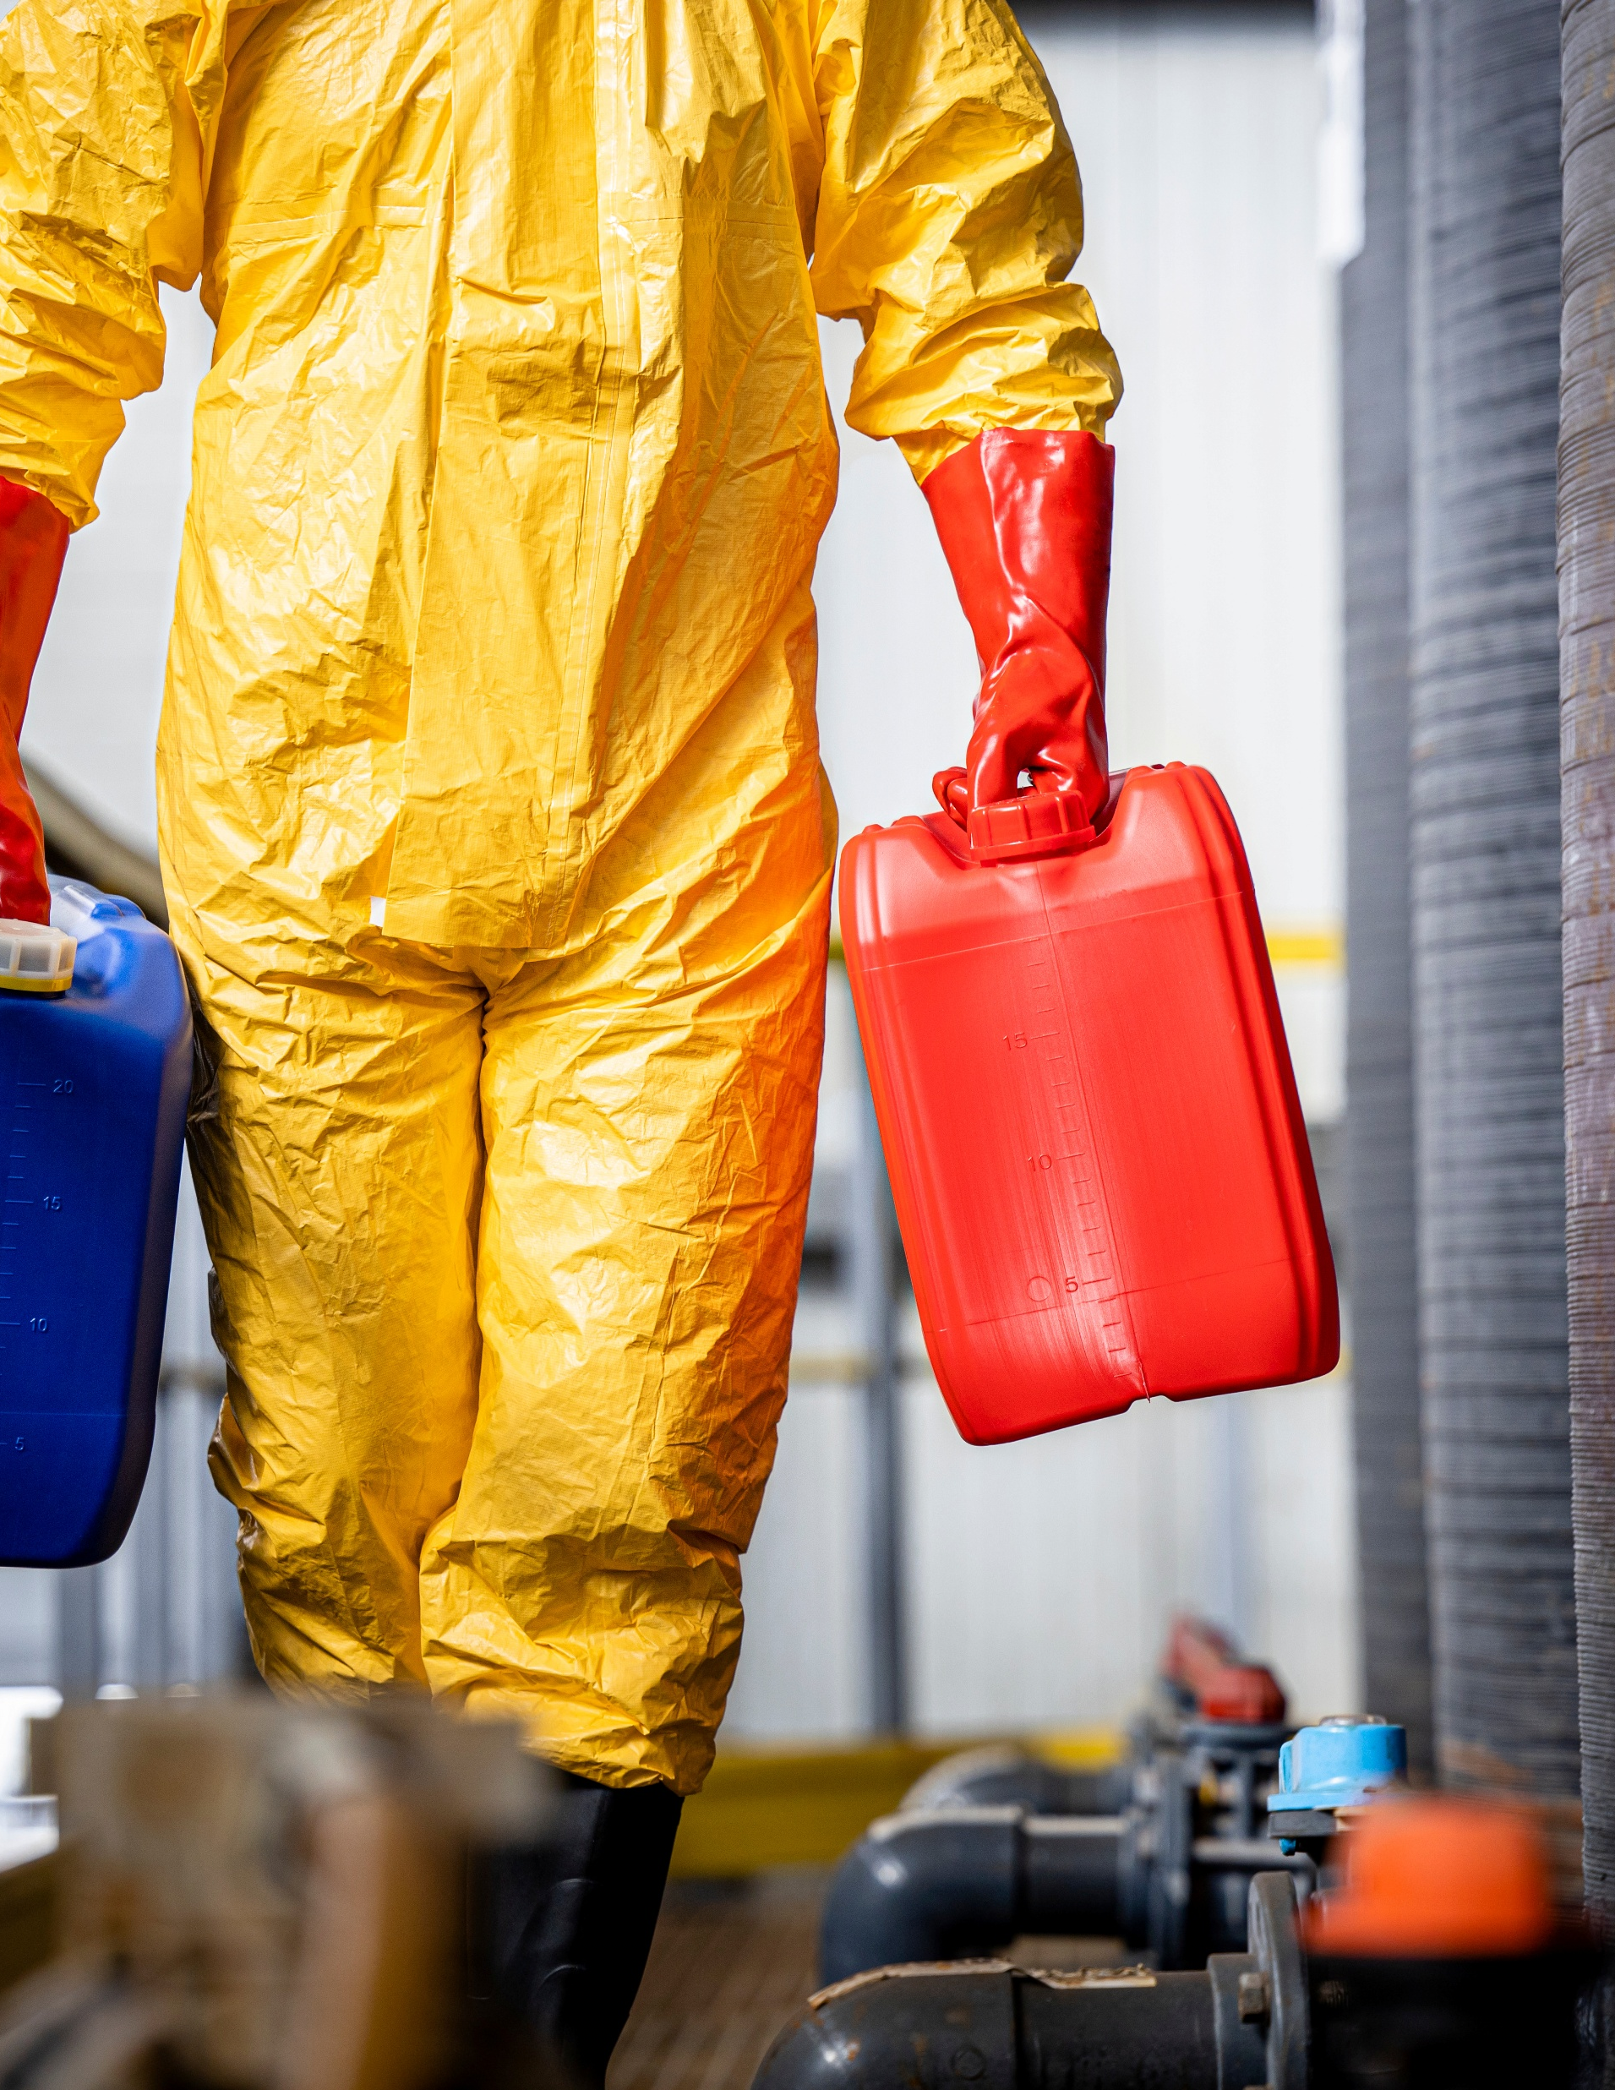
NFPA 1990
CONSOLIDATION of NFPA standards
NFPA 1990 | Type | Field Application
NFPA 1991 | Vapor-Protective | Level A requirements. High-threat vapor protection
NFPA 1992 | Liquid Splash | Level B requirements. Liquid splash protection only
NFPA 1994 | Hazmat/CBRN | Tiered protection. (Classes 1-4) for CBRN incidents
Photo by stock.adobe.com

Slide 9
NFPA 1990, Standard for Protective Ensembles for Hazardous Materials and CBRN Operations
Ensemble Description Using Performance-Based Standard(s) | Integrity† | Material Barrier† | Protection Level
NFPA 1991 worn with NFPA 1981 or NFPA 1986 SCBA | Vapor – Ultrahigh | Permeation – Ultrahigh | A
NFPA 1994 Class 1 worn with NFPA 1981 or NFPA 1986 SCBA | Vapor – High | Permeation – High | A
NFPA 1994 Class 2/2R worn with NFPA 1981 or NFPA 1986 SCBA | Vapor – Moderate | Permeation – Moderate | B
NFPA 1992 worn with NFPA 1981 or NFPA 1986 SCBA | Liquid – High | Penetration | B
NFPA 1994 Class 2/2R worn with NIOSH CBRN APR or PAPR** | Vapor - Moderate | Permeation – Moderate | C
NFPA 1992 worn with NIOSH CBRN APR or PAPR | Liquid - High | Penetration | C
NFPA 1994 Class 3/3R worn with NFPA 1981 or NFPA 1986 SCBA* | Vapor – Low | Permeation – Low | B
NFPA 1994 Class 3/3R worn with NIOSH CBRN APR or PAPR | Vapor – Low | Permeation – Low | C
NFPA 1994 Class 4/4R worn with NFPA 1981 or NFPA 1986 SCBA* | Particle | Viral Penetration | B
NFPA 1994 Class 4/4R worn with NIOSH CBRN APR or PAPR | Particle | Viral Penetration | C
NFPA 1994 Class 5 worn with NFPA 1981 or NFPA 1986 SCBA | None | Repellency/Absorption | B
† Levels for integrity and material barrier defined by specific test criteria in standard
* Respirator combination above minimum requirement
** Respirator combination below minimum requirement

Slide 10


Reading the Label under NFPA 1990
Label Component | What to Verify | Limitation
Certification Mark | Third-party lab logo (e.g., UL, SEI) | Self-certification by a manufacturer is invalid.
Specific Designation | Must state the specific protection level (e.g., Vapor-Protective) | Do not assume all NFPA 1990 suits offer gas-tight protection.
Component Matrix | Lists exact gloves, boots, and respirators tested with the suit. | Substituting unlisted components means the ensemble is no longer the exact certified/tested configuration. Consult manufacturer.
Photo by stock.adobe.com

Slide 11



Key Aspects to Consider
Chemical Protective Clothing Selection
Fabric
  Primary barrier to chemicals
  Determines resistance and breakthrough time
Seams
  Common weak points
  Must prevent leaks at junctions
Garment Design
  Overall coverage and fit
  Impacts comfort, mobility, and protection
Hazard Assessment → CPC Selection
Photo by stock.adobe.com

Slide 12
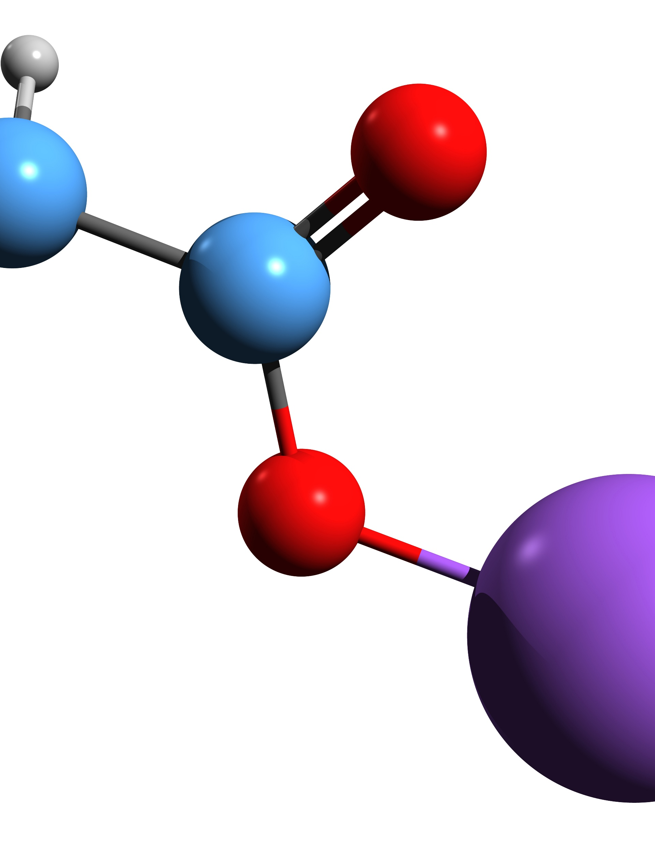
Mechanisms of Chemical Attack
Beyond the Surface
Mechanism | Scientific Definition | Practical Example
Penetration | Bulk flow of a chemical through closures, porous materials, seams, and pinholes. | A liquid chemical seeping through a faulty zipper or an unsealed glove-to-sleeve interface.
Permeation | A molecular-level process where a chemical dissolves into, moves through, and desorbs from the material. | A toxic vapor passing directly through the solid rubber of a glove over a period of hours, with no visible hole.
Degradation | The physical destruction or alteration of the material upon chemical contact. | A boot material swelling, becoming brittle, or dissolving completely when exposed to a specific solvent.
Photo by stock.adobe.com

Slide 13

Degradation
Barrier resistance assessment
Evaluates material compatibility with chemicals
Focuses on physical/chemical changes, not barrier performance
Common Observations:
  Swelling
  Brittleness
  Weight loss
Key Points:
  Mostly reported for chemical gloves (rare for suits)
Degradation = Not suitable for protection
No degradation ≠ Effective barrier
Photo by stock.adobe.com

Slide 14
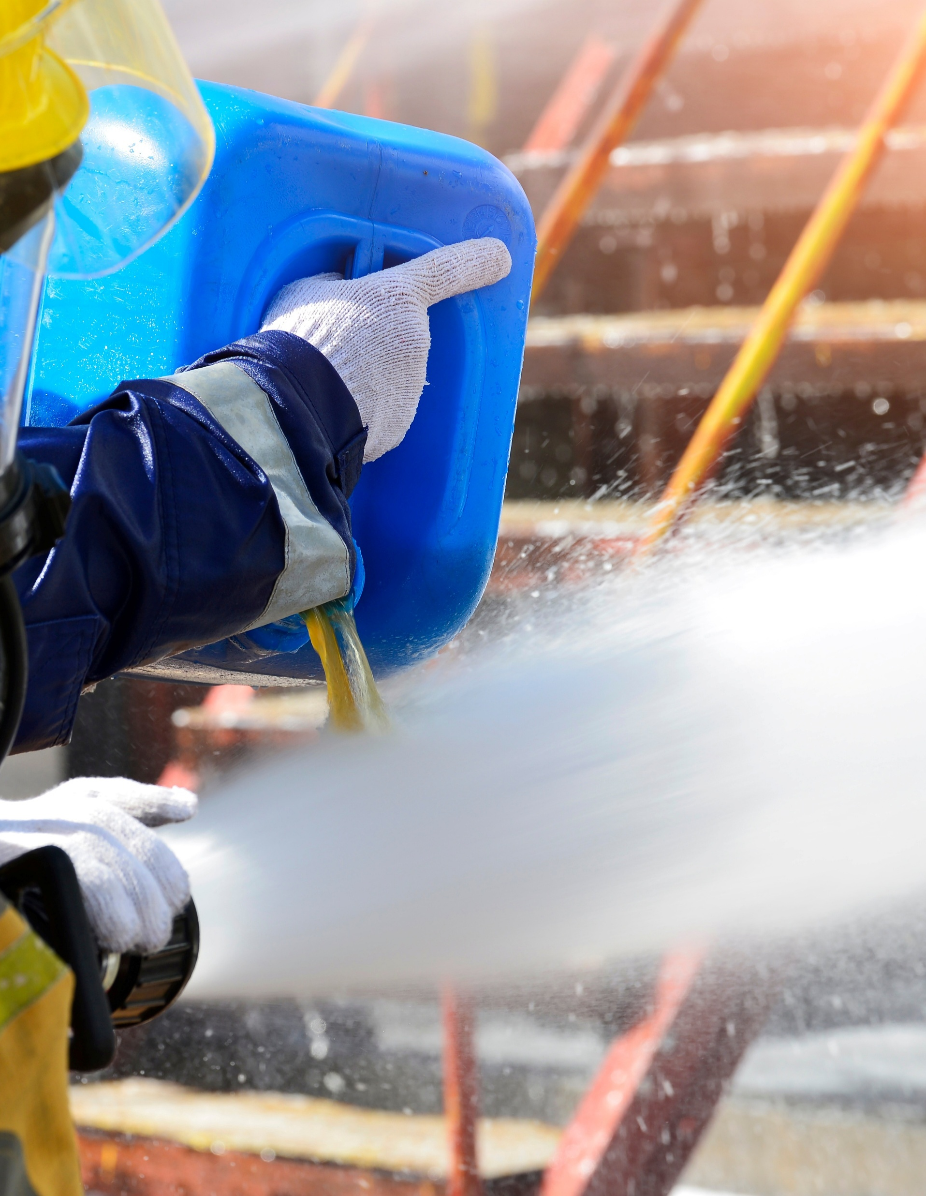
Penetration
Barrier resistance assessment
Evaluates bulk flow of chemicals through material defects (pores, gaps, holes)
Liquid Penetration (ASTM F903)
  Material exposed to liquid chemical under pressure
  Typically, 60-minute test
  Visual check for leakage
  Result: Pass/Fail (qualitative)
Particle Penetration
  Uses non-hazardous test particles (e.g., salt, latex)
  Measures ability to block particles by size
  Result: Filtration efficiency (%)
Viral Penetration (ASTM F1671)
  Uses a bacteriophage
  Result: Pass/Fail (qualitative)
Penetration≠ Permeation
Photo by stock.adobe.com

Slide 15

Permeation
Barrier resistance assessment
Most accurate assessment of chemical barrier performance
Measures movement at the molecular level
Permeation Process:
  Absorption (into material surface)
  Diffusion (through material)
  Desorption (release on inner side)
ASTM F739 Test:
  Works with liquids or gases
  Chemical contacts one side of material
  Opposite side is monitored and sampled
  Result: Breakthrough time at defined permeation rate
Highly sensitive, quantitative results
Photo by stock.adobe.com

Slide 16
Reading the Numbers: Breakthrough Time vs. Permeation Rate
Metric | What It Measures | Field Implication
Normalized Breakthrough Time | The time it takes for a chemical to permeate the material at a specific, standardized rate (usually 0.1 µg/cm²/min). | Often reported as >480 minutes. This is a baseline laboratory metric, not an absolute guarantee of safe wear time in extreme field conditions.
Permeation Rate | The speed at which the chemical continues to move through the material after initial breakthrough has occurred. | Crucial for assessing risk. A slow permeation rate might mean a minor exposure, while a rapid rate means a catastrophic failure of the barrier.
System Testing | NFPA tests of the entire ensemble (seams, visors, gloves, zippers) rather than just flat material swatches. | Ensures that the weakest links—the seams and interfaces—perform to the same standard as the primary suit material.
6

Slide 17
Interpreting Permeation Data
ASTM F739 Permeation testing
Different Reporting Criteria
  ASTM F739 uses 0.1 µg/cm²·min
Why It Matters
  Higher endpoint may miss early permeation
  Can make materials appear more protective than they are
Permeation Curve Insight
  No initial detection → rising permeation → steady state
  May stay below 1.0 but exceed 0.1 µg/cm²·min
Result: “No permeation” may still involve exposure
Verify test method and endpoint before selecting CPC

Slide 18
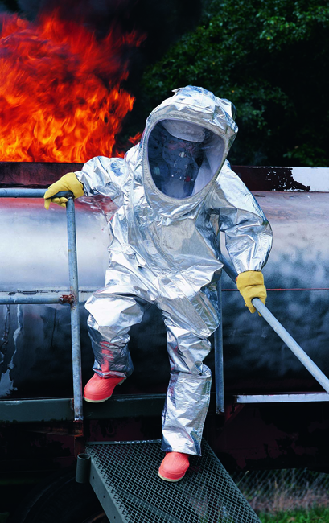
Full-Scale CPC Testing
CPC ASSESSMENT
What it Evaluates
  Entire garment or PPE ensemble
  Interfaces: suit, gloves, respirator
Types of Tests
  Gas tightness
  Vapor inward leakage
  Particle inward leakage
  Liquid integrity
Important Limitation
  Passing ≠ complete chemical protection
  Performance depends on specific chemical hazards
Photo by DuPont
Use full-scale tests to assess design & interfaces
Still rely on permeation data for chemical protection

Slide 19
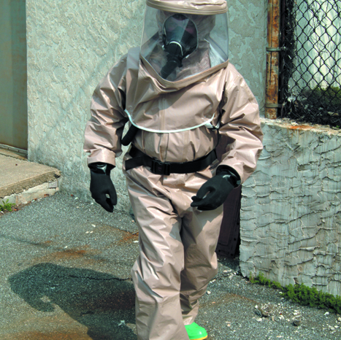
Different Barrier Test Approaches
NFPA 1991
Uses permeation resistance testing for liquids, vapors, and gases
Requires gas-tight integrity testing of the full ensemble
Evaluates all ensemble elements: suit, visor, gloves, footwear, seams, and closures
NFPA 1992
Uses liquid penetration testing rather than vapor permeation testing
Intended only for liquid splash hazards, not toxic vapors or gases
Requires liquid-tight integrity testing
NFPA 1994
Uses multiple methods depending on class:
Class 1, 2, 2R, 3, 3R: permeation testing with varying rigor
Class 4/4R: particulate and viral penetration testing only (no chemical warfare agent permeation testing)
Class 5: repellency and flash-fire performance focus rather than chemical barrier protection
“R: Ruggedized”: Same chemical/biological barrier performance as the corresponding class but higher durability
Photo by DuPont
Select CPC based on hazard level and scenario, not just certification

Slide 20

Glove Selection Core Considerations
GLOVE SELECTION
Chemical Compatibility
  Permeation, penetration, and degradation data
Task Performance
  Grip, dexterity, tactile feedback
  Ability to safely use tools
Duration
  Planned work cycle
  Decontamination time
  Replacement schedule
System Fit
  Glove-to-sleeve interface
  Compatibility with inner/outer glove layers
Photo by stock.adobe.com

Slide 21

Glove Materials: Rules of Thumb to Avoid
GLOVE SELECTION
Common Materials
  Nitrile, neoprene, butyl rubber
  Natural rubber, PVC, laminate barriers
Performance is Chemical-Specific
Factors Affecting Performance:
  Material thickness
  Manufacturing quality
  Task-related stress
Signs of Degradation
  Swelling or discoloration
  Softening or stiffening
  Loss of strength
Photo by stock.adobe.com
When Data are Limited
  Seek manufacturer data
  Use more conservative materials or ensembles

Slide 22
Glove Layering
Glove selection
Level A Protection Requirement
  Inner and outer chemical-resistant gloves
Benefits of Layering
  Provides backup barrier
  Allows removal of outer glove during decontamination or task transition
Limitations
  Reduced dexterity
  Increased hand fatigue
  Must be evaluated during actual tasks
Important Consideration
  Still requires chemical compatibility data
  Must match expected exposure duration

Slide 23
The Chemistry of Protection: Selecting Glove Elastomers*
Material Type | Best Suited For (Target Hazards) | Poor Resistance To | Notes
Butyl Rubber | Ketones (e.g., Acetone), Esters, many highly corrosive acids, and gases (very low gas permeability). | Aliphatic and aromatic hydrocarbons, halogens. | Dense elastomer with excellent resistance to gas permeation and many toxic industrial chemicals. Maintains flexibility at low temperatures. Performance should always be verified for the specific chemical and glove formulation.
Nitrile | Oils, greases, aliphatic chemicals, hydraulic fluids, and many solvents. | Ketones, strong oxidizing acids, nitrogen-containing organics. | Provides excellent physical durability (puncture/cut resistance). Widely used, but dangerous if misapplied to the wrong solvent class.
Neoprene | Broad spectrum: Acids, bases, alcohols, peroxides, and some fuels. | Halogenated hydrocarbons, aromatic hydrocarbons. | Often considered a versatile "middle-ground" material because it combines reasonable chemical resistance with good flexibility, comfort, and physical durability. Chemical-specific compatibility should always be verified.
Viton™ (Fluoroelastomer) | Aromatic hydrocarbons (benzene, toluene), halogenated hydrocarbons, PCBs. | Ketones (e.g., MEK, Acetone), many lower-weight esters. | Extremely high chemical resistance to many severe, highly toxic organics. Often very expensive and offers less dexterity; used for high-threat scenarios.
Laminates (e.g., SilverShield®) | Very broad-spectrum resistance across a wide range of chemical classes. | Physical hazards. Generally poor cut, tear, and abrasion resistance. | These are 2D films welded together. They fit poorly and restrict dexterity. Frequently used as an inner liner beneath a more durable outer glove when both chemical and physical protection are required.
*General material trends only; verify chemical-specific permeation, penetration, and degradation data for the exact product and exposure conditions.

Slide 24

Chemical + Physical Hazards
BOOT SELECTION
Level A & B Protection Requirements
  Chemical-resistant boots with steel toe and shank
Performance Standards
  ASTM F2413
    Impact resistance
    Compression resistance
Key Consideration
  Chemical resistance is separate from:
    Toe and puncture protection
    Slip resistance
    Electrical hazard protection
System integration is crucial
Photo by stock.adobe.com

Slide 25
Grounded in Safety: Boot Materials and Construction*
Boot Material / Type | Primary Application | Key Selection Features
PVC (Polyvinyl Chloride) | Many acids, bases, caustics, fertilizers, and agricultural chemicals. | Often seamless (injection molded), preventing liquid pooling. Poor against most organic solvents. Cost-effective.
Neoprene / Polyurethane Blends | Broad-spectrum hazmat response, petrochemicals. | High durability, remains flexible in extreme cold, good traction. Performance varies by formulation; chemical compatibility should be verified for specific hazards.
Specialty Elastomers (Viton™/Butyl rubber) | High-hazard chemical response operations where maximum resistance to specific chemical classes is required. Common in vapor-protective ensemble systems. | Usually found as the primary boot or overboot on NFPA 1991 ensembles. Extreme chemical resistance.
The "Overboot" System | Protecting the attached sock-bootie of an encapsulating suit. | Encapsulating suits often end in a chemical-resistant fabric "sock." You must wear a durable outer boot over this sock to prevent the suit material from tearing on the ground.
*General material trends only; verify chemical-specific permeation, penetration, and degradation data for the exact product and exposure conditions
8

Slide 26

Conclusion
KEY PRINCIPLES OF PPE selection
Correct PPE Selection
  Based on hazard, exposure, task, and conditions
Standards Framework
  OSHA → Protection categories
  NFPA → Ensemble performance
  ASTM → Material performance
Critical Risk Factors to Manage
  Permeation, penetration, degradation
  PPE interfaces and integration
  Heat burden
Operational Best Practices
  Document selection decisions
  Train & exercise regularly
  Reassess as conditions change
Photo by stock.adobe.com

Slide 27
Contact Info:
Selcen Kilinc-Balci
Department of Health and Human Services (HHS)
CDC/ NIOSH/NPPTL
jcq8@cdc.gov | (412) 386-4086

Slide 28
Thank you.
The findings and conclusions in this report are those of the authors and do not necessarily represent the official position of the National Institute for Occupational Safety and Health (NIOSH), Centers for Disease Control and Prevention (CDC). Mention of any company or product does not constitute endorsement by NIOSH or the CDC.

