Slide 1
Worker Training Program: An Introduction to Response and Resources
Eric Persaud, DrPH
Health Specialist, Worker Training Program
National Institute of Environmental Health Sciences

Slide 2
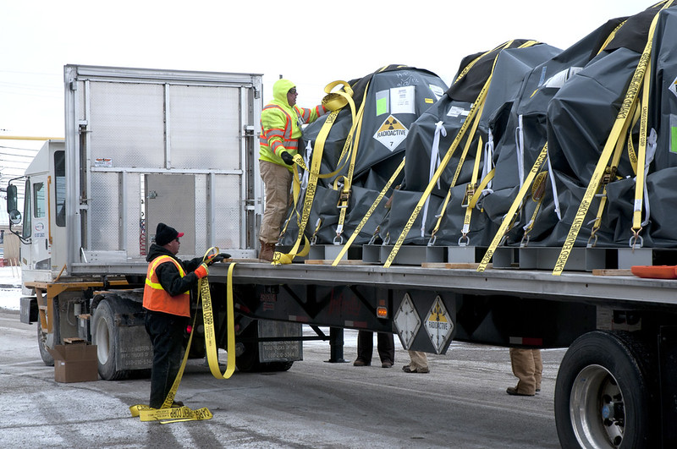
Worker Training Program (WTP) Mission & Network
Mission: Prevent work-related harm by providing training programs for hazardous materials handlers, chemical emergency responders, and waste cleanup workers.
Funds 15 grantees/consortia through cooperative agreements representing
over 100 nonprofit safety and health training organizations.
Provides training in all 50 states, Washington D.C., and U.S. territories.
Worker Training Program: niehs.nih.gov/careers/hazmat/index.cfm
2
Notes:
WTP funds nonprofit organizations with a demonstrated track record of providing high-quality occupational safety and health training to workers involved in handling hazardous materials or in responding to emergency releases of hazardous materials.
About WTP: https://www.niehs.nih.gov/careers/hazmat/about_wetp

Slide 3
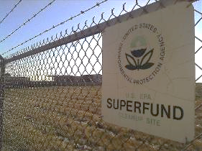
WTP History: Superfund Amendments & Reauthorization Act
Established under Superfund Amendments and Reauthorization Act (SARA) of 1986, Section 126(g)
SARA initiated the Hazardous Substance Basic Research
and Training Program
Hazardous Substance Basic Research and Training Program
Superfund Research Program (SRP)
Fosters multidisciplinary research, fundamental creative discoveries, and innovative research strategies focused on solving problems related to Superfund sites.
Worker Training Program (WTP)
Trains and educates workers who are or may be engaged in activities related to hazardous waste removal or containment or emergency response.
3
Notes:
The Superfund Amendments and Reauthorization Act of 1986 (SARA), Section 126(g), authorizes the program. authorizes an assistance program for training and education of workers engaged in activities related to hazardous waste generation, removal, containment or emergency response and hazardous materials transportation and emergency response.
A variety of sites may pose severe health and safety concerns to workers and the surrounding communities.
These sites contain many hazardous substances, sometimes unknown, and often a site is uncontrolled.

Slide 4
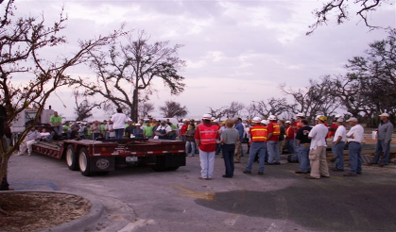
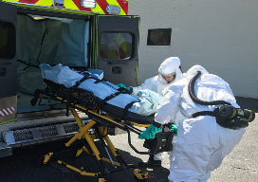

WTP: Special Appropriations for Disasters and Emergencies
Hurricane Katrina (2005): $302K
Deepwater Horizon Oil Spill (2010): $352K
Superstorm Sandy (2012): $180K
Ebola Virus Disease (2014): $10M
COVID-19 (2020): $10M
Consolidated Appropriations Act (2023): $2.5M
4

Slide 5
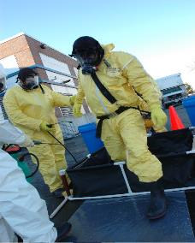

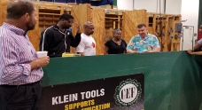
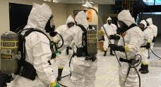

WTP: Funding Mechanisms & Program Areas
U45
Cooperative Agreements
UH4
R43/44
SBIR Grants
Cooperative Agreements
Hazardous Waste Worker Training Program
HAZMAT Disaster Preparedness Training Program
Environmental Career Worker Training Program
NIEHS/U.S. DOE Nuclear Worker Training Program
Small Business Innovative Research (SBIR)
E-Learning for HAZMAT
5
Notes:
Overview of WTP Funding Mechanisms and Program Areas
U45: Programs that train and educate workers engaged in activities related to hazardous materials and waste generation, removal, containment, transportation, and emergency response.
UH4: Programs that train workers who are or may be engaged in activities related to hazardous waste removal, containment, or emergency response at the U.S. Department of Energy (DOE) nuclear weapons complex.
R43/R44: Grants that further the development of E-learning products that support health and safety training of hazardous materials workers, emergency responders, and skilled support personnel; community and citizen preparation and resiliency; and research into the acute and long-term health effects of environmental disasters.
Funding opportunities: https://www.niehs.nih.gov/careers/hazmat/funding

Slide 6
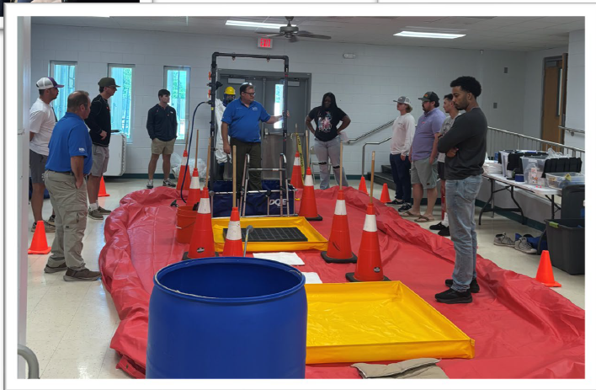
Hazardous Waste Worker Training Program (HWWTP)
HWWTP Metrics
Over 4 million | Workers trained since 1987
2025-2026 Training
56,156 | Workers trained
3,272 | Courses delivered
529,904 | Contact hours
13 | Current award recipients
Nunez Community College, Chalmette, LA-Training students for roles in refinery/chemical plants (NOVA)
Data as of Feb 28, 2026
https://www.niehs.nih.gov/careers/hazmat/training_program_areas/hwwt
Notes:
The first nine months of the HWWT Training Year goes from June 1, 2025 – February 28, 2026.
This year was a little different because not all award recipients received their awards by June 1.
4,117,492 workers trained from the beginning of the program through the first nine months of the 2026 HWWT training year (2/28/2026).
Nunez Community College
Chalmette, LA
16-week program Prepares students for roles in refineries and chemical plants

Slide 7
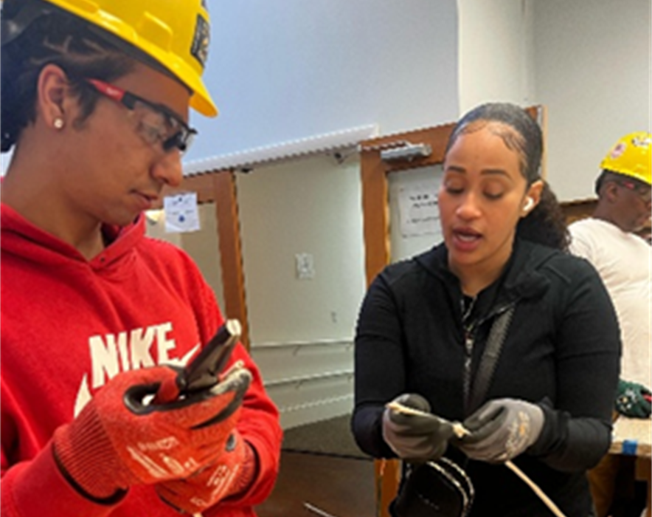
Environmental Career Worker Training Program
ECWTP Metrics
16,064 | Workers trained since 1995
2025-2026 Training
253 | Workers trained
114 | Courses delivered
42,155 | Contact hours
3 | Current award recipients
Job Placement Rates
70% | Overall
58% | 2024-2025
https://www.niehs.nih.gov/careers/hazmat/training_program_areas/ecwtp
Data as of Feb 28, 2026​
Notes:
The Environmental Career Worker Training Program (ECWTP) provides opportunities for individuals from unemployed or under-employed communities to obtain careers in environmental cleanup, construction, hazardous waste removal, and emergency response. To date, more than 15,000 people have been trained by the program's partners, which include community colleges, historically Black colleges and universities, and apprenticeship programs, among others. From 1995 to 2024, the ECWTP has maintained an average job placement rate of 70%, and it has provided an economic boon to communities across the country.

Slide 8
Atlantic Center for Occupational Health and Safety
Carpenters recent survey 50% earning over $100,000 a year and another 40% indicated they are earning over $75,000.
Kevin was living in public housing…previous year earning $1,440. As a journeyman carpenter now receives full benefits…moved out public housing.
MRNY Graduates described that the training contributed to greater job stability, increased confidence, and stronger engagement in their communities.
Notes:
The Atlantic Center for Occupational Health and Safety Training (Atlantic COHST) has a long history of effective training that meets the requirements of the Occupational Safety and Health Administration Hazardous Waste Operations and Emergency Response (HAZWOPER) standard, providing 5.2 million contact hours of hazardous materials knowledge and skills to more than 510,000 workers since 1987.
PI Riley, Grant number U45 ES006179; https://www.niehs.nih.gov/careers/hazmat/awardees/njny

Slide 9
HAZMAT Disaster Preparedness Training Program (HDPTP)
HDPTP Metrics
362,371 | Workers trained since 2005
2025-2026 Training
19,232 | Workers trained
521 | Courses delivered
192,936 | Contact hours
12 | Current award recipients
Data as of Feb 28, 2026​
https://www.niehs.nih.gov/careers/hazmat/training_program_areas/hdpt
Notes:
The HAZMAT Disaster Preparedness Training Program (HDPTP) was established in 2005 in response to lessons learned from national disasters, including the Sept. 11 terrorist attacks. The program supports the development and delivery of disaster-specific training to prepare workers to respond to hurricanes, wildfires, and other natural disasters, as well as man-made disasters and chemical incidents.
About page: https://www.niehs.nih.gov/careers/hazmat/training_program_areas/hdpt

Slide 10
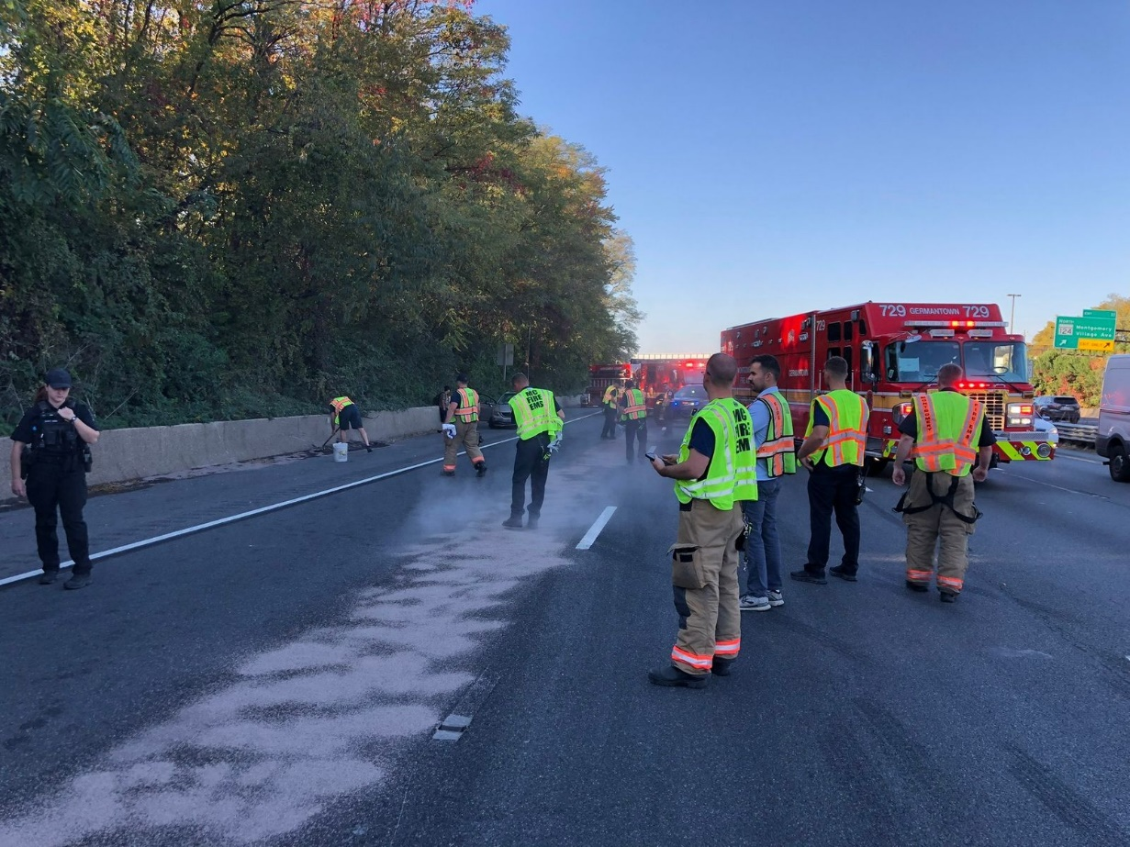
HAZMAT Disaster Preparedness Training Program (HDPTP)
NIEHS provided training/funding after Sept. 11, 2001, terrorist attacks
2005 – HDPTP established
Since its inception, the program has facilitated support and training for natural and man-made disasters*, including Hurricane Katrina (2005), Deepwater Horizon Oil Spill (2010), and the Eaton Wildfires (2025)
WTP-trained HAZMAT workers cleaning up a fuel spill after a multi-vehicle crash in Montgomery County, Maryland. (Photo courtesy of IAFF)
*WTP has received supplemental funding for multiple disasters and health emergencies over the years.

Slide 11
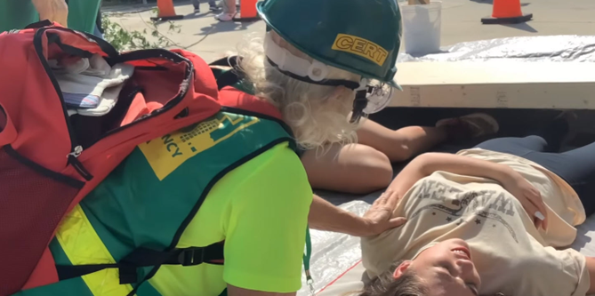
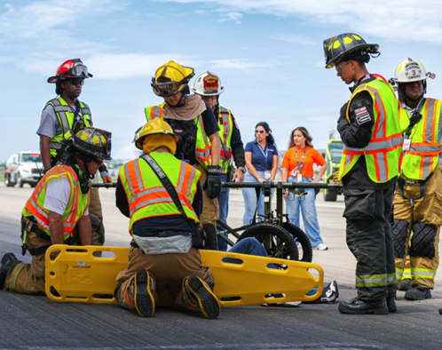
Sustainable Workplace Alliance
Consortium partners, Metropolitan Emergency Response Team (MERT) and the Indian River County CERT, played a significant role in advancing SWA emergency preparedness initiatives in Puerto Rico and Florida
IRC-CERT volunteer assisting an “injured” person
Mass casualty training at Luis Munoz Marin International Airport

Slide 12






Engagement with Other Federal Agencies & Working Groups
U.S. Department of Energy (DOE), Office of Environmental Management
U.S. Department of Health and Human Services, Administration for Strategic Preparedness and Response (ASPR)
U.S. Department of Labor, Occupational Safety and Health Administration (OSHA)
Centers for Disease Control and Prevention (CDC)
National Institute of Occupational Safety and Health (NIOSH)
Substance Abuse and Mental Health Services (SAMHSA)
NIH Office of Behavioral and Social Sciences Research (OBSSR)
Federal Interagency Working Group on Brownfields
Notes:
WTP engages with other federal agencies and working groups on numerous initiatives. A sample of these agencies and working groups is presented on this slide.

Slide 13
Disaster Recovery Engagement via HDPTP in New Mexico
Major Disaster Declaration DR-4886-NM
      Declared on JUL 22, 2025 in response to severe storms, flooding, and landslides in Ruidoso, NM and surrounding areas
      Disaster recovery training through HAZMAT Disaster Preparedness Training Program (HDPTP)
National Partnership for Environmental Technology Education (NPETE)
    OSHA 8-hr Disaster Site Worker Training (DSW) – 10 participants
    Disaster Worker Resiliency Training (2X) – 18 participants
WTP has engaged in multiple stakeholder meetings
      JAN 29, 2026 – Federal partners meeting
      FEB 2, 2026 – Meet and greet w/ ENMU-Ruidoso, NPETE, ASPR, NIEHS WTP
      FEB 20, 2026 – Disaster preparedness discussion w/ ENMU-Ruidoso, NM DHSEM, ASPR, NIEHS WTP

Slide 14
Ongoing engagement/partnerships, etc.
State and local health and emergency preparedness departments
ASPR Center for Response
      Engagement on Alaska Severe Storms, Flooding, and Remnants of Typhoon Halong (DR-4893-AK)
      Rapid needs assessment being executed by ASPR
      WTP is planning Fall 2026 Workshop in Anchorage, Alaska with WRUC and Zender Environmental
ASPR Center for Response and USPHS Commissioned Corps
      Build on mold identification and remediation training for building officials (10) in in Lowndes, Berrien, Mitchell and Coffee counties
      Train a cadre of USPHS officers to provide mold indentification and remediation training in disaster recovery and response operations
ASPR Center for Response / ASPR Disaster Behavioral Health (DBH)
      Disaster resiliency training to fill gaps in rural communities
ASPR Center for Preparedness
      Opioid and infectious disease training for Medical Reserve Corps
United States Coast Guard
      Marine Science Technicians (MSTs) in Corpus Christi, TX require 40HR HAZWOPER in place of Hazardous Material Incident Repsponse (HMIR) course to meet training requirements

Slide 15
Fall Planning Meeting – September 23, 2026 in Anchorage AK
1 to 2-Day Workshop for building capacity of local workforce development and emergency response in Alaska and Rural Villages
How do we support remote villages and communities in need of support before and after extreme weather events?
Typhoon Halong Response: Kotlik Team, Zender began responding to harder-hit communities Tuntutuliak, Kongiganak, Nightmute, Kipnuk, and Kwigillingnok with training, PPE and other support.(WRUC Zender Environmental)

Slide 16
Resources

Slide 17
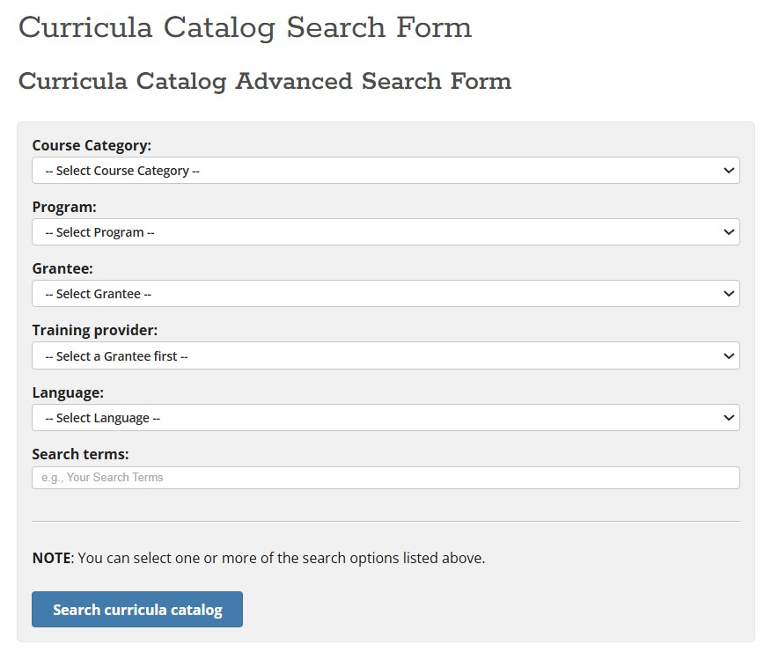
Curriculum Catalog
Notes:
Since 1987, the WTP has supported the development of curricula and the initiation of training programs throughout the country to help employers meet Occupational Safety and Health Administration (OSHA) requirements under the Hazardous Waste Operations and Emergency Response (HAZWOPER) standard (CFR 1910.120). The WTP supports the development of model worker safety and health training.
Catalog: https://tools.niehs.nih.gov/wetp/index.cfm?id=603

Slide 18
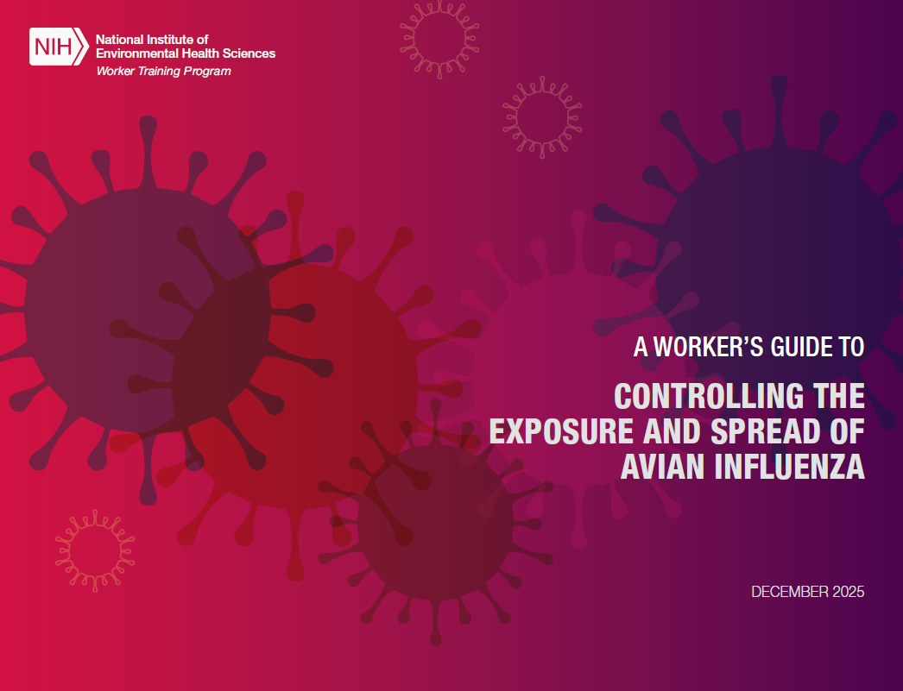

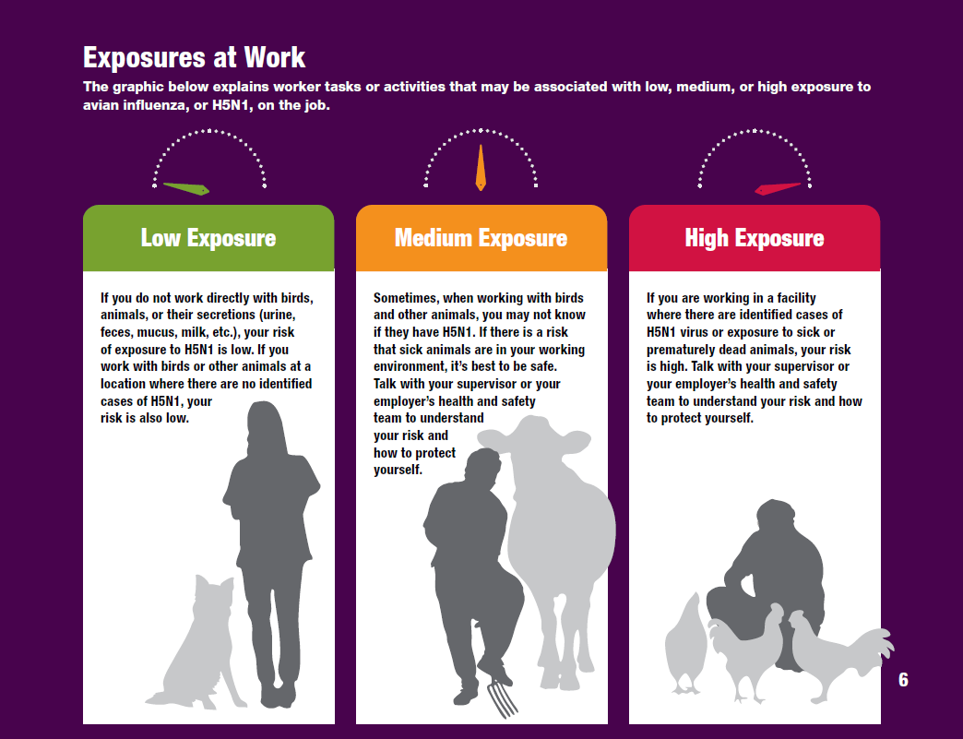
Infectious Disease: Avian Flu (H5N1) Toolkit
New tool is available!
Please help us promote and share this tool.
Also, please let us know if you or partner organizations distribute or use the tool
for outreach, training, etc.
https://tools.niehs.nih.gov/wetp/
Notes:
Another worker hazard we are addressing is the avian flu. The CDC reports that there have been 71 confirmed cases of avian flu in humans since 2024 in the U.S. in 14 states. The new strain of the H5N1 virus we’ve been seeing not only infects wild and livestock birds, but also dairy cows. This opens up the dairy and meat industry to possible H5N1 exposures.
We are currently in the process of finalizing and publishing a Worker’s Guide to Controlling the Exposure and Spread of Avian Influenza. This is a tool to help workers who may be exposed to H5N1 or avian influenza and details how people may be exposed to the virus, human and animal symptoms, and how to prevent exposure at work and at home. We anticipate that this tool will be published on the Clearinghouse website before the end of this year, so stay tuned.
References:
CDC, H5 Bird Flu: Current Situation: https://www.cdc.gov/bird-flu/situation-summary/index.html

Slide 19
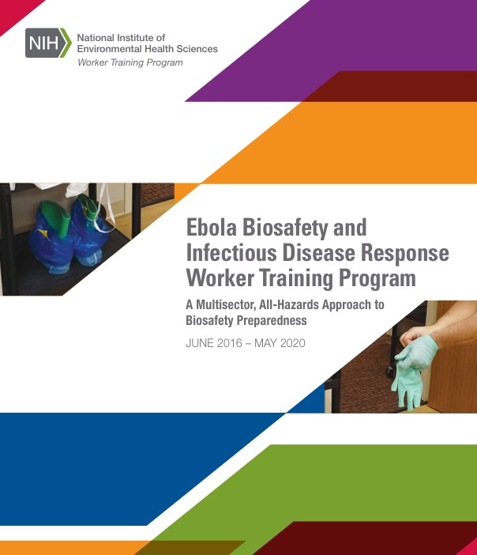

Infectious Disease and Biological Hazards Training
Notes:
NIEHS WTP supports the development and implementation of training programs to prevent occupational exposure to infectious agents that cause diseases like COVID-19 and Ebola. These training programs target workers in a variety of occupations, including workers who face risk of exposure to infectious and biological hazards due to their jobs and assigned tasks, those who have frequent or close contact with the general public, and those with minimal occupational exposure but may have an ongoing risk in their community.
These training programs aim to:
Provide workers with the skills and knowledge to protect themselves and their communities from potential exposure.
Increase organizational awareness and capacity to minimize exposure.
Develop tools, resources, curricula, and training approaches to reduce occupational exposure.
Develop a coordinated approach for infection prevention and occupational health among workers at various levels and facilities.
Promote and establish national, regional, and multistate partnerships to provide training or training support in occupational settings that face the risk of exposure to infectious agents.
Between 2017 and 2020, WTP administered the Ebola Biosafety and Infectious Disease Response Worker Training Program to build federal capacity for biosecurity, biopreparedness, and rapid response to emerging infectious diseases, including developing an infrastructure of trainers and organizations who can be a resource during emergencies. The program was developed in collaboration with the Centers for Disease Control and Prevention, the U.S. Department of Health and Human Services Office of the Assistant Secretary for Preparedness and Response, the Occupational Safety and Health Administration, and the National Institute for Occupational Safety and Health
About page: https://www.niehs.nih.gov/careers/hazmat/training_program_areas/ebola
MUSTID is a searchable portal that provides easy access to resources on infectious disease and worker safety shared by and relevant to the Worker Training Program (WTP) and others interested in worker safety and health: https://tools.niehs.nih.gov/wetp/mustid/index.cfm
The WTP has also developed a pathogen safety data (PSD) guide and training module and a new shortened version of the original training module, for WTP award recipients and other occupational safety and health groups involved in infectious disease response: https://tools.niehs.nih.gov/wetp/index.cfm?id=2554

Slide 20
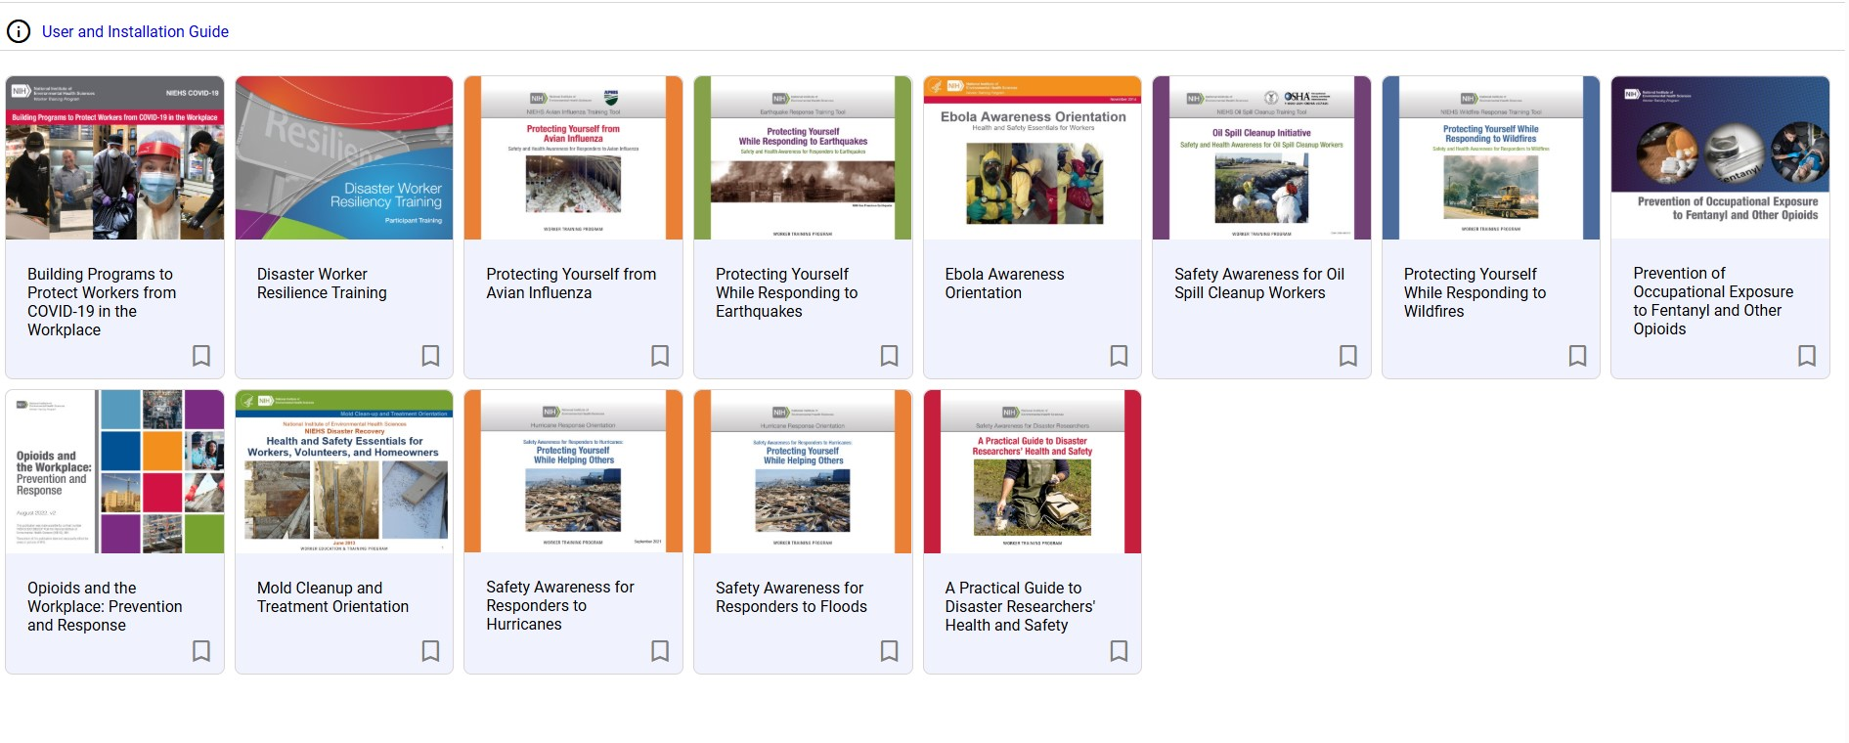
WTP Training Programs and App
Notes:
Booklets are available as a resource to distribute for emergency responders and cleanup workers. These pocket-sized guides address a variety of disaster types, and some are available in more than one language. Download the Disaster Tools app for on-the-go access to WTP disaster training tools.
App: https://tools.niehs.nih.gov/wetp/disasterapp/

Slide 21
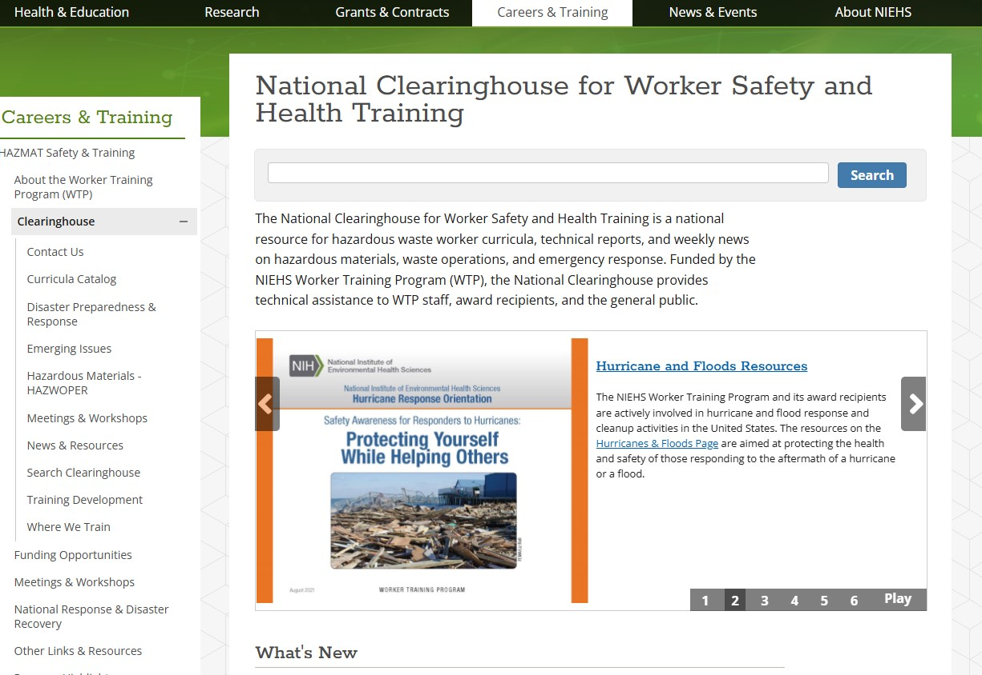
National Clearinghouse for Worker Safety and Health
Notes:
The National Clearinghouse for Worker Safety and Health Training is a national resource for hazardous waste worker curricula, technical reports, and weekly news on hazardous materials, waste operations, and emergency response. Funded by the NIEHS Worker Training Program (WTP), the National Clearinghouse provides technical assistance to WTP staff, award recipients, and the general public.

Slide 22
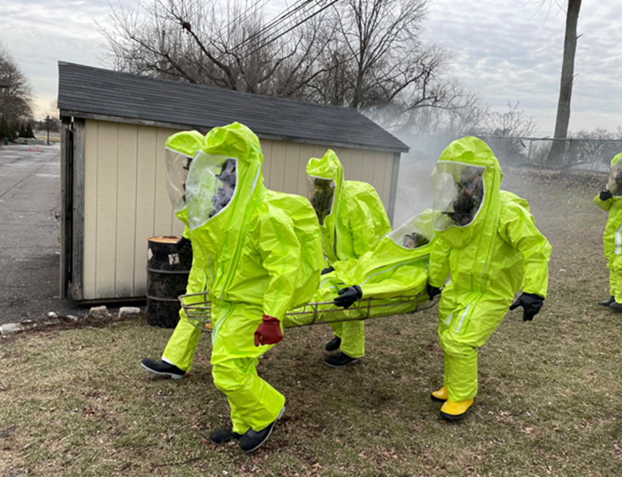
Thank You!
Please feel to reach out anything to connect further.
Eric.Persaud@nih.gov

