Slide 1

Cority Software

Slide 2
Medical Surveillance
EPA’s Occupational Medical Surveillance Program (OMSP) currently services approximately 2,700 employees with FOH costs for FY 2024 ~ $3.7 million
Effectively managing historic, current and future medical and exposure data is vital to protecting the agency’s workforce.
EPA needed a system to comply with OSHA statutory requirements associated with collecting, managing, storing, reviewing and retrieving employee medical surveillance and exposure data.
A digital process vs. paper records could save EPA over $1 million a year.

Slide 3
IH and Safety Modules
OMSP needs additional information to improve medical surveillance exams and overall program. So added 2 other modules:
Industrial Hygiene Module
  Noise and Chemical Monitoring information
Safety Module
  Job Hazard Analysis
  Incident Reporting (including Injury/Illness)

Slide 4
Additional Benefits
Digital medical surveillance form routing
Medical records readily available to employees through “mycority” portal
IH Module
  Track respirator fit tests including automated reminder emails to staff
  Analyze data across the agency to identify trends in job positions or tasks with elevated exposure
  Equipment management (Air pumps, calibrators, heat stress, etc.)
Safety Module
  Equipment management (AEDs, calibrations, fume hoods, etc.)
  Audit/Inspection tracking
  Task assignment and tracking (e.g. equipment inspections)

Slide 5
Timeline – 5 phases
Initiate
Oct-Dec 2025
Kickoff meeting with Cority and EPA SOHD leads.
Workgroups for each module established
Shape
Dec 2025 – Feb 2026
Workshops to review base Cority and EPA needs.
Cority staff configure software to match EPA needs and processes.
Refine
Feb–May 2026
Workshops to review configuration was completed as requested
Confirm
May 2026-June 2026
User Acceptance Testing – final review by EPA staff testing system (instead of Cority demo)
Train the Trainer
Training for EPA SHEM staff.
Go Live
July 2026
Activate software for use by all users and mycority accounts for staff.
Training for EPA SHEM staff.
Help email account established for help requests.

Slide 6
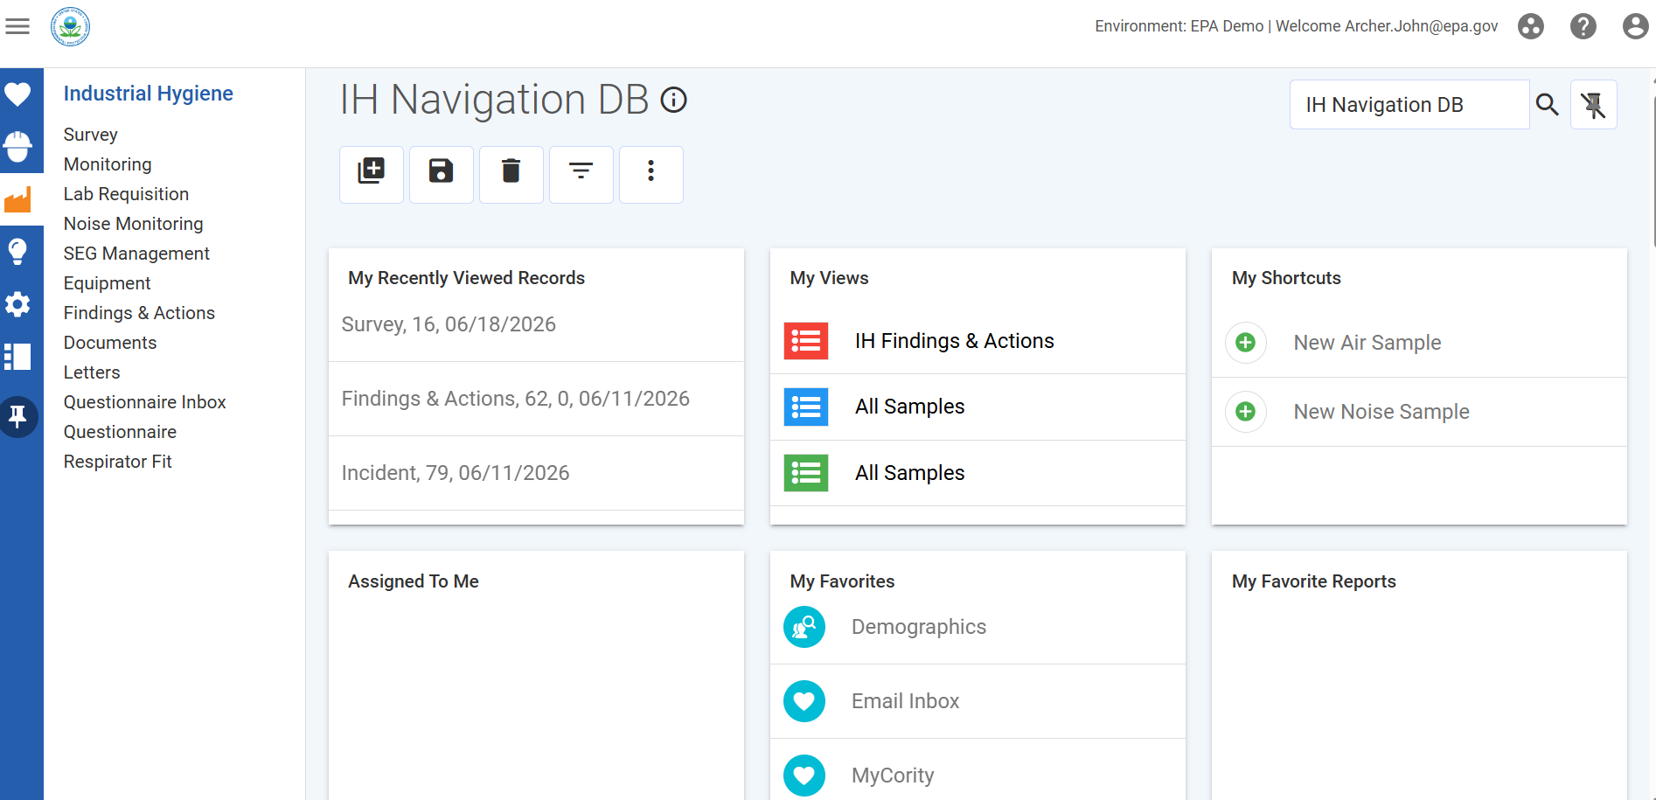
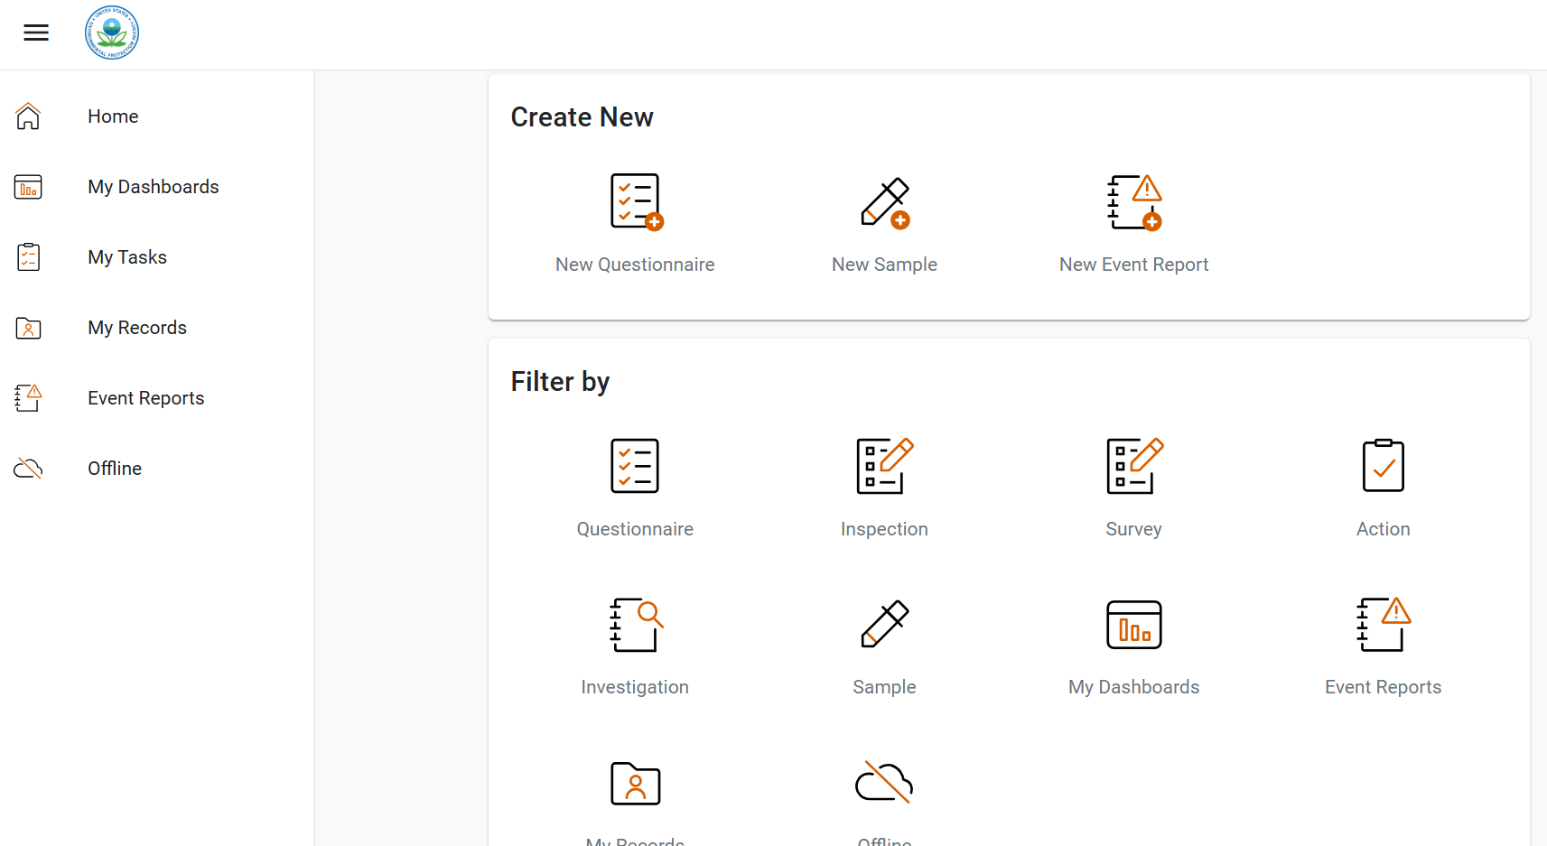
EPA DEMO
EPA Demo Cority Build Environment
https://epa.demo.coritygov.com/dashboardlayout/dashboard.rails?id=2
myCority employee access
https://epa.demo.my.coritygov.com/#/home

