Slide 1
Current NIOSH Efforts in Authoritative Recommendations for Chemical Management
2026 NRT Worker Safety and Health Technical Workshop
June 24, 2026
Falls Church, VA
(virtual presentation)
Todd Niemeier, PhD, CIH
Chief, Risk Evaluation Branch
Division of Science Integration
National Institute for Occupational Safey and Health
1

Slide 2
Overview
Overview of NIOSH Risk Assessment Processes
Immediately Dangerous to Life or Health (IDLH) values
NIOSH Skin Notations
Occupational Exposure Bands
NIOSH Pocket Guide to Chemical Hazards
Application of information to National Response Team Quick Reference Guides
2

Slide 3
What is NIOSH’s Mandate to Conduct Risk Assessments?
The Occupational Safety and Health Act (1970) establishes as part of NIOSH’s mission:
“...to describe exposure levels that are safe for various periods of employment, including but not limited to the exposure levels at which no employee will suffer impaired health or functional capacities or diminished life expectancy as a result of his work experience”
29 USC 669 (a)(3)
3
Notes:
Source: CIB 69, p.vii
Cleared Slide: E Frank May2026

Slide 4


Overview on Risk Assessment
Risk Assessment Process
Foundation of these criteria is quantitative risk assessment
  Methods consistent with National Research Council Guidance
Determining what type of hazard is associated with a chemical or other agent;
Collating the scientific evidence indicating whether the chemical or other agent causes illness or injury;
Evaluating the scientific data and determining how much exposure to the chemical or other agent would be harmful to workers;
Carefully considering all relevant evidence to make the best, scientifically supported decisions
4
Notes:
In 2020, A NIOSH team published a current intelligence bulletin of NIOSH practices in occupation risk assessment. This document established a process that we were already doing, using quantitative risk assessment approaches and using the methodology outlined by the National Research Council in 1983 and 2009.
This risk assessment process simply describes follows 4 steps:
What is risk assessment: The (preferably quantitative) determination of the relationship between the predicted exposure and adverse effects.

Slide 5
Risk Assessment Needs for Chemical Exposures
Hazard Identification: Assessing the weight of evidence on whether an agent of interest causes an adverse effect in exposed workers, and how/why it occurs (mode of action)
Dose-Response Assessment: Determining, measuring, or estimating the relationship between the level of exposure and the degree of change
Risk Characterization: Qualitative and/or quantitative determination of the probability of occurrence, including uncertainties, of known and potential adverse effects in workers under defined conditions of exposure to an agent
    Transforms a dose-response estimate to a dose-risk estimate by extrapolating to a target risk level or workplace risk scenario and/or accounting for uncertainties
5
Notes:
Cleared Slide: E Frank May2026
Source: CIB 69, p.vi

Slide 6
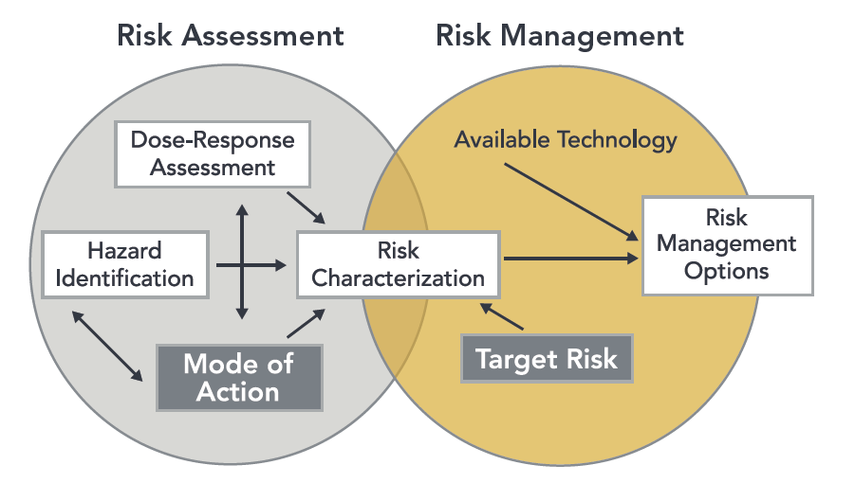
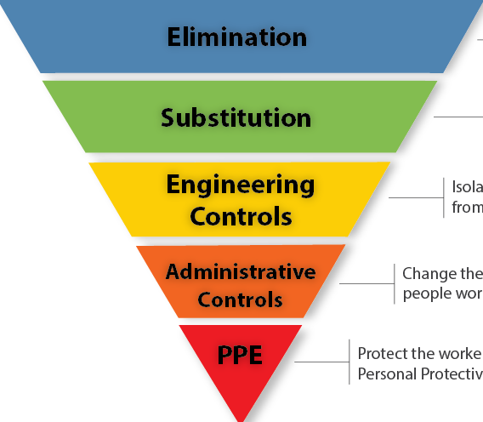
6
Notes:
Cleared Slide: E Frank May2026
Source: CIB 69, p.vii

Slide 7
Types of Risk Assessments NIOSH Does
Recommended exposure limits (RELs): Time-weighted averages (8- or 10-hr workdays, 5d/wk)
Short-term exposure limits (STELs, a.k.a. ST-RELs): Time-weighted averages for short periods (5-15 min)
Ceiling Limits (C): Health-protective limits not to be exceeded (may or may not have a time-averaging period)
Risk Management Levels – Carcinogens (RML-Ca): NIOSH’s updated risk terminology for known carcinogens
Immediately Dangerous to Life or Health (IDLH) Values: Recommendation level for evacuation or donning respiratory protection
Skin Notations (SK): Denote direct or systemic hazards arising from dermal exposure
Occupational Exposure Bands (OEBs): Categorizes chemicals by hazard potential and toxic potency to aid risk management decisions when more detailed assessments are not available
7
Notes:
Cleared Slide: E Frank May2026

Slide 8
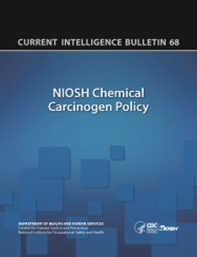
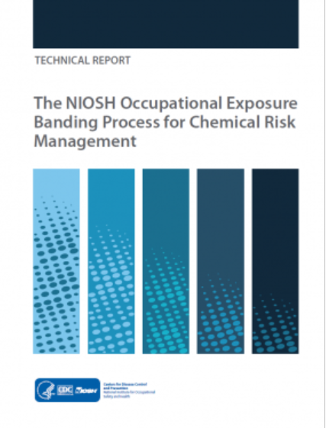

Technical Guidance, Procedures, and Current Intelligence Bulletins (CIB)
CIB 69: NIOSH Practices in Occupational Risk Assessment
CIB 66: Derivation of Immediately Dangerous to Life or Health (IDLH) Values
CIB 61: A Strategy for Assigning New NIOSH Skin Notations
NIOSH CIB 68: NIOSH Chemical Carcinogen Policy
NIOSH Occupational Exposure Banding Process for Chemical Risk Management
8
Notes:
Cleared Slide: E Frank May2026

Slide 9
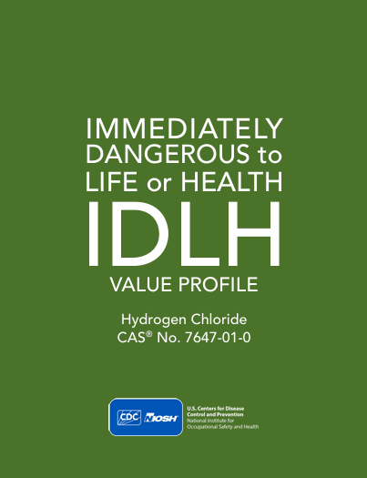
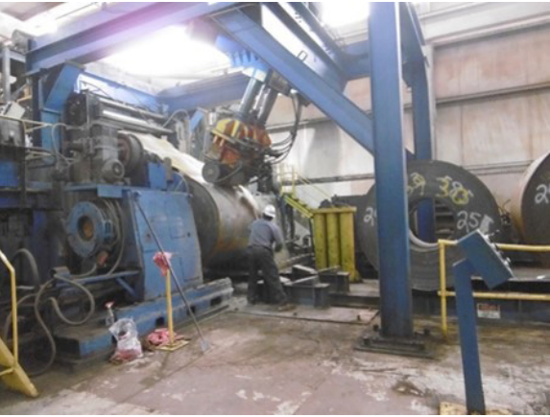
IDLH Value for Hydrogen Chloride
Photo credit: NIOSH
9

Slide 10
Hazard Identification for IDLH Effects
IDLH Values are intended to prevent death, long-term injury, and impairment of ability to escape
IDLH Effects Include:
    Severe Respiratory & Eye Irritation
    Incapacitation & Narcosis
    Cardiovascular Effects & shock
    Death
    Explosion Hazards
NIOSH considers chemical exposures immediately dangerous if they cause the above effects considering a 30-minute escape window
10
Notes:
Cleared Slide: E Frank May2026
CIB 66
IDLH Value Profile for HCl (current), p.1-2

Slide 11
Development of an IDLH for Hydrogen Chloride (HCl)
Intended to protect workers in acute, high-exposure incidents, also guides use of respirators
Original value was set at 50 ppm (1994) based on self-reported respiratory irritation symptoms in a small sample of human subjects in a 1943 experiment
    Not quantitative and based on limited, subjective information
NIOSH updated its IDLH development protocol in 2013 to improve comprehensiveness and transparency
Updating IDLHs for chemicals is ongoing
11
Notes:
Cleared Slide: E Frank May2026
Old IDLH page for HCl: Restored CDC | Hydrogen chloride - IDLH | NIOSH | CDC
CIB 66

Slide 12
Hazard Identification for IDLH Effects
NIOSH reviewed available literature and identified IDLH hazards for HCl:
    Eye irritation based on a study in guinea pigs
    Respiratory irritation based on a study in mice
    Death based on a study of lethal concentrations in guinea pigs
These were consistent with symptoms reported in older reports that used human subjects
12
Notes:
IDLH Value Profile for HCl (current), p.15

Slide 13
Dose-Response for IDLH Effects
Effect | Species | Endpoint | Exposure Metric | IDLH Concentration
Eye Irritation | Guinea Pig | Corneal Opacity | No-Effect Level | 320 ppm
Respiratory Irritation | Mouse | Respiratory Depression | RD₅₀ (half of maximal) | 309 ppm
Death | Guinea Pig | Lethality | LD₅₀ | 1,341 ppm
13
Notes:
IDLH Value Profile for HCl (current), p.15

Slide 14
Risk Characterization for IDLH Effects: Selecting an IDLH Value
NIOSH 2025
Lethality-based value agrees well with self-reported symptoms in human adults and offers a data-based dose-risk estimate
14
Notes:
IDLH Value Profile for HCl (current), p.17

Slide 15
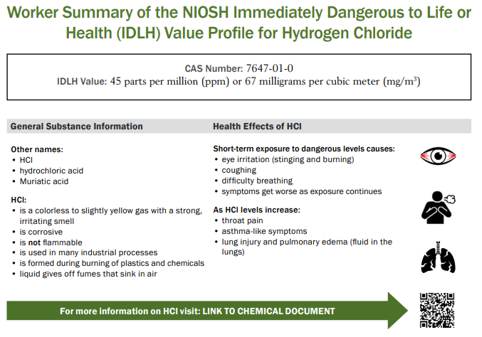
15
Notes:
IDLH Value Profile for HCl (current)

Slide 16
List of IDLH values under current consideration:
Lewisite (currently considering public/peer review comments)
Acetone (initial draft)
2-butanone (initial draft)
Toluene (initial draft
Bromine chloride (initial draft)
Allyl alcohol (initial draft)
16

Slide 17
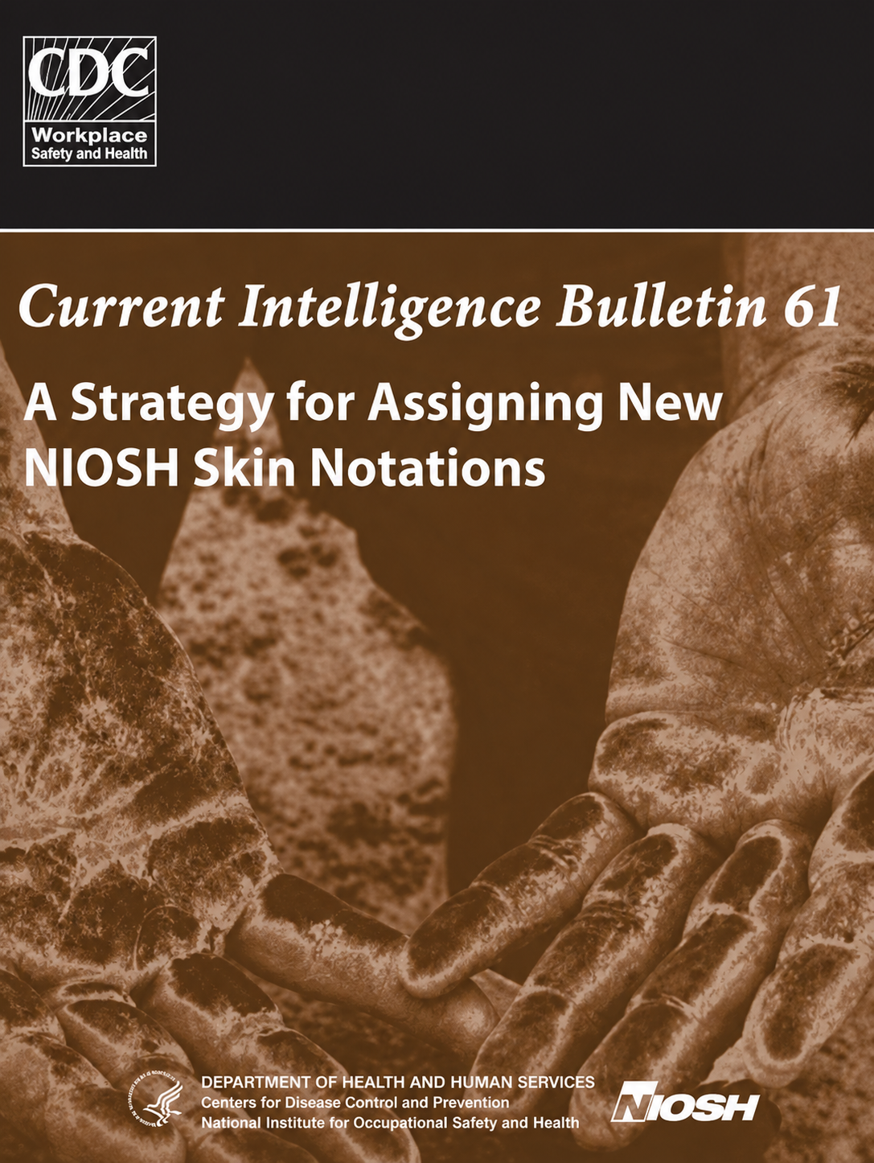
NIOSH Skin Notations
17

Slide 18
Skin Notations Aid in Risk Management of Hazards Occurring Via Skin Exposure
Skin profiles are based on hazard identification of both local (skin) effects and systemic effects of transdermal absorption
Assignment of skin notations (SK) considers the potential for:
    Systemic toxicity following absorption [SK: SYS]
    Severe toxicity following absorption [SK: SYS(FATAL)]
    Adverse skin effects that are reversible [SK: DIR(IRR)]
    Destructive skin effects that are not reversible [SK: DIR(COR)]
    Immune-mediated or allergic skin sensitization [SK: SEN]
    Chemicals not hazardous via dermal exposure are notated [SK]
    Cases of insufficient data are notated [ID^{(SK)}]
18
Notes:
CIB 61, p. 3-8

Slide 19
NIOSH skin notations
19

Slide 20
Skin Notation Documentations
Each SK has a brief technical report summarizing the available data on hazard potential
SK documentations review:
    Scientific data on the physicochemical properties of a chemical
    Human exposures and health effects
    Empirical data from in vivo and in vitro laboratory testing
    The use of computational techniques, including predictive algorithms [e.g., quantitative structure-activity relationships (QSAR)] and mathematical models that describe a selected process (e.g., skin permeation) using analytical or numerical methods
20
Notes:
CIB 61, p. 4

Slide 21
List of skin notations under consideration
Formamide (addressing peer and public comments)
Formic acid (addressing peer and public comments)
Allyl alcohol (addressing peer and public comments)
Phenothiazine (addressing peer and public comments)
Picric acid (addressing peer and public comments)
21

Slide 22
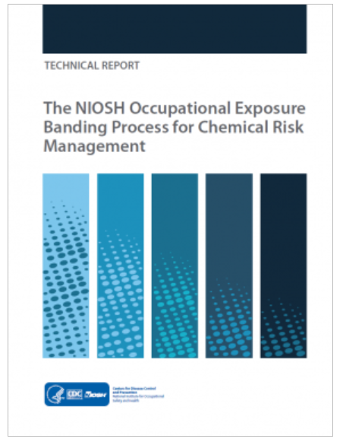
NIOSH Occupational Exposure Banding Process
22

Slide 23
The NIOSH Occupational Exposure Banding Process
A practical framework for chemical risk management when an occupational exposure limit is not available
Why this matters
Most chemicals have no authoritative OELs.
NIOSH OEBs are a consistent, documented way to use hazard data for exposure-control decisions.
Especially useful for screening, prioritization, and communicating hazard severity.
Key messages on Occupational Exposure Bands (OEBs):
Not a replacement for Occupational Exposure Limits (OELs)
Provide health-based exposure ranges
Can support interim risk management and prioritization.
The NIOSH Occupational Exposure Banding Process for Chemical Risk Management (2019-132) | NIOSH | CDC
23
Notes:
NIOSH Occupational Exposure Banding Process for Chemical Risk Management, Executive Summary and Chapter 1, pages iv-vii and 1-3

Slide 24
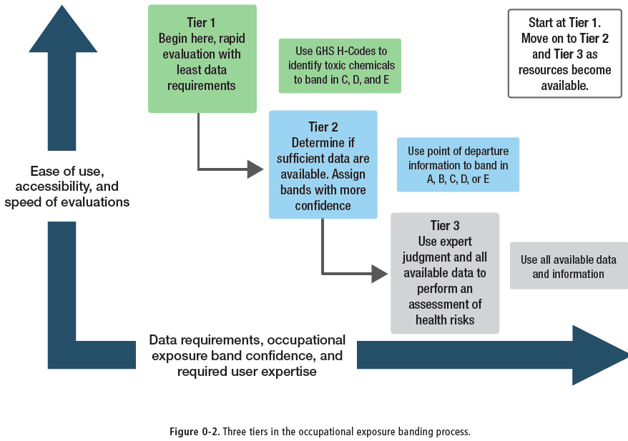
24
Notes:
Executive Summary, page viii (Figure 0-2)
How do we come up with A-E
Tier 1: GHS codes.
Tier 2: Look at NTP, EPA databases
Tier 3: Primary research/studies.

Slide 25
NIOSH OEB Comparison with Occupational Exposure Limits (OELs)
Evaluation findings
91%
98%
Key implication
Tier 2 better reflects total toxicity and should be completed whenever data and expertise allow
Tier 1 bands included the OEL or were more stringent for tested chemicals
Tier 2 bands included the OEL or were more stringent for tested chemicals
25
Notes:
Chapter 1, and Chapter 6, pages vi-vii, 3-10, and 69-82.
NIOSH has performed evaluation exercises to assess consistency of the OEB process with OELs.
To evaluate the Tier 1 process, NIOSH compared the OELs of 606 chemical substances to the derived Tier 1 band for those chemical substances. This evaluation found that the NIOSH Tier 1 banding process resulted in a band that included the OEL or was more stringent than the OEL for 91% of chemical substances.
Five iterative phases of Tier 2 reliability testing were performed to assess Tier 2 as the process evolved. These assessments involved over 130 chemical substances with OELs. Results of these evaluations show that Tier 2 OEBs are highly likely to be at least as stringent as OELs. Tier 2 OEBs include the OEL or are more stringent than the OEL for 98% of chemical substances tested.

Slide 26
NIOSH OEBs are a Tool for Risk Management
OEBs are designed as practical decision-support tools, not as a substitute for full oel development
What OEBs are used for
Inform exposure-control decisions when no authoritative OEL exists
Prioritize chemicals for substitution, elimination, or further evaluation
Support hazard communication and identify the health effects driving concern
Help guide medical surveillance and preparedness planning
Bottom line: The occupational exposure banding process translates toxicology information into an occupational exposure recommendation that can be used before a formal OEL is available.
26
Notes:
Chapter 1, and Chapter 6, pages vi-vii, 3-10, and 69-82.

Slide 27
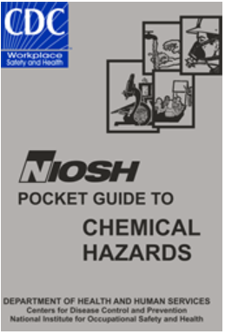
NIOSH Pocket Guide to Chemical Hazards
27

Slide 28
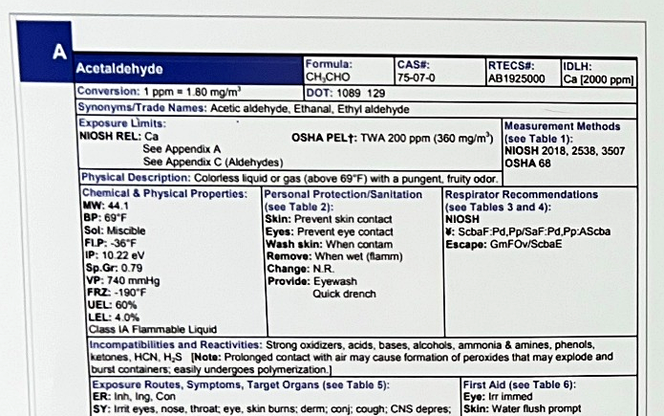
OVERVIEW
What is the NIOSH Pocket Guide?
A practical reference for chemical hazards commonly found in workplaces.
The guide provides:
Descriptive chemical information
Exposure information
Protective recommendations
Emergency first aid recommendations
677 chemicals commonly found in the work environment
28

Slide 29
Reach and Distribution
700,000+
638,000+
84,000+
print copies of the NPG distributed
CD-ROMs distributed
mobile app downloads
29
Notes:
As of 2026

Slide 30
NPG Past to Present
1978
2005
2016
2027?
NIOSH release the first Pocket Guide to Chemical Hazards
Version 6 is printed and becomes the current print edition
Mobile app is released for Android and Apple devices
Version 7
The NPG has moved from a print/CD reference to a resource that also includes mobile access and towards a refreshed re-design in Version 7
30

Slide 31
NIOSH Pocket Guide Update (in progress)
Update information
Expert review
1
2
Chemical and health-effect information updates using governmental databases.
Updated data currently under review by NIOSH subject matter experts; health effects had external review.
CPC / DECON* logic
Respirator verification
3
Decision logic for chemical protective clothing and decontamination recommendations internally reviewed
4
Respirator recommendations updated and verified using the NIOSH Respirator Selection Logic, 2004.
* Chemical protective clothing/decontamination
31

Slide 32
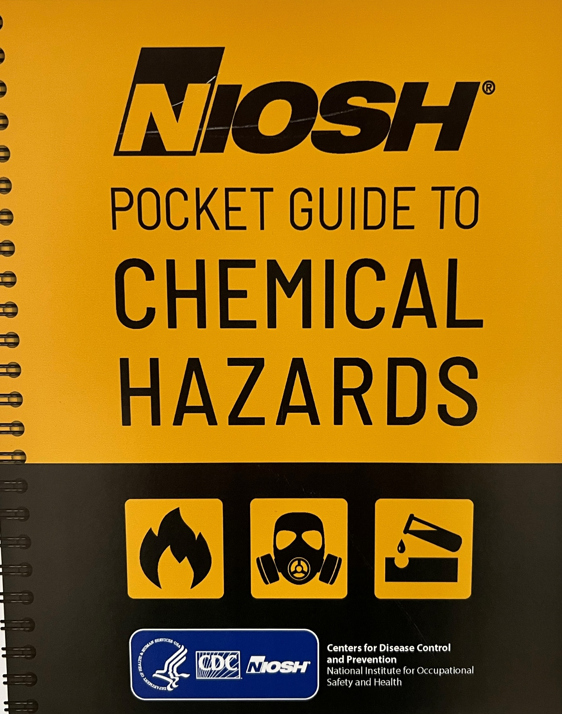
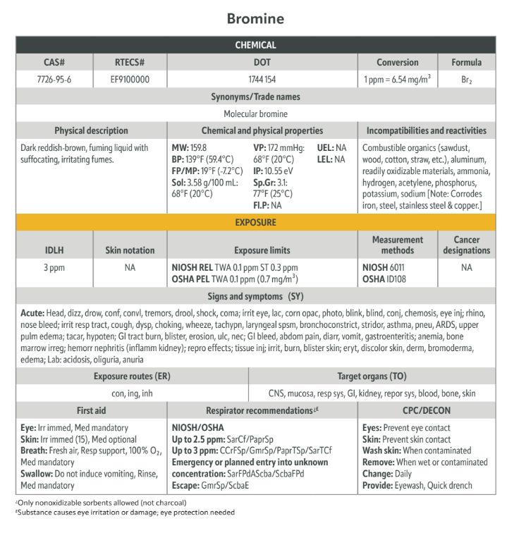
UPDATE PROCESS
NIOSH Pocket Guide Update – Proposed Layout
32

Slide 33
NIOSH Pocket Guide- Next Steps
Currently conducting quality control evaluation for final formatting
Anticipate initial NIOSH internal review process (anticipated by Fall 2026)
Aiming for 2027 publication for both print and online versions
33
Notes:
Chapter 1, and Chapter 6, pages vi-vii, 3-10, and 69-82.

Slide 34
Application of Information to National Response Team Quick Reference Guides
NIOSH subject matter experts continue to serve on the National Response Team Quick Reference Guide committees
What additional information/feedback do you have for us regarding occupational chemical management activities?
34
Notes:
Chapter 1, and Chapter 6, pages vi-vii, 3-10, and 69-82.

Slide 35
References
NIOSH [2009]. Current intelligence bulletin 61: a strategy for assigning new NIOSH skin notations. Cincinnati, OH: U.S. Department of Health and Human Services, Centers for Disease Control and Prevention, National Institute for Occupational Safety and Health, DHHS (NIOSH) Publication No. 2009–147
National Research Council (NRC) (2009). Science and Decisions: Advancing Risk Assessment; The National Research Council of the National Academies, National Academies Press: Washington, DC, USA.
NIOSH [2013]. NIOSH pocket guide to chemical hazards. Cincinnati, OH: U.S. Department of Health and Human Services, Centers for Disease Control and Prevention, National Institute for Occupational Safety and Health. DHHS (NIOSH) Publication No. 2010-168c, http://www.cdc.gov/niosh/npg/. NIOSH [2013].
NIOSH [2014]. Current intelligence bulletin 66: derivation of immediately dangerous to life or health (IDLH) values. Cincinnati, OH: US Department of Health and Human Services, Centers for Disease Control and Prevention, National Institute for Occupational Safety and Health, DHHS (NIOSH) Publication 2014–100Skin notation CIB
NIOSH [2019]. Technical report: The NIOSH occupational exposure banding process for chemical risk management. By Lentz TJ, Seaton M, Rane P, Gilbert SJ, McKernan LT, Whittaker C. Cincinnati, OH: U.S. Department of Health and Human Services, Centers for Disease Control and Prevention, National Institute for Occupational Safety and Health, DHHS (NIOSH) Publication No. 2019-132
NIOSH [2020]. NIOSH practices in occupational risk assessment. By Daniels RD, Gilbert SJ, Kuppusamy SP, Kuempel ED, Park RM, Pandalai SP, Smith RJ, Wheeler MW, Whittaker C, Schulte PA. Cincinnati, OH: U.S. Department of Health and Human Services, Centers for Disease Control and Prevention, National Institute for Occupational Safety and Health. DHHS (NIOSH) Publication No. 2020-106 (revised 03/2020),
NIOSH [2025]. Immediately dangerous to life or health (IDLH) value profile: hydrogen chloride, CAS® No. 7647-01-0. By Frank E, Chittiboyina S, Leshner M, Edmondson M, Niemeier RT. Cincinnati, OH: U.S. Centers for Disease Control and Prevention, National Institute for Occupational Safety and Health, DHHS (NIOSH) Publication No. 2025-110
35
Notes:
Chapter 1, and Chapter 6, pages vi-vii, 3-10, and 69-82.

Slide 36
Contact Info:
Todd Niemeier
Division of Science Integration
rbn4@cdc.gov
Acknowledgements:
Evan Frank, PhD, DABT
Fouzia Farooq, PhD
Naomi Hudson, DrPH

