Slide 1
CBRN Responder Overview
16 June 2026

Slide 2



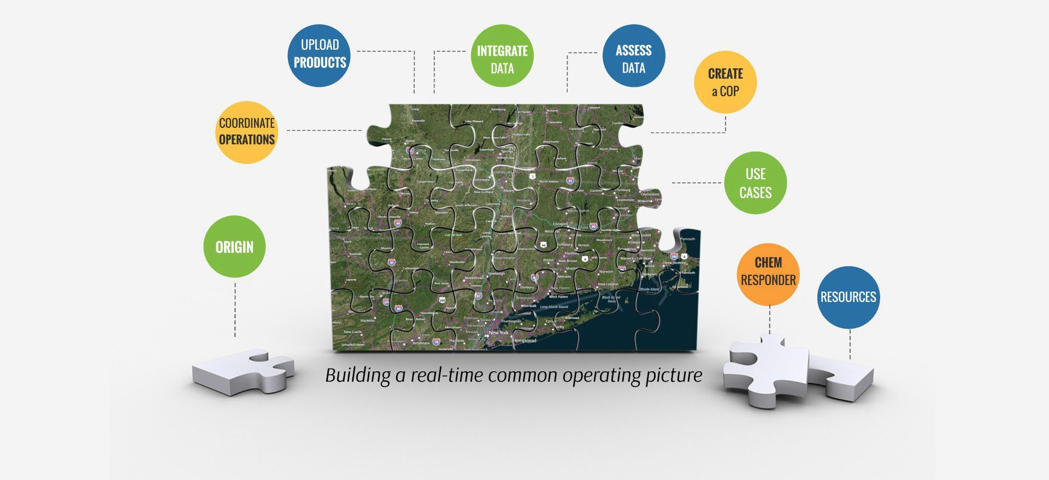

Slide 3
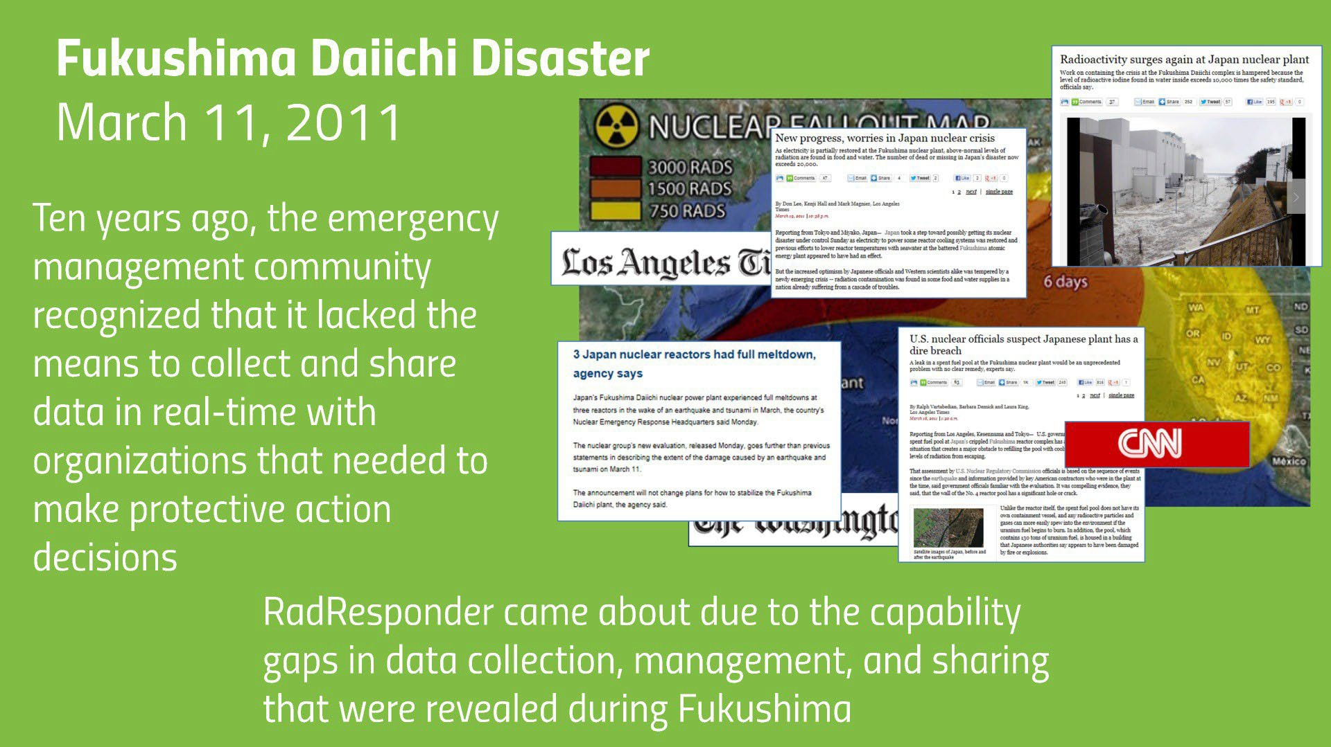
Origins
15

Slide 4
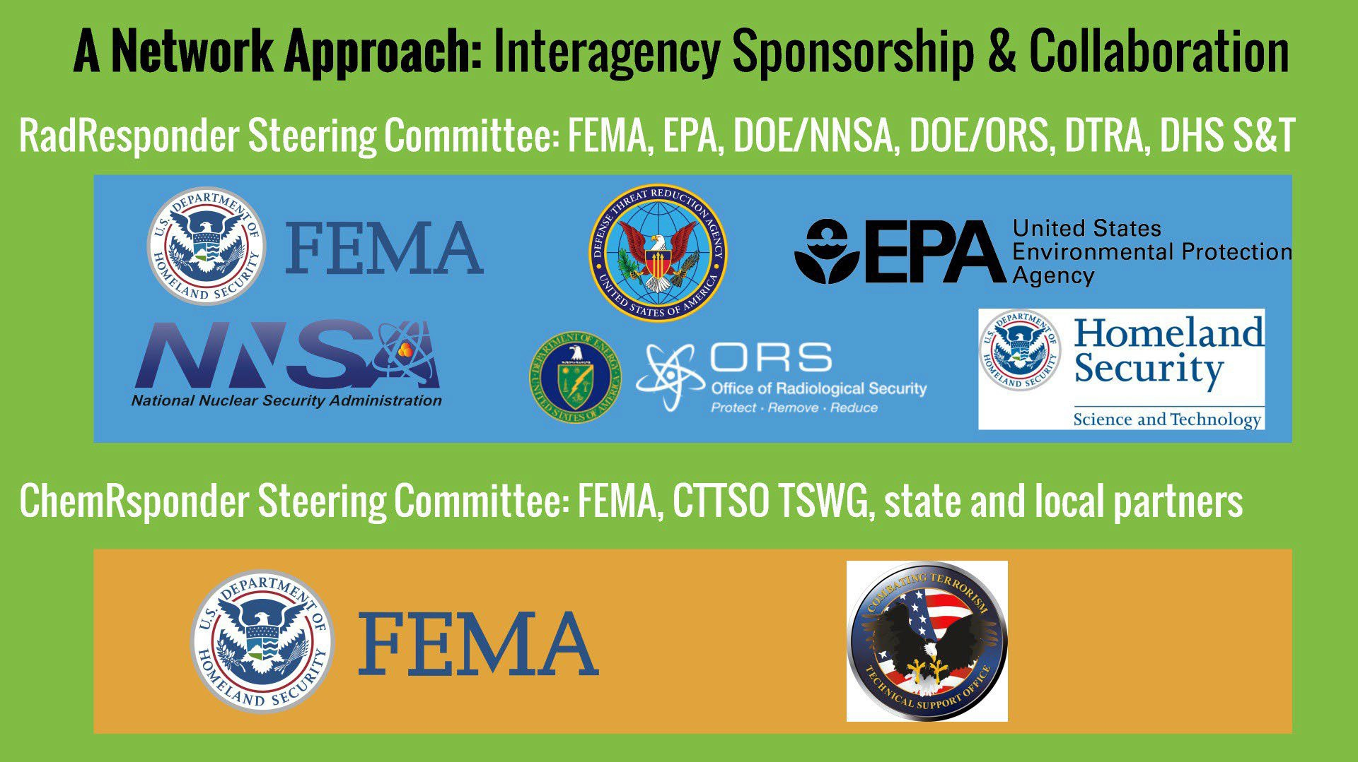






Origins
And many other state and local agencies

Slide 5



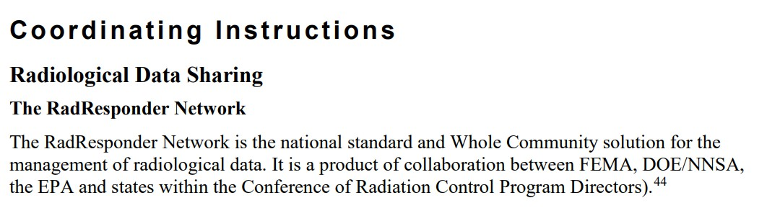
Origins

Slide 6






Origins
CBRNResponder Timeline
RadResponder Launched (2013)
IMAAC Portal Launch (2021)
ChemResponder Launched (2018)
CBRNResponder Launched
(2019)
RadResponder codified in NRIA (2016)
BioResponder Launch (2022)

Slide 7


Slide 8
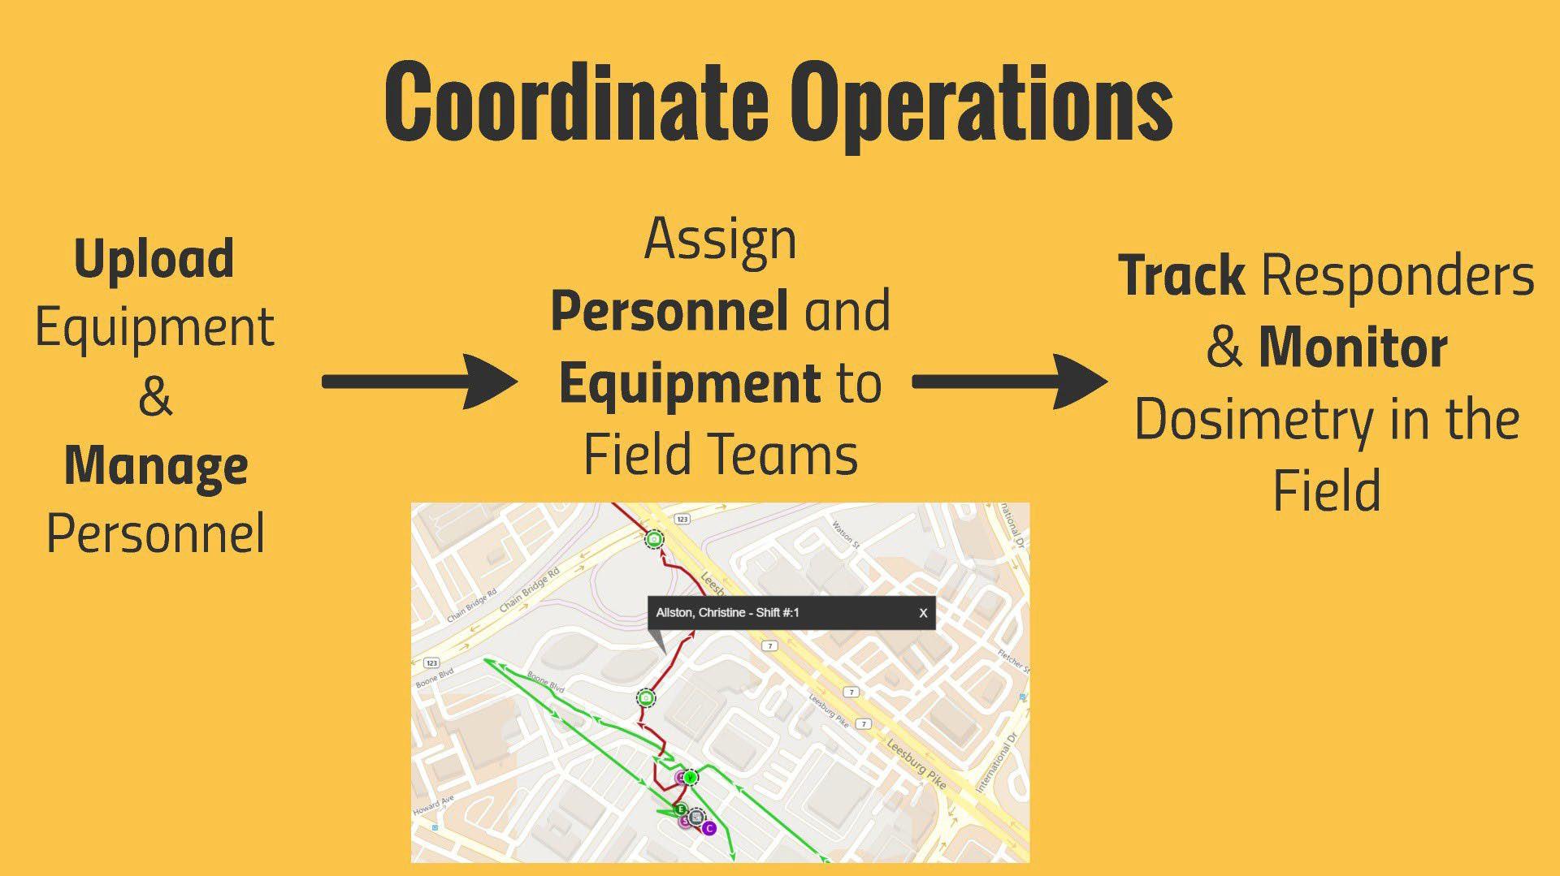
Coordinate Operations

Slide 9
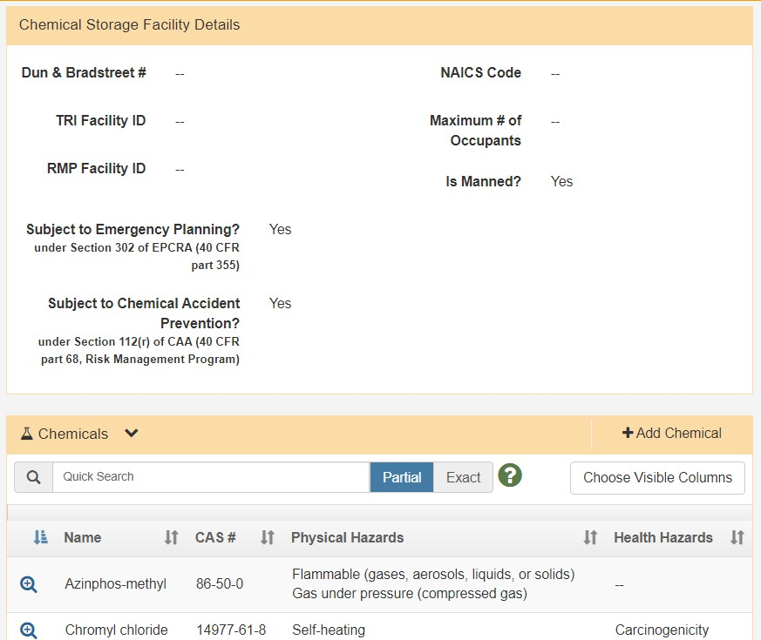
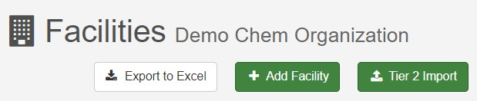
Coordinate Operations
Upload Facility Information
Tier II Data
Chemicals
Documents
Floor Plans
Points of Contact

Slide 10
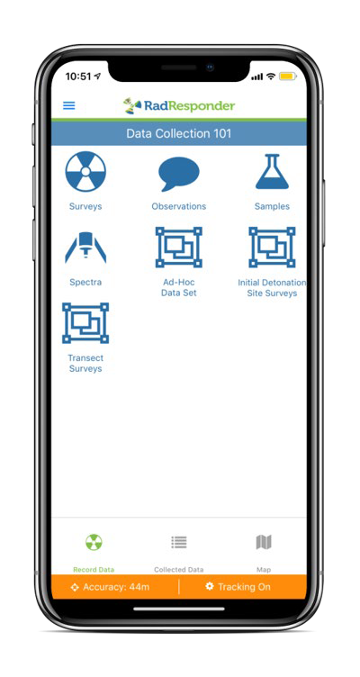
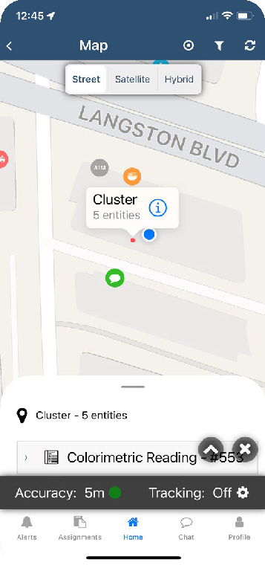
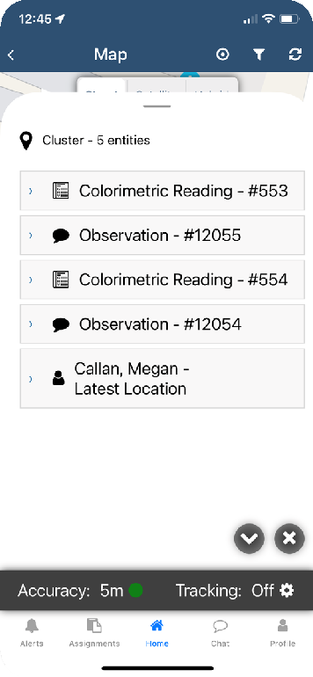
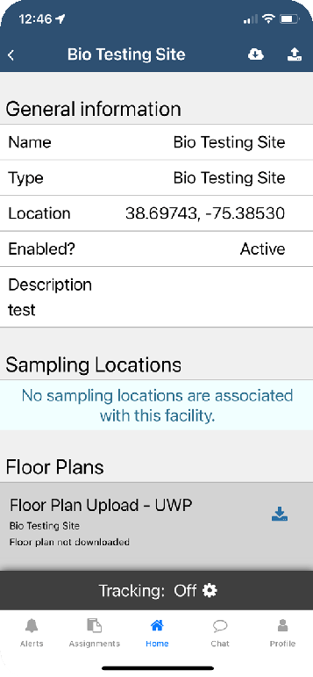
Coordinate Operations
Maintain Situational Awareness
Display data points, facilities, sampling locations, and responders on the event map
Search and filter facilities
View facility details: chemicals present, quantity, descriptions, locations, and contacts

Slide 11

CRCs

Slide 12
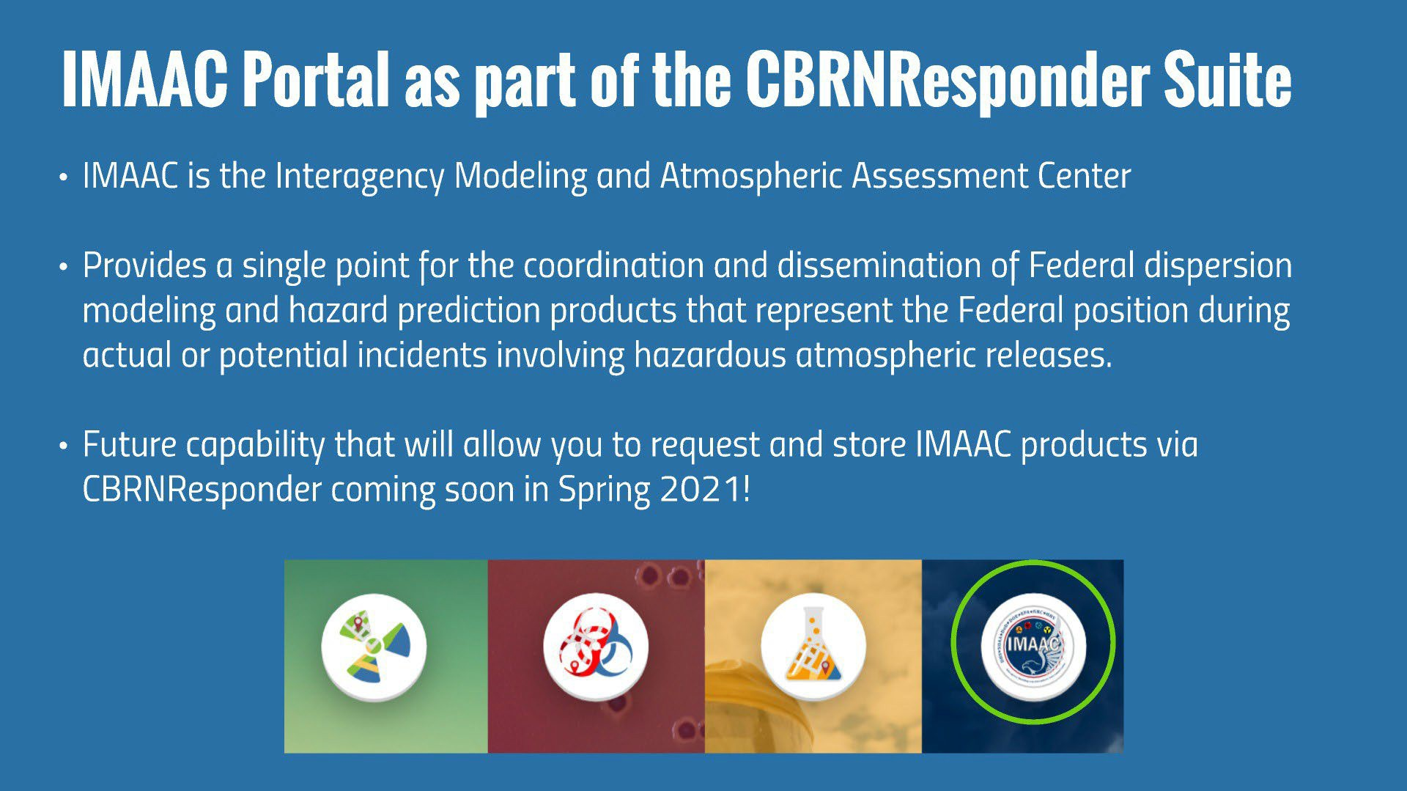
Upload Products
Upload Products
Launched September 2021 for all CBRNResponder users to request exercise model support!

Slide 13
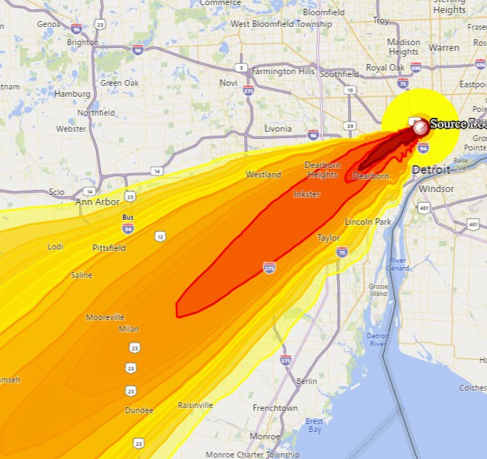
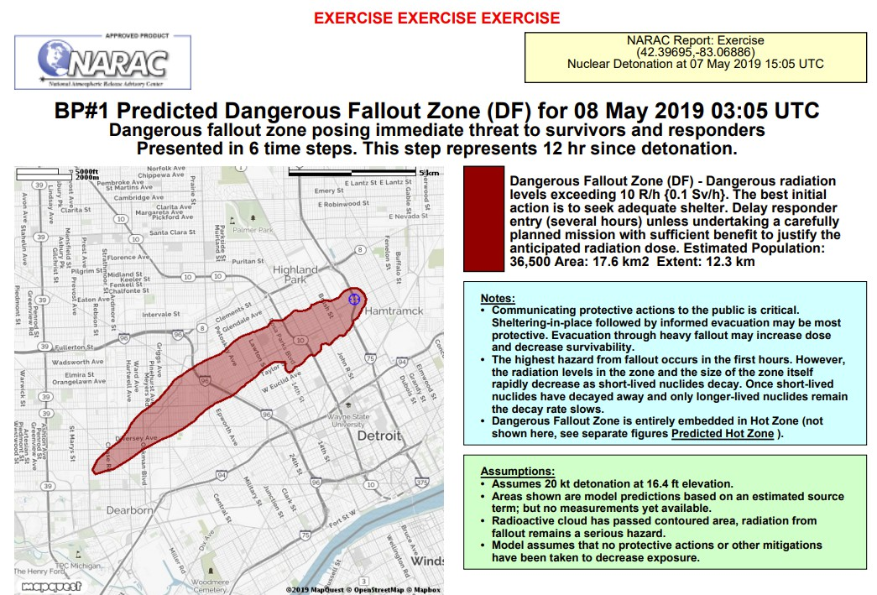

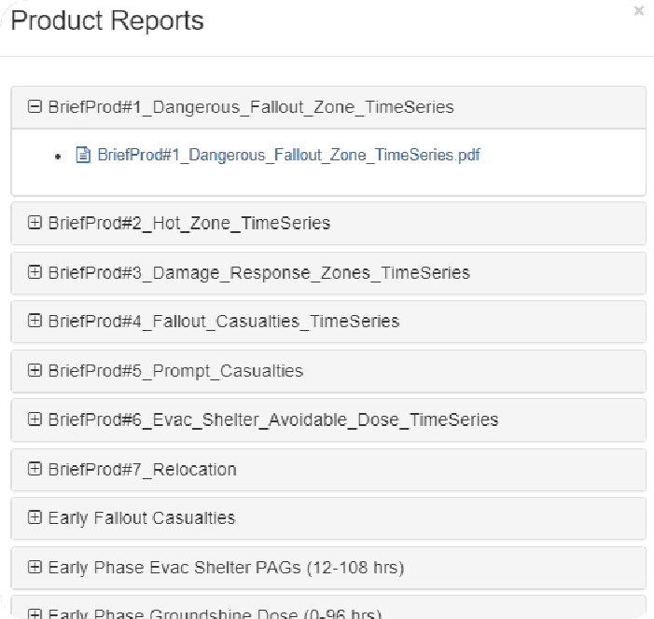
Upload Products

Slide 14
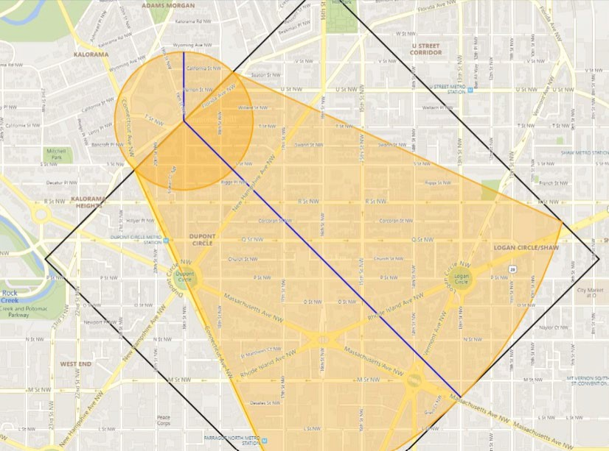
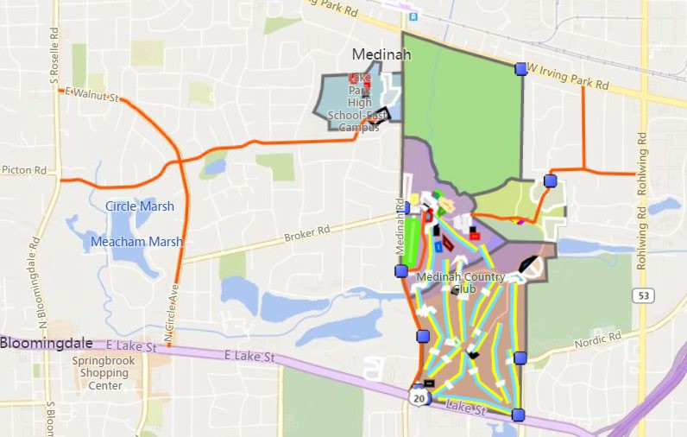
Upload Products
Upload your own GIS files (KML, KMZ, or Shapefiles)
ERG, Aloha or DTRA products
Critical infrastructure
Weather
ERG Protective Distances
User Uploaded GIS Files

Slide 15
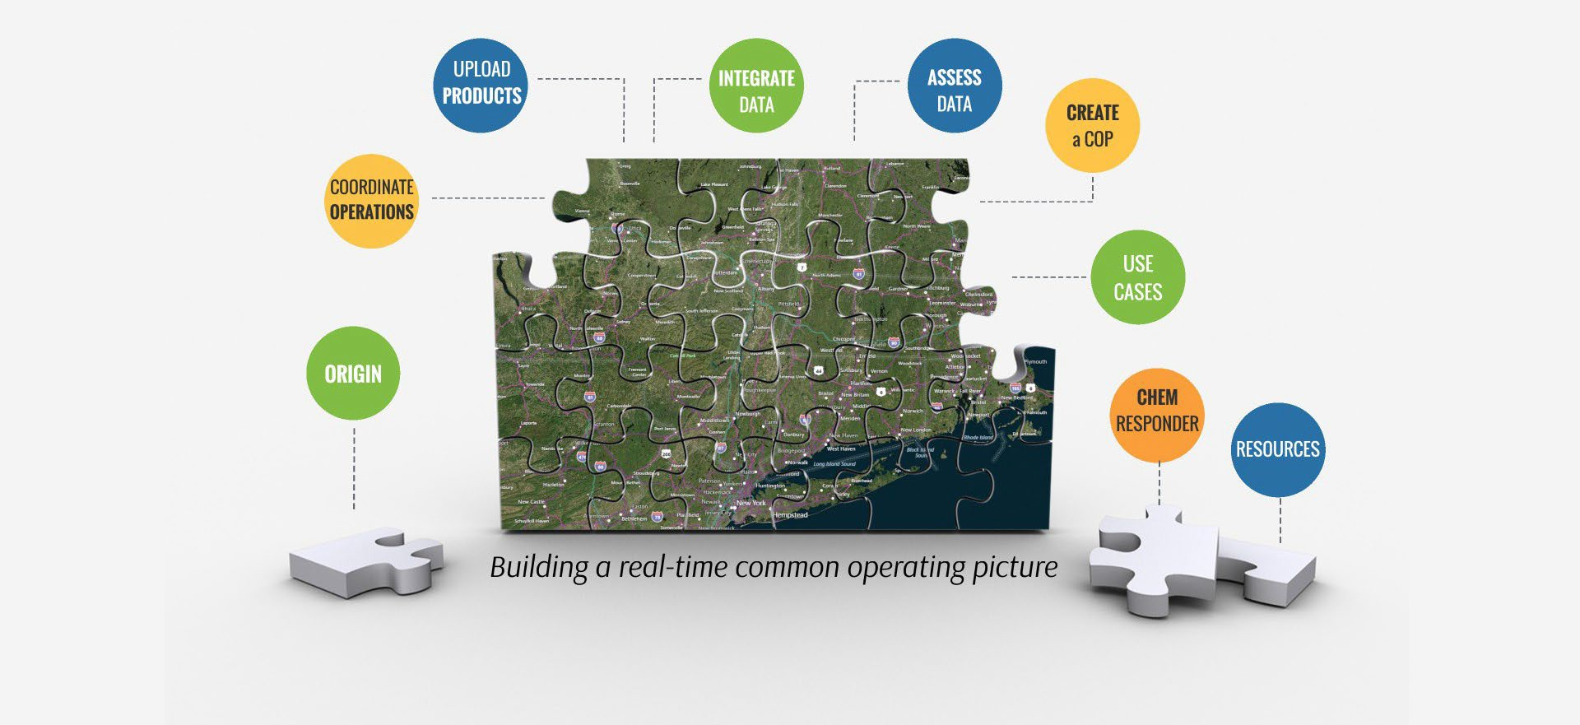
CRCs & Indoor

Slide 16
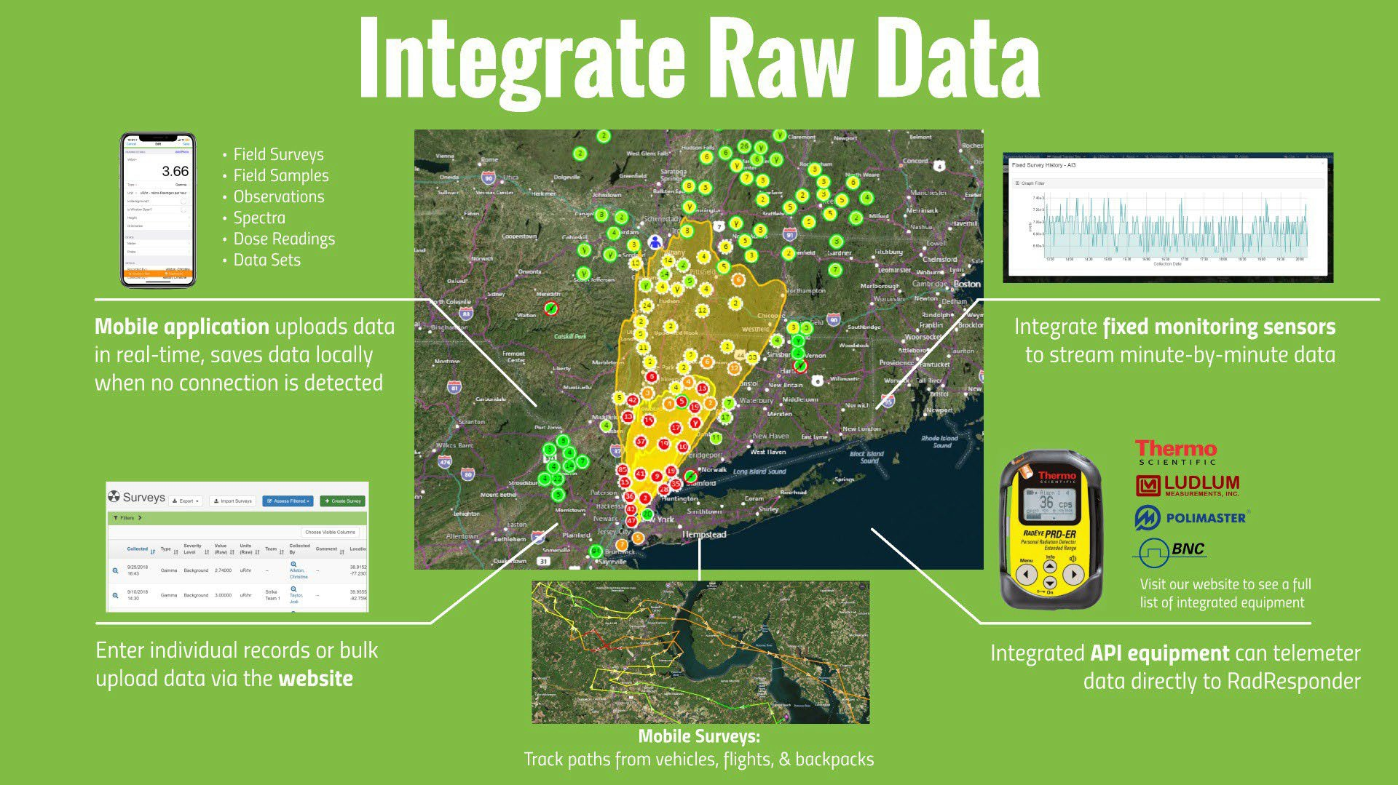
Integrate Data

Slide 17
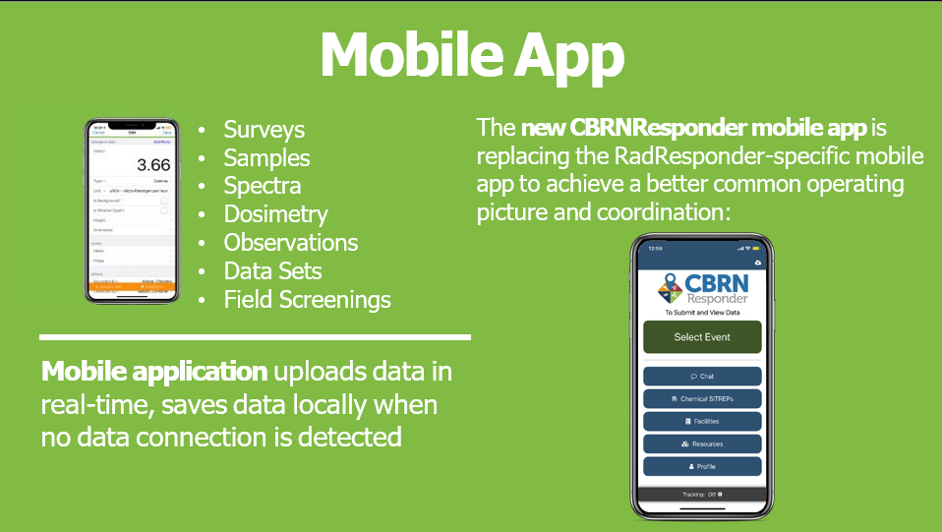
Integrate Data

Slide 18
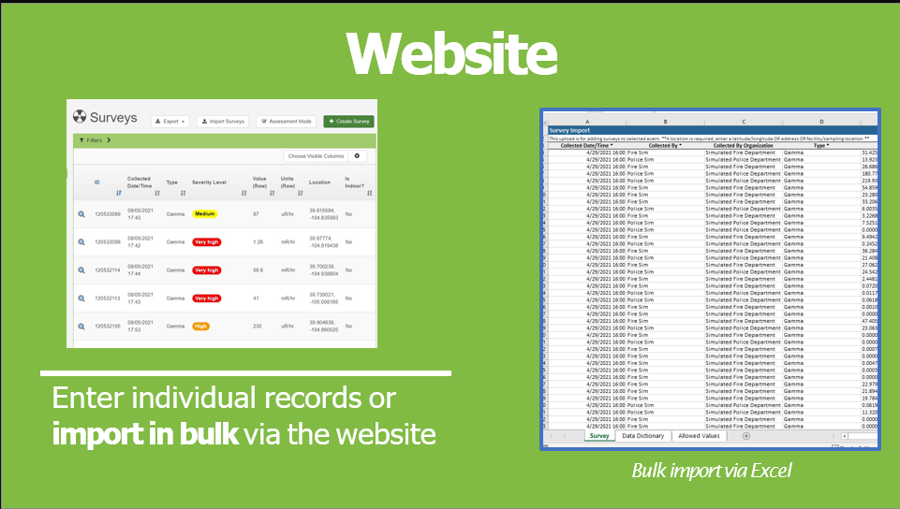
Integrate Data

Slide 19
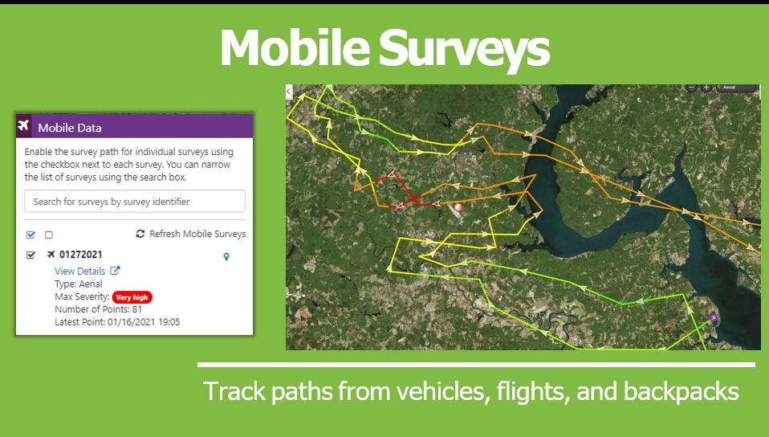
Integrate Data

Slide 20
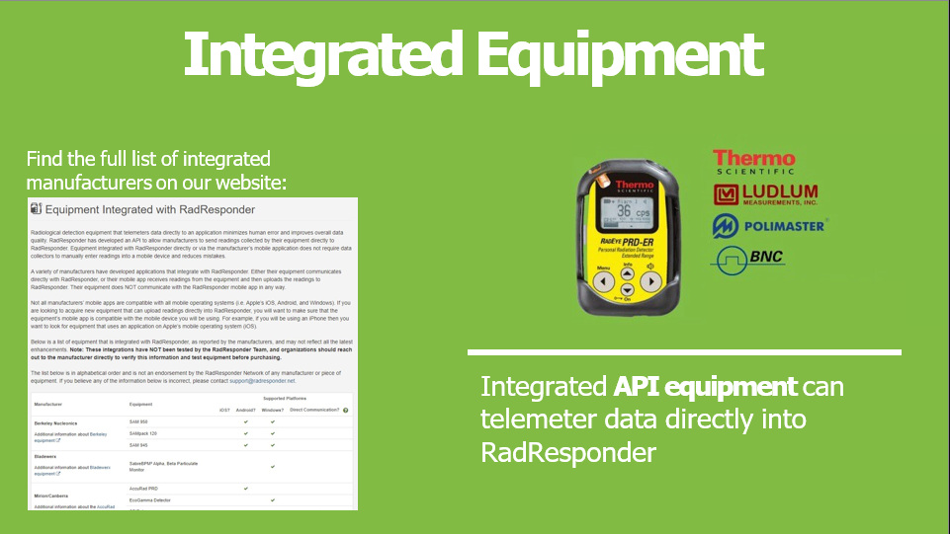
Integrate Data

Slide 21
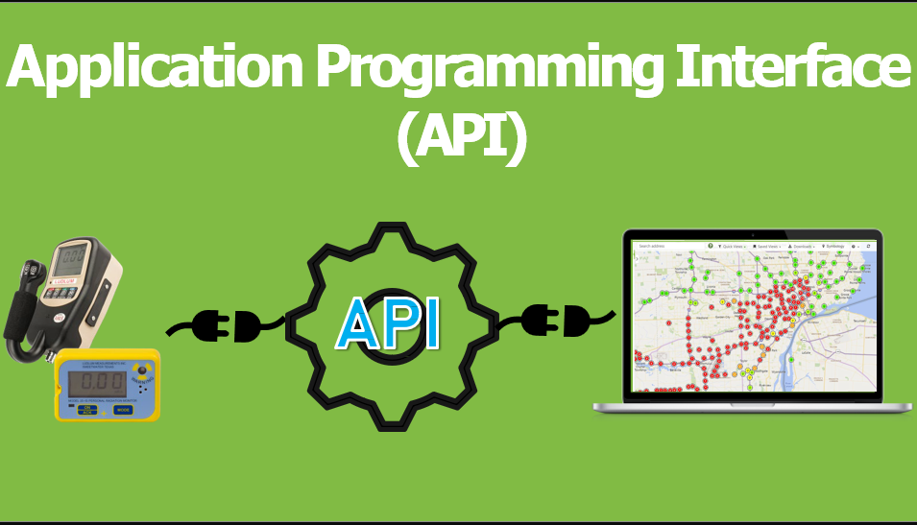
Integrate Data

Slide 22
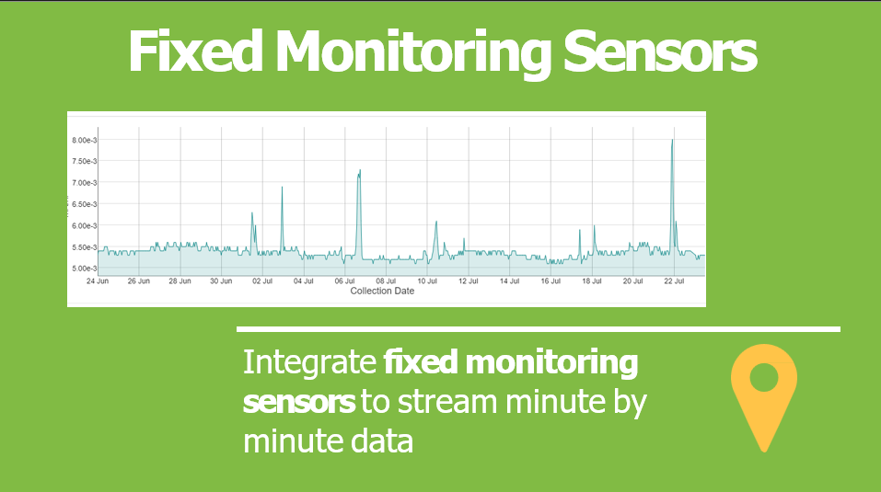
Integrate Data

Slide 23
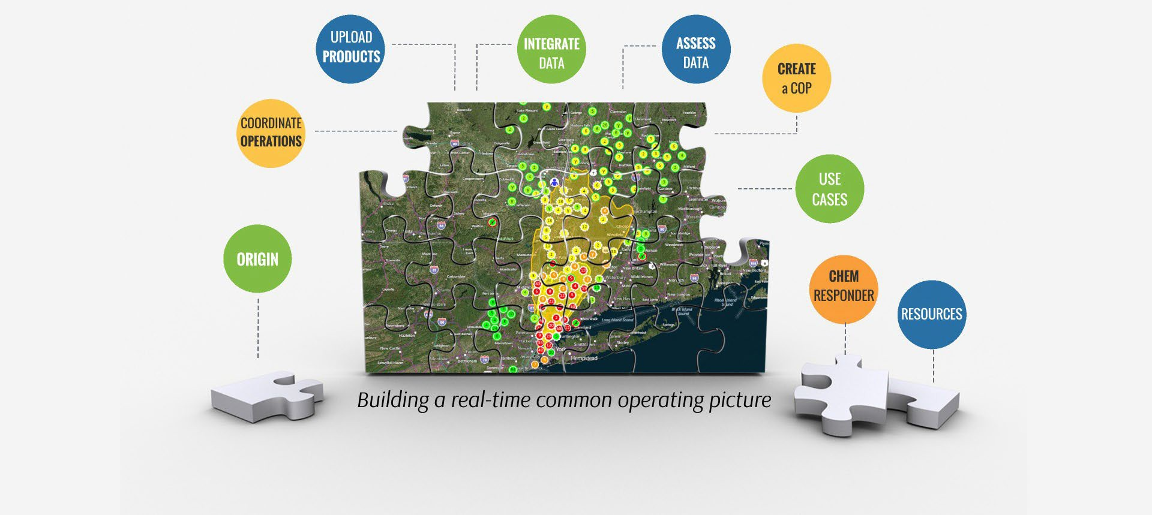
CRCs

Slide 24
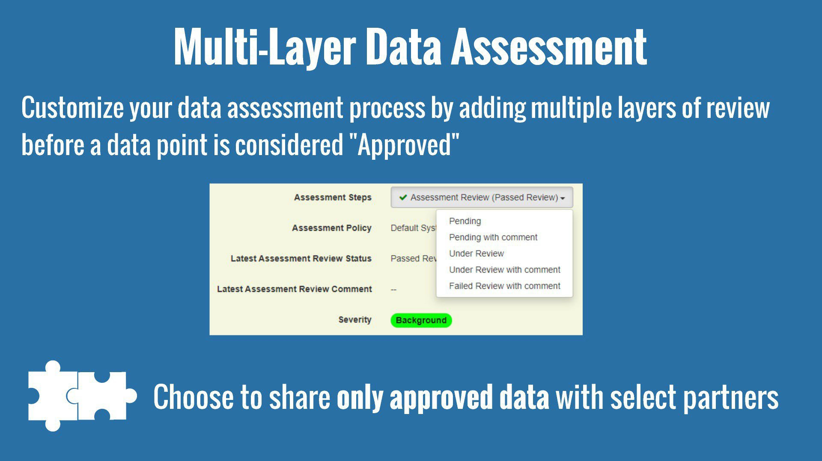
Assess Data

Slide 25
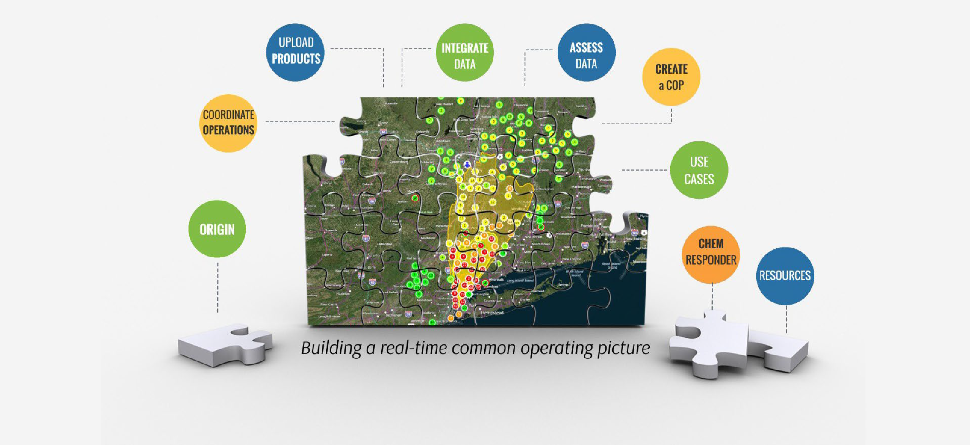

CRCs

Slide 26

Create COP
Establish Default Partnerships
State
Local Fire
Police
Dept
State Department of
County Public
Emergency Management
Health Dept
US EPA
DOE RAP Team
Share data real-time

Slide 27
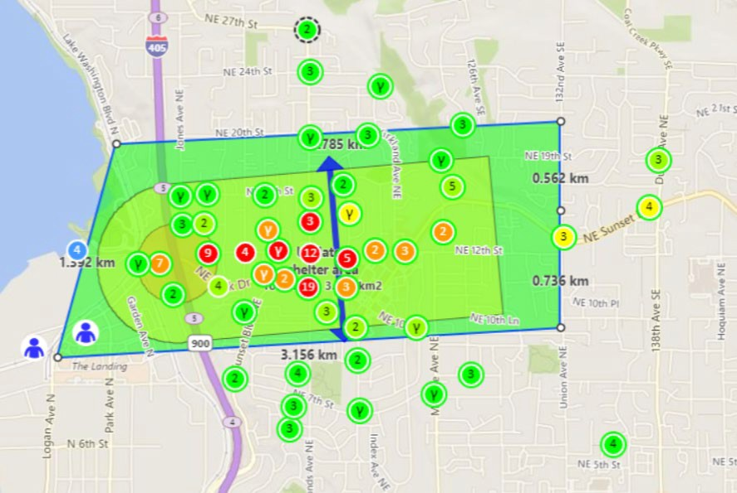
Create COP
Enables decision Making

Slide 28
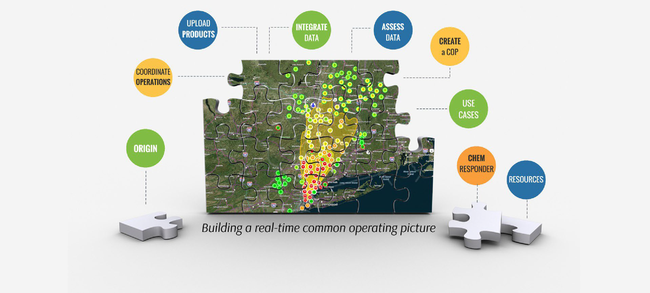

CRCs

Slide 29
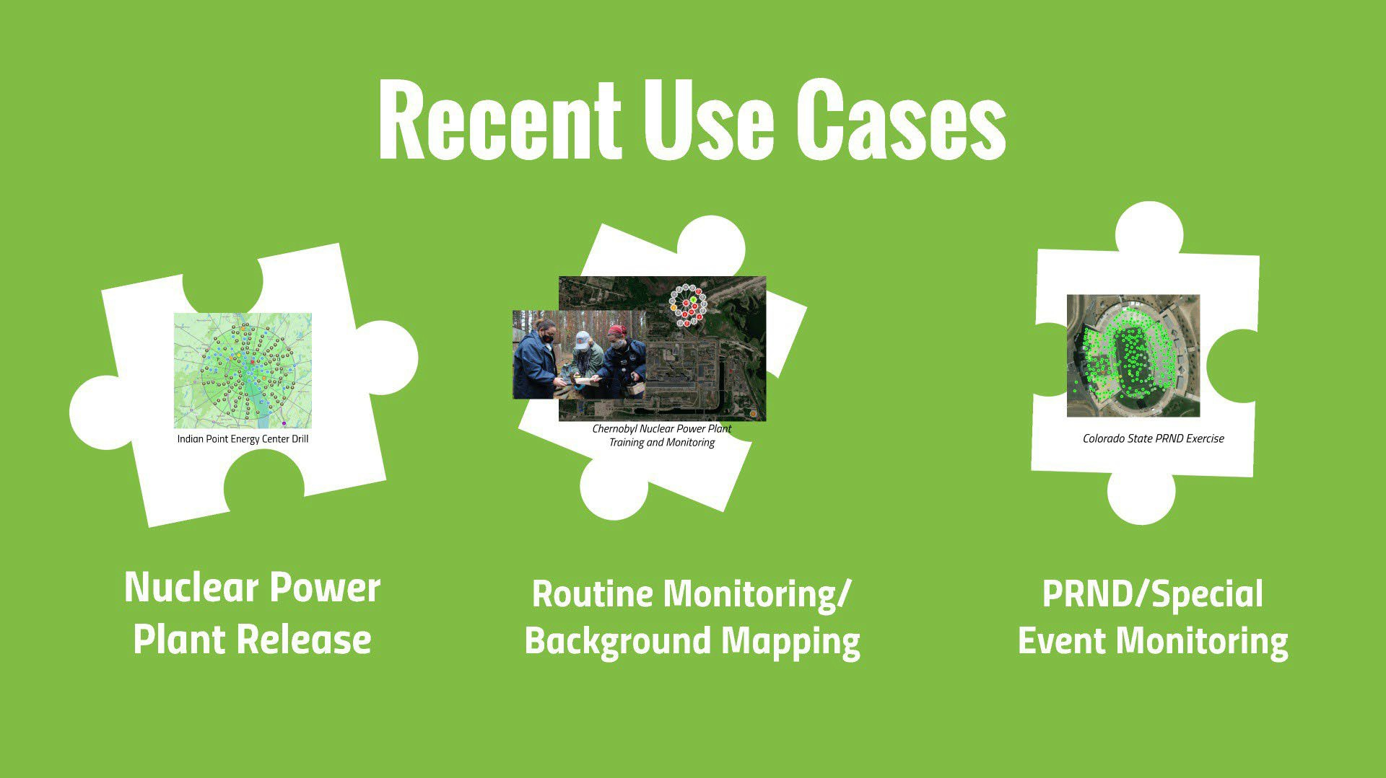


Use Cases

Slide 30
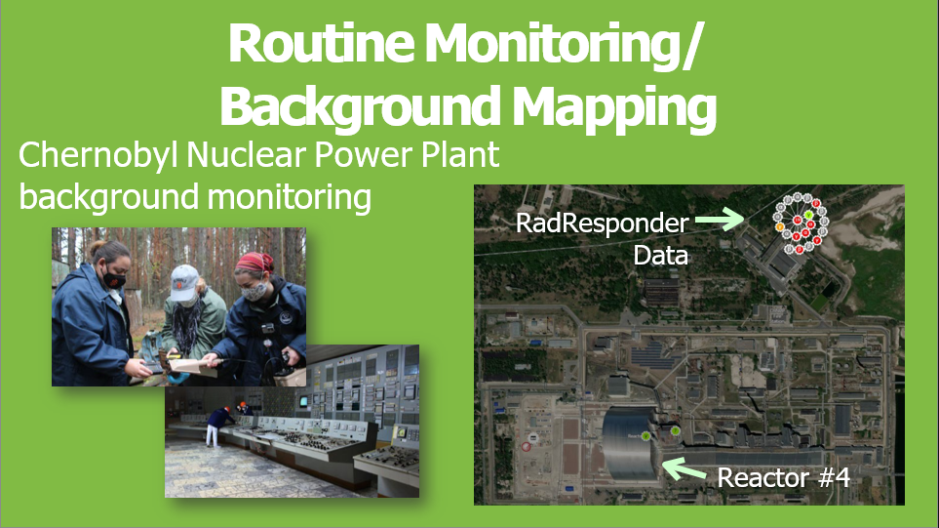
Use Cases

Slide 31
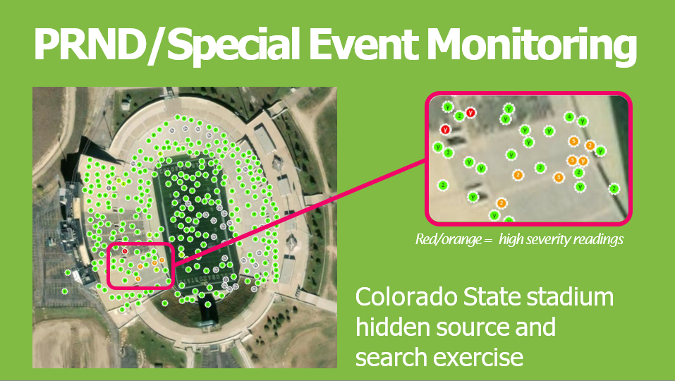
Use Cases

Slide 32
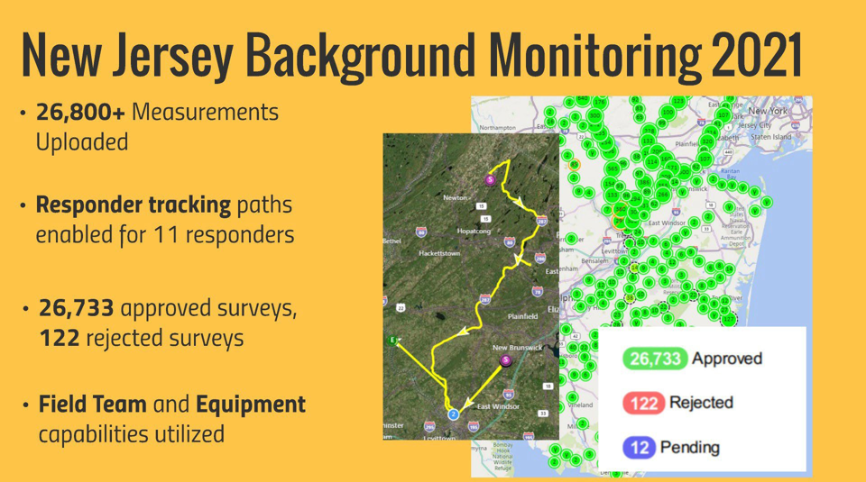
Use Cases

Slide 33


Use Cases

Slide 34

Indoor Monitoring

Slide 35
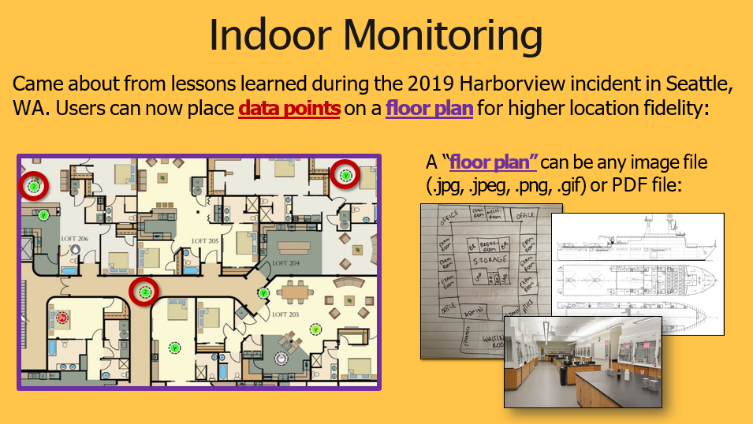
Indoor Monitoring

Slide 36
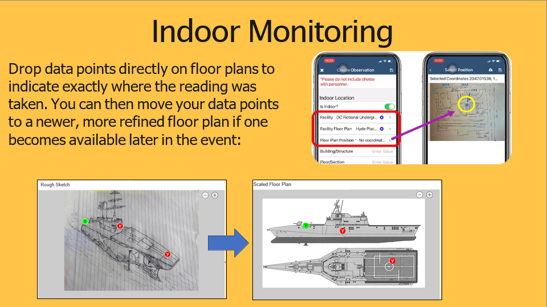
Indoor Monitoring

Slide 37
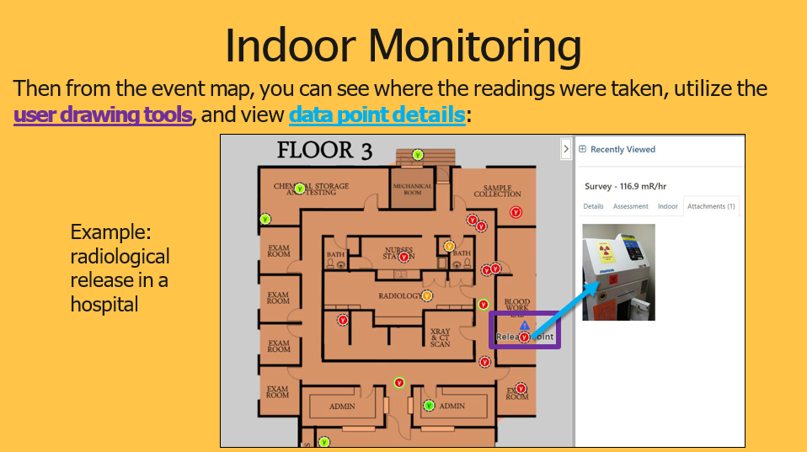
Indoor Monitoring

Slide 39
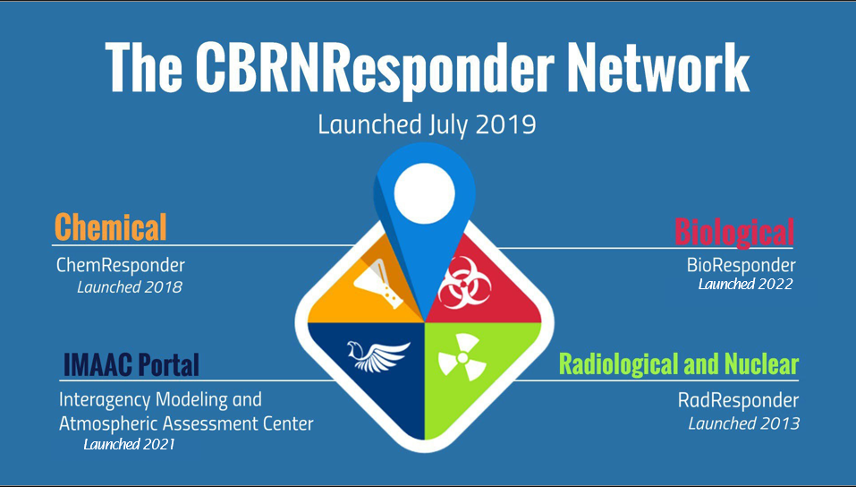
Network

Slide 40
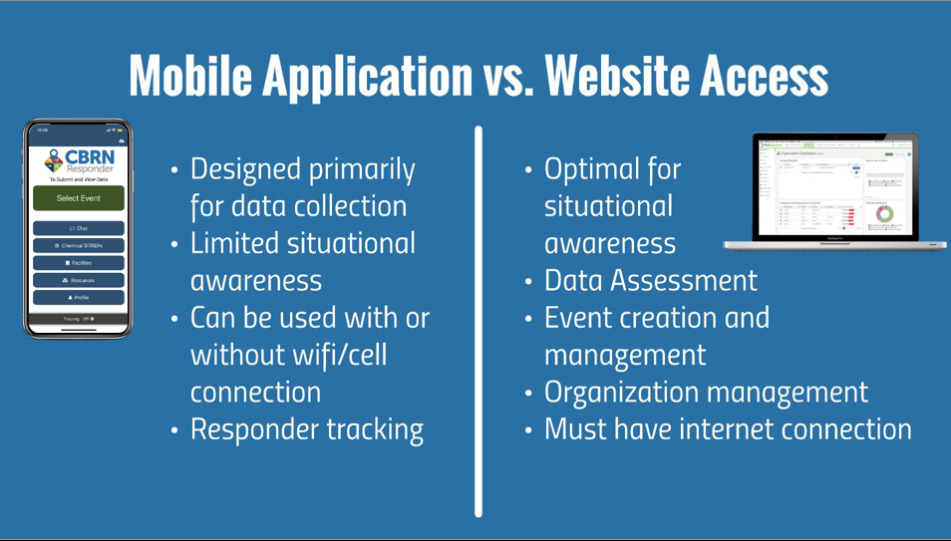
Network

Slide 41
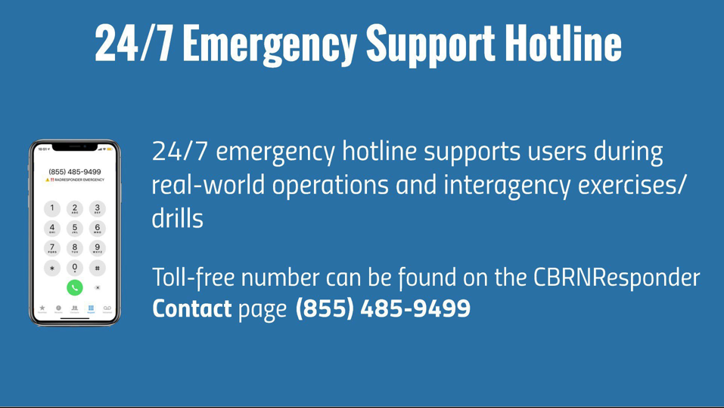
Network
844-719-3477

Slide 42
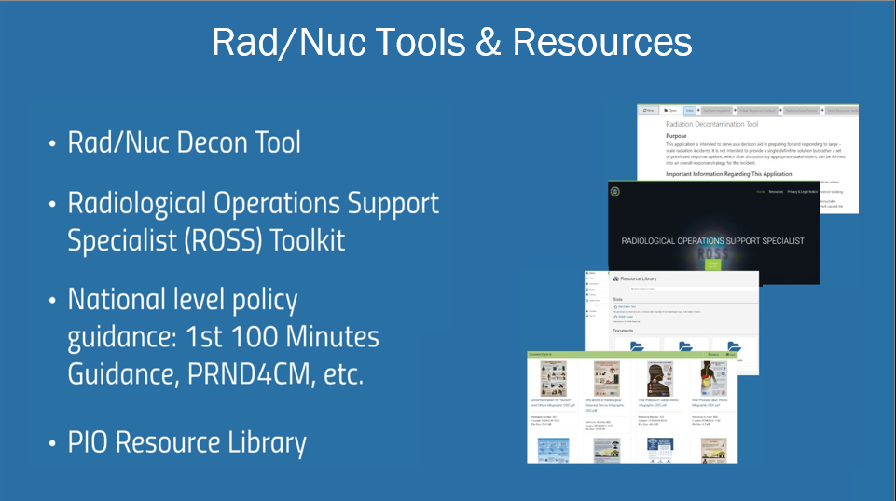
Network

Slide 43

Network

