Slide 1
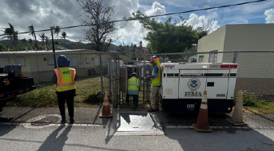
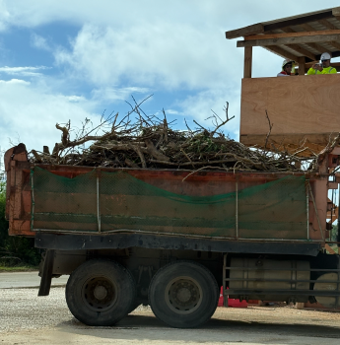
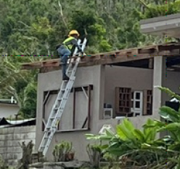
Army corps of engineers incident reporting
STAFFORD ACT EVENT IN SUPPORT OF FEMA
(SINLAKU EVENT)

Slide 2
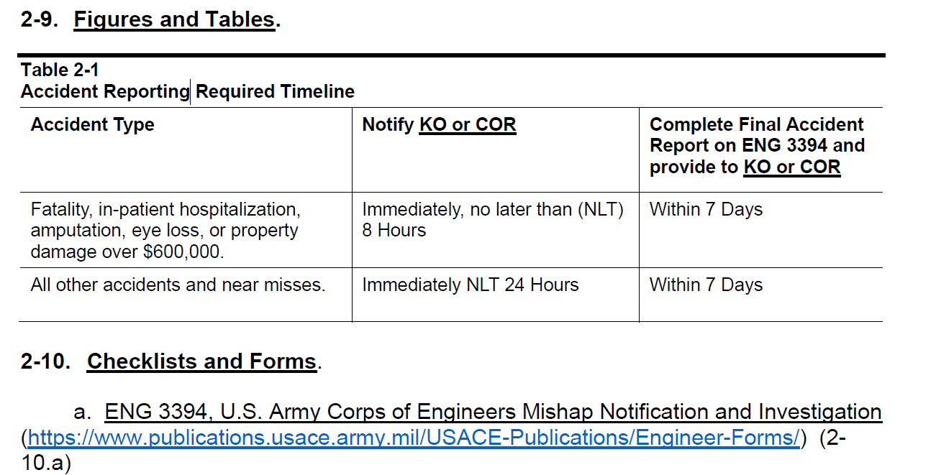
Army corps of engineers safety manual EM 385-1-1

Slide 3
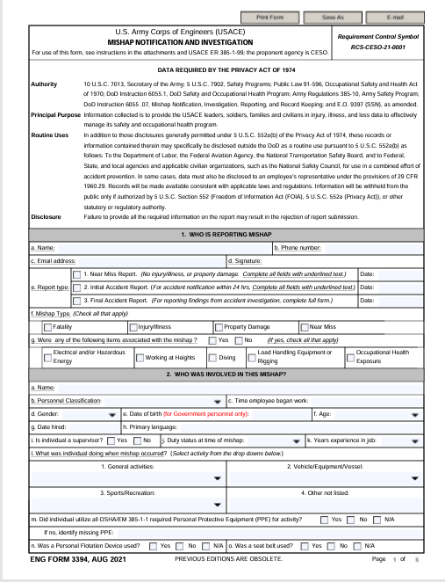
ENG FORM 3394, AUG 2021

Slide 4
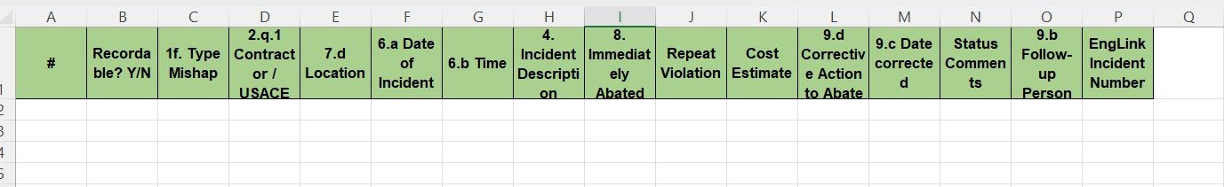
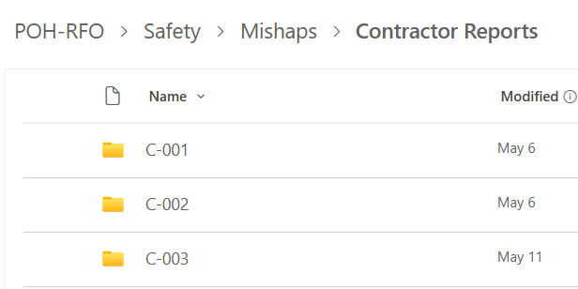
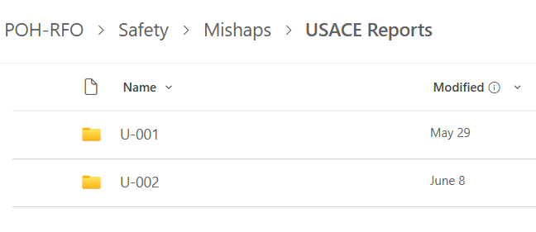
Excel tracking log/contractor-USACE

Slide 5
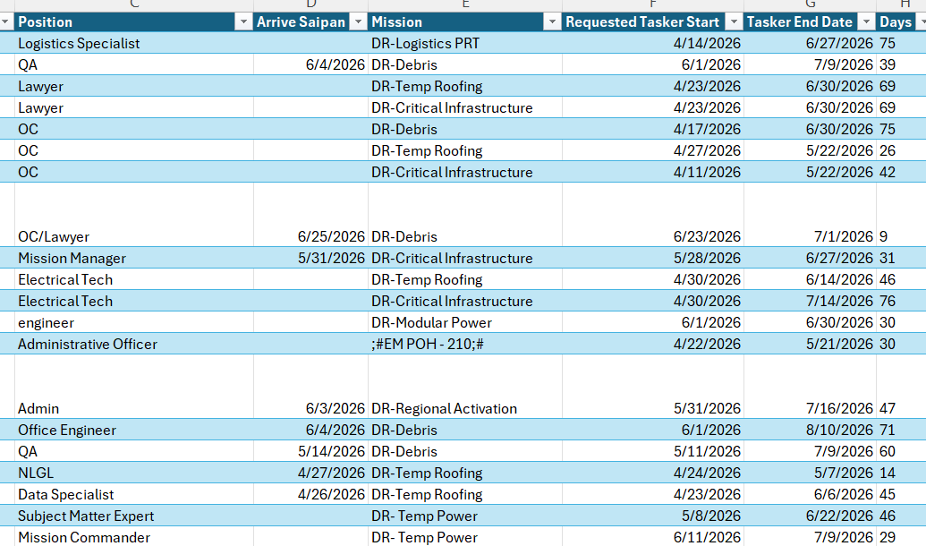
Tracking usace manhours for osha 300 reporting

