Slide 1


Improving Emergency Response to River Spills with EPA’s Riverine Spill Modeling System (RSMS)
RRT3 and Inland Area Committee Meeting
Chincoteague, VA
May 5-7, 2026
Jim Goodrich (OASES/ERSB), Sam Dinkins (ORSANCO), and Sudhir Kshirsagar (Global Quality Corp.)

Slide 2
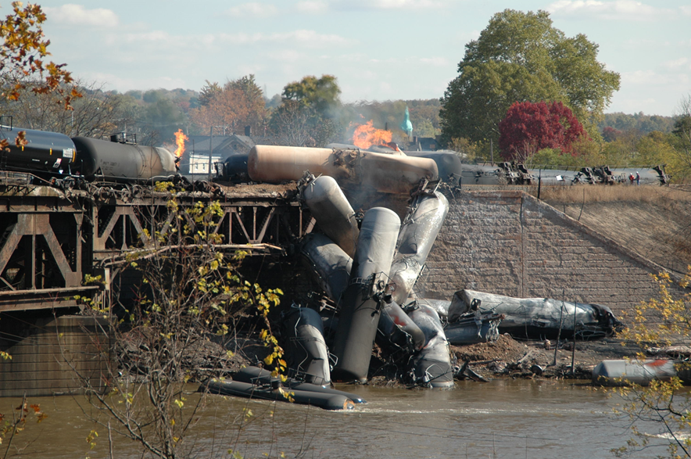
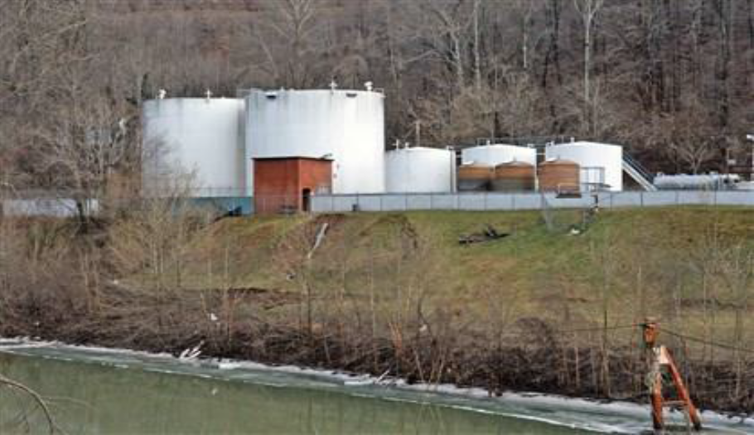
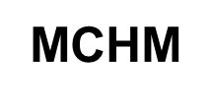
USEPA Riverine Spill Model Development
Bakken Crude Oil

Slide 3
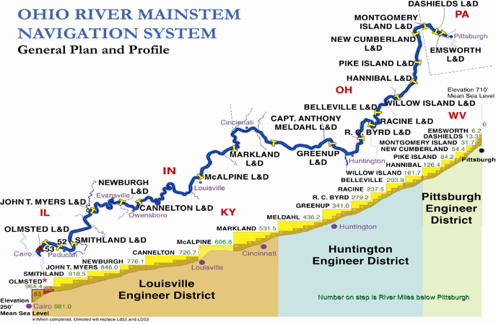
Riverine Spill Modeling System (RSMS) Software
Collaborative project with EPA, Ohio River Valley Water Sanitation Commission (ORSANCO), Global Quality Corporation (GQC), and the US Army Corps of Engineers (USACE)
ORD developed Cloud-based RSMS that simulates a 2-D spill transport
RSMS uses real time river data from USGS and the USACE
RSMS leverages the predicted river flows provided by NOAA/USACE HEC-RAS
When a spill happens, ORSANCO shares the RSMS predictions with water utilities to plan intake closures
The model has been used to provide utilities decision making support during real spills on the Ohio River for the past thirty years
The model can be expanded to other waterways

Slide 4
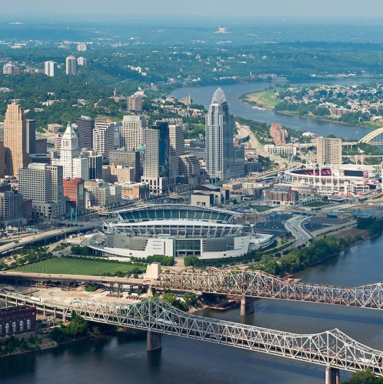
Source Water Quality is Vulnerable
981 navigable miles on the Ohio river and 2582 navigable miles counting all the 34 major tributaries.
$43 B estimated value of commodities transported/yr.
180 M tons/yr through the Ohio River Lock & dam system
5 M people depend on the Ohio River for drinking water
37 drinking water intakes
38 power plants
Almost 600 permitted industrial and municipal dischargers
~ 200 marinas
160 species of fish

Slide 5
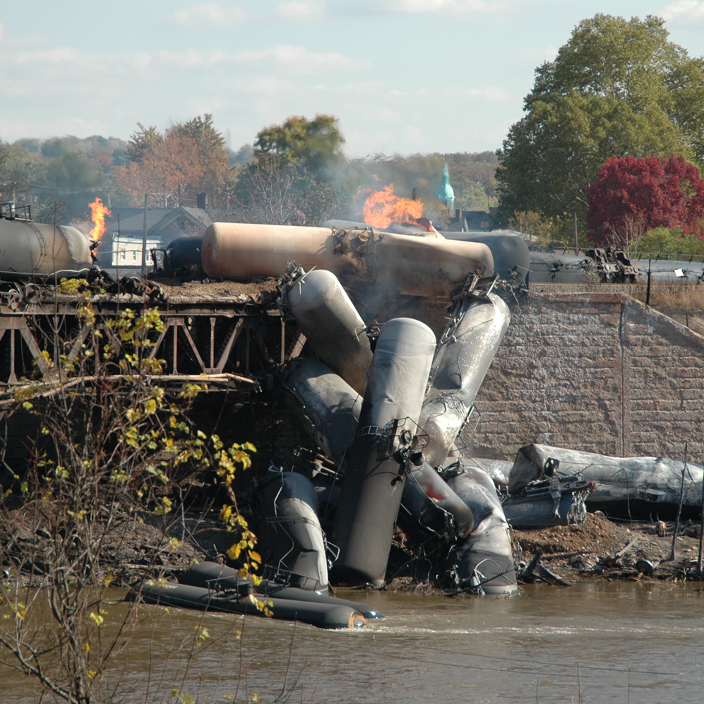
Example Risks to the Ohio River
Over 230 spills reported annually by the National Response Center to ORSANCO
Majority of spills were:
  Unknown sheen
  Vessel related
  Industrial/municipal facilities located on banks
Dozens of different materials spilled in the Ohio River
75 highway and bridge crossings over the Ohio River
Pipeline crossings, Too Numerous To Count
Operational Technology (OT) Cyber Vulnerabilities?

Slide 6
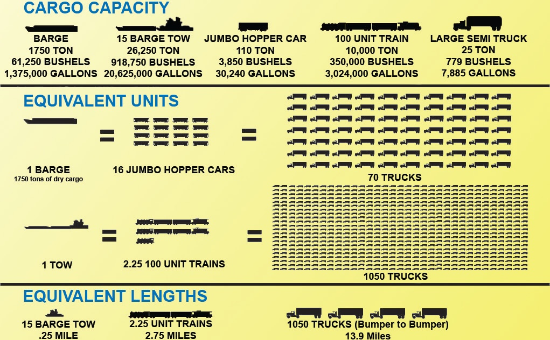
What Could be the Magnitude of a Spill?

Slide 7
Goals for RSMS
On demand real time river spill modeling:
Enable water treatment plant decision makers to get quick, accurate, and accessible information about spills within their source water supply network
  Input spill volume and location (mile marker) and push the button.
  Information on leading edge and trailing edge and maximum concentration expected at intake
  Are existing plant treatment systems or alternative water supplies sufficient?
  Hazardous Substance Facility Regulation Risk Analysis
Future: Be able to model and predict worst case spill events to increase water system resiliency nationally. Also, an informative and beneficial for source water protection table-top training opportunity

Slide 8
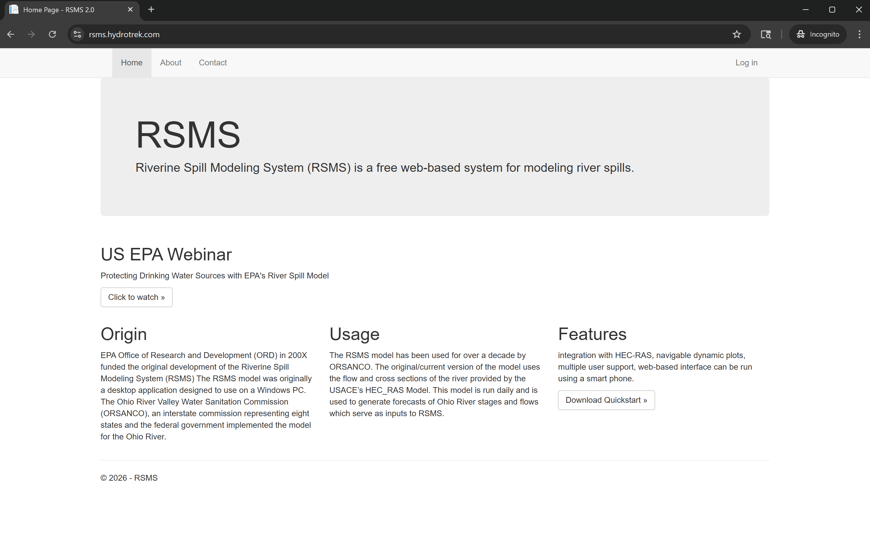
Riverine Spill Modeling System (web-based)
rsms.hydrotrek.com

Slide 9
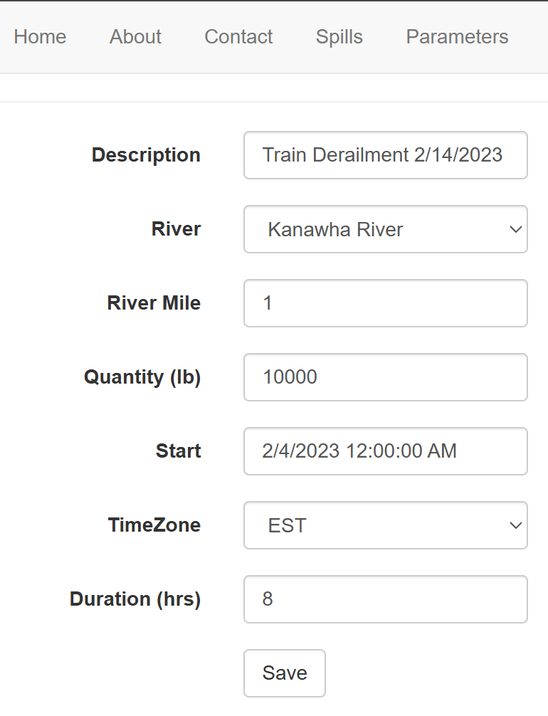
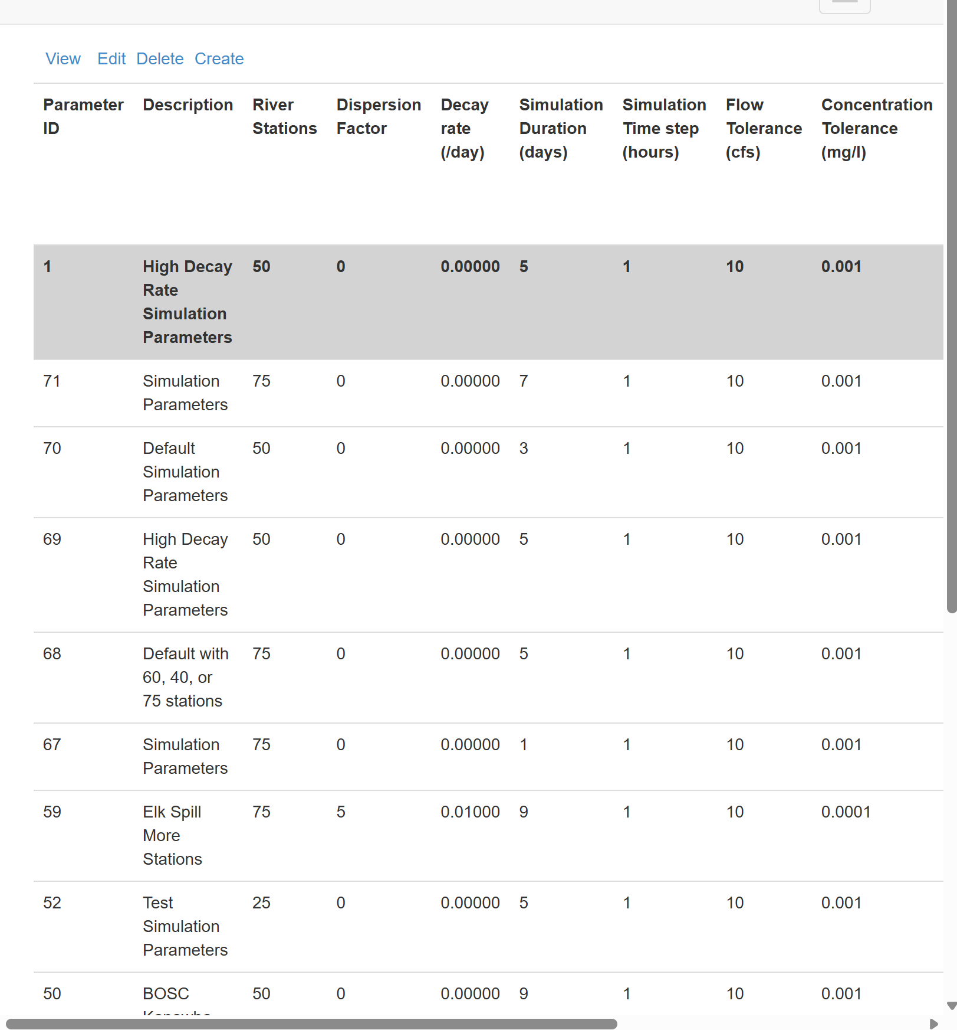
Simulating a Spill is User-Friendly
Specify Spill Information and Simulation Parameter Settings, Click “Simulate”

Slide 10
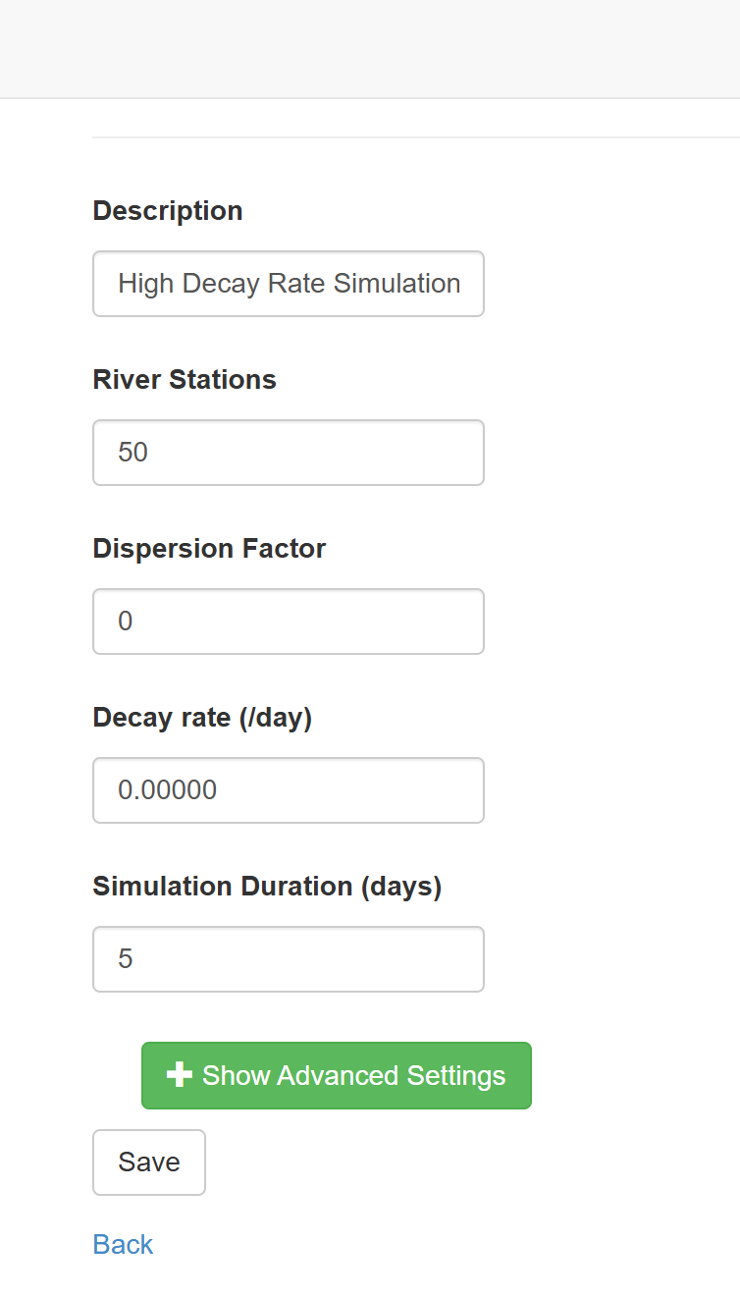
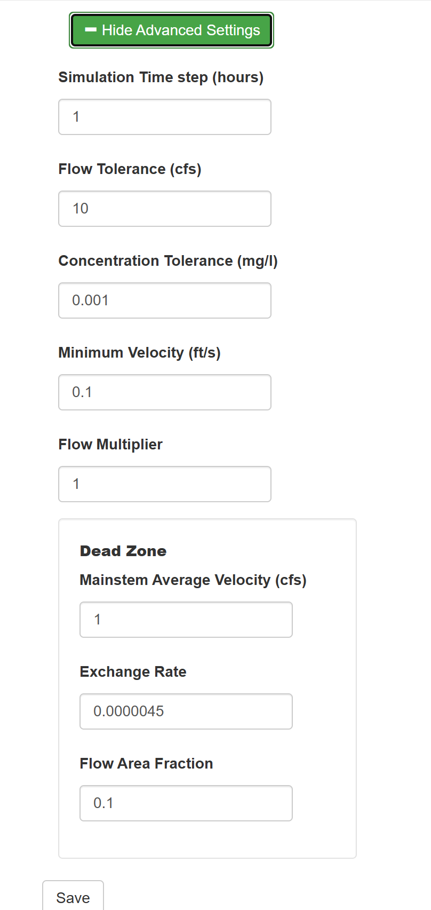
Edit Basic and Advanced Simulation Parameter Settings

Slide 11
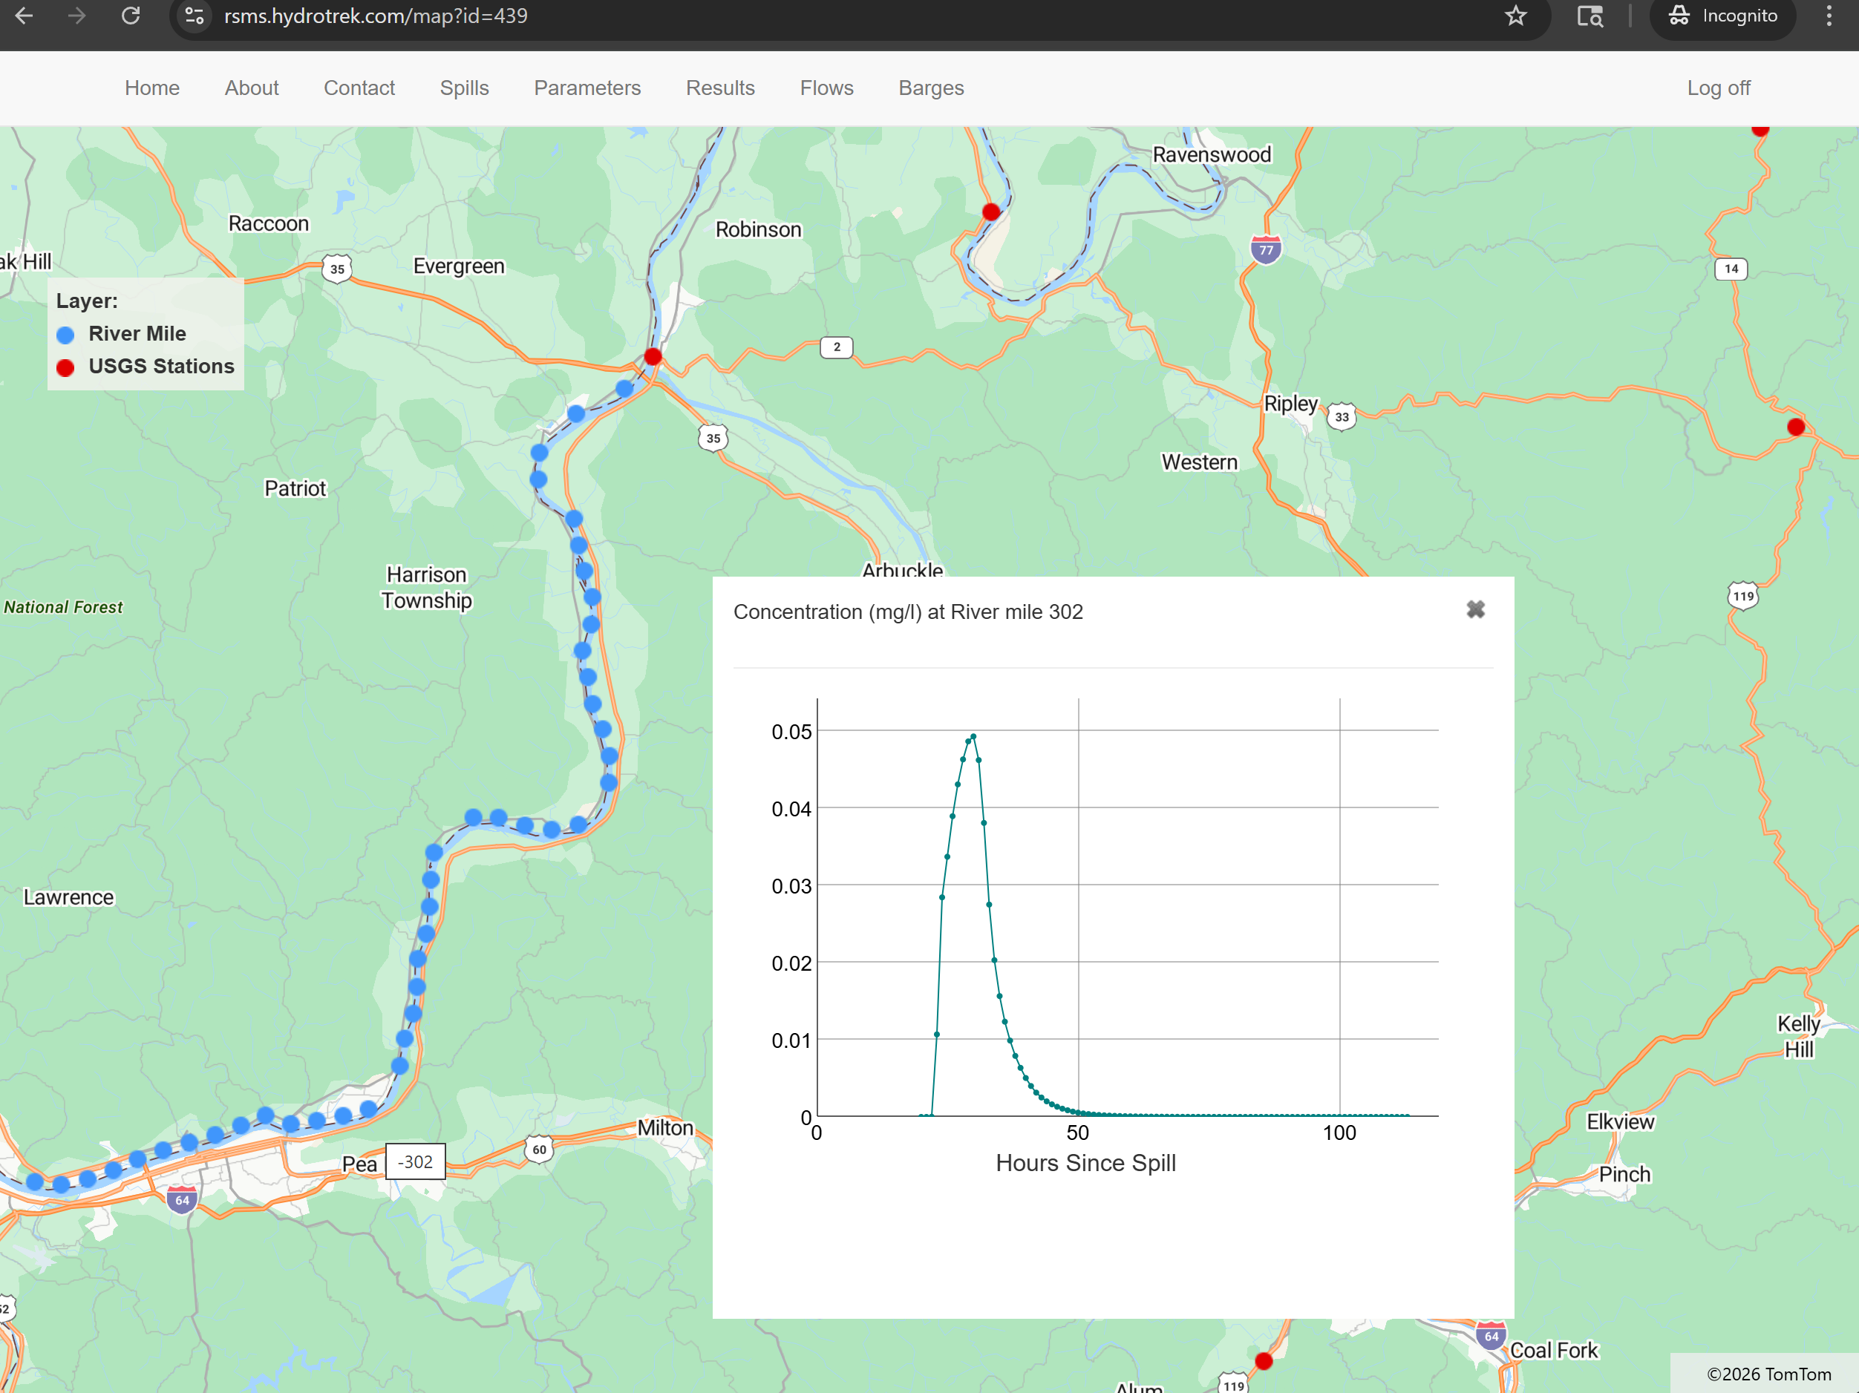
Interactive Map-based Exploration of Results
Click on a downstream rivermile (blue dot) to see the plume

Slide 12
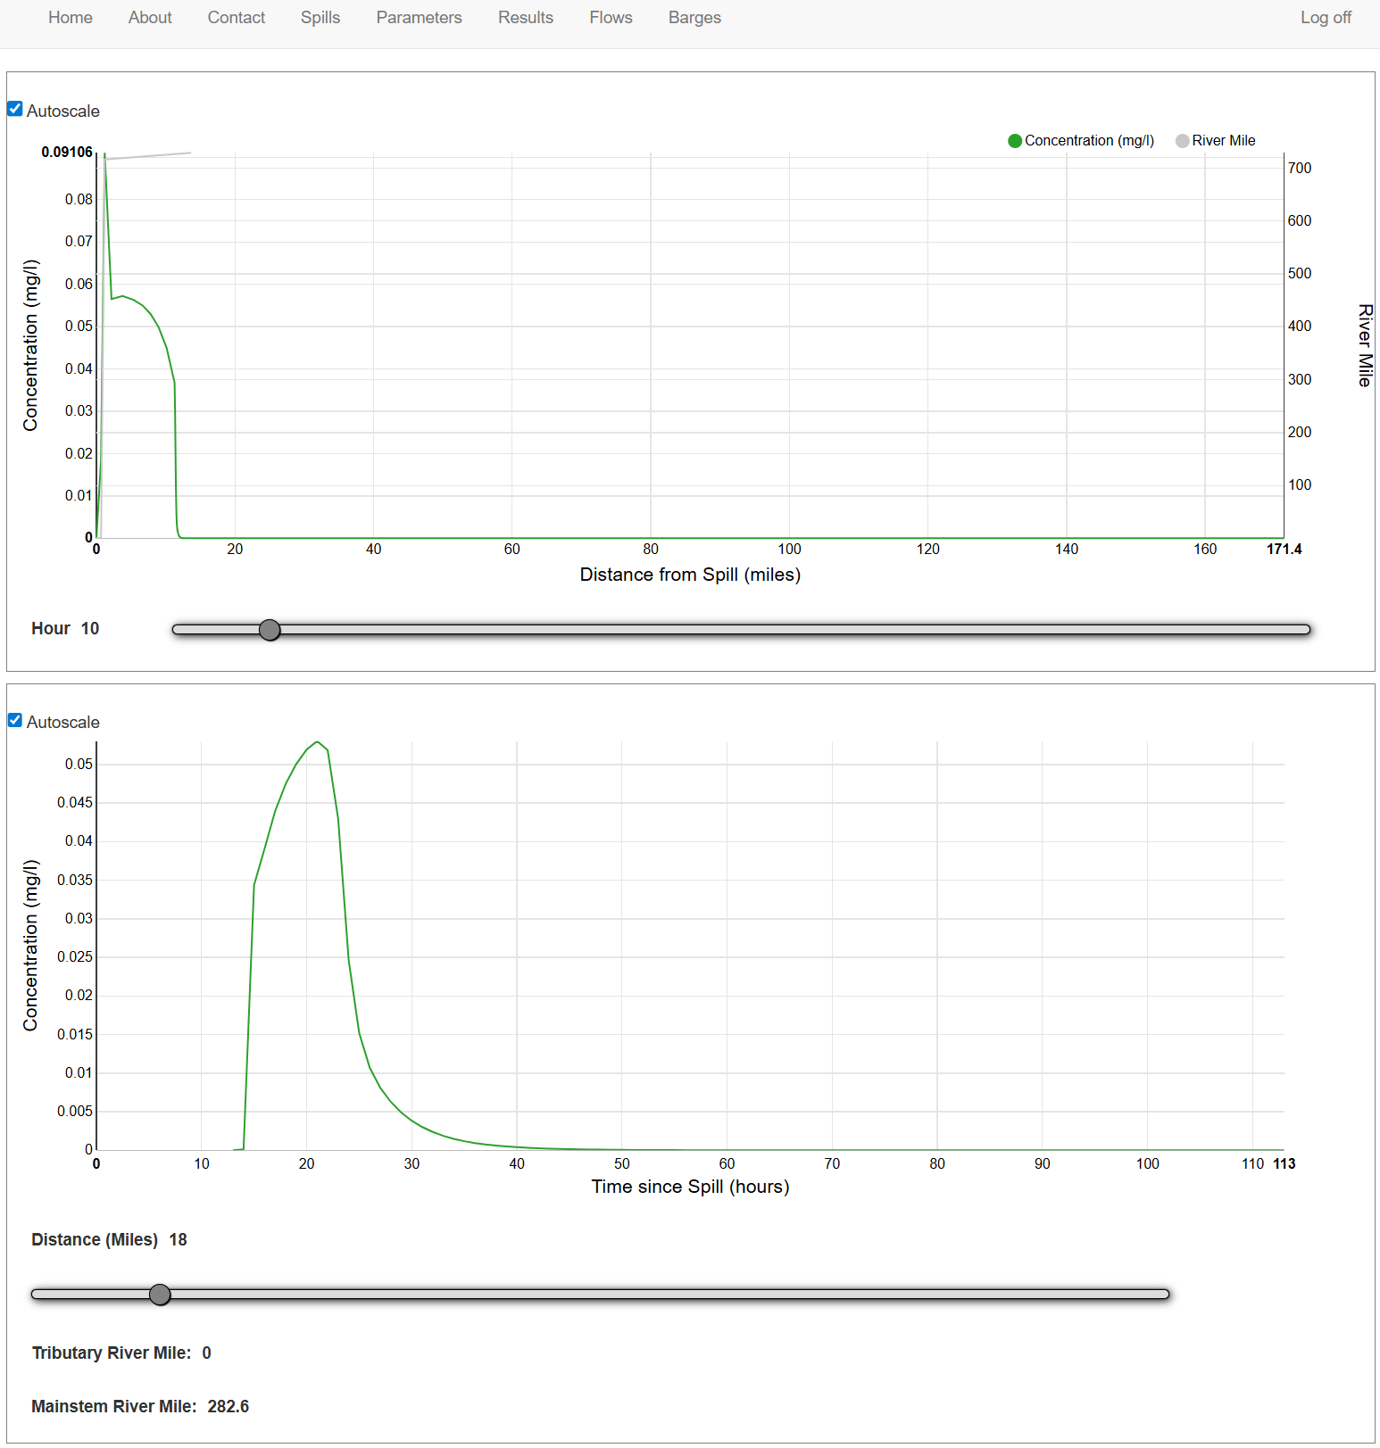
Plume Concentrations by Time & Location

Slide 13
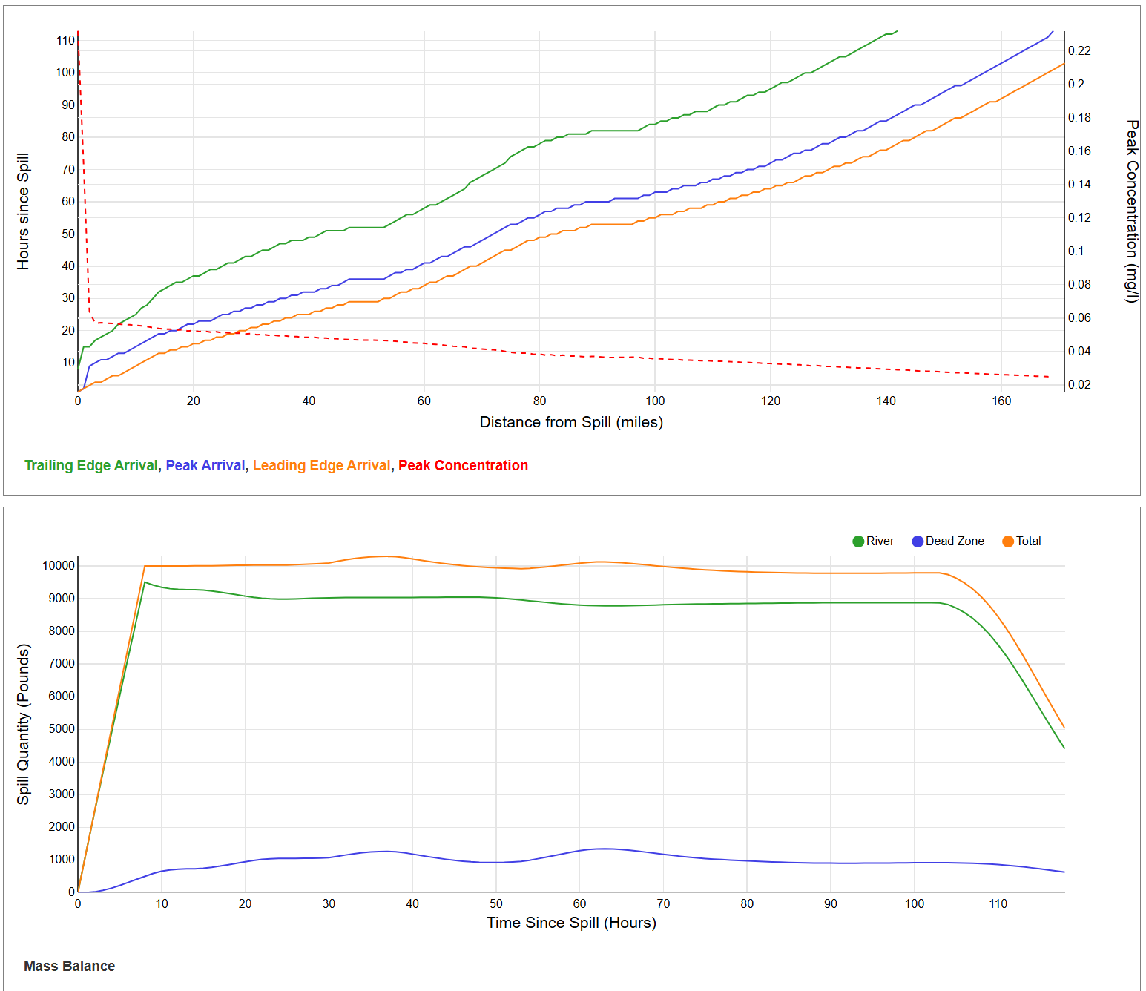
Plume Arrival Times and Mass Balance

Slide 14
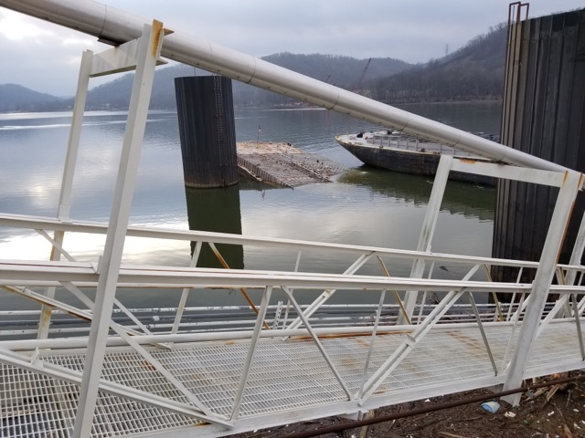
UAN Barge Incident – Initial Report
Notification – December 19, 2017
National Response Center report indicated barge “cracked in half” while offloading (ORM 478.7)
  Urea ammonia nitrate was discharging into the river
  Amount of release initially not reported
Time-of-Travel modeling requested by KY Division of Environmental Program Support, Louisville Water Company, US Coast Guard, Clifty Creek Power Plant

Slide 15
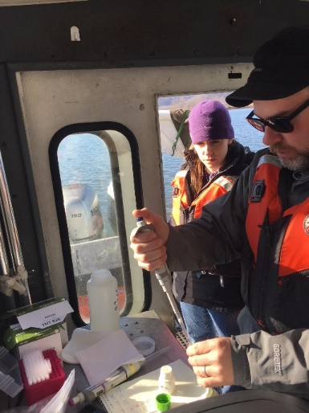
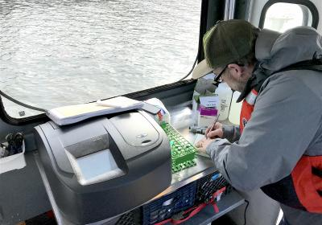
Fixed Station Monitoring
Initial time-of-travel model estimated travel time to Louisville at 9 days (i.e. 12/28/2017)
Precipitation increased river velocities significantly
  Moved up projected arrival at Louisville by 2.5 days (i.e. mid-day on 12/25/2017)

Slide 16
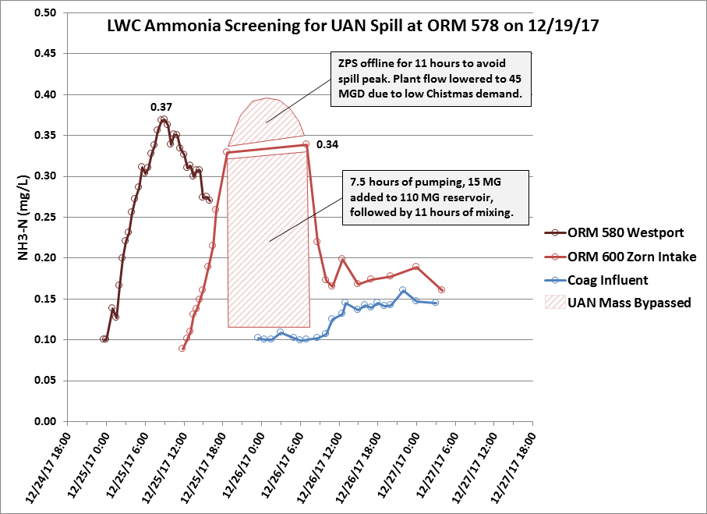
Plume Avoided

Slide 17
Application to East Palestine Incident

Slide 18
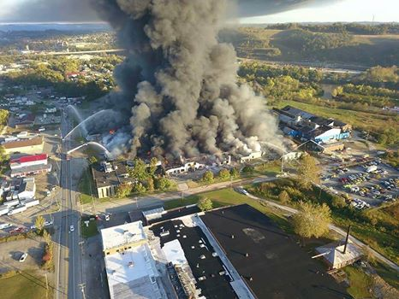
Key Questions During Spill Response?
What?
Where?
How much?
Actions taken?
Concentration?
When will it arrive at downstream intakes?
How long is the plume?

Slide 19
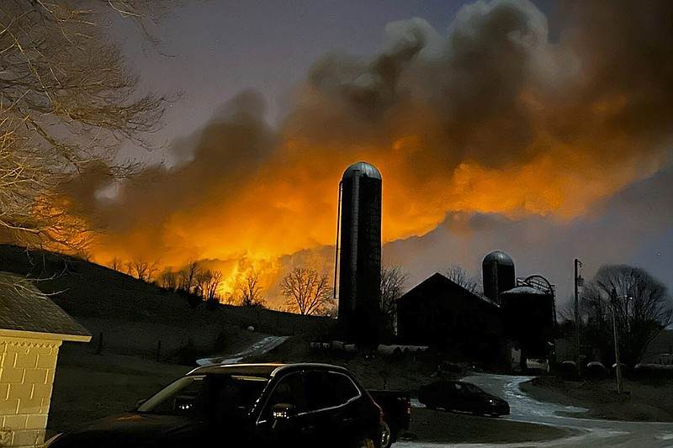
Initial Details – Train Derailment
Feb 3, 2023 – Train derails in East Palestine, OH
  Large fire reported
  Some cars carrying unknown hazmat
  Reported as “POTENTIAL RELEASE”
Feb 4, 2023 –
  Fire ongoing, but reduced
  5 vinyl chloride tankers derailed
  Other hazardous material railcars also
  burned
  Unknown materials/quantities released
  Sulphur Run to Leslie Run impacted by runoff
  Fish kill observed
  Incident location is 19 stream miles to the Ohio River
Melissa Smith via AP

Slide 20
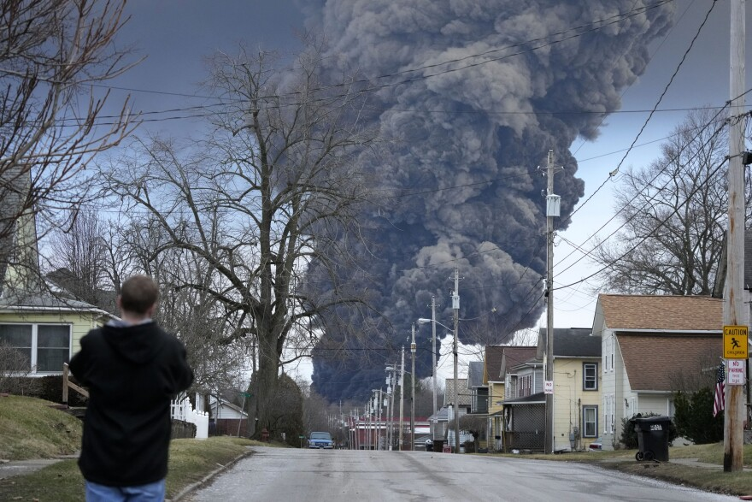
Many Unknowns
Feb 5, 2023 –
  Pressure buildup noted in vinyl chloride railcar
  Water quality sampling of nearby creeks underway
Feb 6, 2023
  Products being transported include:
    Vinyl chloride
    Butyl acrylate
    Benzene residue
    Combustible liquids
  Volumes released unknown
  Unknown if materials will reach the Ohio River
  Weirton, WV Organics Detection Station (ODS) running samples every 2 hours
Gene J. Puskar / AP

Slide 21
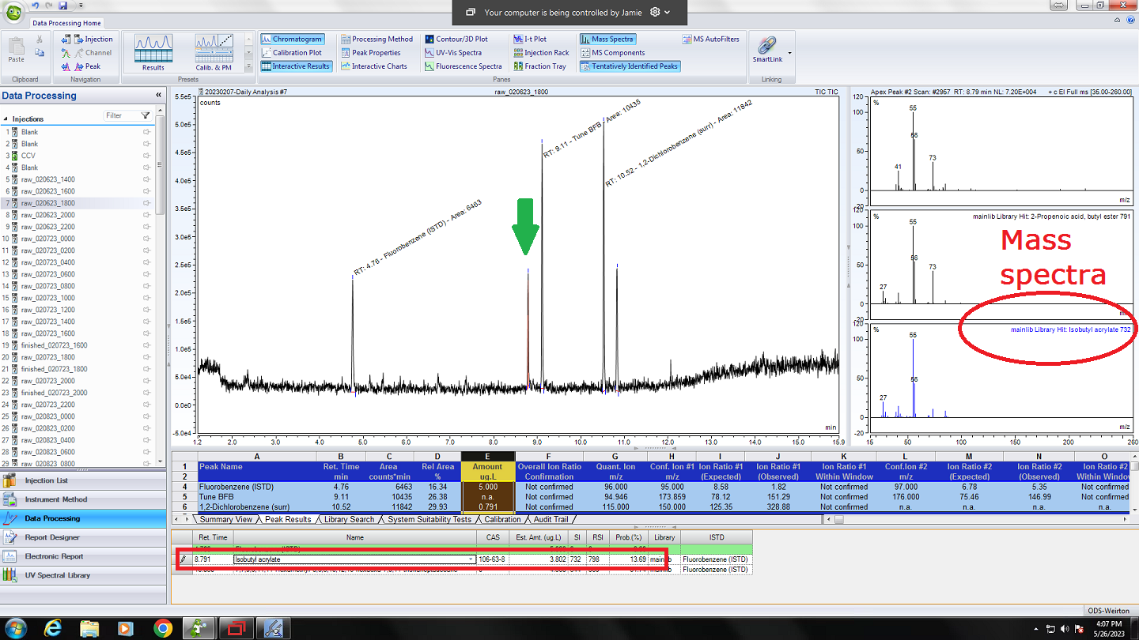
Initial Detection in Ohio River
Weirton, WV Feb 6, 2023 at 1600

Slide 22
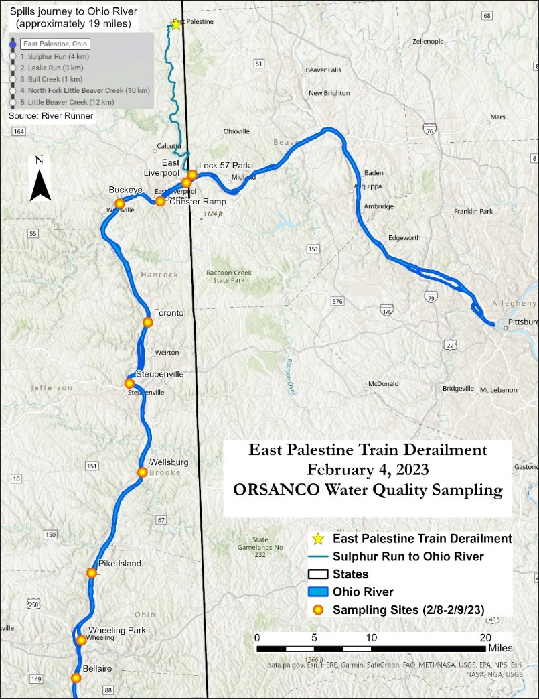
Ohio River Sampling Initiated
Feb 8-10, 2023 –
ORSANCO conducts sampling
  Little Beaver Creek, PA to Sistersville, WV
  Approximately 100 river miles
Define where spill plume is located
Utilized ORSANCO ODS to provide quick screening results along Ohio River main stem

Slide 23
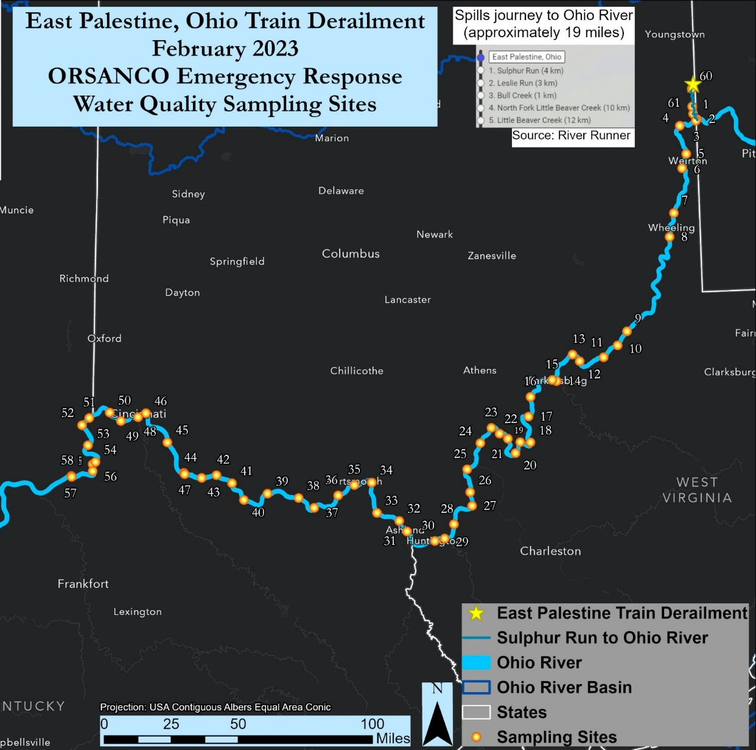
February 10, 2023
Detection
Non-Detect
Surface Grab Samples analyzed at Wheeling, WVA ODS; presence/absence
Ref | City | Mile Point | State | Date | Time | n-Butyl Acrylate (p/a)
1 | Grimms Bridge | Beaver 3.0 | OH | 2/10/2023 | 1350 | present
2 | Lock 57 Park | Beaver 0.2 | PA | 2/10/2023 | 1300 | present
3 | East Liverpool | 40.2 | OH | 2/10/2023 | 1420 | absent
 | Chester | 43.0 | OH | 2/10/2023 | 1125 | absent
6 | Steubenville | 65.3 | PA | 2/10/2023 | 1605 | present
 | Follansbee | 70.8 | OH | 2/10/2023 | 1300 | absent
 | Wheeling River Grab | 86.0 | WV | 2/10/2023 | 1600 | present
8 | Bellaire | 93.9 | WV | 2/10/2023 | 1715 | absent
 | Moundsville | 101.7 | WV | 2/10/2023 | 1750 | present
 | New Martinsville | 126.0 | WV | 2/10/2023 | 1900 | present
 | Sisterville | 137.2 | OH | 2/10/2023 | 1945 | present

Slide 24
Tracking Leading Edge
Sample
Analyze
Model
Report
Plan
Feb 11-19, 2023 –
Transitioned sampling to tracking leading edge
  Sampled 50 to 120 miles per day
  Early on plume traveled ~25 miles/day
  Later, velocities increased to ~100 miles/day
Modeling informed water utilities and field sampling crews

Slide 25
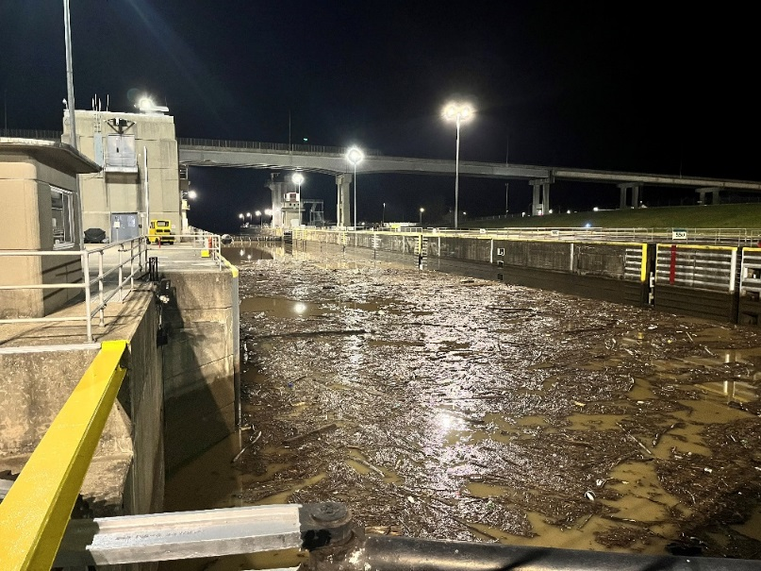
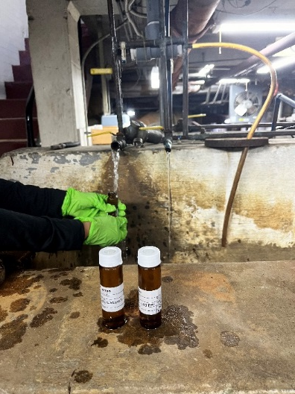
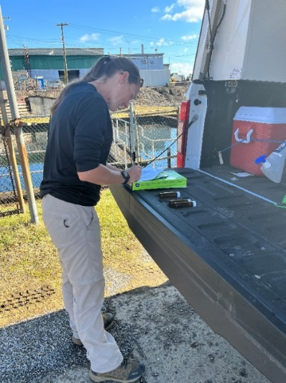
Downstream Tracking Concludes:
Feb 19-20, 2023 –
Fixed station sampling at Markland Locks & Dam
  ~500 miles downstream of derailment
  Sampled every two hours from lockwall
  Samples analyzed by Louisville Water
Feb 21-22, 2023:
Fixed station sampling at Cannelton Locks & Dam
  ~700 downstream of derailment
  Sampled every two hours from lockwall
  Samples analyzed by Evansville Water
All samples from Markland & Cannelton non-detect

Slide 26
The Bottom Line
River systems and inland waterways in US are vital to commerce, jobs (navigation), power supply, recreation, and drinking water supply (public health)
Accidental spills and releases are already affecting the ability to provide navigation and clean water supply (Homeland Security)
Threat to drinking water safety and Homeland Security greatly underestimated
We are building a software product with the Ohio River Valley Water Sanitation Commission (ORSANCO) for State Emergency Response Agencies, Federal On-Scene Coordinators, the Coast Guard, and Water Utilities
Tool enables emergency responders and water utilities to know when and for how long to close river intakes and adjust treatment operation in response to spills
Tool also enables preparation and training for potential worst-case scenarios and long-term asset management and resilience planning

Slide 27

Research Plans
Update and improve RSMS Application Interfaces
Integrate additional databases such as railroad bridges, pipelines, barge terminals
Develop Project Scenarios to desired watersheds for Area Contingency Planning, Worst Case Discharge Plans, and Geographic Response Plans
Pilot Western Pennsylvania tributaries?
  Product recovery potential
  Development of local level tactical deployments
Integrate RSMS with Rapid Response Teams’ GIS Viewer

Slide 28
Modeling Research Needs
Verification/calibration of model time-of-travel based on East Palestine and other spills
Artificial Intelligence/Machine Learning (AI/ML) analyses of historical flow data/scenario development
Backcasting mode to investigate potential sources of unknown spills
Understand the effects of dam aeration and turbulence on contaminants
Sensitivity analysis of model input variables
Portable water quality Gas Chromatograph evaluations to enable faster modeling results

Slide 29
Thank You!
Jim Goodrich
  Goodrich.james@epa.gov
Sam Dinkins
  sdinkins@orsanco.org
Sudhir Kshirsagar
  sudhir@gqc.com
Disclaimer: This presentation has been subjected to the Agency’s review and has been approved for publication. The views expressed in this presentation are those of the authors and do not necessarily represent the views or policies of the Agency. Any mention of trade names, commercial products, and/or services does not imply an endorsement or recommendation for use by the U.S. Government or EPA.

