Slide 1
RRT3 Spring Tabletop Exercise

Slide 2
Ground Rules
All Ideas Are Valid
Do Not Fight The Scenario
Validate the RCP and RRT Processes/Procedures…NOT Response Actions
State your name and agency before you speak
Silence Devices
Minimize Acronyms
Ask Questions
* We are validating the RCP and RRT Processes and Procedures.
* Due to time constraints, we may not be able to solve all issues at this TTX. Open items will be documented for the After-Action Report.
Notes:
Reminder: We do not need to get to a “yes” or “no” decision. We want to validate and improve our products!

Slide 3
Objectives
Exercise the Incident Specific RRT Activation Process
Validate RRT3 guidance/tools for the Incident Specific RRT (ISRRT) Consultation and Recommendations
  RRT3 Guidance for Decanting of Contact Water
  Surface Washing Agent (SWA) Preauthorization Test and Evaluation Protocol
  Chemical and Biological Countermeasures Protocol
  Environmental Consultation Guidance and Form
Discuss agency considerations for RRT3 Environmental Products

Slide 4
Artificialities
Simulated Spill Event
  Again, don’t fight the scenario
Scripted Event Updates – The set of injects are specifically designed to make standard mechanical recovery insufficient, forcing a discussion about Alternative Response Techniques as a primary strategy.
Simulated Environmental, Public Health, and Economic Impacts are based on general information during May timeframe

Slide 5
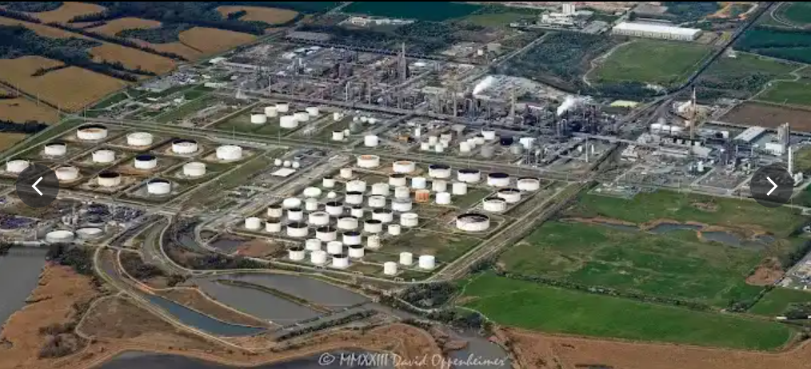
Delaware Bay Refinery Overview
Location: Delaware City, 5,000-acre site along the Delaware River
Throughput Capacity: 180,000 barrels per day
Storage Capacity: 15 million barrels
Complexity: One of the largest and most complex refineries on the East Coast, capable of processing diverse heavy and high-sulfur crude oils
Products: Variety of products, including conventional and reformulated gasoline, diesel, low-sulfur diesel, and home-heating oils
Support Infrastructure & Logistics: Storage tanks (crude oil and various refined products), Marine Terminal, Rail & Pipeline access
Environmental Management Systems: Wastewater Treatment Plant, Retention & Collection Ponds
Notes:
Support Infrastructure & Logistics:
Tank Farm / Storage: Extensive network of storage tanks holding crude oil and various refined products. Total storage capacity is over 15 million barrels.
Marine Terminal: Deep-water port on the Delaware River capable of docking Very Large Crude Carriers (VLCCs) for efficient offloading of crude oil.
Rail & Pipeline Access: Integrated logistics for receiving raw materials and distributing finished products via an extensive network of pipelines and a railcar loading facility.
Power & Utilities: Includes a cogeneration facility that produces both electricity and steam for refinery operations, improving energy efficiency.
Wastewater Treatment Plant: An advanced, multi-stage facility designed to treat all process water before it is discharged. This is critical for protecting the Delaware River.
Retention & Collection Ponds: A series of engineered ponds used to:
Manage stormwater runoff from the site.
Serve as an emergency containment system for spills.
Allow for the settling and initial treatment of oily water before it enters the main treatment plant.

Slide 6

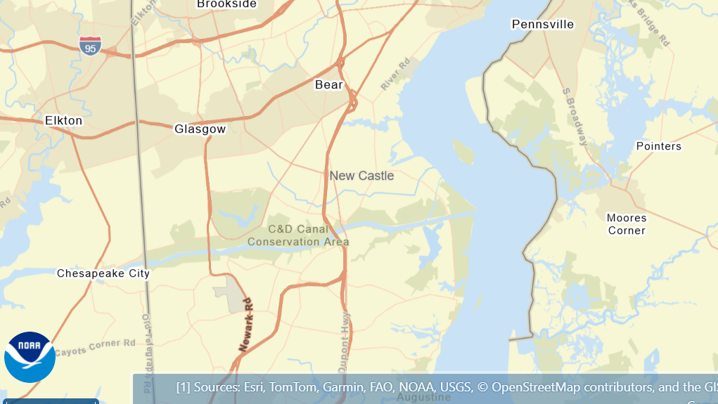




Delaware Bay Refinery: Surrounding Area - ERMA Overview
Notes:
Use ERMA Overview to Display/Discuss
Inland versus Coastal Zone
Cultural & Historical Significance
Route 9 Coastal Heritage Scenic Byway connects key historical sites.
Historic Towns:
New Castle: Delaware's colonial capital with 18th-century architecture.
Delaware City: Tied to the historic C&D Canal.
Odessa & Port Penn: Preserved 18th & 19th-century port towns.
Military Landmarks: Fort Delaware (Civil War) and Fort DuPont.
Rich Heritage: Home to the John Dickinson Plantation and originally inhabited by Lenni Lenape tribes.
Environmental Landscape
Delaware Bay Estuary: A globally important wetland, crucial for shorebirds and the world's largest horseshoe crab population.
Major Wildlife Areas:
Bombay Hook National Wildlife Refuge
Pea Patch Island Nature Preserve (largest heronry in the northeast)
Thousand Acre Marsh
Conservation: Protected by the Delaware Coastal Zone Act (1971), though the refinery remains a significant industrial and environmental presence.
Public Use & Recreation
Outdoor Activities: Abundant opportunities for bird watching, hiking, fishing, and hunting.
Water Recreation: Popular area for boating on the Delaware River, Bay, and C&D Canal.
Ecotourism: A growing destination for nature-focused tourism and education.
Parks & Beaches: Home to popular destinations like Cape Henlopen and Delaware Seashore State Parks.

Slide 7
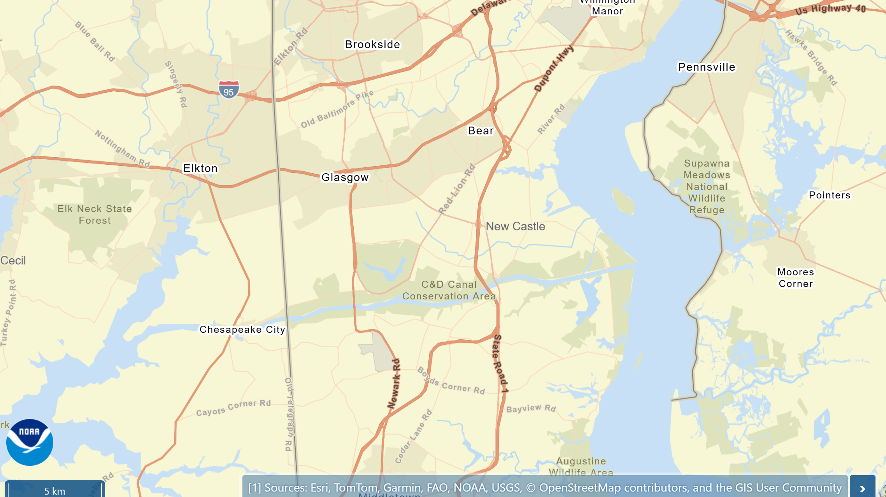
Notes:
https://erma.noaa.gov/atlantic#layers=1&x=-75.66363&y=39.60212&z=11.2&panel=layer

Slide 8
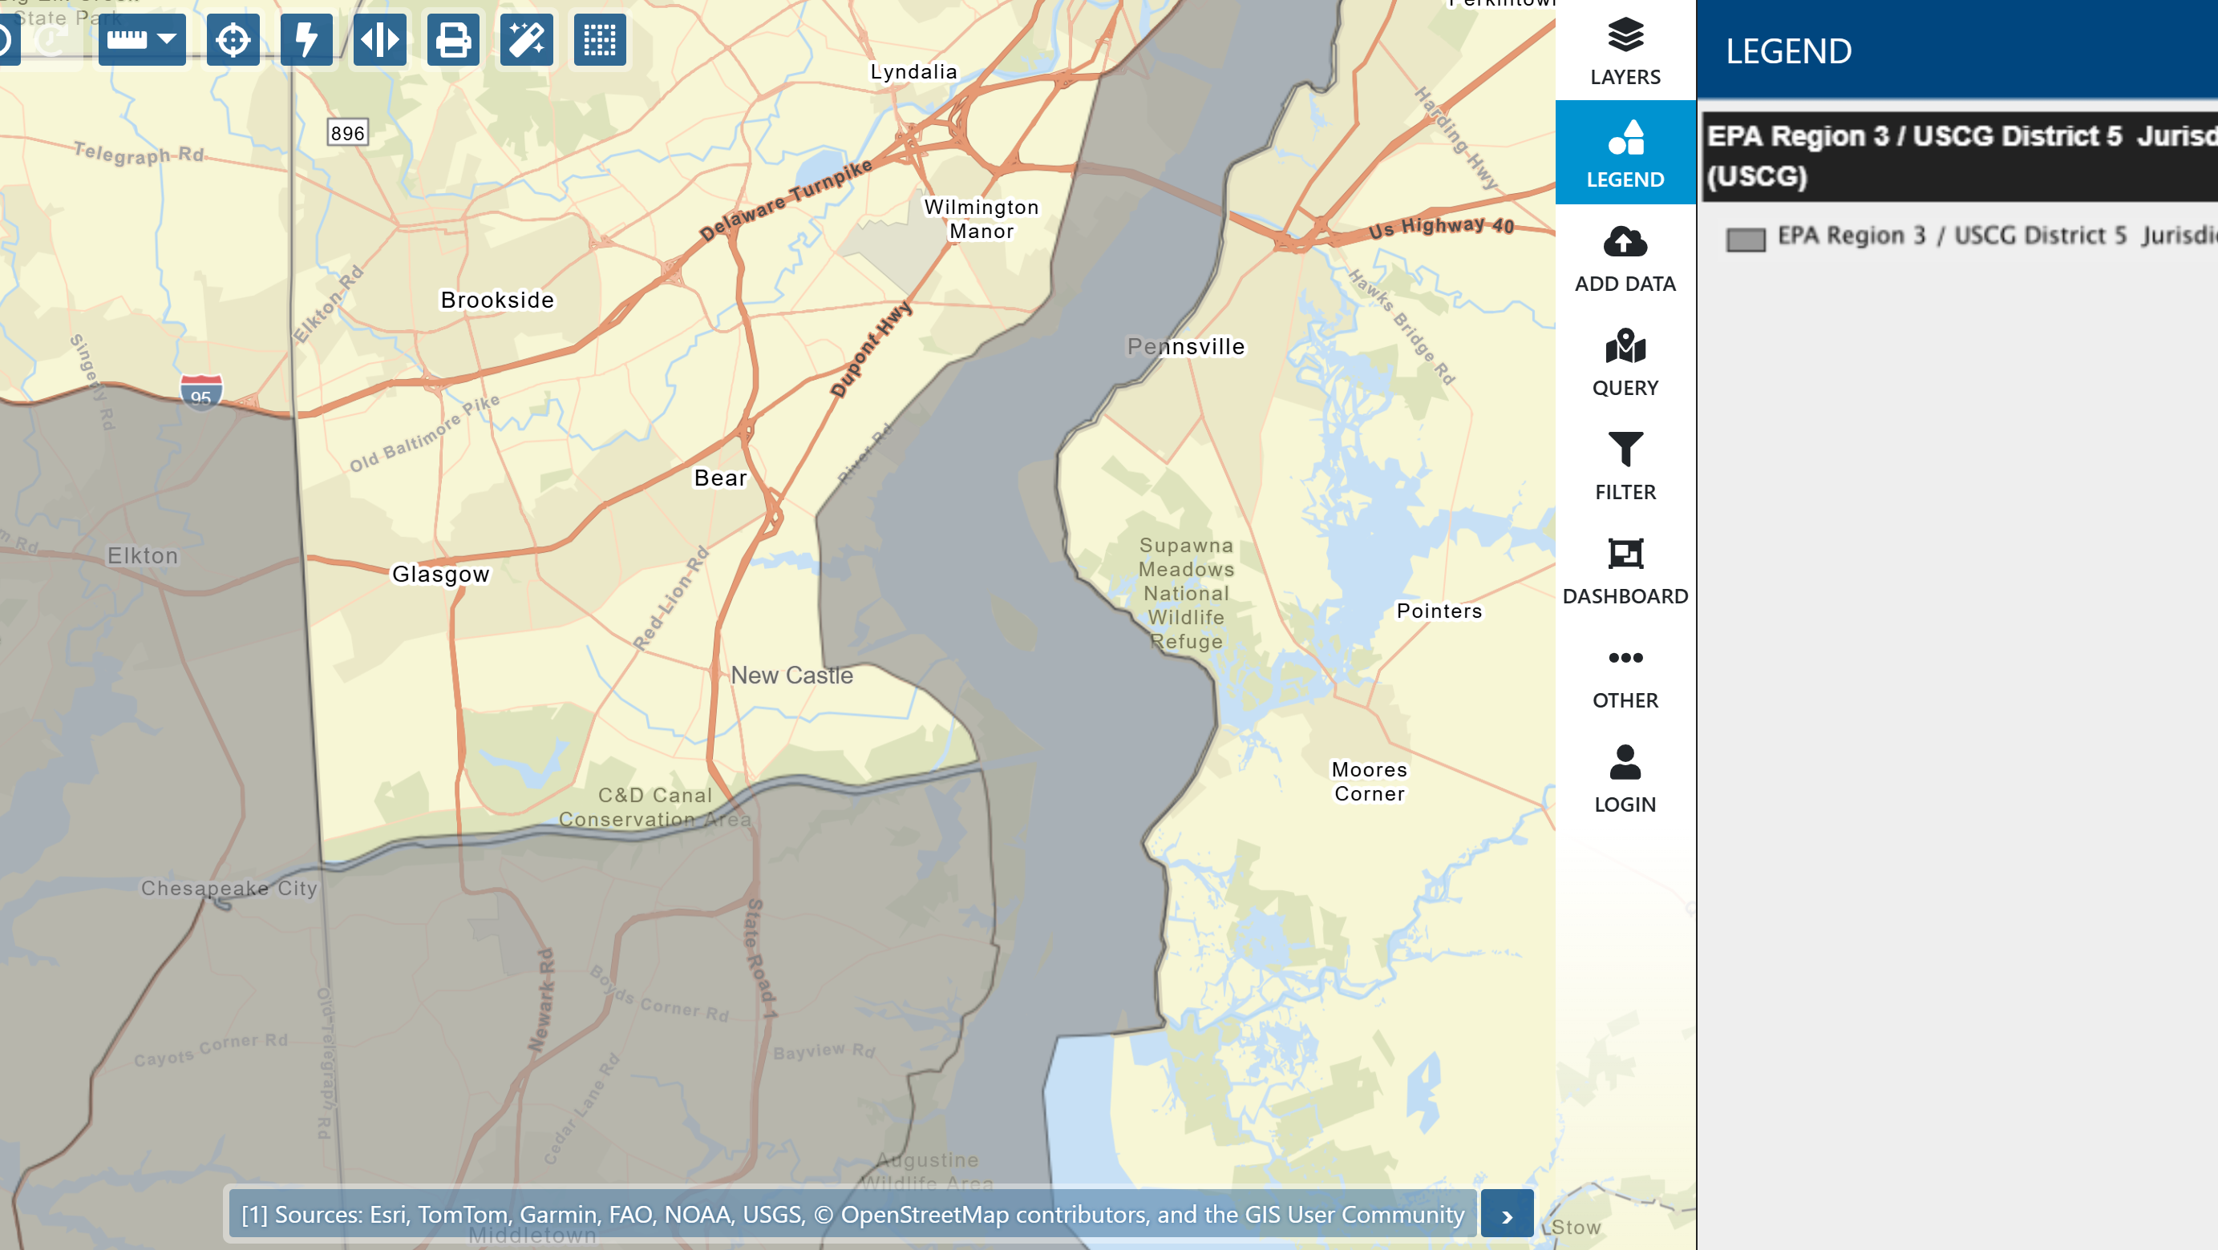

Slide 9
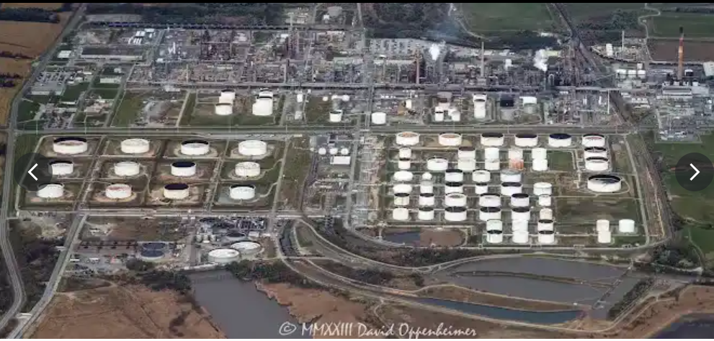
STARTEX
Notes:
Aerial overview of the facility

Slide 10
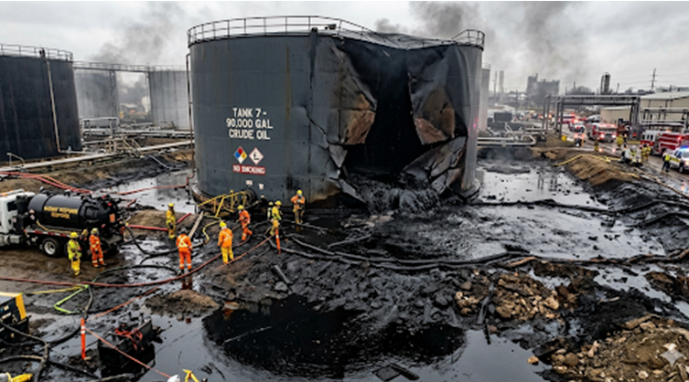












Scenario
On 5 May 2026, the Delaware City Refinery, a major refining and storage hub, was inundated by storm surge. The storm surge physically lifted an above ground Storage Tank from its concrete foundation. The tank, holding approximately 90,000 barrels of heavy crude oil at the time, was battered by debris in the turbulent water, causing a catastrophic structural failure near its base
An estimated 1.2 million gallons (approx. 28,500 barrels) of crude oil escaped from the tank.
The facility is on the border of the inland/coastal zone.
BBL

Slide 11
Resources at Risk
Environmental Conditions:
  Water temps steadily rising through May. Highly variable; the "salt front" pushes upriver as freshwater flow decreases, increasing salinity in the area. Strong, tidally-driven currents are a dominant factor in both the river and the canal. Warming air temperatures with increasing chances of thunderstorms.
Economic Impact:
  C&D Canal: One of busiest canals in the world with 25,000 vessels transiting annually.
  Port of Wilmington: Handles over 400 ships and 6 million tons of cargo annually, generating an estimated $436 million in business revenue and $41 million in annual state and regional taxes. More in 2027.
  Port of Wilmington is responsible for approximately 5,900 direct, indirect, and induced jobs.
  Commercial & Recreational Fishing: May is a key month for both commercial and recreational fishing in the Delaware River and Bay.
  Tourism: Recreational Boaters, Ferry Services, Cruise Tours, Special Events, Waterfront Businesses
Environmentally Sensitive Areas and Wildlife:
  Tidal Salt Marshes and Forested Wetlands
  Horseshoe Crab Spawning Beaches
  Striped Bass Spawning Area
  Federally Endangered/Threatened)
    Red Knot
    Atlantic Sturgeon
  Migratory Shorebirds
  Invasive Blue Catfish
Cultural/Historic Resources :
  Fort Delaware State Park
  Shipwrecks
  Tribal
Notes:
In May, the stretch of the Delaware River from Delaware City to the Cedar Swamp area, along with the C&D Canal, experiences a dynamic interplay of environmental factors. This period marks a significant transition from spring to summer conditions, influencing water characteristics and weather patterns.
Water Conditions
A key driver of the environmental conditions in this region is the freshwater inflow from the Delaware River and its tributaries. This freshwater mixes with the saltwater from the Atlantic Ocean, creating a salinity gradient that fluctuates based on river flow and tides.
Typical water conditions in May:
Water temperatures in the Delaware River rise during May. While specific historical data for May in this exact location is limited, data from nearby locations shows a warming trend. For instance, at the mouth of the Delaware Bay in Lewes, water temperatures are around 52°F in early April and can be expected to be significantly warmer by May. At a station further upriver in Philadelphia, water temperatures are around 59°F in early April, indicating a general warming trend moving up the river. Data from Trenton shows a temperature of 52°F in early April, suggesting a complex temperature profile along the river. The C&D Canal's temperature is influenced by both the Delaware River and the Chesapeake Bay. The general warming trend of the region in May will also apply to the canal.
The salinity in this part of the Delaware River is highly variable. During periods of high freshwater inflow, typically in the spring, the "salt front" (the leading edge of seawater with a chloride concentration of 250 mg/L) is pushed further downriver.
In May, as freshwater flows from spring rains and snowmelt decrease, the salt front begins to move upstream. The area between Delaware City and Cedar Swamp is in the oligohaline to mesohaline zones, meaning salinity generally ranges from 0.5 to 18 parts per thousand (ppt).
However, during drier conditions, higher salinities can be expected. Salinity in the C&D Canal is also variable, influenced by the exchange of water between the Delaware and Chesapeake Bays.
Currents in the canal can be strong and change direction with the tides. Delaware River is tidal in this region, with a significant tidal range. This tidal influence creates strong currents that vary in speed and direction throughout the day. The tidal cycle is semidiurnal, meaning there are two high tides and two low tides each day.
The C&D Canal experiences strong tidal currents, which can reach up to 3 knots. The direction of the current reverses with the tide.
Environmentally Sensitive Areas and Wildlife
Priority - Resource Name – Description – Location. Protective Measures&/ Special Instructions
High - Red Knot (Federally Threatened) - Delaware Bay shoreline, beaches, and mudflats. Crucial feeding on horseshoe crab eggs for migration. Avoid all human disturbance on beaches. Area is a critical stopover point.
High - Horseshoe Crab Spawning Beaches Delaware Bay shoreline, especially sandy beaches from Delaware City to Cedar Swamp area. Largest spawning population in the world. Eggs are a vital food source for migratory birds. Prohibit access to documented spawning beaches.
High - Striped Bass Spawning Area C&D Canal and Delaware River. Spawning occurs from April 1 to May 31. ZERO HARVEST of striped bass is permitted during this period.
Medium - Migratory Shorebirds (Ruddy Turnstone, Sanderling, Semipalmated Sandpiper) - Delaware Bay shoreline, beaches, and mudflats. These species rely heavily on horseshoe crab eggs for food. Minimize human activity and vehicle traffic on beaches to prevent disturbance.
Medium - Tidal Salt Marshes & Forested Wetlands (Cedar Swamp)Shoreline from Delaware City south to the Cedar Swamp Wildlife Area. These areas provide critical nesting and breeding habitat for numerous bird species, including threatened and rare species. Avoid any activities that would alter hydrology or vegetation.
Low - Invasive Blue Catfish - C&D Canal and associated tributaries. Predatory and competes with native fish. Monitor population and report any large concentrations.
Historic Towns and Settlements
Delaware City: This quiet riverfront town boasts historic architecture and a "small town America" culture. In early May, beginning of the season for ferry tours to nearby historic sites.
Chesapeake City: This picturesque Victorian town was quite literally built by the C&D Canal. Many of its homes and gardens date back to the 1800s and are on the National Historic Register.
Military and Maritime History
Fort Delaware State Park: Located on Pea Patch Island, this Civil War-era fortress is a major historical landmark. Originally built to protect the ports of Wilmington and Philadelphia, it later served as a prison for Confederate soldiers. The fort is accessible by ferry from Delaware City from late April through October.
C&D Canal Museum: Housed in the original 1830s pump house in Chesapeake City, this museum details the fascinating history of the Chesapeake and Delaware Canal. Visitors can see the original steam-powered pumps and waterwheel that operated the canal's locks, as well as artifacts from its construction.
The canal itself is one of the busiest in the world, with over 25,000 vessels transiting it annually.
Natural and Cultural Landscapes
Cedar Swamp: Historically, this area was the hunting grounds of the Pokagon Band of the Potawatomi People. The landscape, once a mix of prairie, wetlands, and forests, was significantly altered by early settlers and agricultural practices. Today, efforts are underway to restore the native landscapes.
Historic Events in May: While specific dates vary, May often marks the beginning of the tourist season. In nearby New Castle, the Arasapha May Market is a long-standing tradition, and "A Day in Old New Castle" is held on the third Saturday of the month, featuring historical reenactments and tours.
Commercial and Recreational Fishing: A Seasonal Harvest
May is a key month for both commercial and recreational fishing in the Delaware River and Bay, though it is subject to strict regulations to protect spawning fish populations.
Commercial Fishing:
Striped Bass: The commercial striped bass season is open in May for gill net fishermen in the Delaware River and Bay.
American Shad: This species is also commercially fished in the Delaware River.
Eel: The commercial eel fishery is open year-round.
Other Species: A variety of other species are commercially harvested in the bay, including bluefish, croaker, and summer flounder, though some fisheries, like weakfish, have closures in May.
Recreational Fishing:
Striped Bass: While recreational striped bass fishing is popular, there are specific size and possession limits in effect.
Black Sea Bass: The recreational season for black sea bass opens in mid-May.
Other Species: Anglers also target species like summer flounder and tautog, though seasons and limits vary.
Tourism and Recreation: A Growing Sector
The scenic beauty and historical significance of the area attract a growing number of tourists, supporting a variety of maritime-related recreational activities, especially as the weather improves in May.
Boating: The C&D Canal and Delaware River are popular with recreational boaters. Towns like Chesapeake City and Delaware City offer marinas and docking facilities for transient boaters.
Ferry Services: The Cape May-Lewes Ferry transports over 750,000 passengers and 250,000 vehicles annually, supporting tourism on both sides of the bay.
Cruises and Tours: Various companies offer cruises and tours on the Delaware River and Bay, including tours of historic sites like Fort Delaware.
Events like the opening day of the Kalmar Nyckel sailing season in May draw visitors to the area.
Waterfront Businesses: Restaurants, shops, and bed and breakfasts in towns like Delaware City and Chesapeake City cater to boaters and tourists, contributing to the local economy.

Slide 12
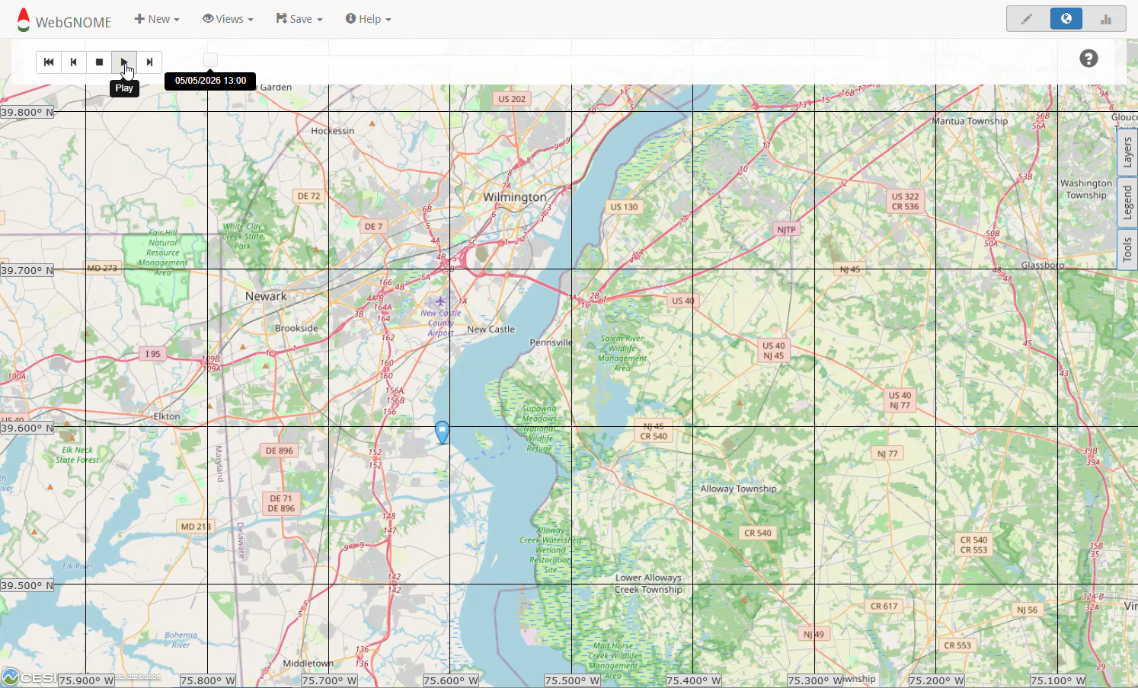
Trajectory

Slide 13
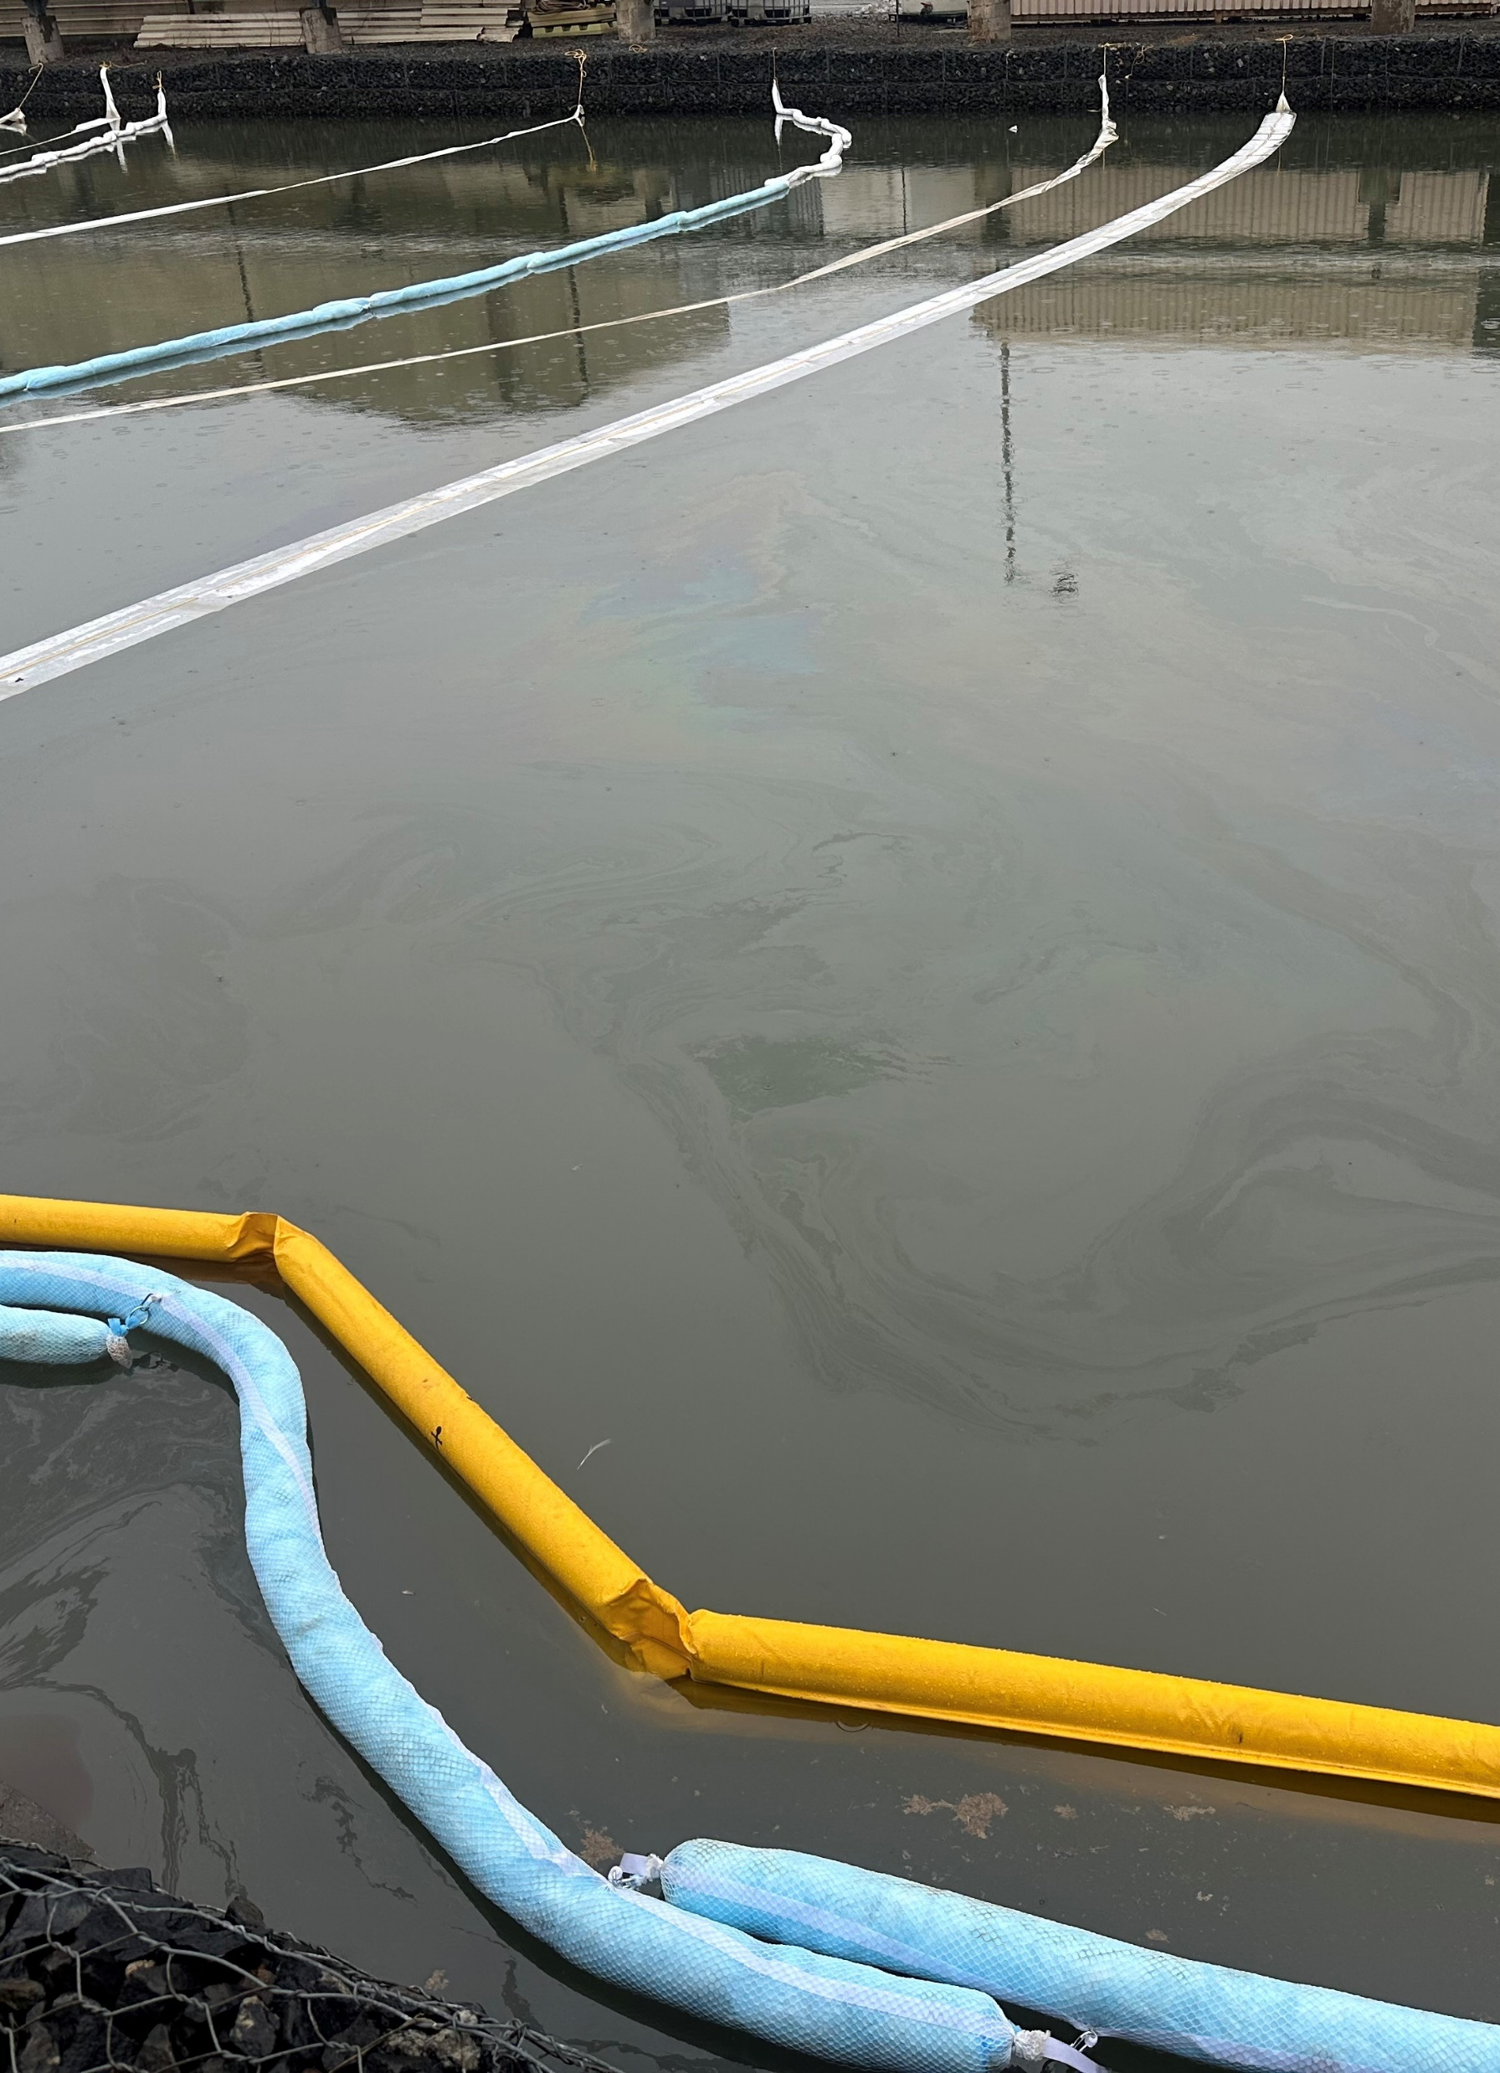
Scenario Problem Set #1
- Decanting
The primary containment berm, designed to hold the tank's contents, was compromised when the release caused a section of the earthen wall to collapse and crude oil poured into the refinery's internal stormwater drainage system. The system directed the massive flow into the East Holding Pond, the final checkpoint before the water treatment plant.
The East Holding Pond, which was already near 80% capacity following a wet fall, is covered with a thick, dark layer of crude oil. The outfall structure has been immediately boomed off by emergency crews to prevent a direct release. Skimming barges have been deployed onto the pond, but their progress is slow against the immense volume of oil.
The National Weather Service has issued a Coastal Flood Warning and Flash Flood Watch for the entire region. A powerful, slow-moving Nor'easter is churning up the Atlantic coast, forecasted to bring sustained gale-force winds and 6-10 inches of rain to the Delaware City area over the next 36 hours.
The FOSC is requesting a ISRRT consultation to address proposed decanting of the retention pond due to potential overflow from additional rainfall/flooding.

Slide 14
Decanting Checklist & Guidance Document Highlights
Appendix I
Appendix II
Appendix V
  Decanting of Contact Water Operational Checklist

Slide 15
ISRRT Activation Questions
Which agencies should be on the ISRRT activation?
Does the guide/tool provide the necessary info?
What information or resources does each agency have to assist the Unified Command through this ISRRT consultation?
How would the ISRRT recommendations be documented?

Slide 16
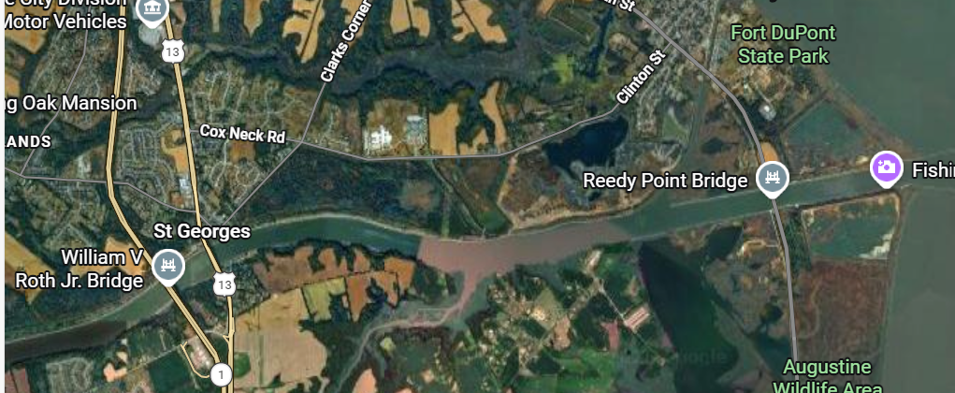
Scenario Update
Notes:
Scenario Update: Over the next 3 days, crude oil has moved 4.5 miles up the river to the St. Georg’s bridge coating the canal sides. Once inside the narrower, more confined environment of the C&D Canal, the oil's movement is now primarily driven by the canal's own currents and the wakes of passing vessels. As water levels fluctuate with the tide and passing ships create small waves, the sticky, viscous crude oil adheres to the canal's riprap and vegetated banks. This process is repeated with each tidal cycle, leaving a thick, black "bathtub ring" of oil coating the sides of the canal for several miles.
The oil smothers intertidal plants and invertebrates, and the sheen on the water's surface prevents oxygen from reaching the aquatic life below.
Dual FOSC issue with Sector MD-NCR. 2 Sector MTSRU due to commercial vessel traffic.

Slide 17
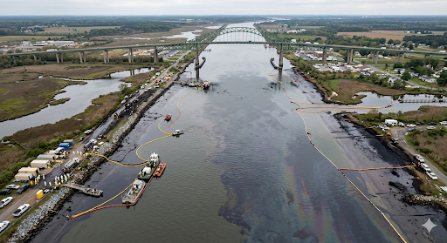
Notes:
Environmental Impacts: The C&D Canal and surrounding Delaware Bay estuary are ecologically rich and sensitive.
Habitat Destruction: Extensive oiling and contamination of the tidal marshes and wetlands flanking the canal, particularly around Augustine Wildlife Area and the Reedy Point Preserve.
Wildlife Casualties: Immediate impact on shorebirds, waterfowl, and wading birds (e.g., herons, egrets) that use the canal as a feeding and nesting ground. Widespread fish kills due to toxicity and asphyxiation are likely.
Fisheries Collapse: The canal is a vital nursery and migratory path for blue crabs, striped bass, and other commercially important species. The spill would contaminate larvae and adult populations, leading to immediate and long-term stock depletion.
Water Column Contamination: Dissolved and dispersed oil will create a toxic environment throughout the water column, impacting phytoplankton and zooplankton, the base of the local food web.
Public Health Impacts: Communities like Delaware City and Chesapeake City are in close proximity to the canal.
Air Quality Advisories: The release of Volatile Organic Compounds (VOCs) from the crude oil would necessitate air quality monitoring and "shelter-in-place" advisories for residents, especially those with respiratory conditions.
Recreational Closures: Immediate closure of all public access points, parks (e.g., Lums Pond State Park access), and boat ramps along the canal. Warnings against swimming, kayaking, and fishing would be issued.
Drinking Water Threat: Potential (though indirect) threat to local aquifers and water intakes, requiring immediate testing and contingency planning by local water authorities.
Mental and Community Stress: Anxiety and stress among residents due to health concerns, economic uncertainty, and the visual impact of the environmental damage.
Economic Impacts: The C&D Canal is a critical commercial artery, and the region relies heavily on its maritime and recreational economy.
Shipping & Commerce: Full closure of the C&D Canal to all commercial traffic. This severs the primary inland waterway route between the Port of Baltimore and the Port of Philadelphia, forcing vessels to make a much longer, costlier journey around the Delmarva Peninsula. Daily economic losses are estimated in the tens of millions.
Commercial Fishing: Immediate shutdown of all commercial crabbing and fishing operations in the western Delaware Bay and the C&D Canal. This results in total income loss for watermen and impacts seafood processors and distributors.
Tourism & Recreation: The spill would devastate the local tourism season. Charter boat operators, marinas, waterfront restaurants, and bait-and-tackle shops would see a complete collapse in business.
Property Devaluation: Waterfront properties along the canal would face significant, potentially long-term, devaluation due to shoreline contamination and aesthetic damage.
Cleanup Costs: The response and cleanup operation would be a massive, multi-year effort costing hundreds of millions to billions of dollars, involving federal, state, and private resources.

Slide 18
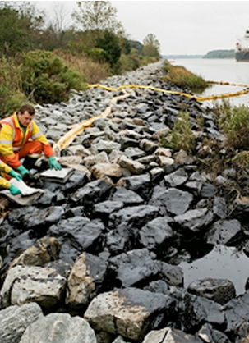
Scenario Problem Set #2 – Surface Washing Agents
Due to a combination of a strong tides and prevailing winds, the spilled crude oil has reached the Chesapeake and Delaware (C&D) Canal. Despite the deployment of containment booms, the strong currents at the canal's entrance have overwhelmed initial response efforts. A significant portion of the oil has entrained into the canal system and has adhered to the canal's riprap and vegetated banks.
SCAT has recommended using alternative response techniques
The FOSC is requesting a ISRRT consultation to address proposed use of surface washing agents to deter the contaminated water from going into the surrounding aquaphor.
Notes:
Coating the Canal Sides:
Once inside the narrower, more confined environment of the C&D Canal, the oil's movement is now primarily driven by the canal's own currents and the wakes of passing vessels. As water levels fluctuate with the tide and passing ships create small waves, the sticky, viscous crude oil adheres to the canal's riprap and vegetated banks. This process is repeated with each tidal cycle, leaving a thick, black "bathtub ring" of oil coating the sides of the canal for several miles. The oil smothers intertidal plants and invertebrates, and the sheen on the water's surface prevents oxygen from reaching the aquatic life below.
Ecological and Economic Impact:
The spill has devastating effects on the local ecosystem and economy.
The oil is toxic to fish, crabs, and other marine life in both the river and the canal.
The coating of the canal banks destroys critical habitat for birds and other wildlife.
The C&D Canal is forced to close to recreational boating, and shipping traffic is severely restricted, causing significant economic disruption.
The cleanup process is long and arduous, involving extensive manual and mechanical removal of the oil from the canal's banks, and long-term monitoring is required to assess the full extent of the environmental damage.

Slide 19
SWA Protocol & Guidance Documents Highlights
SWA Washing Agents Preauthorization Test and Evaluation Protocol
  Introduction
  Surface Washing Agent Defined
    What to Consider
    Target Areas
  Criteria for Considering the Use of Surface Washing Agents
  Constraints Governing Test Use of Surface Washing Agents
  Appendix: State Regulatory Requirements
Notes:
Need consultation. No BE so will fall under the Countermeasures Protocol
- Good discussion for RRT and potential tasker for Spill Countermeasures Workgroup

Slide 20
ISRRT Activation Questions
Which agencies should be on the ISRRT activation?
Does the guide/tool provide the necessary info?
What information or resources does each agency have to assist the Unified Command through this ISRRT consultation?
How would the ISRRT recommendations be documented?

Slide 21
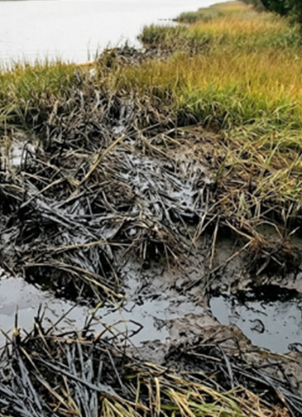
Scenario Problem Set #3 – Surface Removal Options
The spilled crude oil has continued to impact the Chesapeake and Delaware (C&D) Canal which includes wetlands, marinas, waterfront properties and is increasingly disrupting the Marine Transportation System (MTS).
There is significant impact of the crude oil spill to the shoreline marsh areas along 4.5 miles of the C&D canal. Relying on mechanical recovery alone in a marsh is a losing battle against time, terrain, and cost of the response.
SCAT has recommended using alternative response techniques
Due to the spill trajectory/impacts the FOSC is requesting an ISRRT consultation for the use of cut/burn/flush options due to limited ability of responders to get into the marshes and potential additional environmental/wildlife/economic impacts.
Notes:
Case for use of Alternative Response Techniques.
Relying on mechanical recovery alone in a marsh is a losing battle against time and terrain. It's a slow, physically destructive process that allows the oil to inflict maximum long-term damage by becoming part of the sediment, while the cleanup effort itself causes significant secondary harm.
By contrast, using in-situ burning as a primary tool offers a rapid, highly efficient, and minimally intrusive method to remove the vast majority of the oil before it can cause irreversible harm. Supplementing this with targeted vegetation cutting allows responders to surgically remove heavily concentrated oil that may not be suitable for burning.
This combined, alternative approach prioritizes the long-term health of the marsh by minimizing physical disruption and removing the pollutant quickly, giving the ecosystem the best possible chance to recover.
More Detailed Argument :
Skimmers are ineffective in shallow, debris-filled water. The dense vegetation prevents booms from working and acts like a sponge, holding the oil. Most of the oil is trapped where machinery cannot go. Vegetation cutting allows responders to physically remove the heavily oiled plants, which are the primary "source" of contamination in the marsh.
An in-situ burn can be initiated remotely, reaching deep into the marsh where no boat or person could ever go, removing up to 95% of the oil in that area.
Mechanical recovery is a painstaking, laborious process of collecting small amounts of oil over a long period. This slow pace gives the oil maximum time to seep into the sediment, where it becomes a source of chronic, long-term pollution. An in-situ burn is the single fastest method for removing large quantities of oil. It can eliminate in hours what would take mechanical methods weeks or months to collect. This speed is critical to preventing the oil from penetrating the marsh soil.
Responders using heavy equipment, boats, and extensive foot traffic will trample vegetation, compact the delicate soil, and churn oiled sediment, mixing the pollution deeper into the ecosystem. This "intrusive cleanup" can sterilize the marsh and severely delay natural recovery. An in-situ burn requires minimal personnel and equipment on the ground, preserving the physical structure and root systems of the marsh. While cutting is intrusive, it can be done surgically, targeting only the most heavily oiled areas and creating pathways, which is far less damaging than widespread trampling.
Mechanical recovery creates enormous volumes of oily water and solid waste (sorbents, contaminated debris). This waste must be collected, stored, transported, and disposed of, creating a massive and expensive logistical challenge. An in-situ burn converts the oil primarily to its gaseous components, leaving very little residue. This virtually eliminates the logistical burden of waste handling, allowing resources to be focused on other critical response activities.

Slide 22
Oil Spill Response Application Checklist & Guidance Highlights
Region III Area Zone Map
Letters of Agreement
Decision Tree
Oil Spill Response Application/Checklist
Region III Regional Response Team Guidelines for In-Situ Burning of Oil Impacted Herbaceous Wetlands
Wetland In-Situ Burn Evaluation Checklist

Slide 23
ISRRT Activation Questions
Which agencies should be on the ISRRT activation?
Does the guide/tool provide the necessary info?
What information or resources does each agency have to assist the Unified Command through this ISRRT consultation?
How would the ISRRT recommendations be documented?

Slide 24
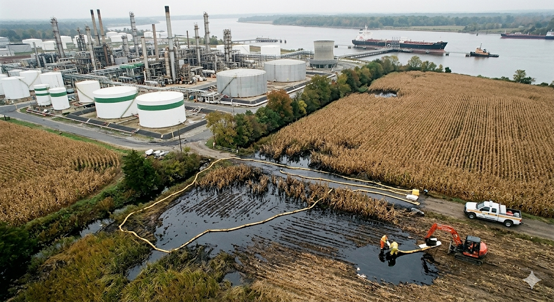
Scenario 4 – Agricultural Response Discussion/Recommendations
Oil entrainment from the spill has impacted the neighboring cornfields.
Due to the shallow water table, The oil has saturated the topsoil and reached the underlying aquifer. It then "floated" on the water table and spread horizontally, creating a large, mobile underground "plume" of contamination that moved with the groundwater flow. The area of contaminated groundwater has become many times larger than the surface spill itself.
40 acres of mature corn are a complete financial loss for the farmer. The land cannot be replanted until extensive and costly soil remediation is completed, which could take years. The impacted farm is unable to fulfill its contracts with local grain elevators or ethanol plants, causing a minor but concentrated disruption in the local supply chain.
The FOSC is requesting an ISRRT consultation for In-Situ Burn
Notes:
What do you do with the oiled corn?

Slide 25
Oil Spill Response Application Checklist & Guidance Highlights
Authority
USCG/EPA Boundary Map
Region III Inland In-Situ Burn Evaluation and Response Checklist

Slide 26
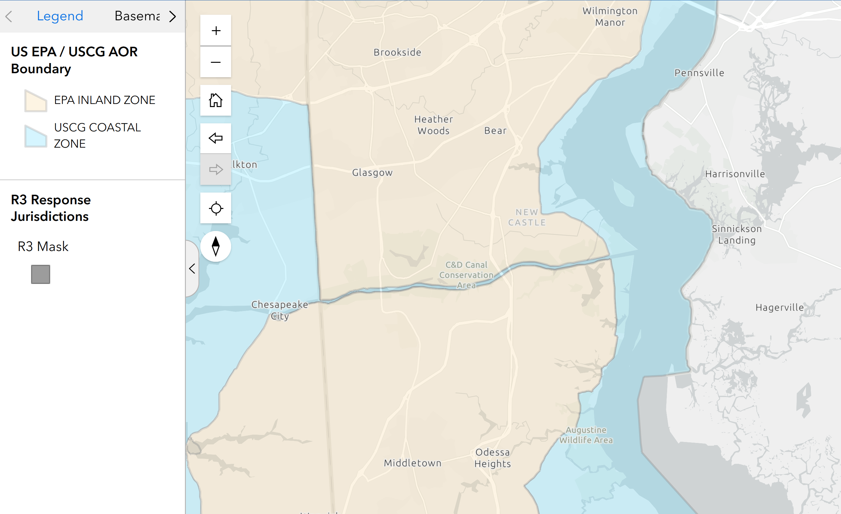
Notes:
https://experience.arcgis.com/experience/8e5e4f2887334225a1d88ffd5d73123b/

Slide 27
ISRRT Activation Questions
Which agencies should be on the ISRRT activation?
Does the guide/tool provide the necessary info?
What information or resources does each agency have to assist the Unified Command through this ISRRT consultation?
How would the ISRRT recommendations be documented?

Slide 28
ENDEX
Feedback and Lessons Learned
  Follow-up Plan/Product Update(s)
  Workgroup Tasking
  Other concerns for future TTX

Slide 29
