Slide 1
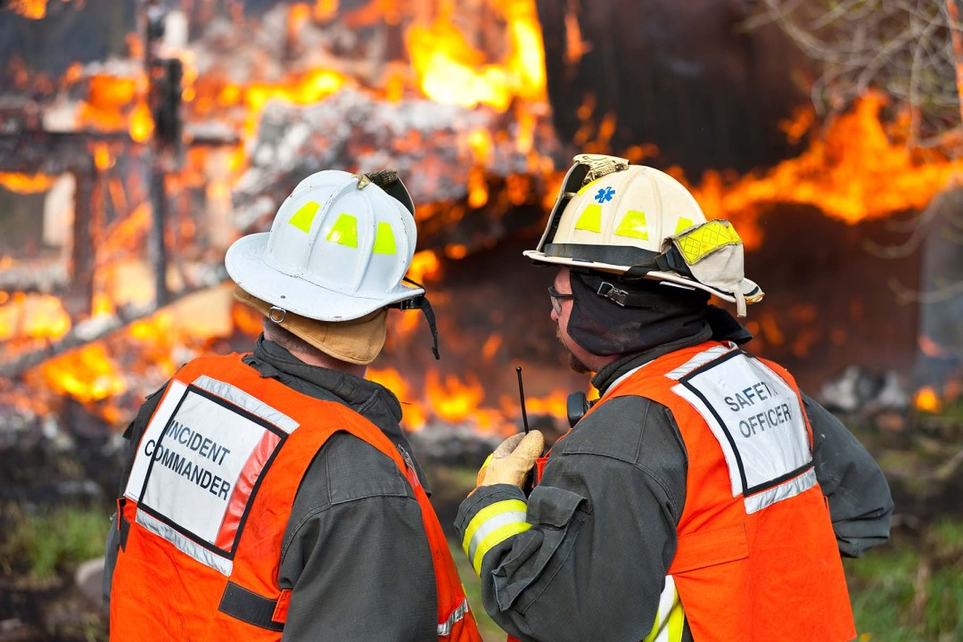
RRT III
Coordinator’s Report
Sabina Bastias
RRT3 Coordinator
May 6, 2026

Slide 2
Upcoming 2026 RRT Meetings
RRT Meeting
Locations
RRT Meeting
Locations
RRT Meeting
Dates
RRT Meeting
Dates
RRT 1
May 5 | Boston, MA
June 3-4 | Hudson Valley
May 19-20 | St. Thomas
Dec 8-10 | TBD: PA
May 12-14 | Atlanta, GA
TBD | TBD
May 6-7 | Dallas, TX
RRT 7
Aug 26 | Virtual
Oct 21-22 | Denver, CO
July 22-23 | TBD
Sept 23 | Boise, ID
Sept 10 | TBD
Summer | Virtual
RRT 2
RRT 8
CRRT
RRT 9
RRT 3
RRT 10
RRT 4
Alaska
RRT 5
Oceania
RRT 6

Slide 3
2025 Annual Report Highlights

Slide 4
Number of Pollution Reports: 10, 796
Number of Federalized Cases: 25
Number of Criminal Cases: 1

Slide 5
Notable Cases
US Navy - DDG Gravely
Reagan National Airport Incident
Lord Industrial Fire
IMTT Chesapeake
Severe WV Flooding Event
SPS Technologies Fire
Colonna's Shipyard
Oil Release in Norfolk, Virginia
Post Helene - New River Clean-Up Sandbridge Nimmo Parkway Bentonite Clay Spill
Mystery Sheen Jones Falls Outfall
Johns Hopkins Diesel Spill - Inner Harbor
Riggins Run Crude Oil Spill
NRG Power Plant Discharge
WAWA Wildwood NJ
US Steel Clairton Coke Works
M/V W-Sapphire Explosion
F/V Mary Grace - Sunken Vessel
M/V W SAPPHIRE Explosion
PEPCO Spill in Washington DC
Dredge Barge William L. Price
P/C Fire Farley State Marina
BAE Systems
Capsized vessel, Egg Island Point
DC Diesel Release
CSX Train Derailment
M/V ASIAN CAPTAIN
CHIQUITA VOYAGER Fire
Bristol Health and Rehab
Lumen Tech
TUG HAWAII
Notes:
30 cases. RRT3 Activation 2026 – mention that it occurred. RRT3 convened an ISRRT for determination to use decanting procedures to reduce the threat of sheen overflow from the Calpine Power Plant retention pond located in Edgemoor, DE (Calpine LLC).

Slide 6
Agency | Outgoing Personnel | Incoming personnel
DHHS/CDC –ATSDR | Emily Adler
District of Columbia, DC DOEE |  | Eric Humes
DOD – USACE | BG John Lloyd, Division Commander - NAD | COL Jesse Curry, Division Commander - NAD
DOD – USACE | COL Robert McTighe, Division Deputy - NAD | COL Eric Swenson, Division Deputy - NAD
DOD – USACE | Michael Ganley, RCO Chief - NAD | Michael Crosby, Acting RCO Chief - NAD
DOL – OSHA | Jacob Ladd | Theresa Downs, ARA EP OSHA
USCG - Sector Buffalo (D9) | Possibly LT Jacqueline Attanasio (IMD Chief), LTJG Emily Hughlett (IMD Assistant Chief) | LTJG Reshmi Joseph (IMD)
USCG - Sector Delaware Bay (D5) | CAPT Kate Higgins-Bloom - Summer 2026 | Currently Unknown
USCG - Sector Maryland-National Capitol Region (D5) | CDR Caren Damon – Deputy Sector Commander; LCDR Christopher Bodner – EMFR Chief; LT Monet Welsh – IMD Chief / FOSCR; LTJG Aidan Simmons – ERI / SUAS Coordinator; MSTC Joshua Campbell - FOSCR | CDR Patrick McMahon – Response Department Head; LT Alexander Feltman – EMFR Deputy Chief
USCG - Sector Ohio Valley (D8) MSU Huntington | LCDR Maxwell Walker (XO) | TBD
USCG - Sector Ohio Valley (D8) MSU Pittsburgh | CDR Justin Jolley | CDR Michael Metz
USCG - Sector Virginia (D5) | CAPT Peggy Britton, LT Michael Long, LT Heather Lukasik, LT Christopher Johnson, LTJG Erika Sawicki | 2 LT, 1 LTJG, Currently Undesignated
Virginia, VDEM | Shawn Talmadge, State Coordinator (VDEM) | John Scrivani, State Coordinator (acting), VDEM agency leadership changes: John Scrivani has been appointed the State Coordinator of Emergency Management by the current administration. Chery Adkins has been appointed the Chief Deputy State Coordinator.
West Virginia, WVDEP | Temporary April-Nov - Nate Meadows | Temporary April-Nov - Brad Wright

Slide 7
Upcoming Events

Slide 8
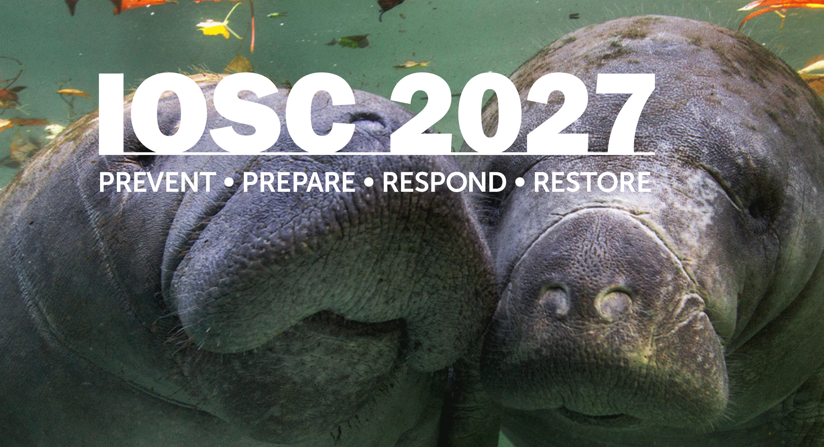


Slide 9
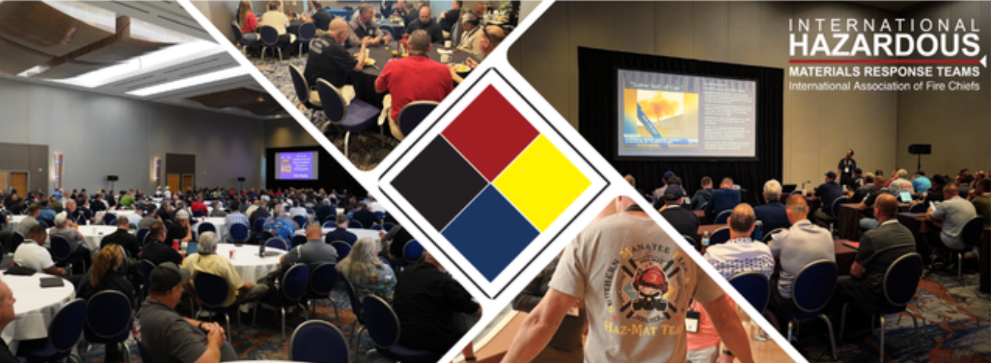
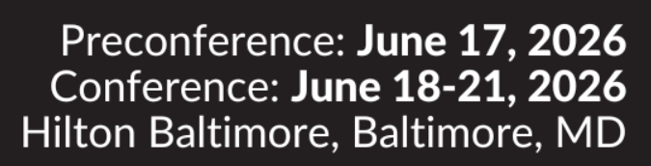
Notes:
https://hazmat2026.eventscribe.net/index.asp

Slide 10
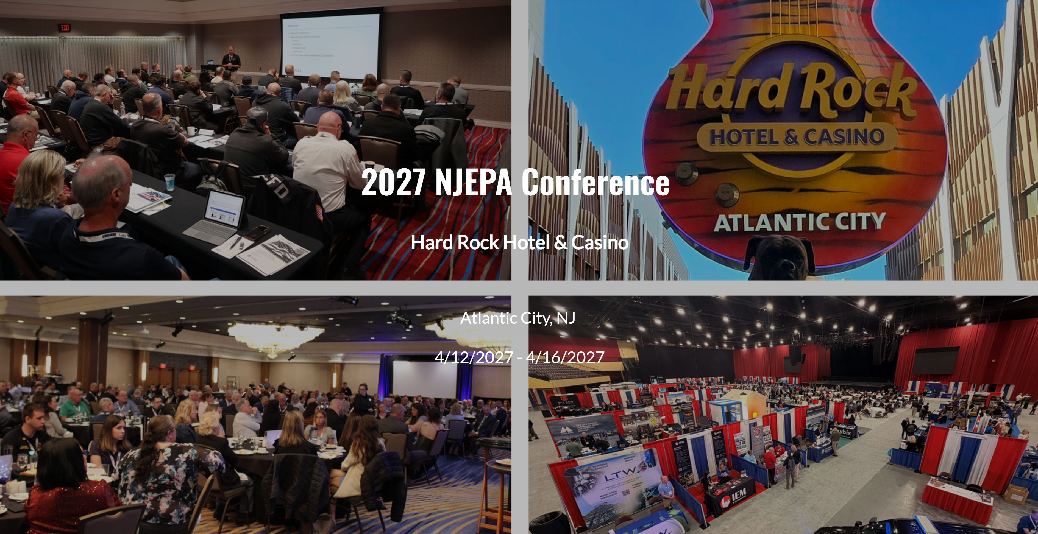


Slide 11

Notes:
https://www.cleanamericas.com/

Slide 12
NRT Worker Safety and Health technical conference
June 24-26, 2026 (tentative dates)
More details coming soon
Interested? Contact Young Wheeler wheeler.young@dol.gov or Mishari Hanible <hanible.mishari@dol.gov>

Slide 13
Exercises and Trainings

Slide 14
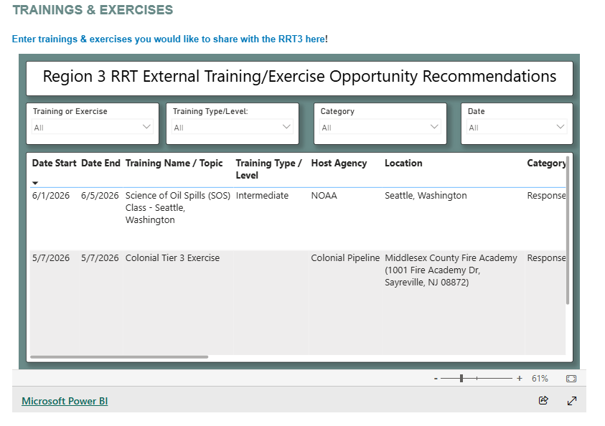

Slide 15
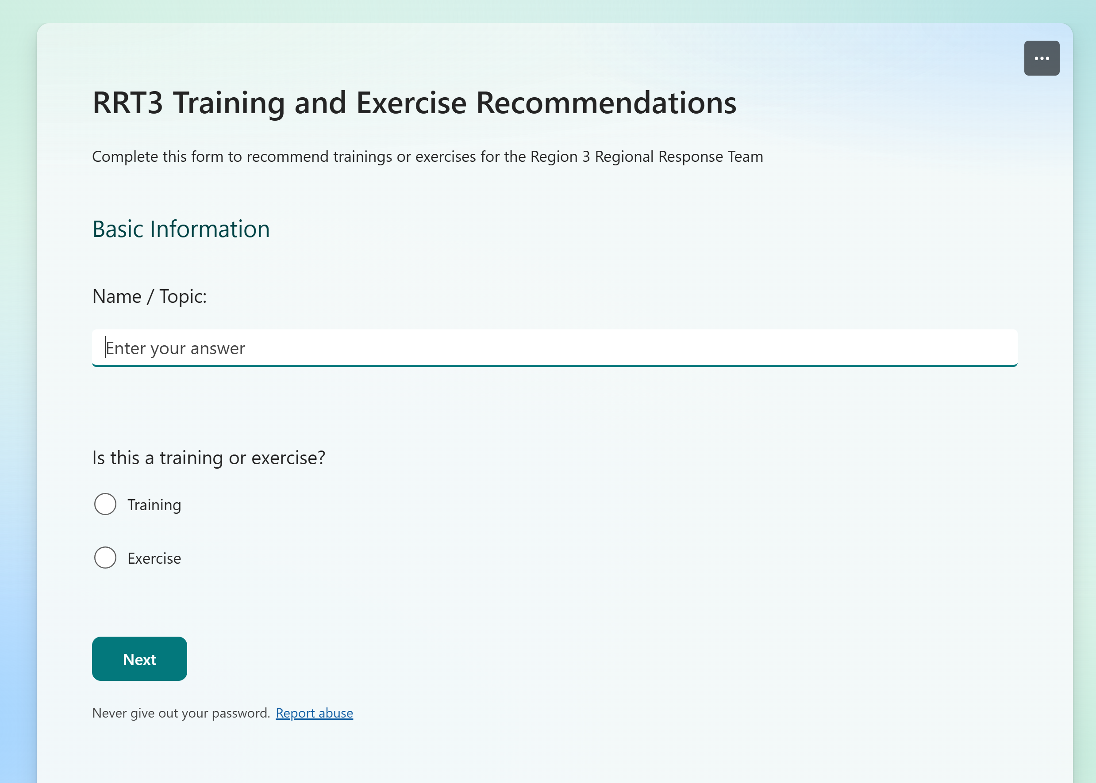
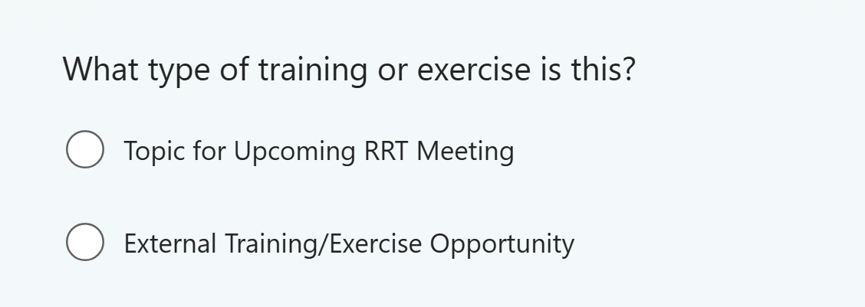

Slide 16
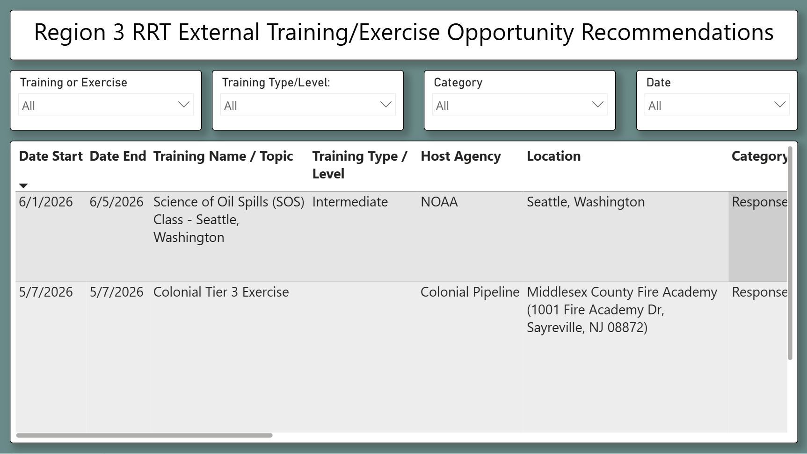
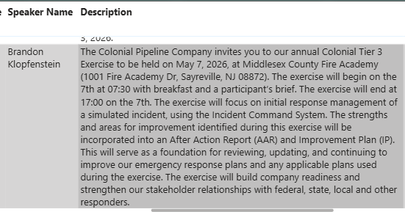

Slide 17
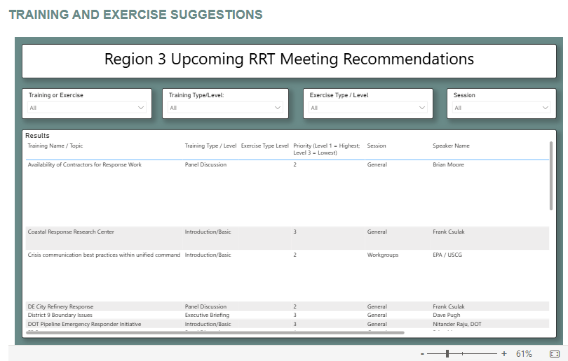

Slide 18
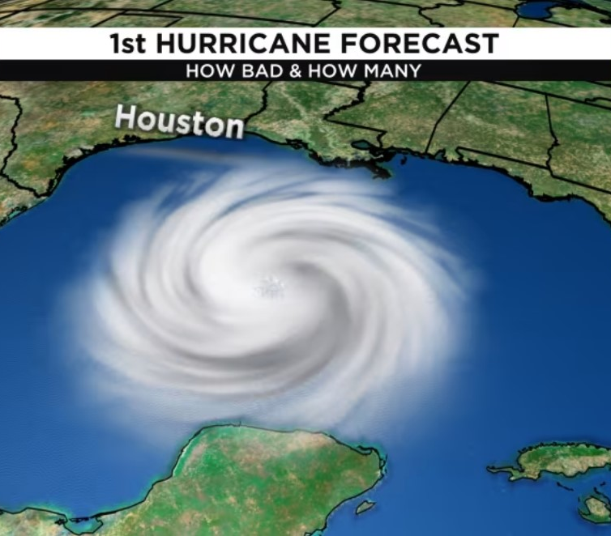
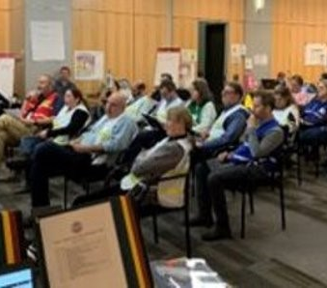
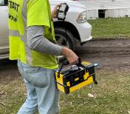
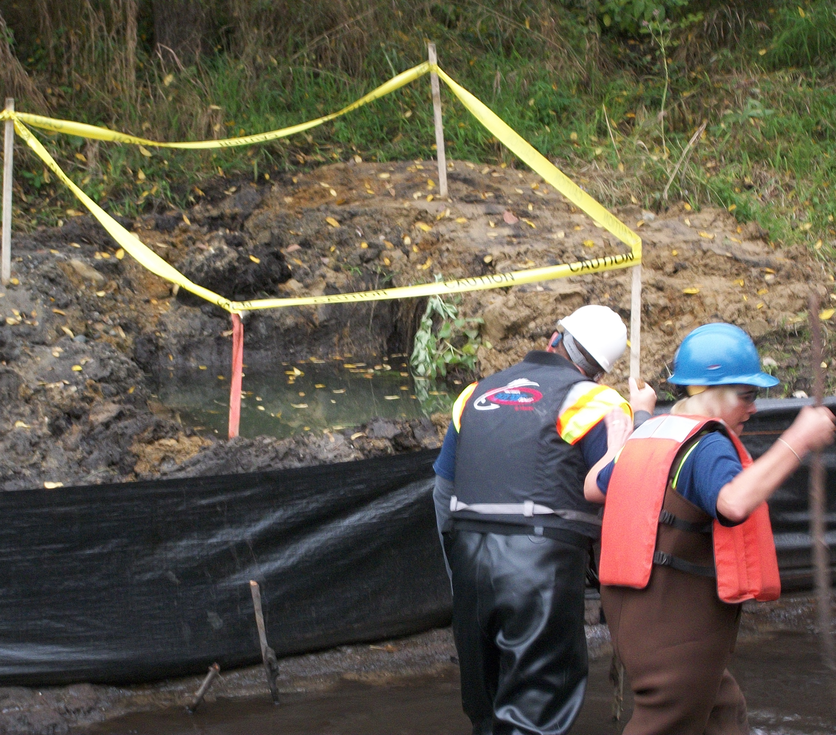
  Use the entry forms to highlight your events:
    Conferences
    Meetings
    Workshops
    Exercises
    Training
    Other Events that we can share in your area,
    region, nationally and internationally

