Slide 1
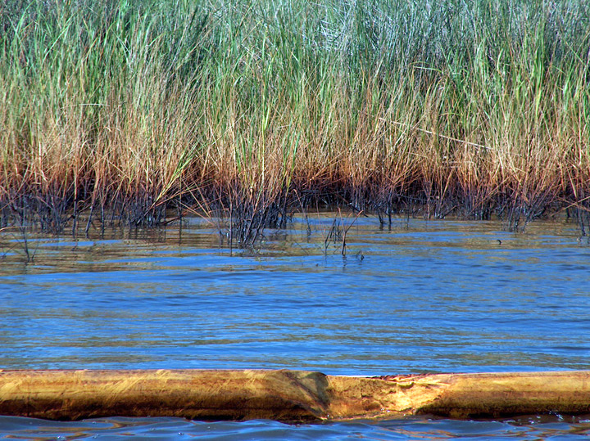
William Whitmore, SSC
Will be providing NOAA SSC coverage for:
USCG Sector New York
USCG Sector Delaware Bay
RRTII
RRTIII william.whitmore@noaa.gov
Cell: (617) 877-2806 (Preferred)
Office: (978) 494-0689‬
24-Hr Emergency Spill Response Line: (206) 526-4911
NOAA Restoration Center
55 Great Republic Drive
Gloucester, MA 01930

Slide 2
LCDR Blair DeLean
Will be providing NOAA SSC coverage for:
USCG Sector Maryland NCR
USCG Sector Virginia
Silver Spring, MD blair.j.delean@noaa
Cell: (854)202-2738
24-Hr Emergency Spill Response Line: (206) 526-4911305
1305 East West Highway
Silver Spring, MD

Slide 3
Brad Benggio
Will be providing NOAA SSC coverage for:
USCG Sector North Carolina brad.benggio@noaa
Cell: (954)684-8486
24-Hr Emergency Spill Response Line: (206) 526-4911
909 SE 1st Avenue, Room 714
Brickell Plaza Federal Building
Miami, FL 33131

Slide 4
Personal Contact Information
Email: frank.csulak1957@gmail.com
Cell: (732)766-1967

