Slide 1




Managing HazMat Impacts and Modernizing Recovery: Virginia’s Helene Experience
Elizabeth “Liz” Lohman - Virginia Department of Environmental Quality Scott Sproles - Virginia Department of Emergency Management
Myles Bartos - US Environmental Protection Agency
Ben Porter - US Army Corps of Engineers

Slide 2
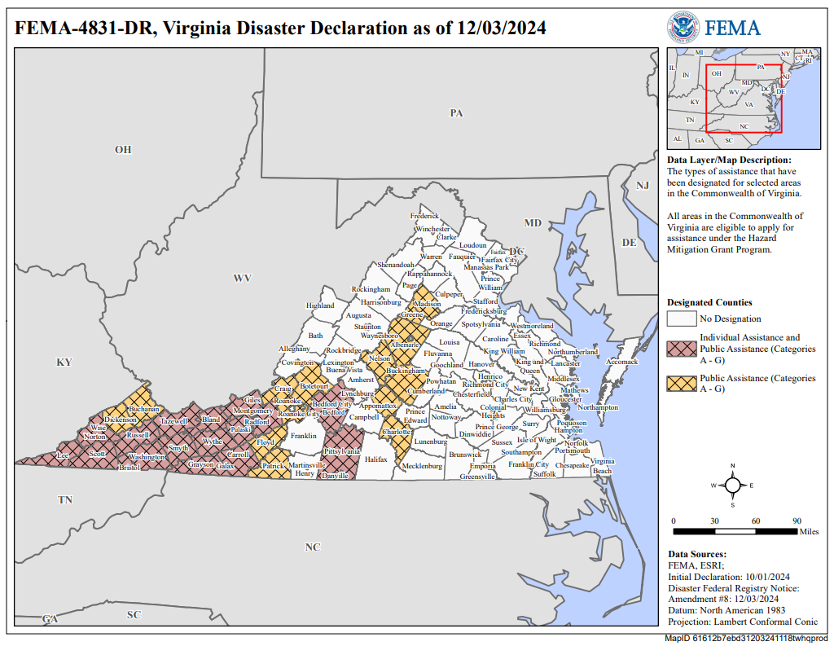
Tropical Storm Helene (FEMA 4831)
Emergency declaration included 37 Localities in southwest and central Virginia.

Slide 3
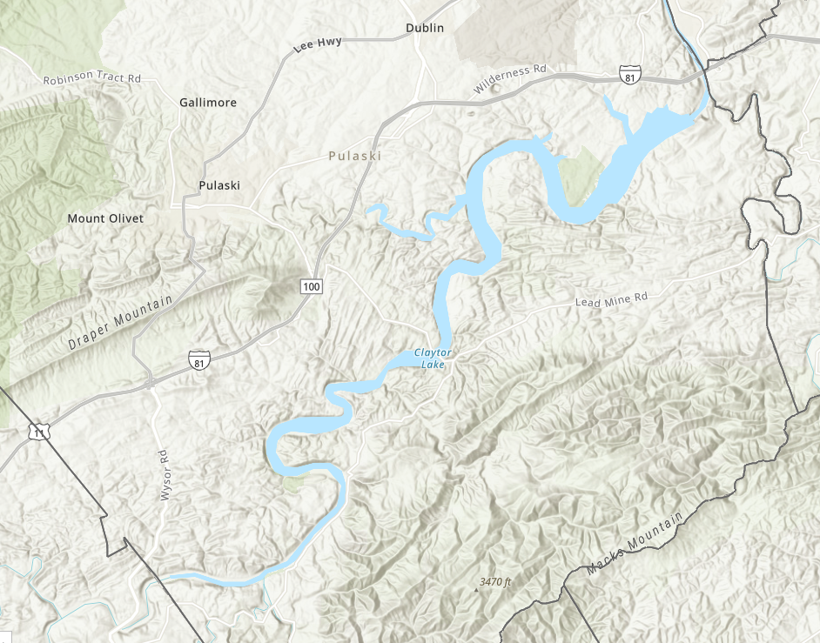
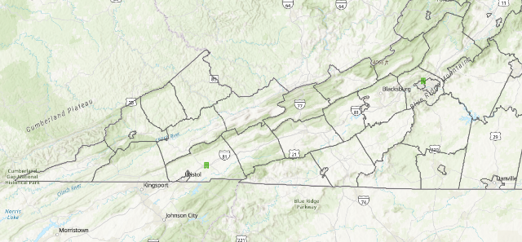
Claytor Lake
(Pulaski Co, Virginia)
Fed by the New River
4,472-acre impoundment
21 miles long
Drinking water, power generation, recreation
Appalachian Power Company operates the reservoir and the hydroelectric generating unity

Slide 4
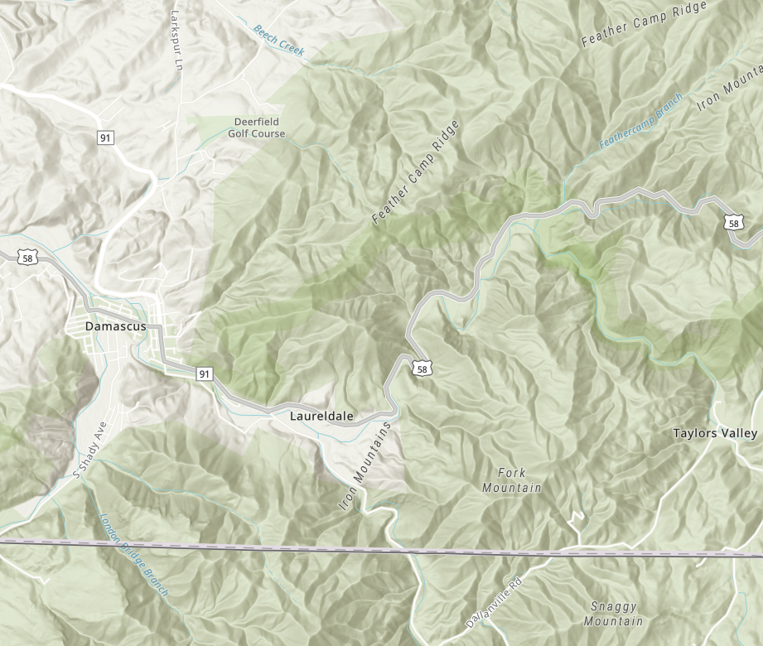
Damascus (Washington Co, Virginia)
Trail Town USA
778 (2020 Census)
Hundreds of thousands of tourists annually
Convergence of five major trails: AT, Virginia Creeper Trail, Iron Mountain Trail, US Bicycle Route 76, and the Mid-Atlantic Backcountry Motorcycle Route
Laurel Creek runs through town and joins Holston River System.

Slide 5
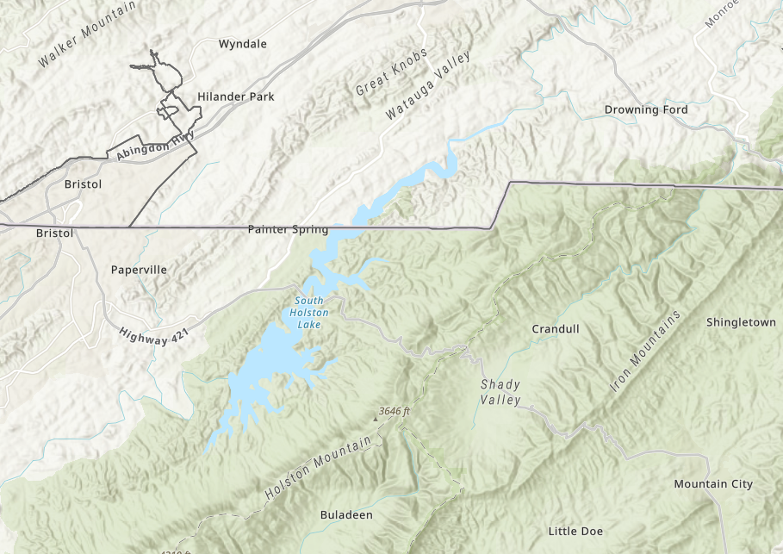
South Holston Lake
(Washington Co, Virginia
and Sullivan County Tennessee)
Fed by the Holston River system
7,580-acre impoundment (1,600 acres in Virginia)
24 miles long
Flood control, power production, recreation
Tennessee Valley Authority (TVA) operates the reservoir and the hydroelectric generating unity

Slide 6

Tropical Storm Helene Timeline
COV Debris Taskforce working with federal and state partners to support local governments with debris removal at ROW and waterway debris removal
Oct 2024 – mid 2025
American Relief Act – Grant funds for water/wastewater infrastructure and debris recovery and capacity building
2025
Field deployment: VDEM, Regional HazMat Teams, DEQ, and state contractors
Sept 28
FEMA Mission Assignment to EPA for broader hazmat and special waste support
Oct 5
Hurricane Landfall
Florida
Sept 26
Debris Taskforce
Oct 2
Landfall
Response
Recovery
Mitigation
Tropical Storm
TN-NC-VA
Sept 27
EPA/Contractors deploy under CWA / OPA90 authority
Sept 30
Wastewater treatment plant damage assessments
Oct 2
Virginia Tech provides aerial image / data analysis to
Oct 2
EPA / Contractor support hazmat recovery from waterways and communities
Oct 2024 – Jan 2025
FEMA Mission Assignment to USACE – Claytor Lake Debris Removal
Nov 2024 – Jan 2025

Slide 7

Emergency Support Function (ESF) 10
Oil and HazMat

Slide 8
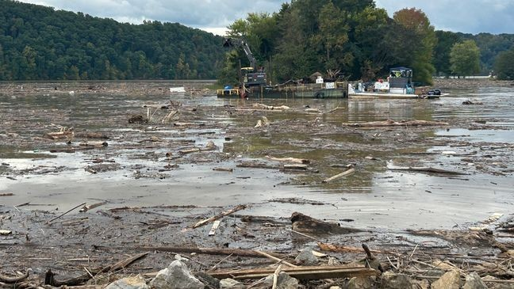
Claytor and South Holston Lakes
The lakes contained large masses of woody debris, oil and hazmat tanks and containers, propane tanks, white goods, demolition debris, and other solid waste.

Slide 9
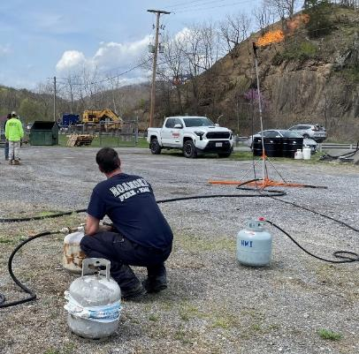
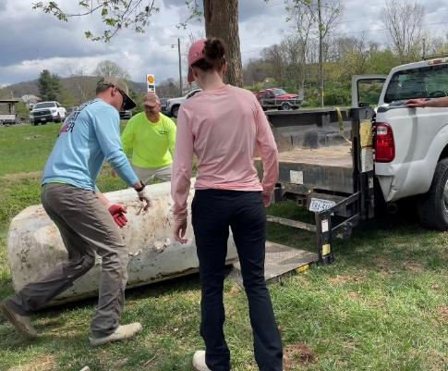
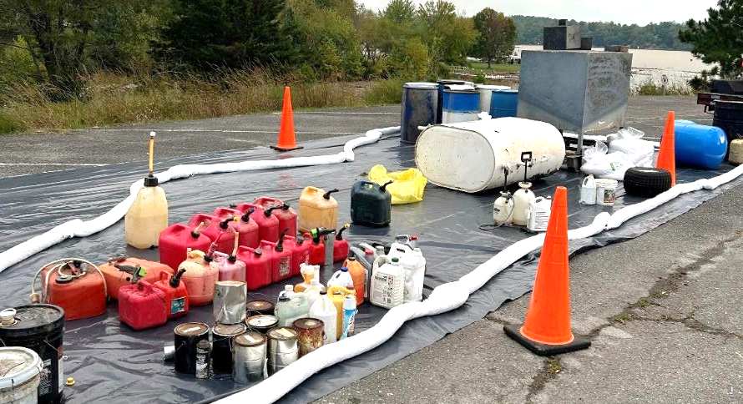
Resources
REGIONAL HAZMAT TEAMS
Teams assisted with recovery of hazmat on water and with initial categorization and segregation
CONTRACTING
Two funding mechanisms:
DEQ State-Lead Contract
DEQ emergency procurement procedures
FUNDING MECHANISM
Two funding mechanisms depending on material:
Virginia Petroleum Storage Tank Fund (VPSTF)
Virginia Environmental Emergency Response Fund (VEERF)
Notes:
The DEQ has a statutory responsibility to respond to environmental emergency situations that pose an immediate threat to human health and/or the environment. Environmental emergency situations may involve petroleum or hazardous materials spills and releases, leaking underground or aboveground petroleum storage tanks, or a disaster response following manmade or natural disasters.
DEQ will work with a responsible party and emergency response partners in response to an environmental emergency situation. If a responsible party is unknown, or unwilling or unable to take timely and/or appropriate response actions to mitigate the release of oil/hazmat, DEQ staff coordinates with local and state public safety agencies on what actions are required. Where an environmental emergency exists and with the correct approvals, DEQ may use or issue contracts to mitigate the impacts of an actual or threatened release.
Response actions are funded through the Virginia Petroleum Storage Tank Fund or the Virginia Environmental Emergency ​​​​​​​​​​​​​​​​​​Response Fund. When DEQ uses VPSTF or VEERF funds for a contract, the agency is authorized to recovery its costs.

Slide 10
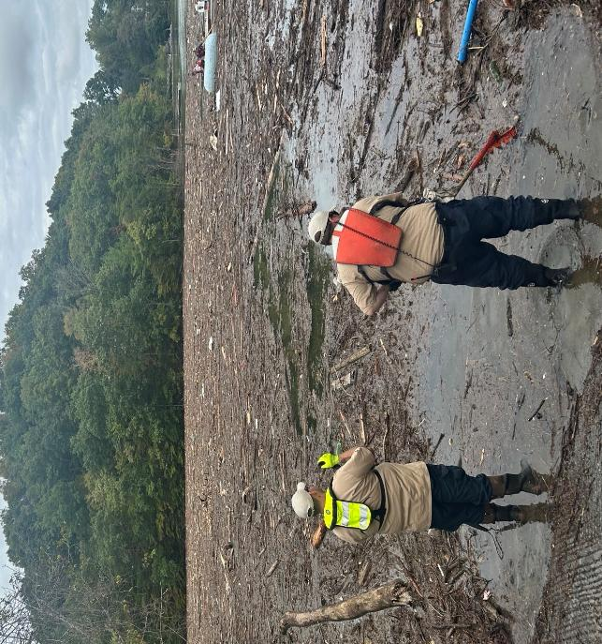
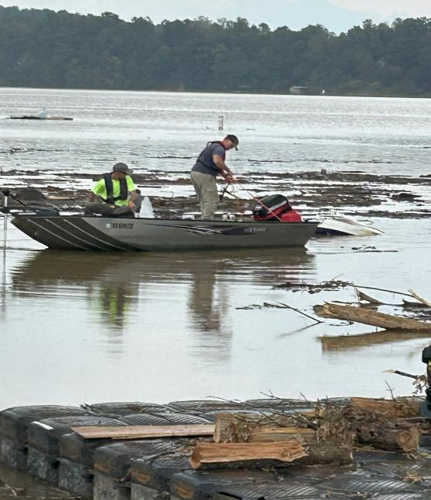
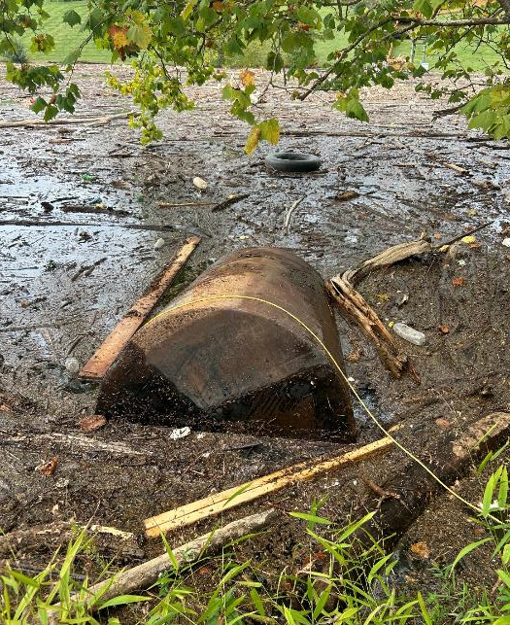
Challenges

Slide 11
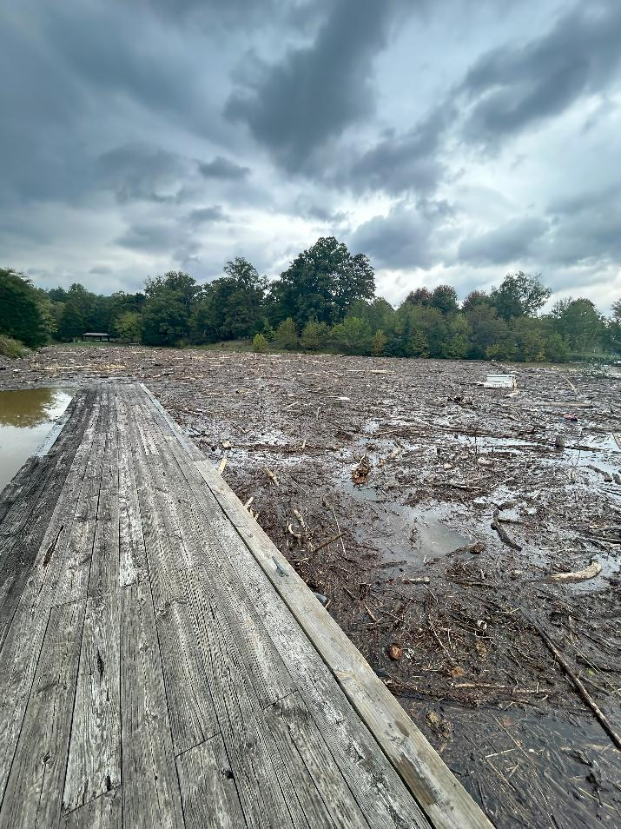
HazMat Recovery
CONTRACTING IN A MULTI-STATE EVENT
Virginia's petroleum state-lead contractors had already deployed to other states affected by Helene before we could activate them fully.
RIGHT KIND OF RESOURCE
Debris conditions required flat-bottom boats with trolling motors. Insufficient numbers nor locally-owned fleets met the need.
WEATHER
Winds continuously shifted debris across the lake.

Slide 12
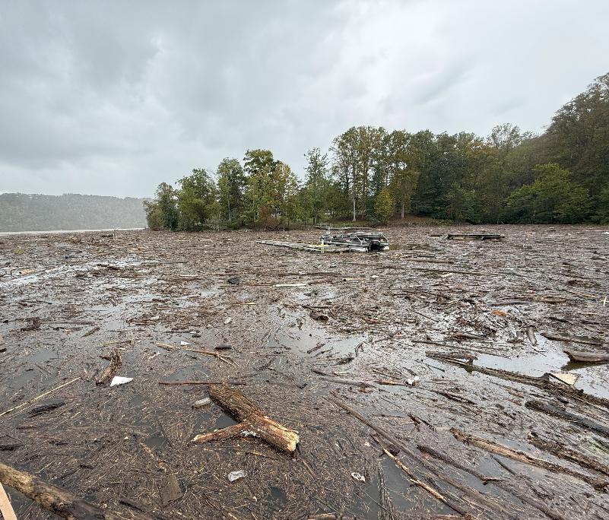

USCG Auxiliary and exclusion zones
RECREATIONAL USERS
Recreational boaters and personal watercraft entered active debris fields, attempting to salvage property from the water.
A handful of users got trapped. HazMat operations had to be suspended for rescue. Response timeline disrupted.
REQUEST: USCG SECTOR VIRGINIA
DEQ submitted a direct request to the Coast Guard. USCG Auxiliary lake unit deployed to establish and enforce exclusion zones.

Slide 13
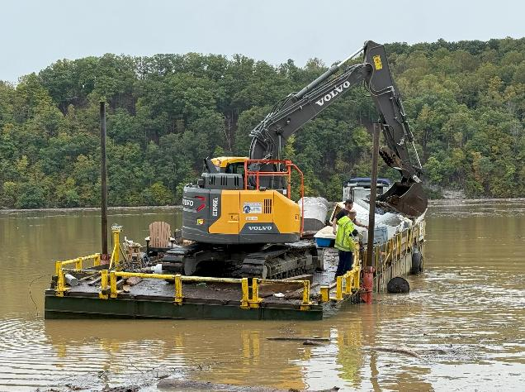
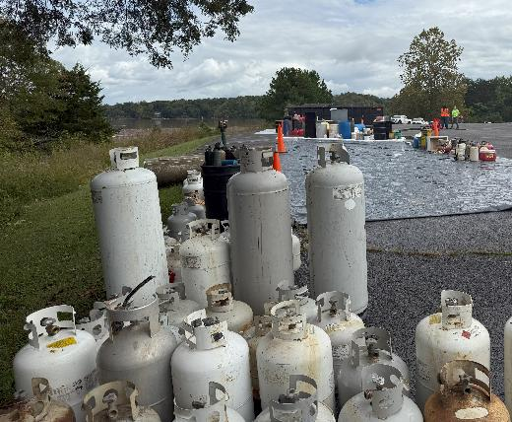
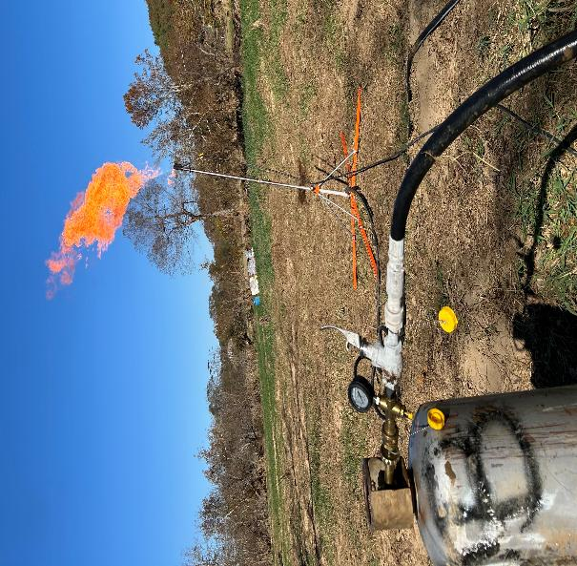
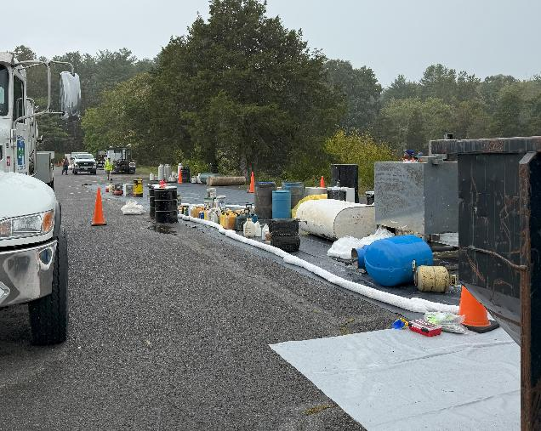
Staging and Security
STAGING AREAS
Recovered hazardous materials were staged at public access boat ramps. Materials were categorized, segregated, and packaged for transport and off-site management.
SECURITY
Materials were staged and containerized but not secured. No evidence of tampering or vandalism.
Some scrap metal removed.

Slide 14
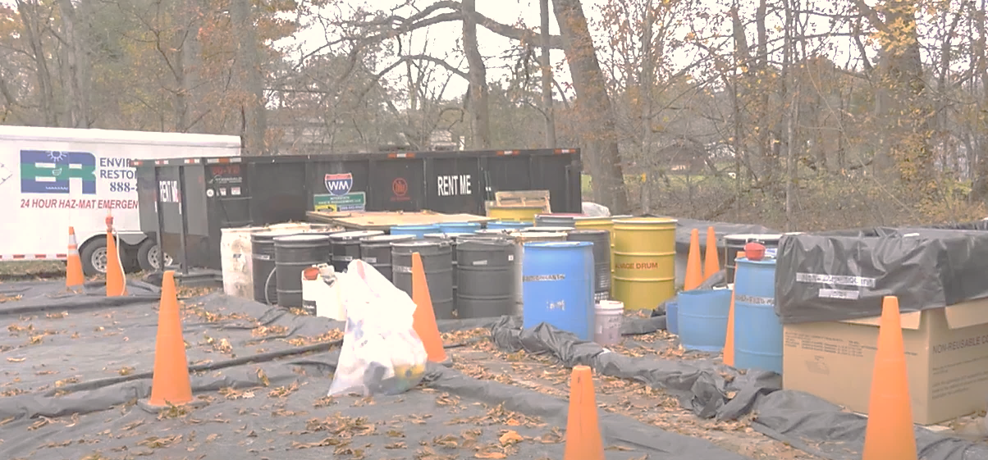
FEMA Mission Assignment: EPA
CWA/OPA AUTHORITY
Initial deployment authority limited EPA’s ability to respond non-petroleum materials.
MISSION ASSIGNMENT
The MA suspended the statutory ceiling EPA was operating under and allowed EPA to support the recovery of a broader class of materials.
EXPANDED MISSION
Oil, hazardous substances, gas cylinders and tanks, refrigerators, asbestos containing materials, household hazardous waste

Slide 15
Helene Response
RESPONSE PARTNERS
Virginia Department of Emergency Management
Virginia Department of Environmental Quality
and state-lead contractor
US Environmental Protection Agency
and emergency response contractors
September 29 – January 24, 2025
Small Containers (<55 gallons)
3,405
Small Cylinders (<20 pounds)
1,596
Drums (55 gallons)
146
COUNTIES
Response and recovery efforts were concentrated in the following counties:
Giles
Grayson
Montgomery
Pulaski
Washington
Wythe
Large Cylinders (>20 pounds)
68
Large Containers (>55 gallons)
139
Propane Tanks (20 pounds)
133
Source: EPA and DEQ

Slide 16
Emergency Support Function (ESF) 3
Wastewater Infrastructure and Debris

Slide 17
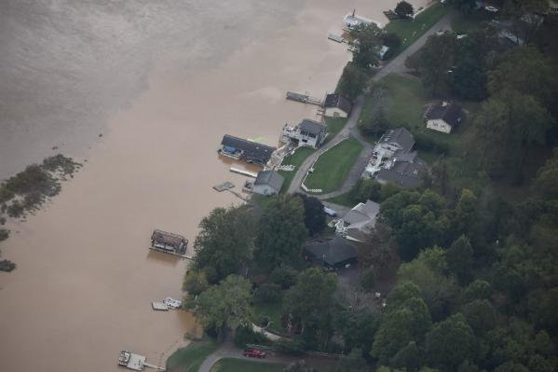
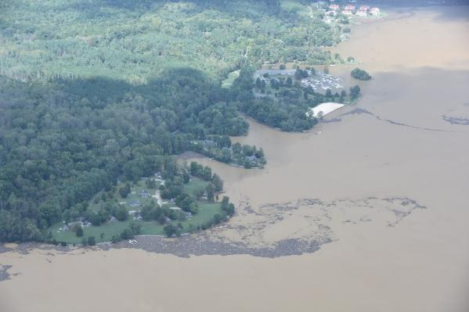
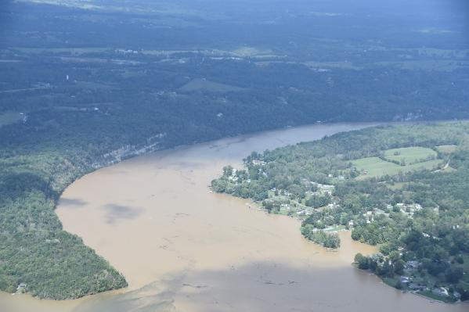
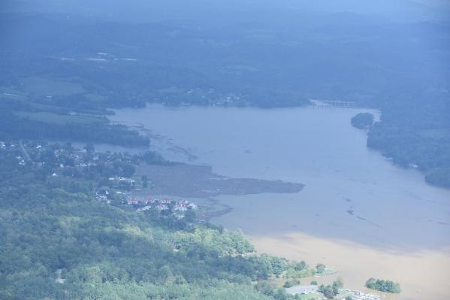
Claytor Lake Imagery – Good For Perspective
But Not For Analysis
AERIAL IMAGERY
Civil Air Patrol flies post-event missions to collect aerial images with a 35 mm camera pointed out the window.
USE CASES
Rapid situational awareness, confirmation of impacts and scale
Public communication
Resource allocation
LIMITATIONS
Produces oblique photographs; angle shifts with every image
Cannot be georeferenced, orthorectified, or overlapped

Slide 18


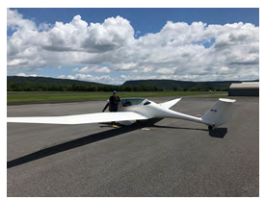
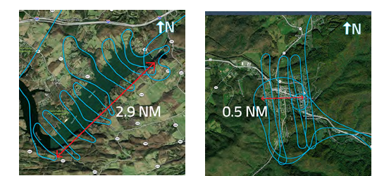
Aerial Images of Claytor Lake and Damascus
Engaged Virginia Tech’s Uncrewed Systems Lab to assist with the collection of high-definition imagery that can be used for data analysis
Phoenix U-15 Motorglider
Flight path in Claytor Lake
Flight path in Damascus

Slide 19
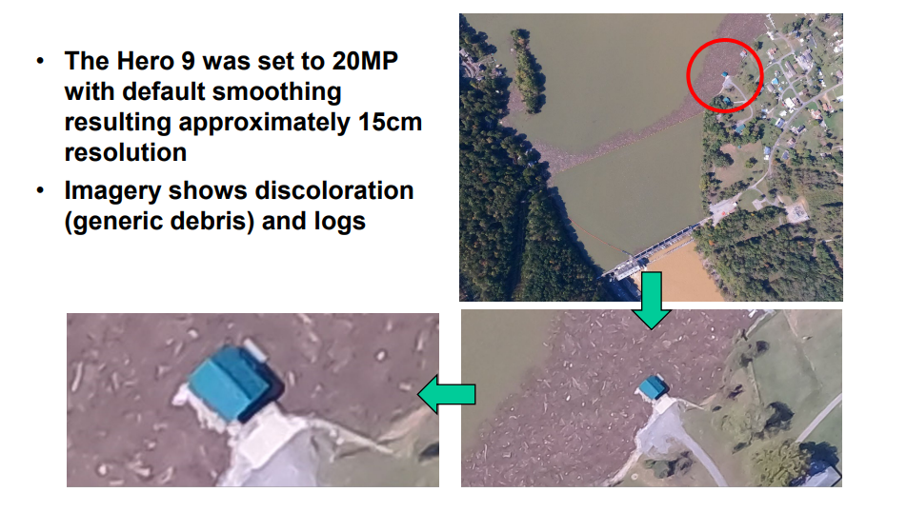
Claytor Lake Imagery Used For Analysis

Slide 20
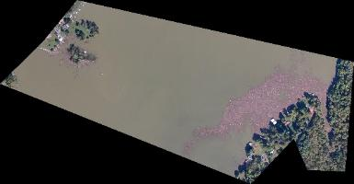
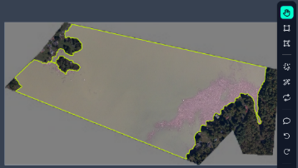
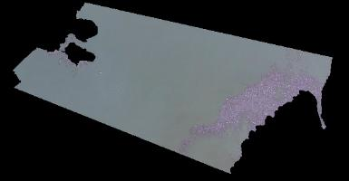
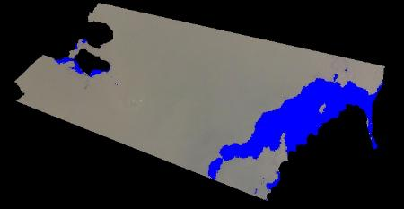
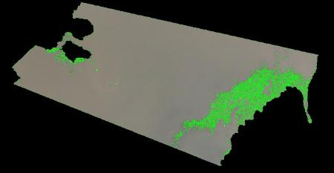
Debris Detection in Claytor Lake
Segmentation of Lake and Land in Roboflow (Machine learning-based tool)
Section of Lake
Segmentation in Roboflow
Extracted Lake
Debris Detection
Color thresholding
Edge Detection

Slide 21
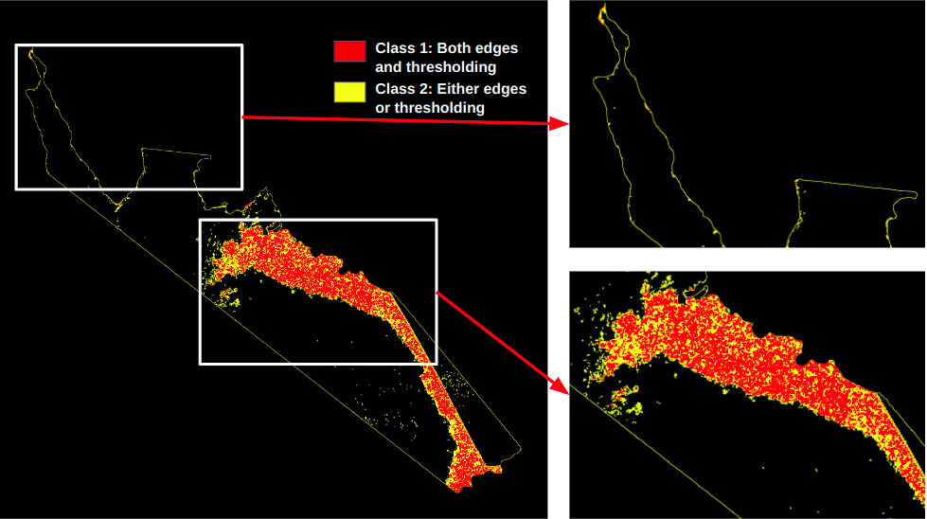
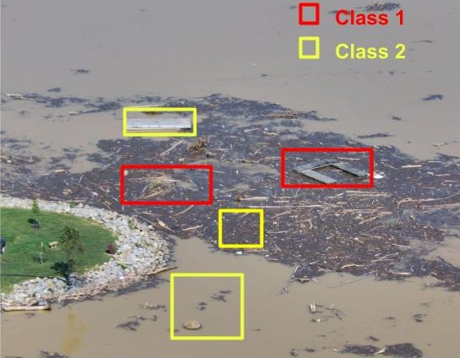
Debris Classification & Area Estimation
OUTPUT
Estimation of area of debris in acres. Estimation validated with solid waste tipping receipts.
Attempted to estimate different debris depth classifications (logs and mulch) to derive an estimated volume (cubic yards) of debris. More challenging.

Slide 22
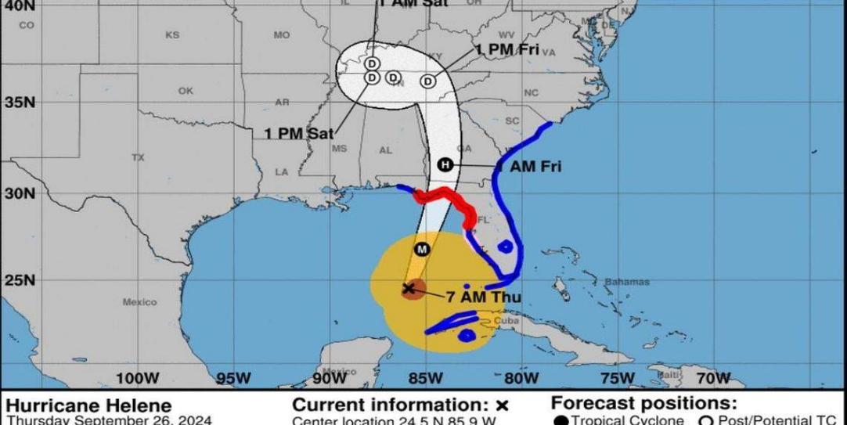

Tropical Storm Helene
4831DR-VA-COE-NAD-03 response brief

Slide 23
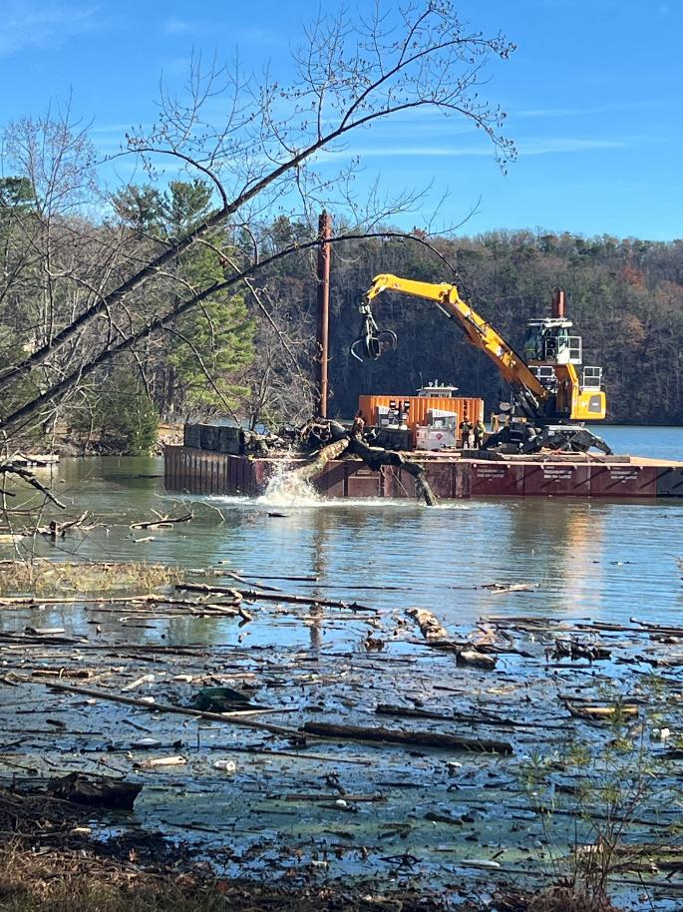

CLAYTOR LAKE DEBRIS REMOVAL (4831DR-VA-COE-NAD-03)
EPA | Coordination with EPA started early in our mission. EPA had already initiated HHW and white goods disposal operations at Claytor Lake and continued concurrently with USACE operations. Any HHW removed by our contractor was transferred to EPA’s temporary holding cell for processing.
Mission Strengths | Strong State/Federal partnership FEMA, USACE, EPA, USCG, DEQ, DCR, FOCL 0 Injuries Contractor capability (Maui wildfire experience) Quick DEQ permitting to increase landfill daily capacity
Mission Issues | Recreational boating activity created significant safety risks for operations on the lake Stranded debris on private property was a concern KTR removed debris under and around docks and disposed, but left debris firmly on private property Non-standard PSMAs (water borne debris) Denominator, denominator, denominator (& reporting) Meandering debris with no boom

Slide 24
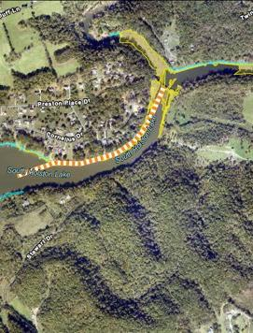
SOUTH HOLSTON DEBRIS REMOVAL
TVA | TVA manages the South Holston Lake/Reservoir primarily for hydroelectric power generation but also has missions to include flood risk management, low-flow augmentation, aquatic habitat management, and recreation.
Strengths | ESF3 Team and Debris TF COA development and planning flexibility Strong support for operations from local interests Strong support from the Commonwealth
Issues | Fluctuations in water level complicated scope of FEMA MA PPDR vs ROW vs Public Assistance & MA type TVA was not concerned with debris in area used as reservoir Sec 106 consultation & approval. Mixed debris from unrelated events (Helene vs. winter storms) Stranded debris on private property was a concern Addressed by COV efforts, homeowners to move debris to ROW and COV KTR removed and disposed

Slide 25
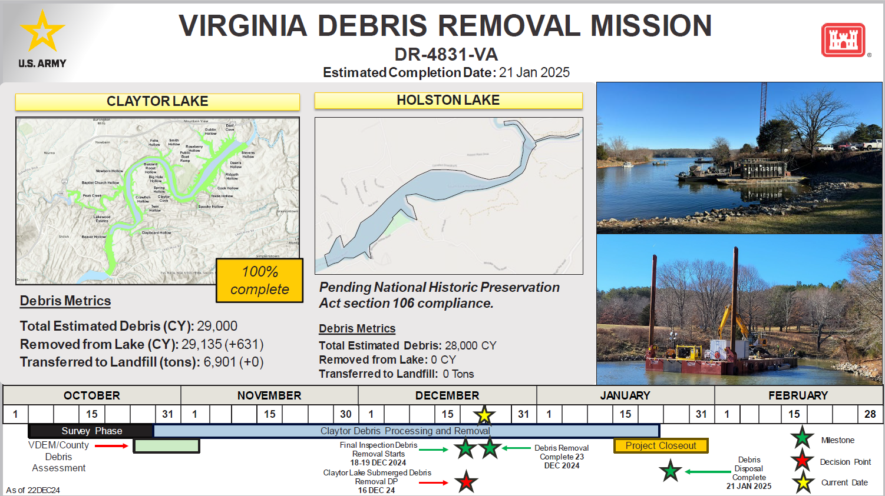

Slide 26
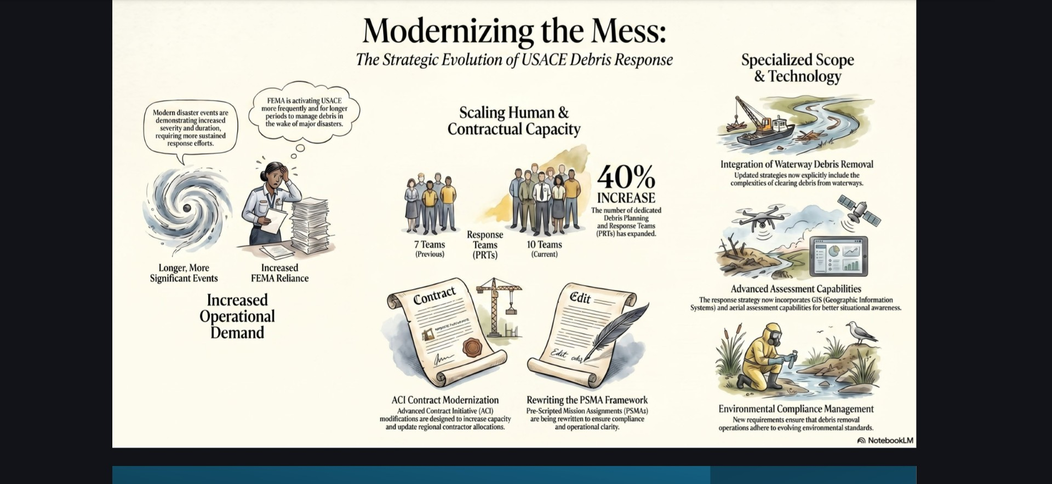

Slide 27
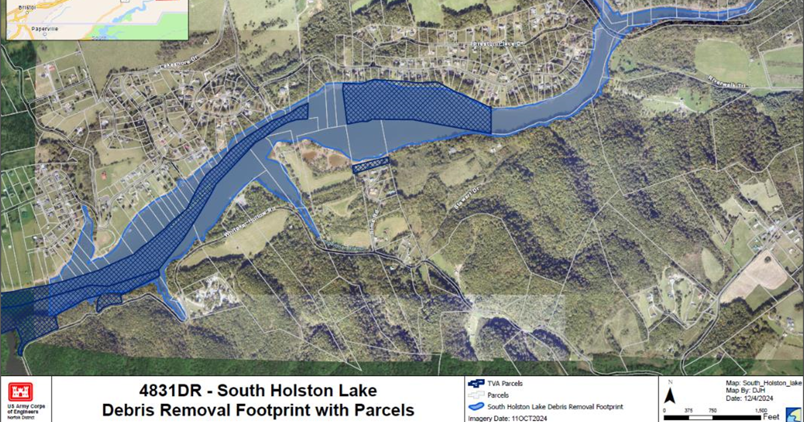

Slide 28


ESF 3 – Public Works & Engineering
DEQ’s role is to provide SITUATIONAL AWARENESS and SUPPORT for wastewater treatment plants and solid waste management facilities and to connect facilities with available resources for the restoration of public works systems.
800+
300+
Wastewater Treatment
Plants (WWTPs)
Solid Waste Management
Facilities (SWMFs)

Slide 29
WWTP and SWMF damage assessment
THE TOOLS WE HAVE
WHAT THE SURVEYS DON'T DO
Under our ESF3 role, DEQ deploys pre-storm surveys to wastewater treatment plants and solid waste management facilities.
Capture detailed damage assessments or cost of temporary vs. permanent repairs.
WHAT THE SURVEYS DO WELL
WHAT FILLED THE GAP
Catch high-level infrastructure, service, and operational issues fast.
Extensive one-on-one outreach with affected facilities. Resource-intensive, but the only way to get damage detail.
EMERGING: EPA REGION 3 ENGAGEMENT
EPA Region 3's ESF 3 branch is now engaged on WWTP damage tracking. A recent R3 water/wastewater workshop focused on state–federal information sharing and capturing improvements.

Slide 30



Institutional, Legal, and Other Surprises
Who owns the debris in a hydropower lake?
Who authorizes HazMat cleanup on private flooded property?
Who pays when a landfill loses airspace to storm debris?
Lakes built for hydroelectric generation have complex property, license, and easement structures. The Commonwealth had to obtain an Attorney General opinion establishing state authority to remove debris from state waters.
EPA could remove storm-related HazMat from private parcels but needed identified property owners and written access permission. Property identification was time-consuming; VDEM and DEQ assisted.
USACE field estimates were what got shared with facility operators for planning. SWMFs are not eligible for FEMA PA reimbursement for airspace consumed by storm debris. Fortunately, Helene, debris volumes recovered came in under initial estimates.

Slide 31
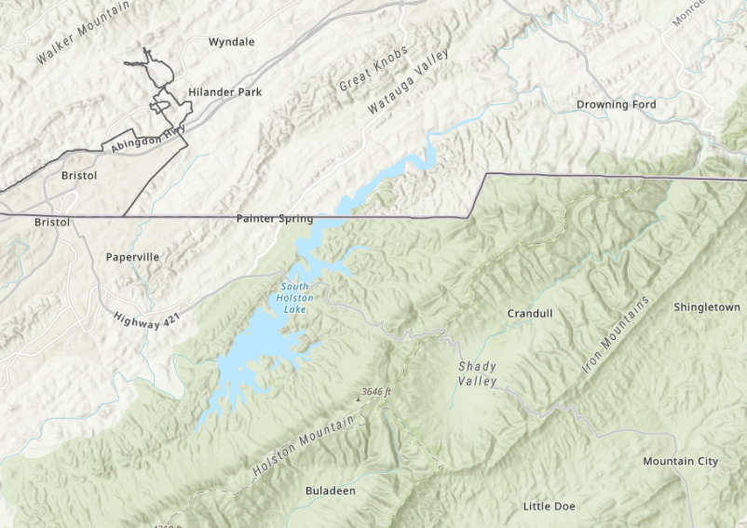

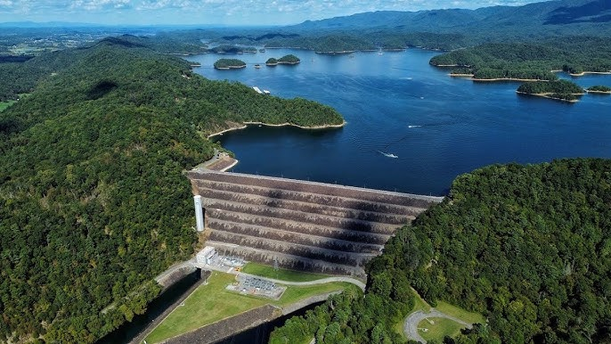
Interstate Debris
VIRGINIA
South Holston Lake straddles VA & TN
TENNESSEE
Debris originated in Virginia waters. Wind distributed material across the state line into Tennessee.
DIFFERENT FEMA REGIONS
VIRGINIA
FEMA Region 3
TENNESSEE
FEMA Region 4
Interstate debris coordination requires working across two state governments and two regional federal structures.

Slide 32
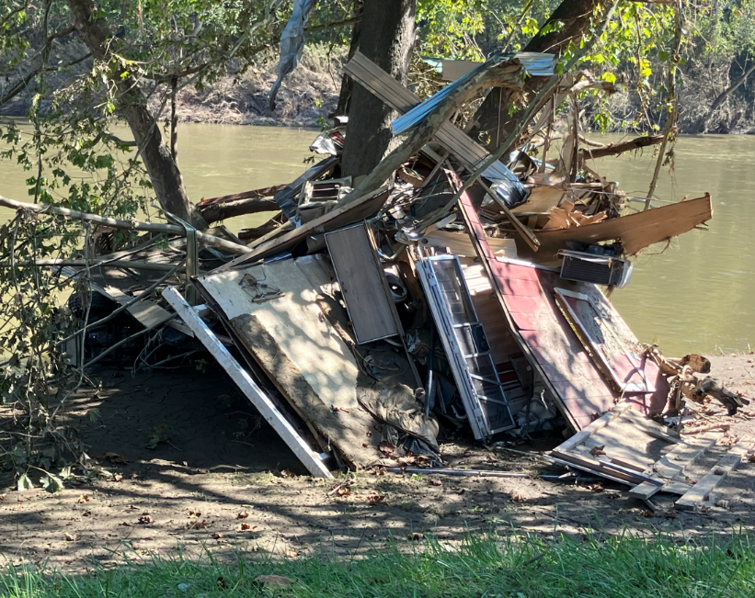

Debris Task Force
COV Debris Task Force
Co-chaired by VDEM and DEQ. Activated during Helene. First activation in decades for a debris event of this scale.
WHAT IT FACILITATED
Multi-agency and contractor coordination
River and waterway access
Habitat protection and wildlife impact mitigation
EMERGING:Updated Debris Appendix to the COV Recovery Annex. VDEM-facilitated work group, currently in final draft.

Slide 33

What Went Well
The response worked because of things that are easy to underestimate
Federal partner coordination
Mission Assignment template worked — fast
Virginia Tech proved under real conditions
VDEM, DEQ, EPA, USCG, USACE, and FEMA moved quickly and stayed aligned. Long-standing relationships paid off.
Several days from scope-gap recognition to EPA operating under expanded authority.
Aerial imagery and LiDAR delivered information the state didn't previously have.
Debris Task Force framework held
AG opinion resolved hydropower question
EPA Region 3 leaning in on WWTP support
First waterway-debris activation in decades. The institutional framework was sound.
A governance issue that could have delayed debris removal was resolved in time to proceed.
An emerging partnership on ESF 3 water and wastewater is forming out of post-Helene engagement.

Slide 34
The Gaps We're Closing
What Helene exposed about Virginia's current capabilities and what we are building to address each gap.
01
No Dedicated Aircraft
Fixed-wing light-sport aircraft equipped with HD imaging and LiDAR sensors, capable of the low, slow flight post-disaster assessment requires.
Virginia relies on Civil Air Patrol Cessna aircraft that cannot fly low or slow enough for high-definition imagery — and have zero LiDAR capability.
▶
02
No Analytical Pipeline
Machine learning debris classification, orthomosaic generation, and HEC-RAS flood modeling workflows integrated with DEQ field operations.
Even when imagery is collected, no systematic process exists to analyze it and translate results into recovery priorities, debris estimates, or flood risk information.
▶
03
No Standing Partnership
Formalizing Commonwealth – Virginia Tech partnership with a dedicated damage assessment team, licensed pilots, and on-call analytical capacity.
The Virginia Tech collaboration during Helene was ad hoc. There is no formal agreement, standing team, or guaranteed capability for future events.
▶

Slide 35
ARA Grant Awarded: Building the Capability
Virginia DEQ has been awarded a $13.5 million EPA State and Tribal Assistance Grant (STAG) under the American Relief Act 2025, addressing unmet needs from Tropical Storm Helene. Funds not yet deployed.
$13.5M
$10.1M
Debris Removal
Removal of debris ineligible for FEMA PA from 37 declared localities
$1.4M
Debris Mgmt Planning
Total Grant
Award
Debris management plans for 9 PDCs and their localities
Included
Tabletop Exercises
HSEEP-compliant TTXs to validate debris plans across affected regions
$800K
Aerial Imagery & LiDAR
Fixed-wing aircraft + LiDAR payload. Formal DEQ–Virginia Tech partnership
$871K
Response Equipment Cache
3 HazMat response equipment caches for rapid deployment
FY2026–FY2028 · DEQ as primary grantee · Sub-grants to localities, PDCs, VDEM & Virginia Tech

