Slide 1
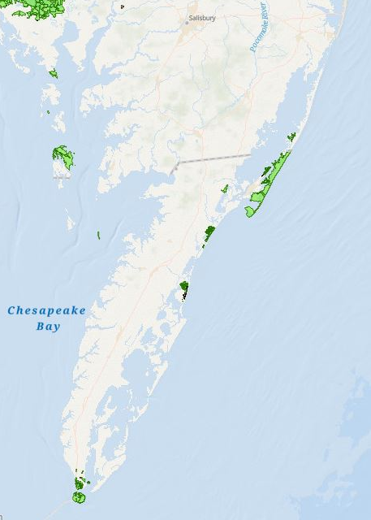



Virginia
Welcome to
Chincoteague
National Wildlife Refuge Complex!
Region III Area Committee Meeting
May 6, 2026
Chincoteague NWR &
Wallops Island NWR
Eastern Shore of Virginia NWR &
Fisherman Island NWR

Slide 2
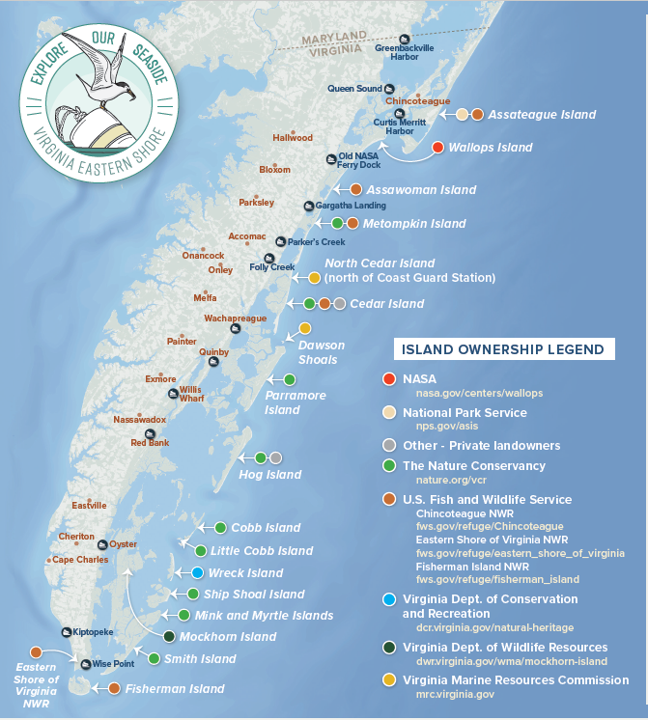






“…partners share a common goal of protecting natural resources, while balancing sustainable recreation and economic use of the seaside.”

Slide 3
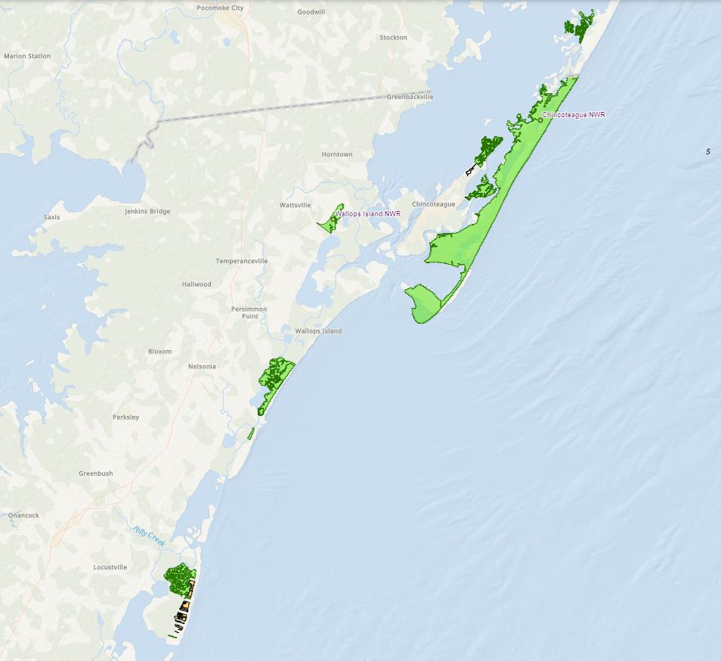
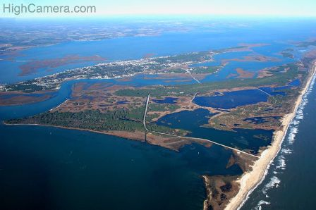
Chincoteague & Wallops Island NWRs
Accomack County, Virginia and
Worcester County, MD
Wildcat Marsh Unit
CNWR = 14,032 ac
WINWR = 373 ac
Morris Island Unit
Assateague Island Unit
Wallops Island NWR
Assawoman Island Unit
Metompkin Island Unit
Cedar Island Unit
Highcamera.com

Slide 4
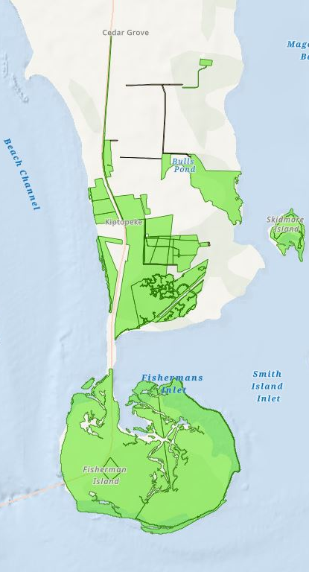
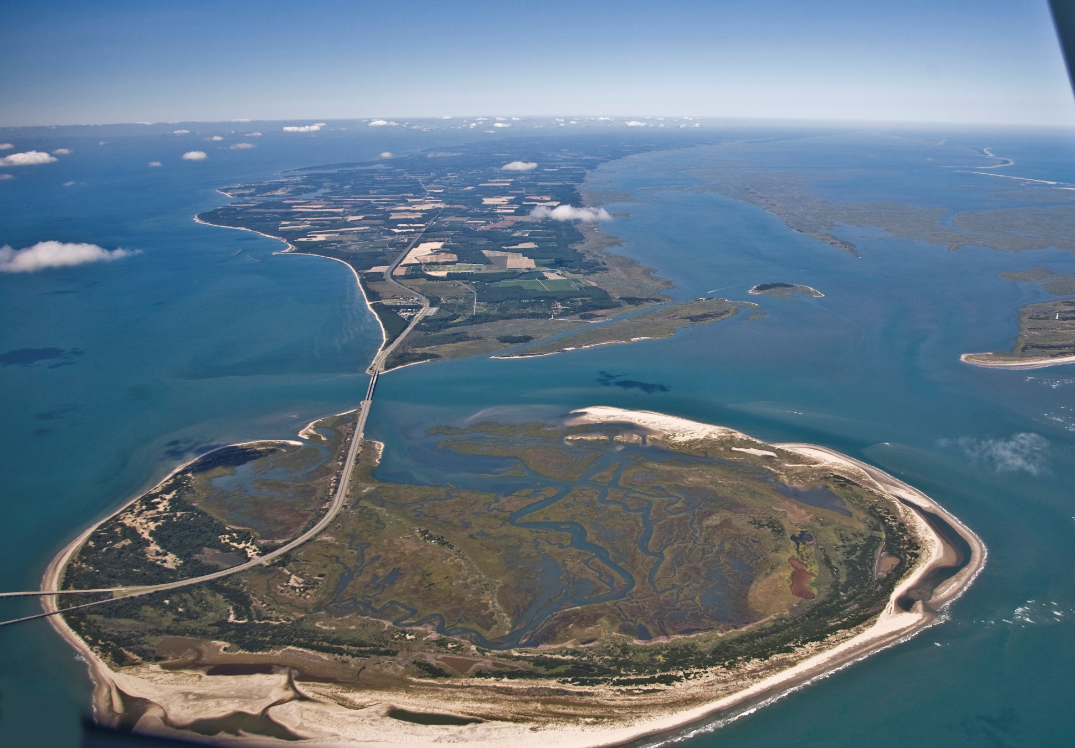
Eastern Shore of Virginia & Fisherman Island NWRs
Northampton County, Virginia

Slide 5
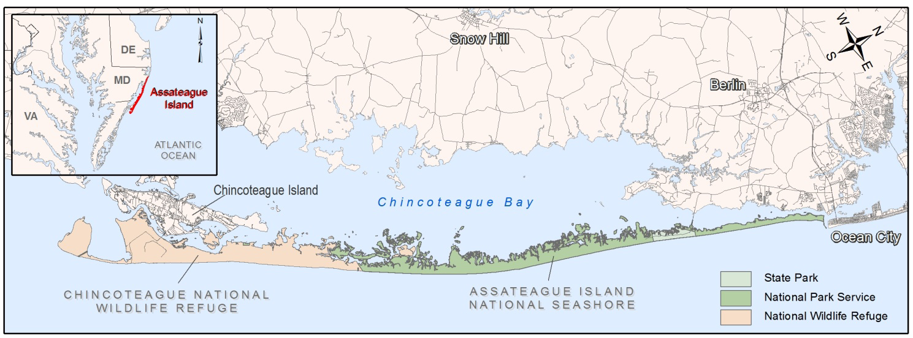


Chincoteague NWR and Assateague Island National Seashore
Chincoteague National Wildlife Refuge, USFWS (1943) - 9,021 ac
Assateague State Park, MDNR (1956) - 630 ac
Assateague Island National Seashore, NPS (1965) - 8,983 ac on Assateague and Mainland & ~22,393 ac Ocean/Bay

Slide 6
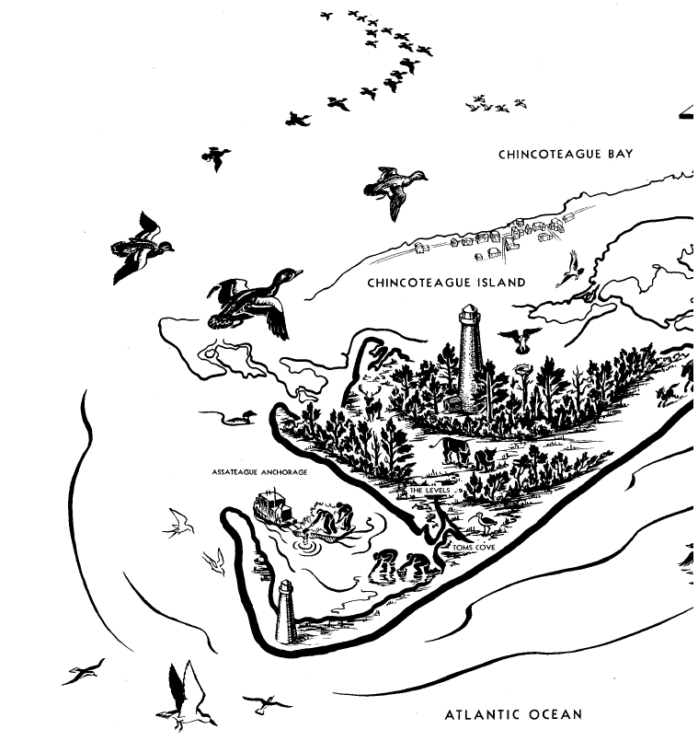


Chincoteague National Wildlife Refuge
“If we are to preserve the remaining waterfowl, and the sports and recreation which depend on them, we must set apart for the birds, refuges like Chincoteague, where they may find these simple and necessary creature requirements: food, rest, security.”
- Rachel Carson (1947)

Slide 7
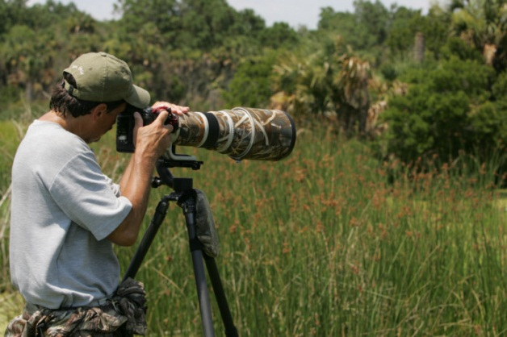
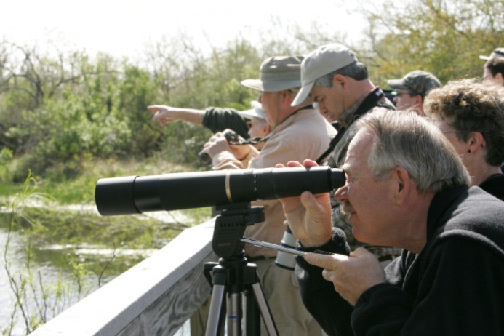
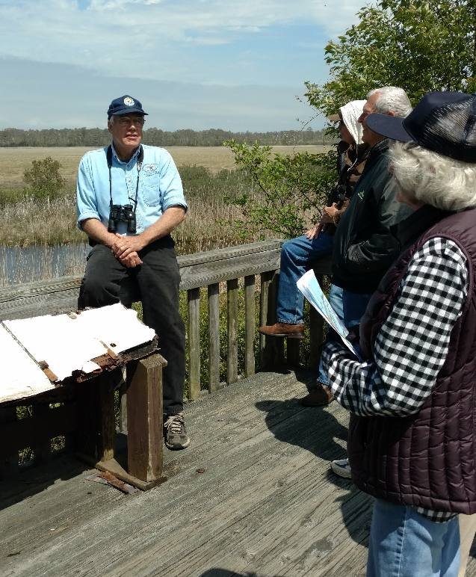
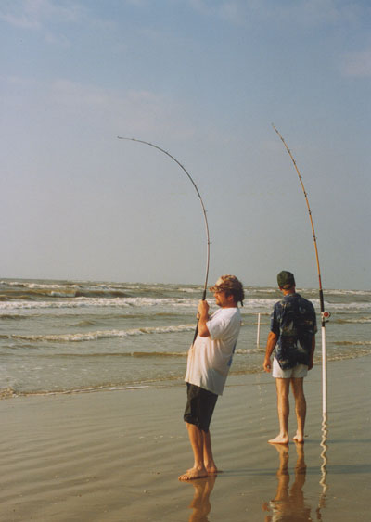

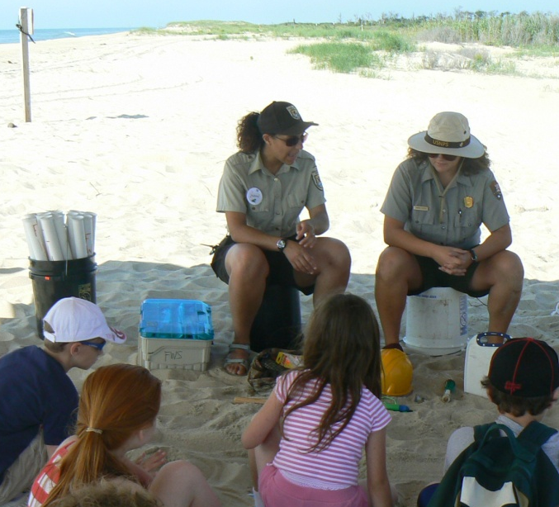
Wildlife-dependent recreational uses
Hunting
Fishing
Wildlife Observation
Photography
Environmental Education
Interpretation

Slide 8
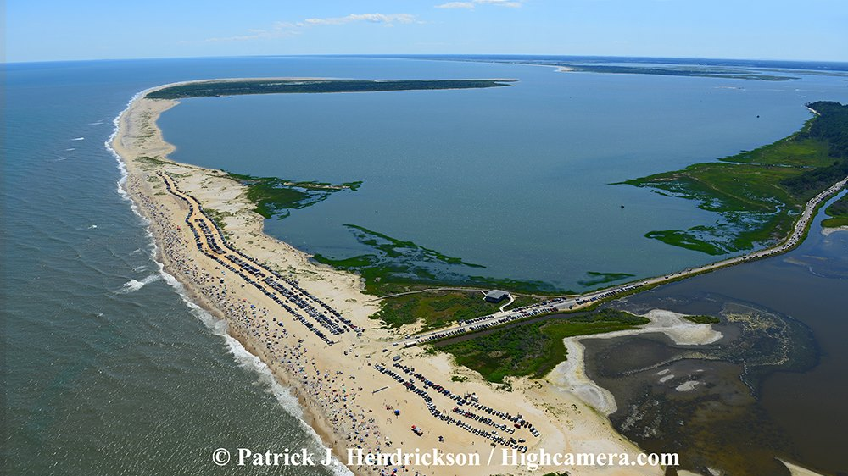
“Assigned Area” for Recreational Beach

Slide 9
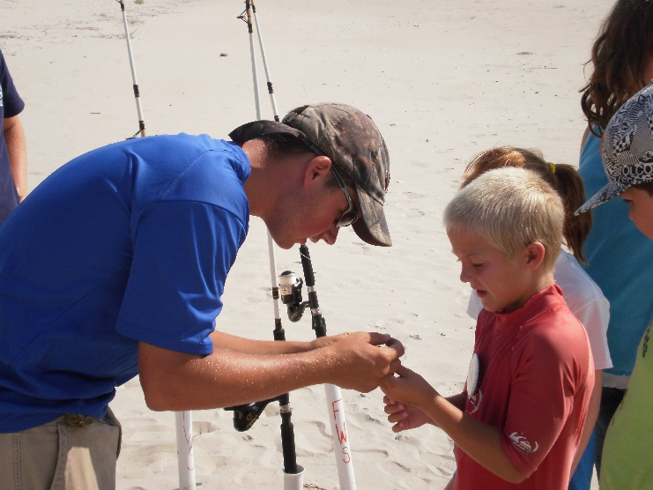

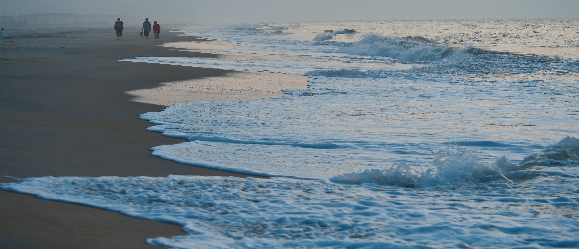
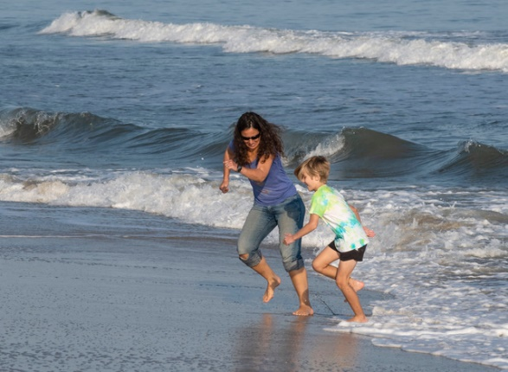
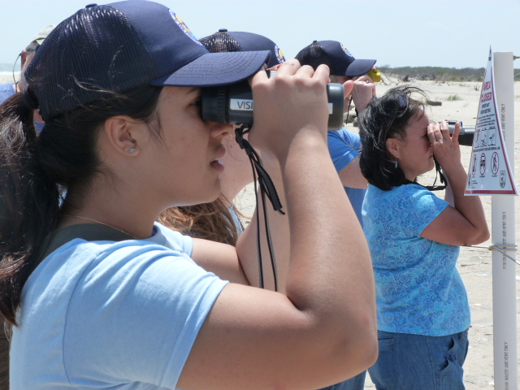
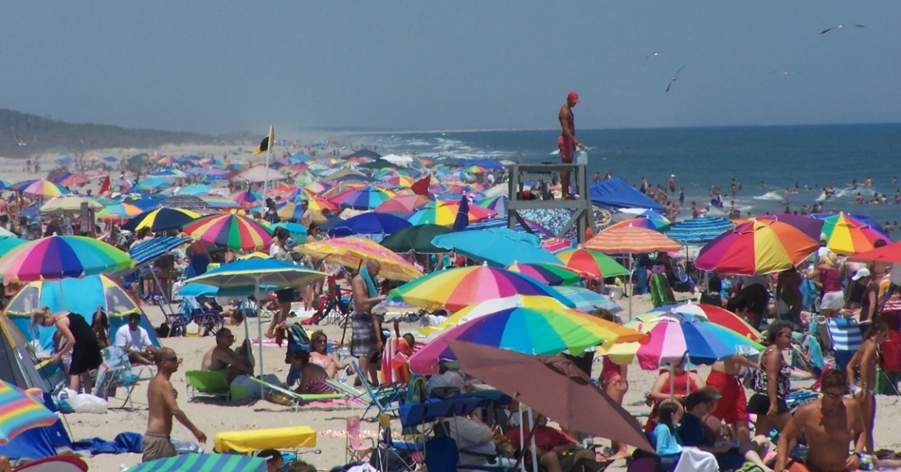
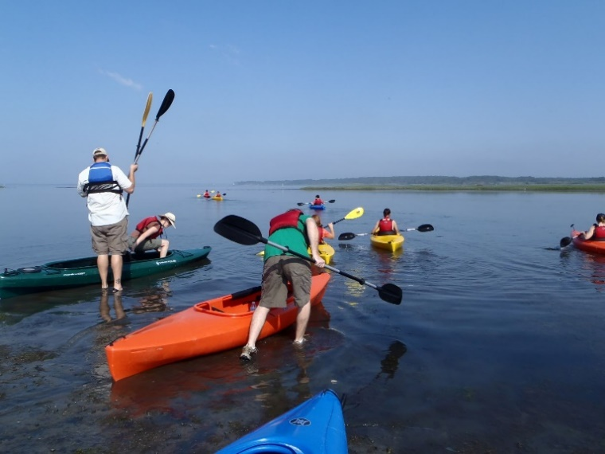
Recreational Beach
Annual Visitation Averages 1.4 Million

Slide 10
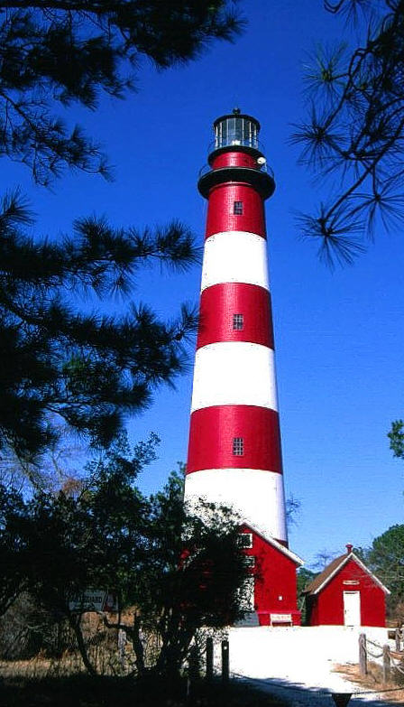

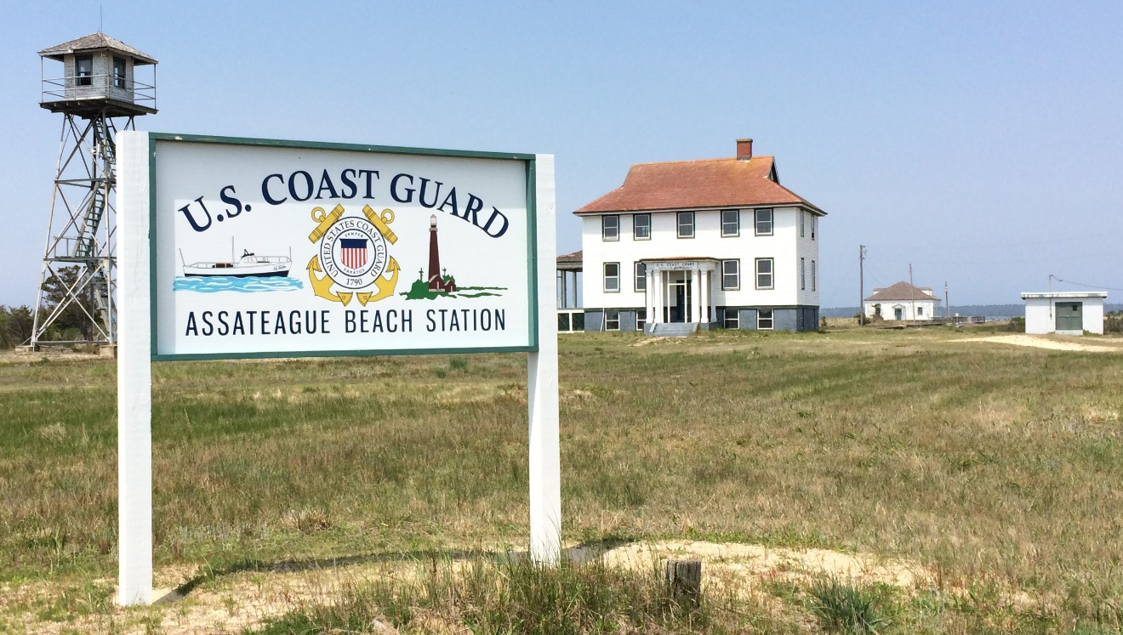
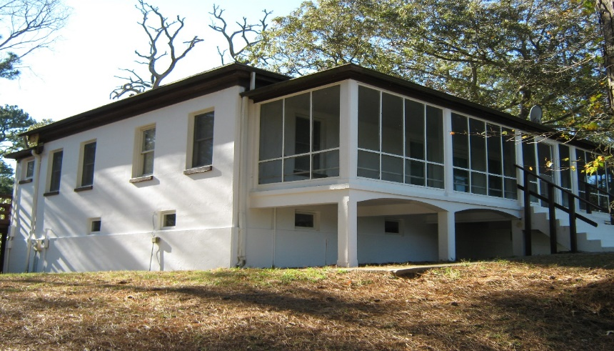
Cultural Resources
Assateague Lighthouse
Assateague Village
U.S. Coast Guard
Life Saving Station

Slide 11
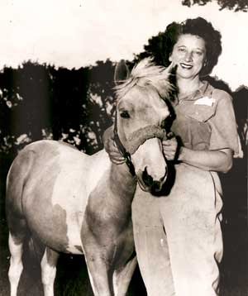
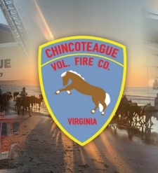


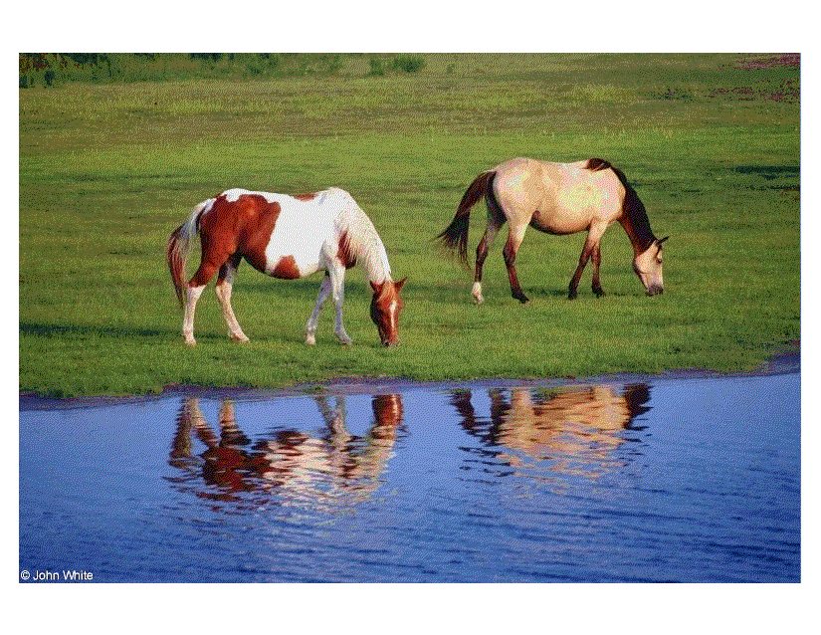
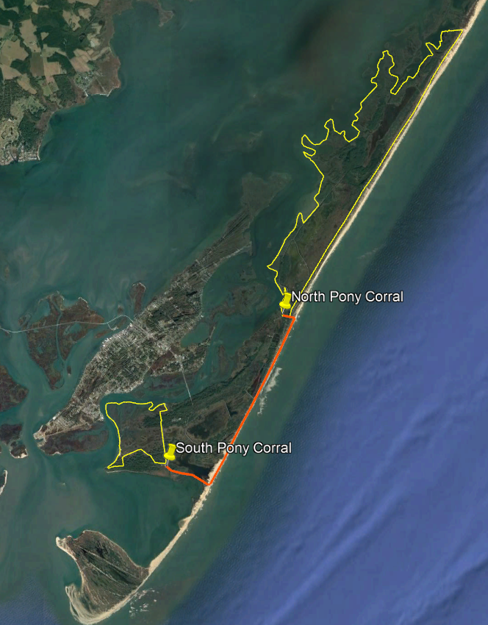
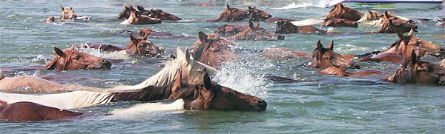

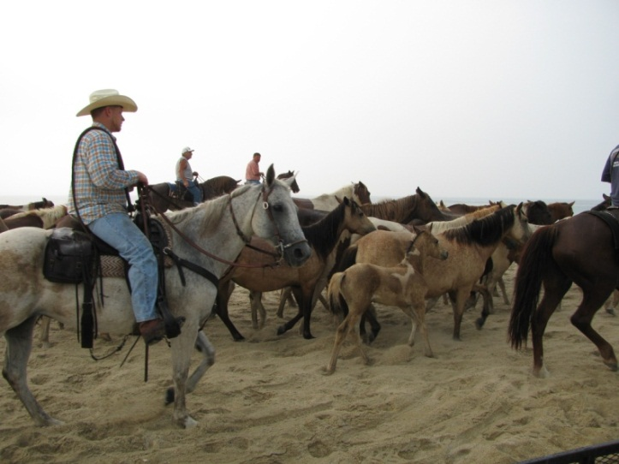
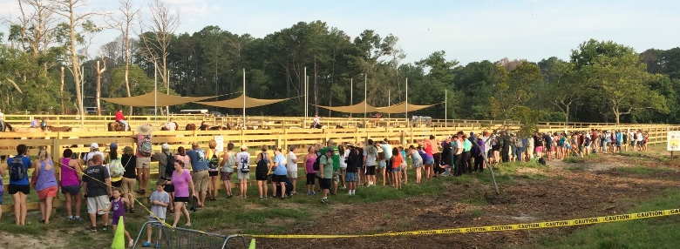
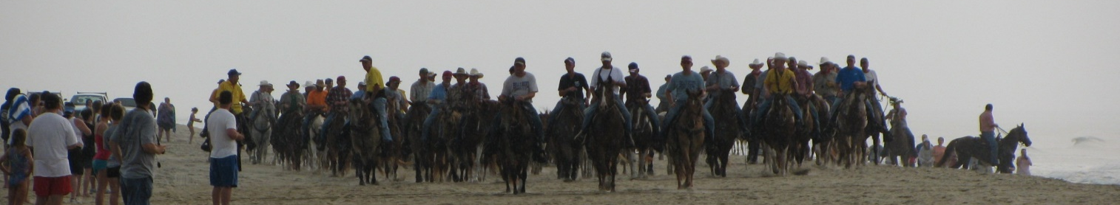
Chincoteague Ponies

Slide 12
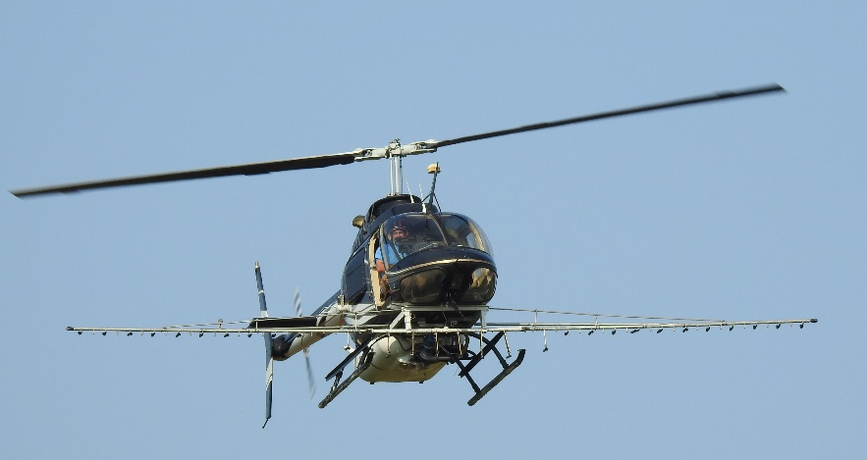
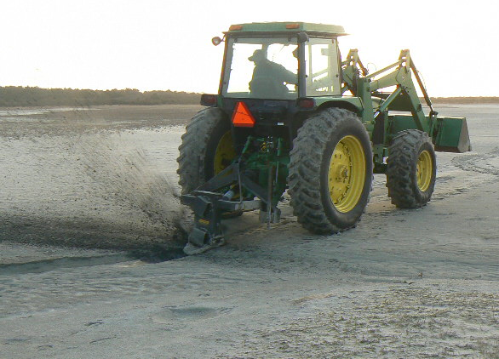
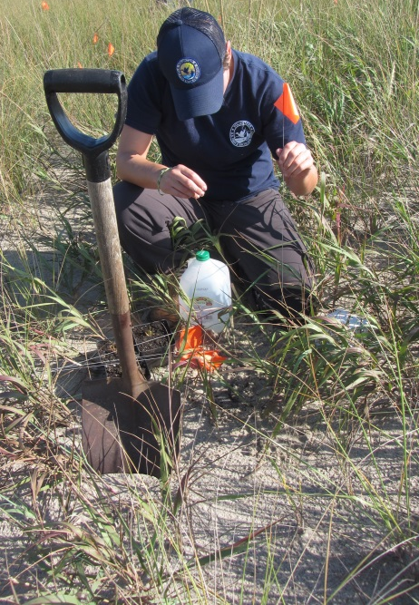
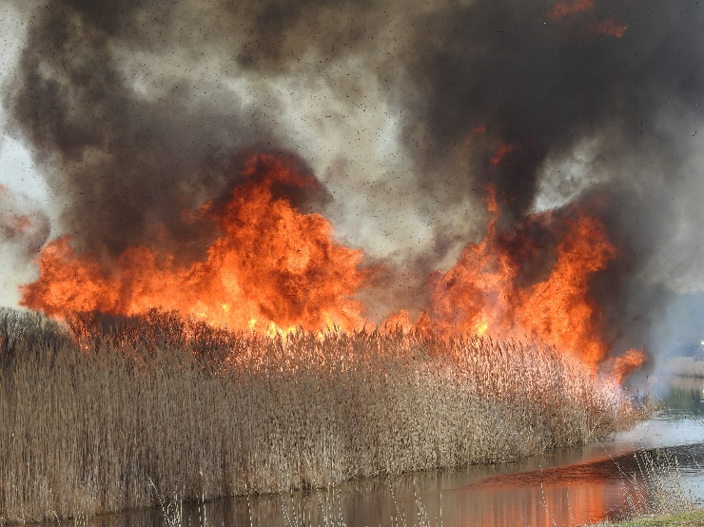
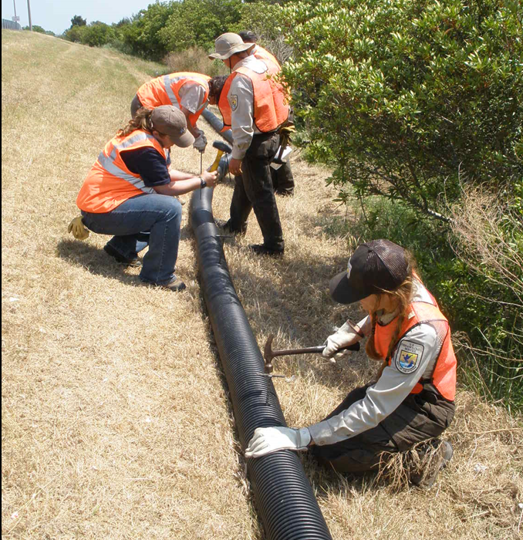
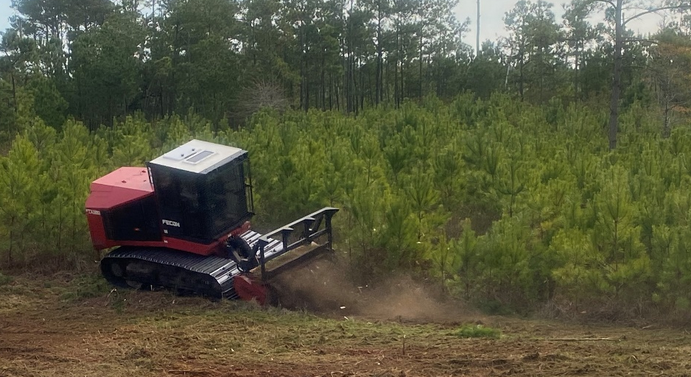
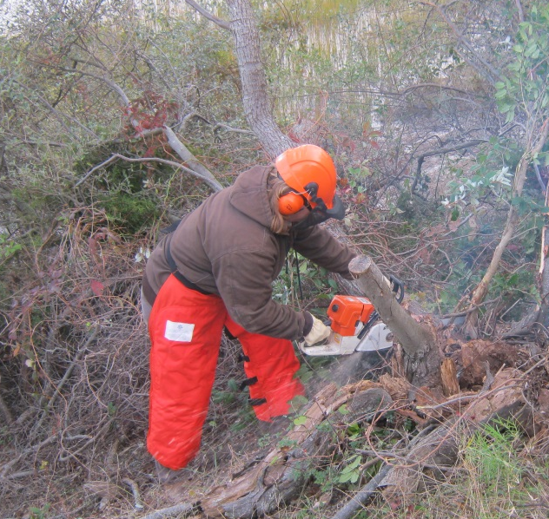
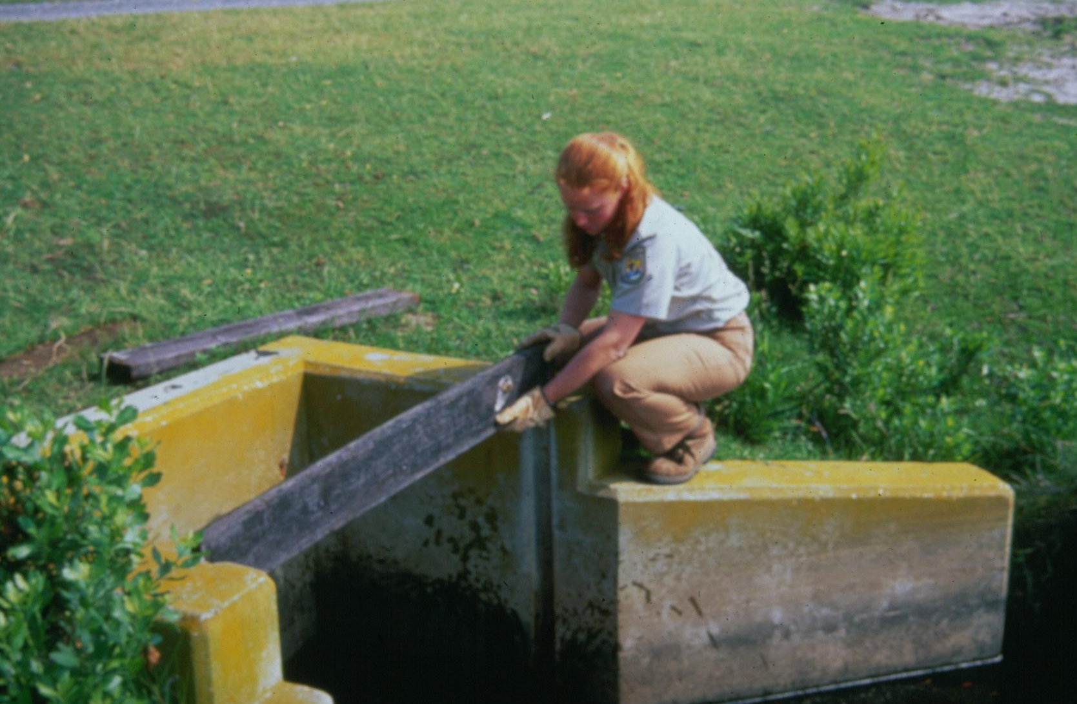
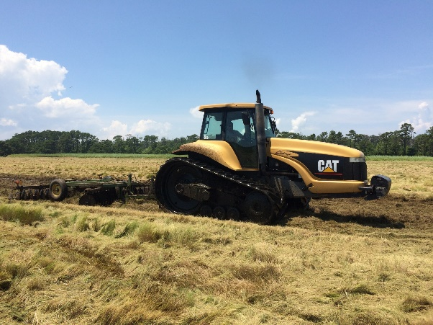
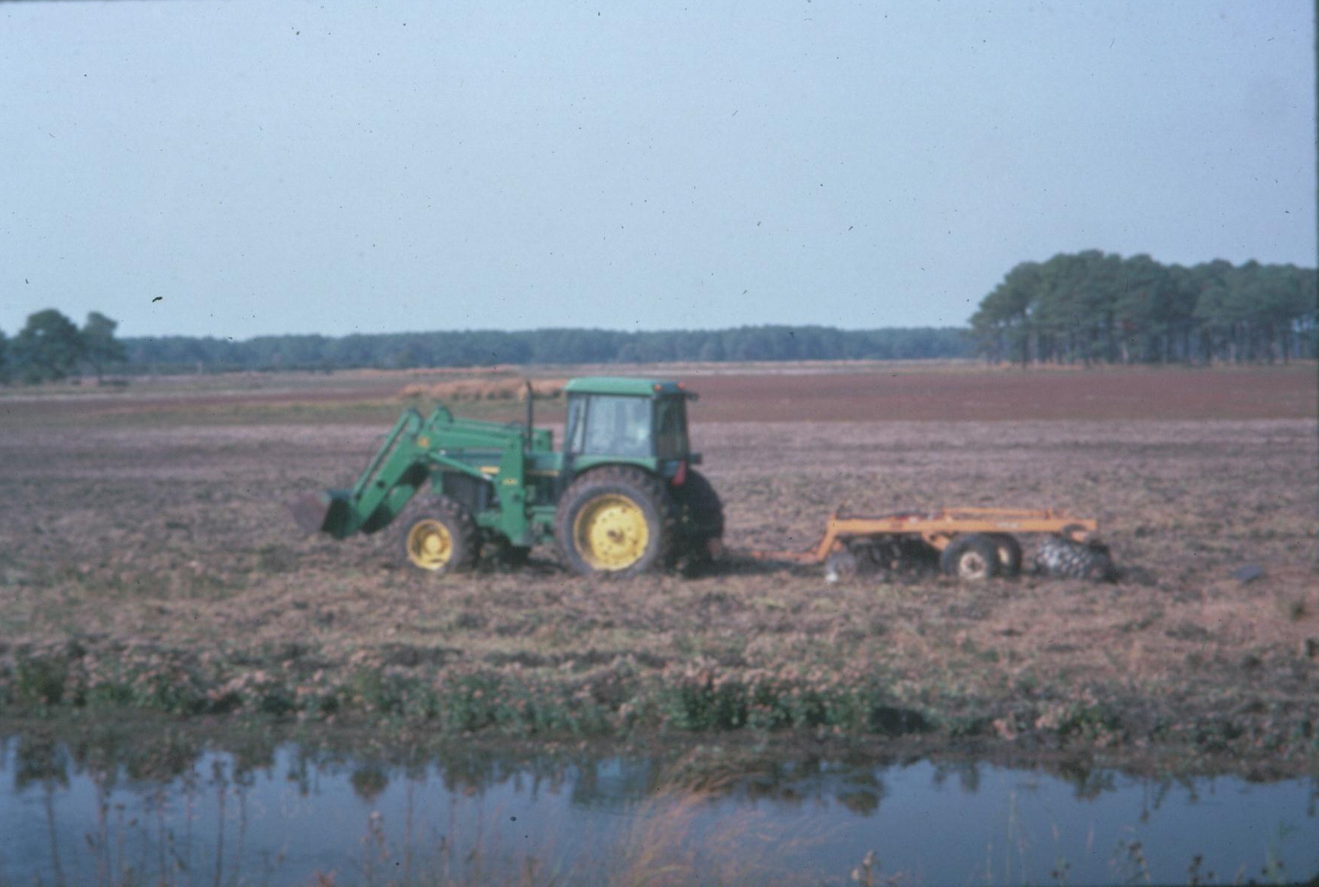
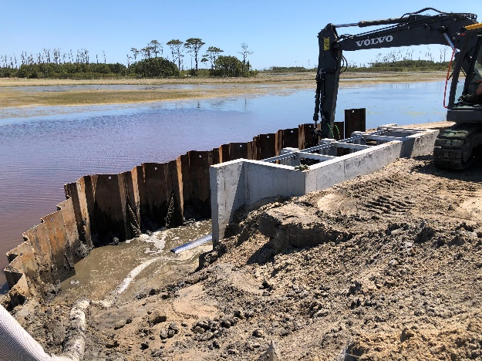
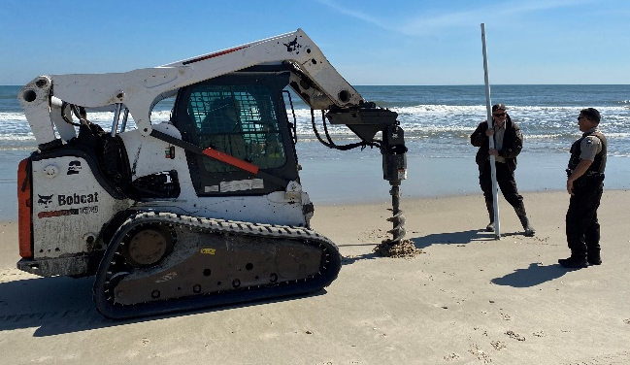
Refuge Management Actions

Slide 13
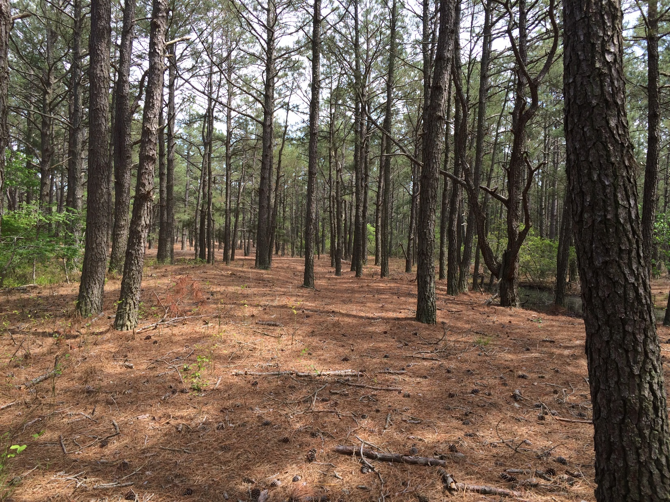
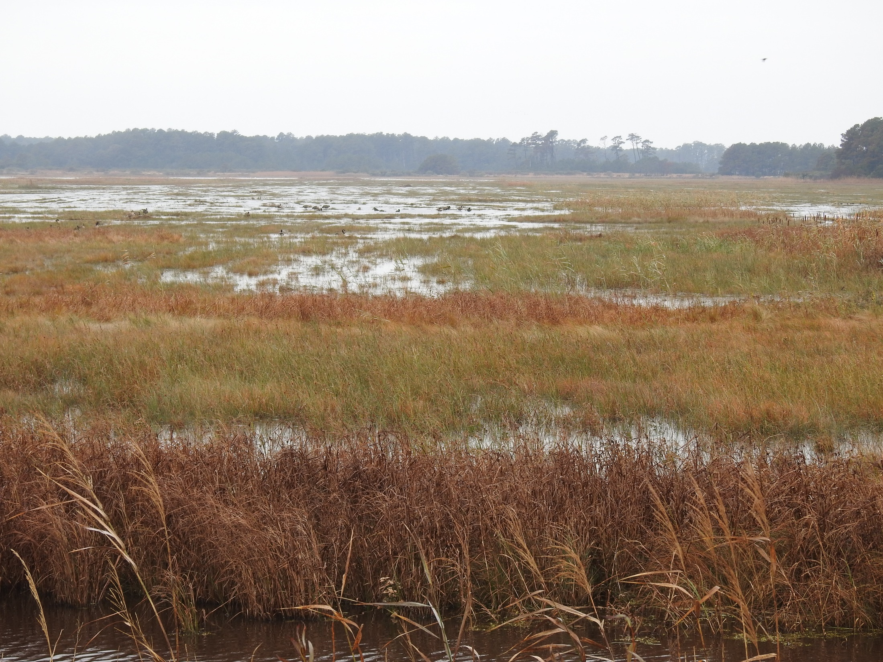
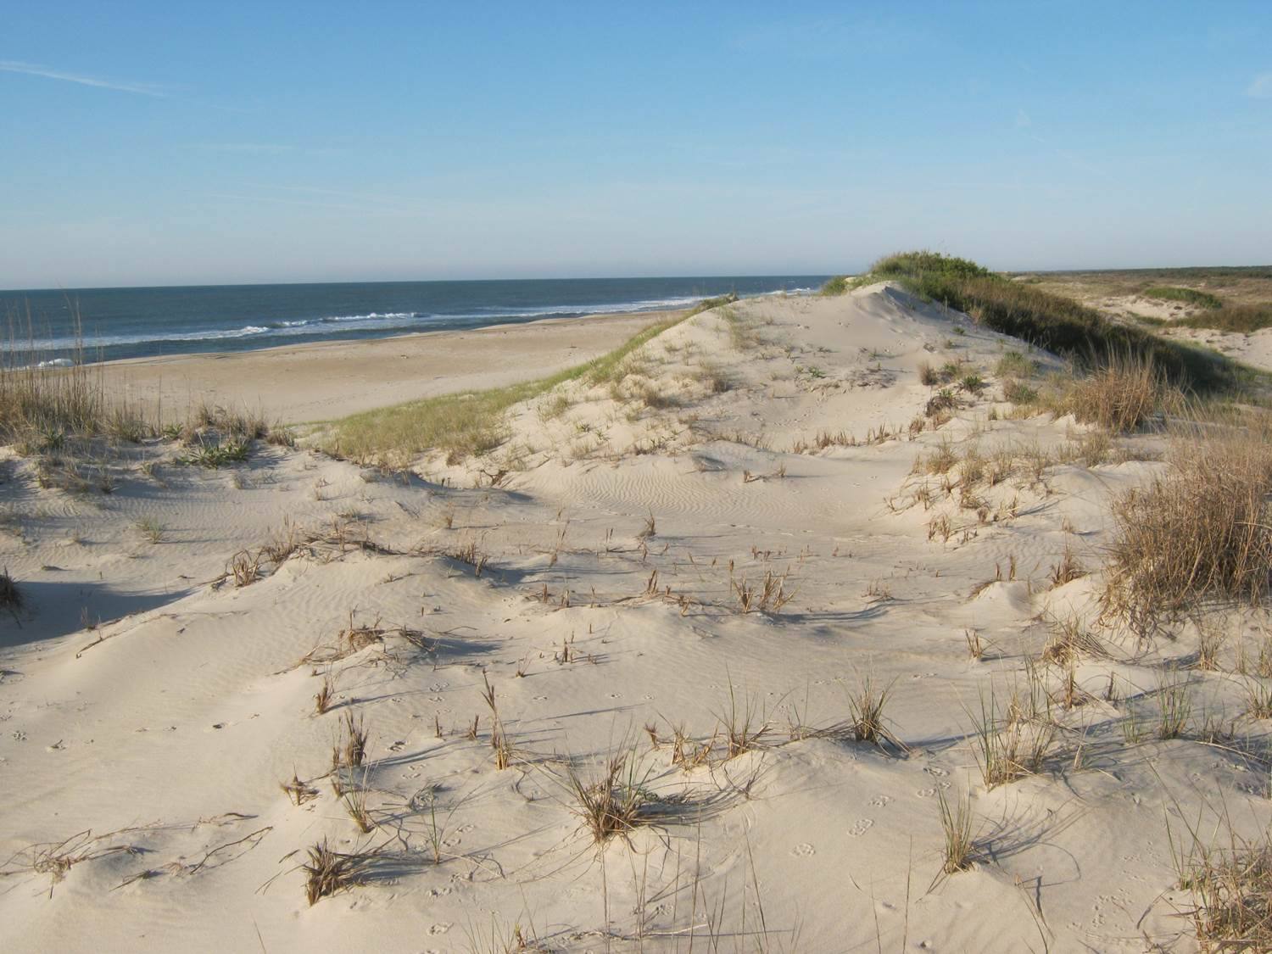
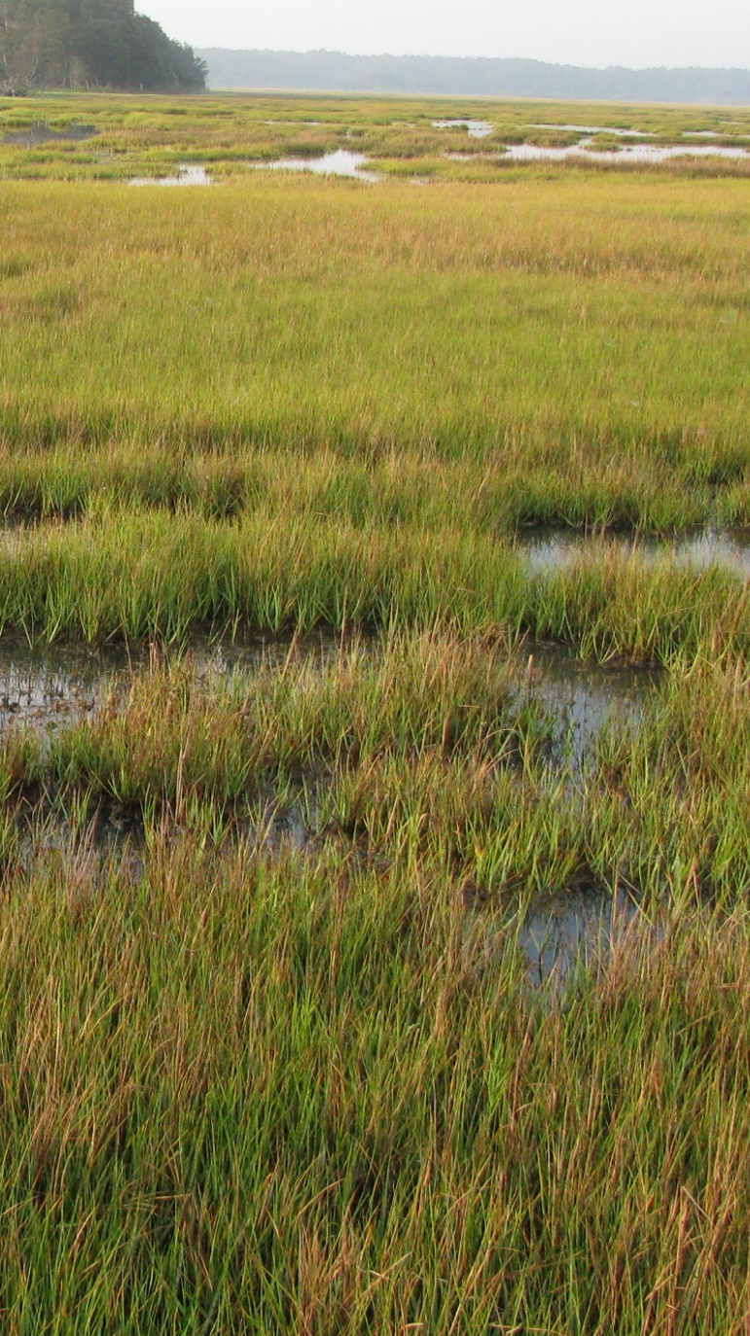
Habitats of Chincoteague NWR

Slide 14


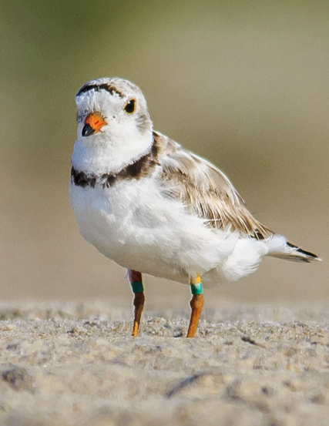
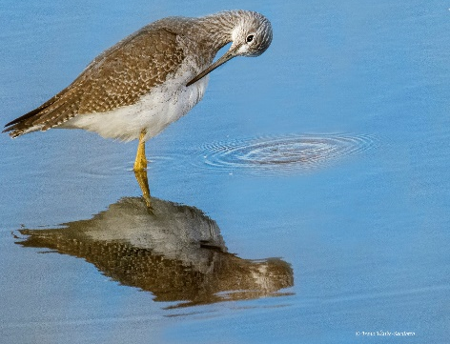
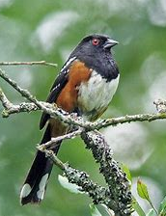






Inventory & Monitoring – CNWR
M. Hartley/FWS
ACJV

Slide 15






Slide 16


Slide 17




Beach Profile & Jurisdiction on Assateague Island
MEAN LOW WATER
Modified: FWS
Credit: Neil McCoy, courtesy of Explore Our Seaside

Slide 18

Hook
3.5 miles (~5.6 KM)
(seasonal closures)
Overwash
1.5 miles (~2.4 KM)
(seasonal closures)
Public Beach
3 miles (~4.8 KM)
Patrick J. Hendrickson/ Highcamera.com

Slide 19


Hurricane Sandy-Monday, October 29, 2012

Slide 20

Public Beach Comparison 2011 vs 2018 (nor’easter)
(Patrick J. Hendrickson - Highcamera.com)

Slide 21


Mixed-energy (wave and tide) barrier islands
Assawoman Island
Gargatha Inlet
Metompkin Island

Slide 22


Barrier Island Migration – Sand Overwash
Sand overwash
Exposed Peat
(former salt marsh)

Slide 23

Barrier Island Migration – Shoreline Change on Cedar Island

Slide 24


Public Beach 2006-2024
(Patrick J. Hendrickson - Highcamera.com)
02-19-2024
03-16-2024
http://world.time.com/timelapse2/
https://earth.app.goo.gl/XKNJBG

Slide 25



Shoreline Change Monitoring
Psuty, et al. (2010) to track the neap tide high tide swash line

Slide 26



National Assessment of Shoreline Change

Slide 27








ACJV
ACJV
M. Hartley/FWS

Slide 28

Salt Marsh Profile & Jurisdiction on Assateague Island
Modified: FWS

Slide 29






Slide 30








Integrated Waterbird Monitoring & Management (IWMM)
  13 impoundments (~2,000 ac)
    3 conversions
  4 beach “units”

Slide 31



Environmental Sensitivity Index (ESI) Map

Slide 32


Slide 33









Assateague Island, VA Beach Relocation
Timeline: Planning, NEPA & Current Status
2008-2010
Chincoteague Alternative Transportation Study
2010
Comprehensive Conservation Plan (CCP)
Purpose & Need
2011
CCP Significant Issues – Structured Decision-Making Workshop
2015
CCP EIS Final
Record Of Decision Approved
2018
Environmental Assessment for Recreational Beach Relocation
Structured Decision Making Workshop
“The purpose of the study is to gather information, identify transportation issues, and develop and analyze possible alternatives.”
Identified Best Location
for Recreational Beach (Approved in ROD)
What is the most responsible and sustainable (20-50 years) combination of a parking lot and access to a one-mile recreational beach on Assateague Island with the least impact to wildlife and habitat?
EA: The ROD committed to the completion of an additional study to analyze the site design of the parking areas (infrastructure and facilities needed to support the recreational beach relocation).

Slide 34




Assateague Island, VA Beach Relocation
Timeline: Planning, NEPA & Current Status
2022-2024
NSFLPT Grant
Wetland Permitting
FHWA Design & Realignment
2025
Air National Guard
Eight 2-week rotations support construction activities April - July
2026
Construction activities continue with contractors and FWS/NPS support
2027
Opening New Public Beach Access and Parking
. Participating ANG units include:
210th RED HORSE Squadron – NM
202nd RED HORSE Squadron – GA
203rd RED HORSE Squadron – VA
200th RED HORSE Squadron – OH
171st Civil Engineer Squadron – PA
185th Civil Engineer Squadron – IA
$17.7 million
FHWA NSFLTP
U.S. Department of Transportation Federal Highway Administration Nationally Significant Federal Lands and Tribal Projects
Rapid Engineer Deployable
Heavy Operational Repair Squadron Engineer (RED HORSE)
Prime Base Engineer Emergency Force
(Prime BEEF)

Slide 35

N
Chincoteague
Assateague
New Beach Access
Existing Beach

Slide 36

North OSV (1 mile)
Public Beach (3.1 miles)
Recreational Beach (2 miles)

Slide 37


Slide 38


Slide 39


Incident Information
At 8:00am on 31 March 2022, USCG Sector Virginia notified the NOAA SSC that a NAVY Hawkeye plane crashed just north of Chincoteague Island in a marsh at approximately 7:30pm on Wednesday 30 March. One crew member died, two rescued. Aircraft had 1,650 gals of JP-5 on board at time of incident. Navy and Sector Virginia response teams enroute. Sector Virginia requested resources at risk and trajectory.

Slide 40

Incident Information
2009– Ship stranding on Toms Cove Hook.

Slide 41


Slide 42






























Partnerships!

Slide 43

Chincoteague National Wildlife Refuge Complex
Thank you!
Luis Ramos
Notes:
I want to close by thanking you for the opportunity to showcase the complex. And, I want to thank all of the great staff here for all of the work they do, day in and day out. Just in the few weeks I’ve been here, I can already tell this is a super group of dedicated people.
With that, if there’s time, we can take any questions.

