Slide 1
USFWS Perspective: CSX Providence Forge Derailment
RRT3 Meeting

Slide 2
USFWS Spill Response Role
• Technical assistance
• Natural Resource Trustee
• ICS participation for resource protection
•Wildlife & environmental response via PRFA

Slide 3
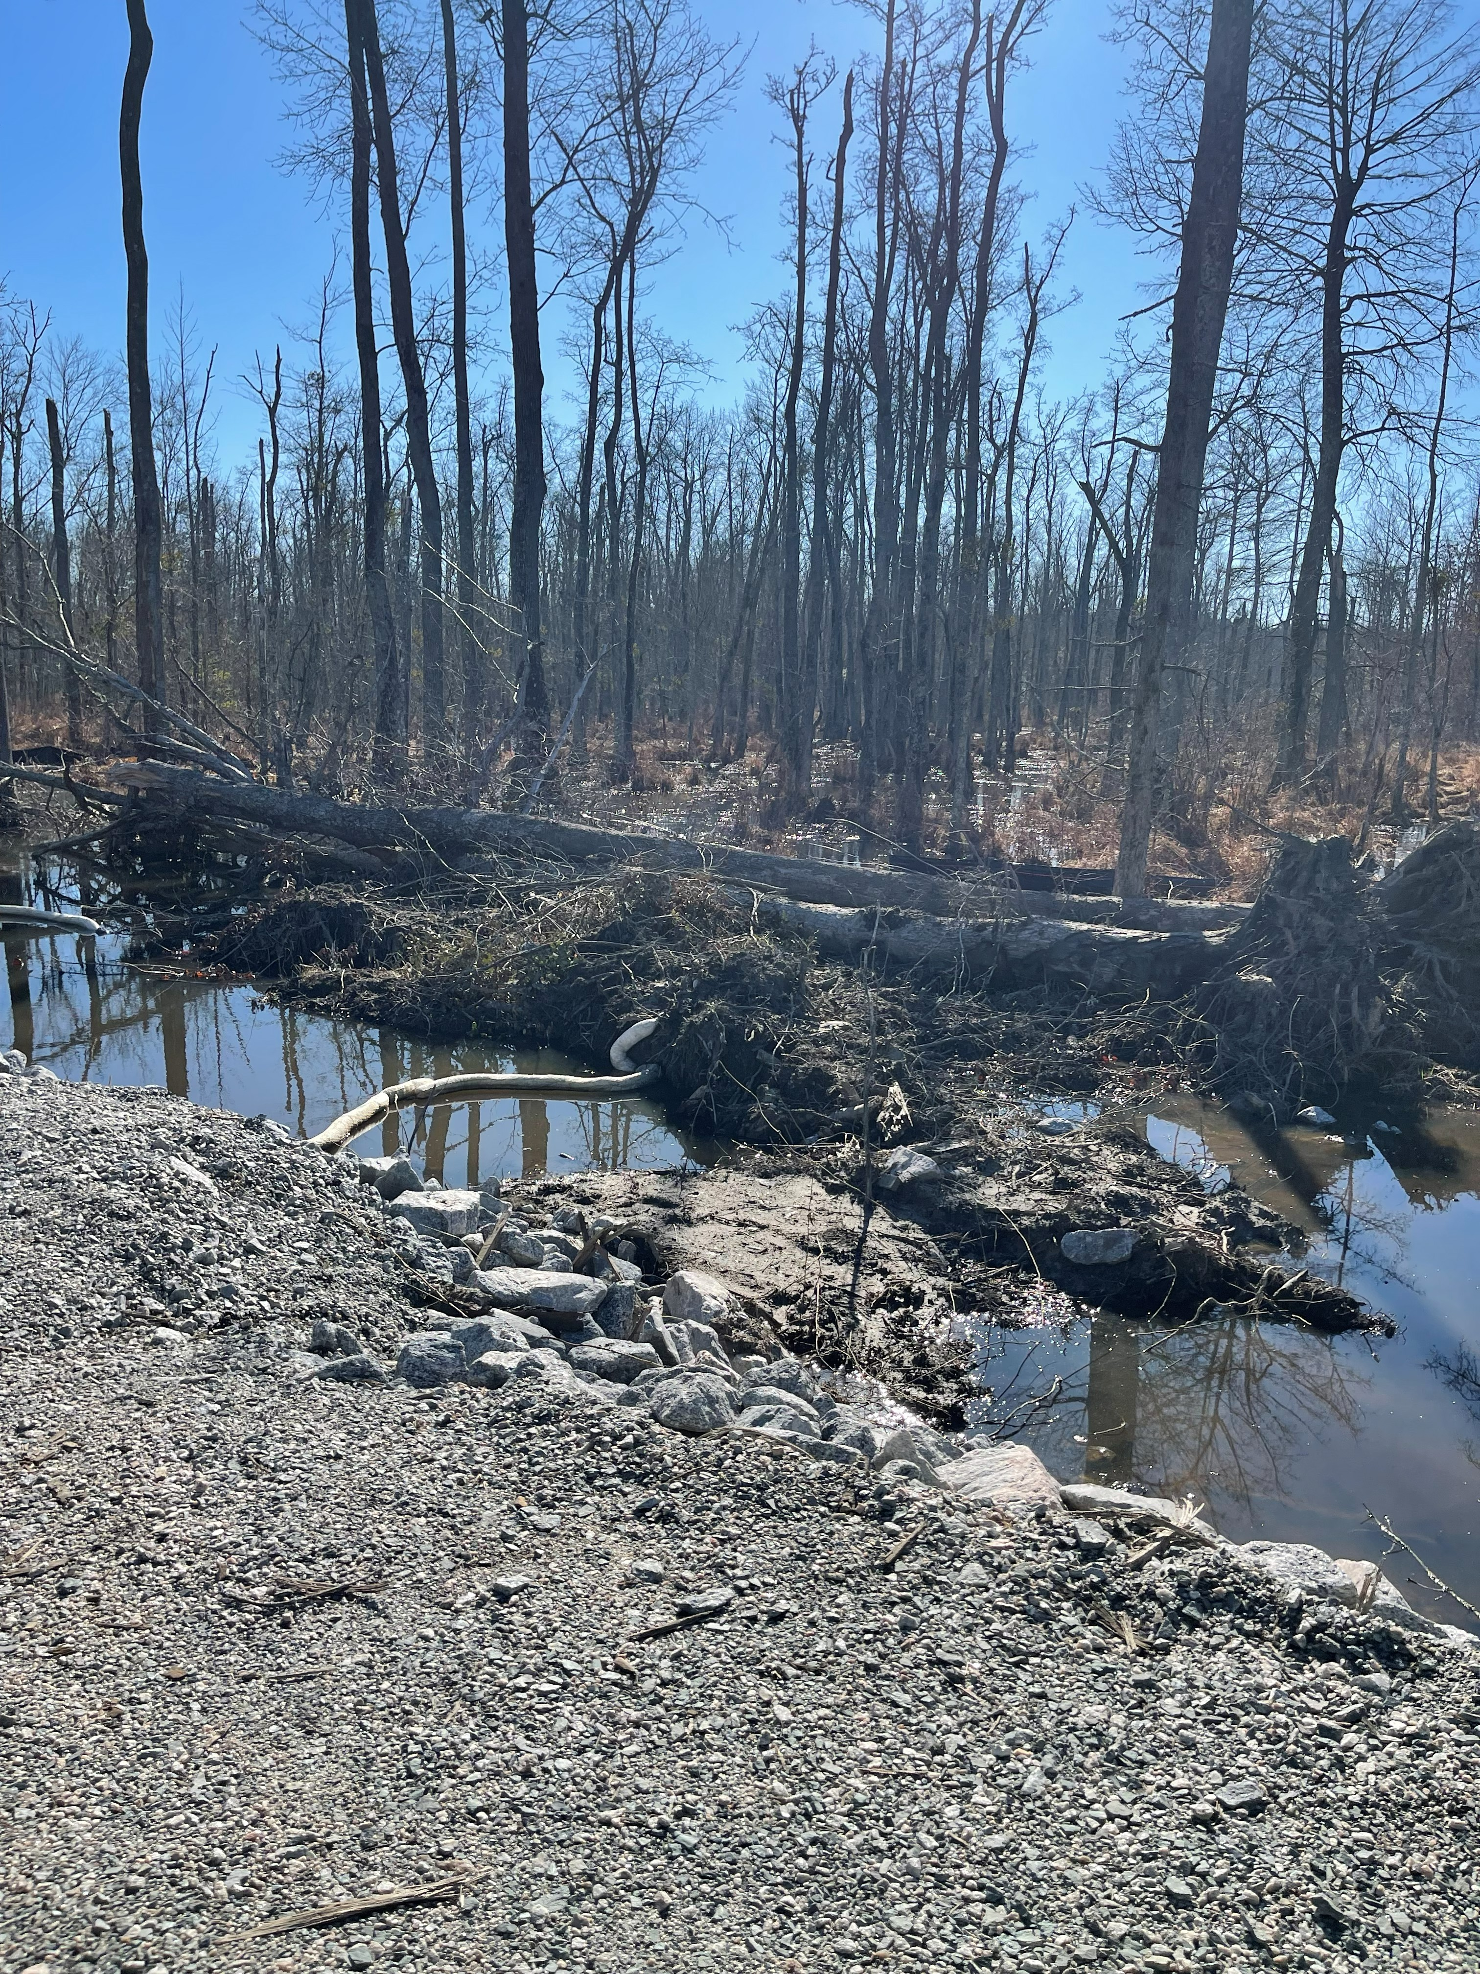
USFWS Concerns
• Coal & diesel release into Chickahominy wetlands
• Fish kill
• Northern long-eared bat habitat
• Migratory bird habitat

Slide 4
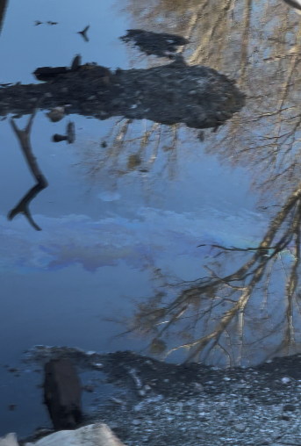
USFWS/DOI Activities
• Coordinated with DEQ, EPA, and Tribal partners
• Provided BMPs
• Reviewed plans - provided detailed comments on Corrective Action Plan

Slide 5
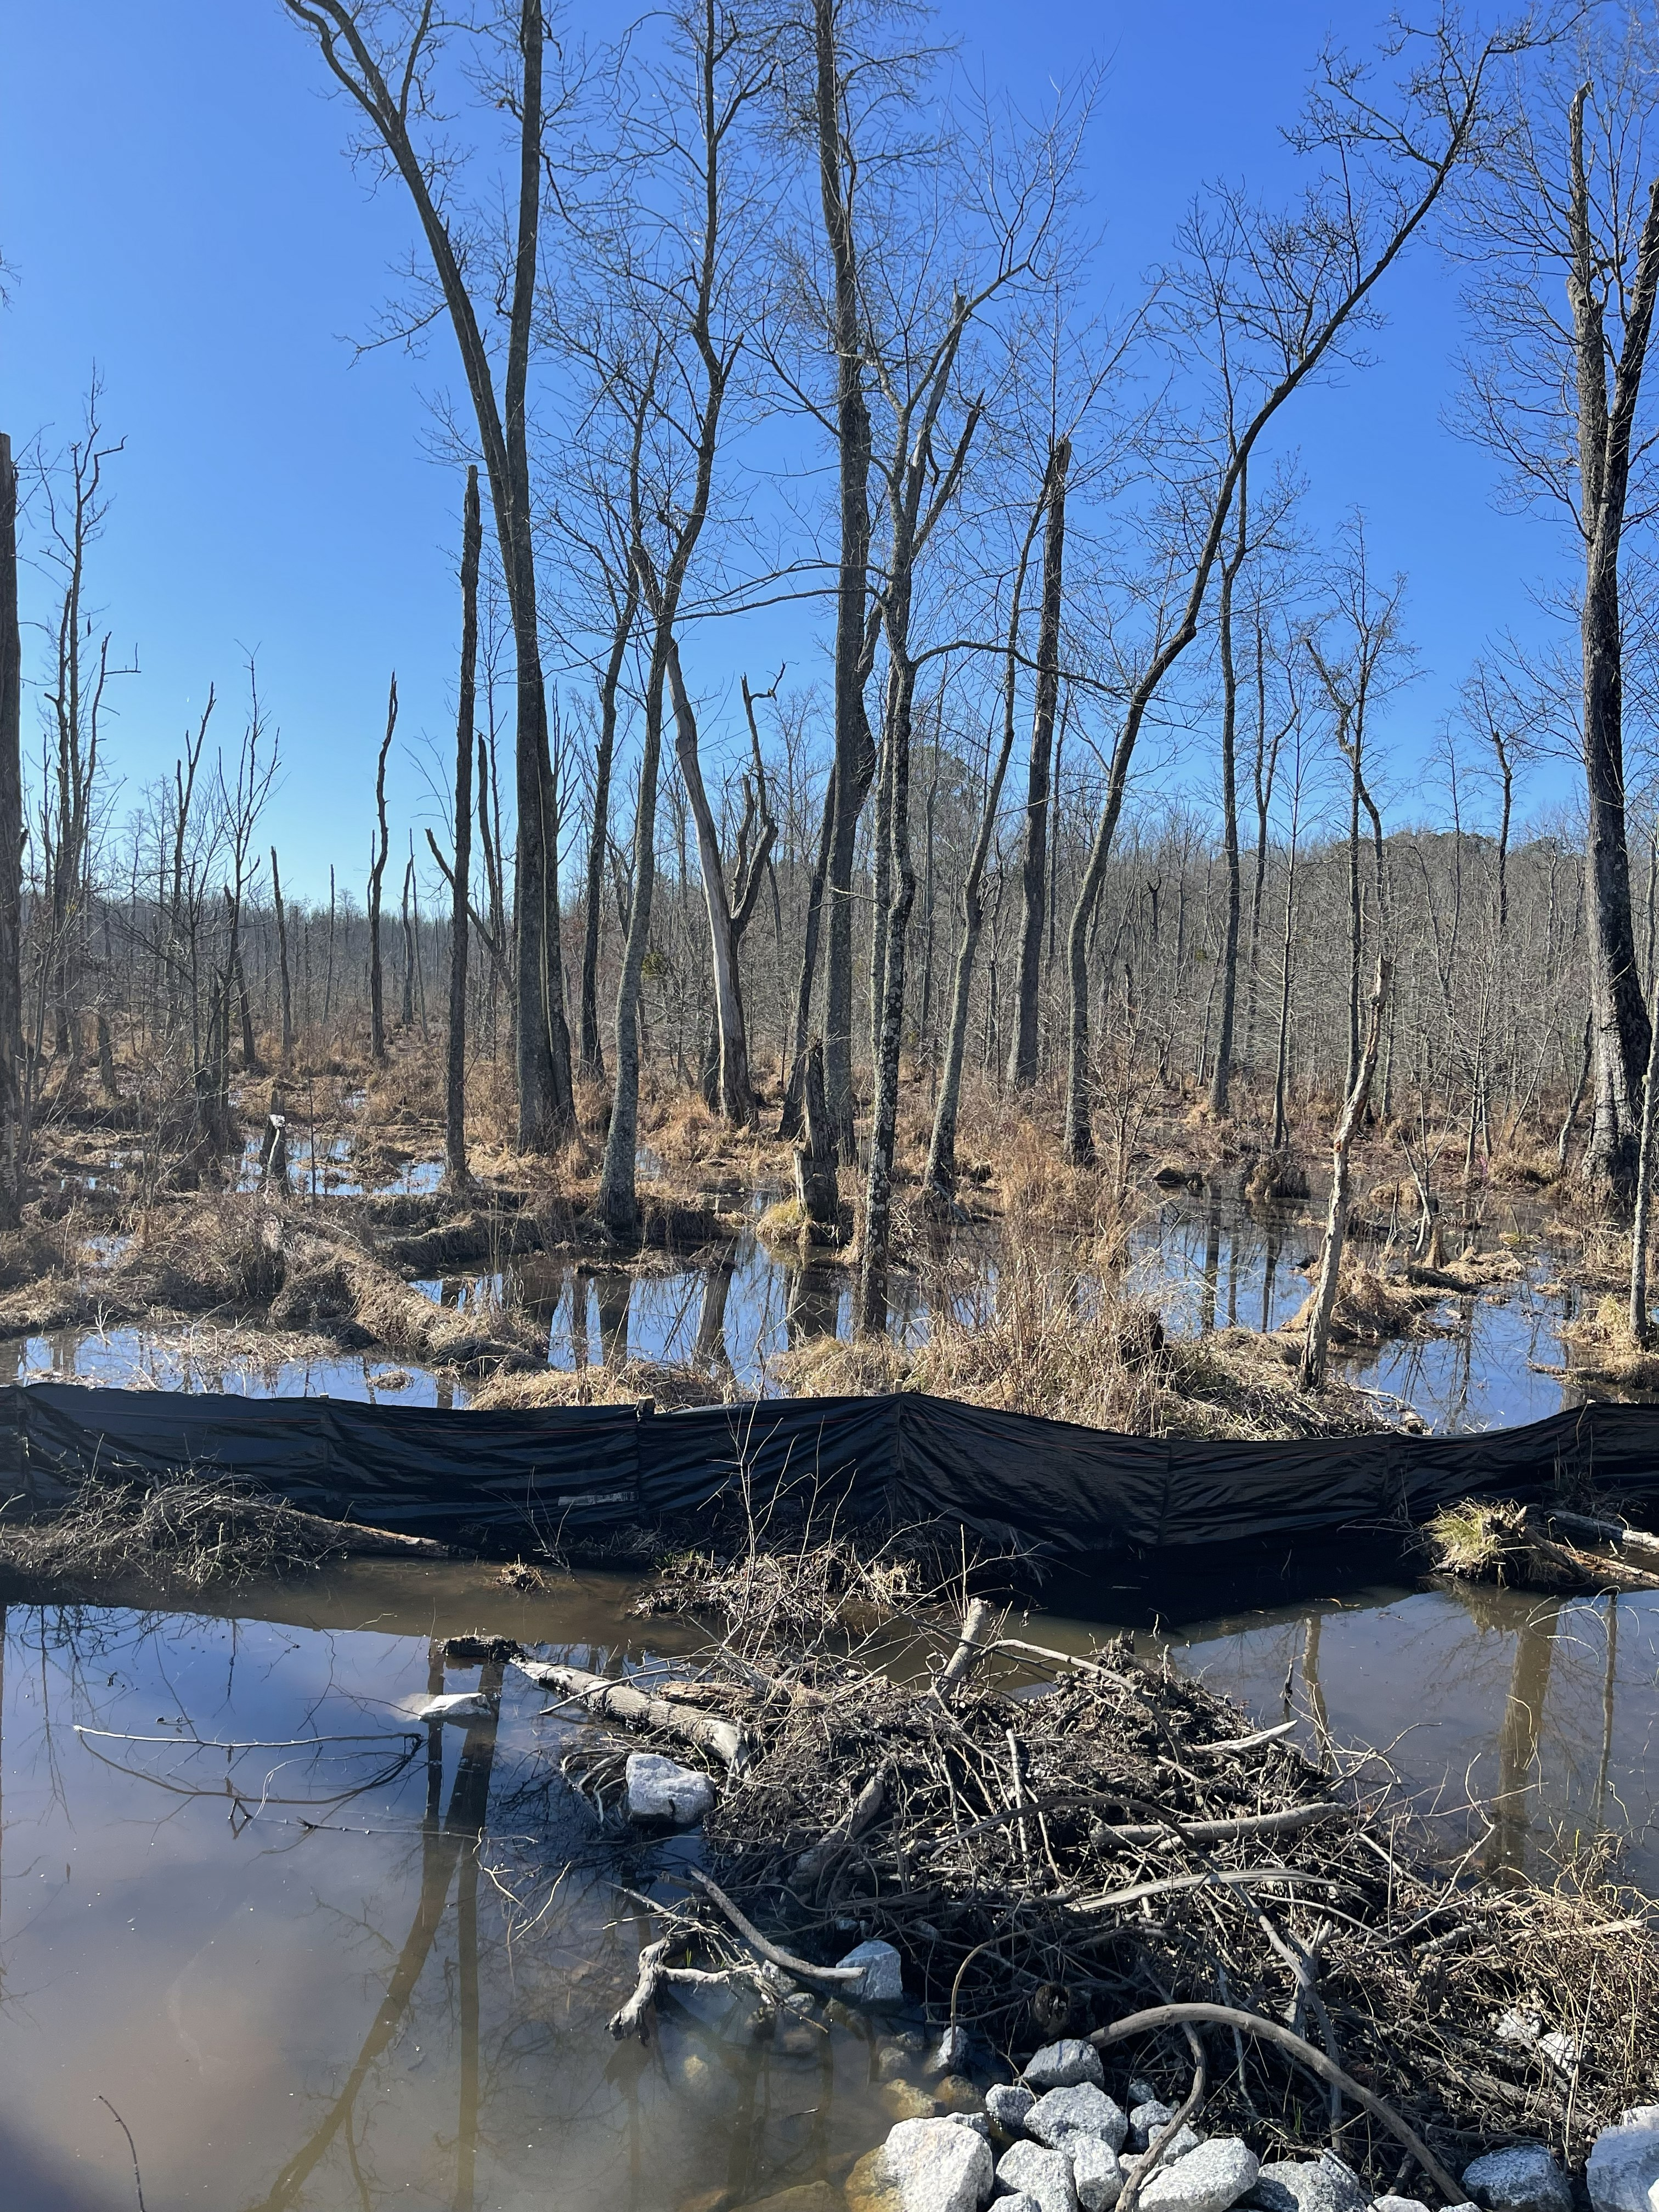
Key CAP Comments
• Add soil transect south of tracks
• Increase planting density of some species
• Longer monitor based on plant survival

Slide 6

Challenges in Wildlife Response
Follow up after initial notification
Under utilization and limited deployment of FWS personnel
Wildlife assessments

Slide 7
Requests to Partners
Assess wildlife early
Coordinate when tactics change that could affect T&E species
Complete and document ESA consultation
Request PRFA support when needed

