Slide 1
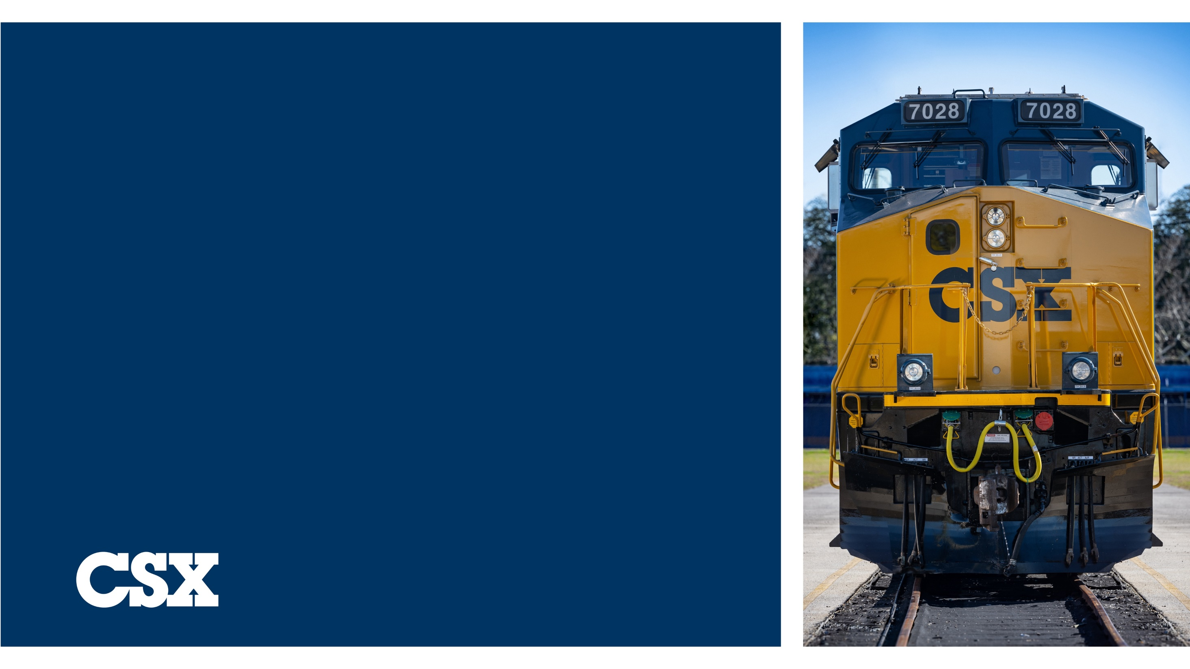

Incident Response Summary
Providence Forge, Virginia
2025

Slide 2

AGENDA
Incident Overview
Pre- and Post-Aerial Imagery
ICS Organization
Incident Objectives
Timeline
Work Progression
ICS Recordkeeping
Stakeholders
Summary

Slide 3
Incident Overview

Slide 4

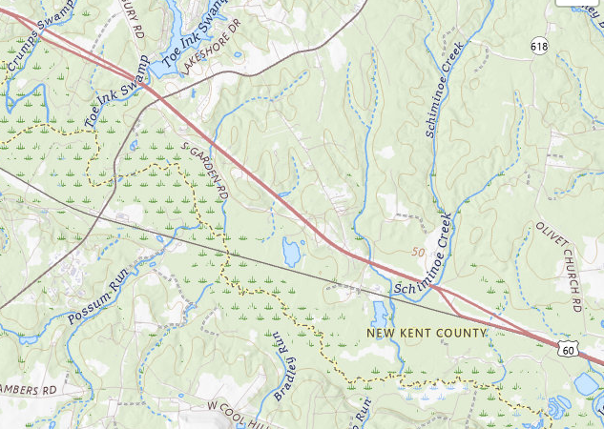

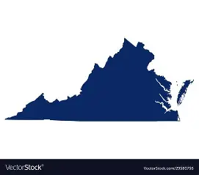



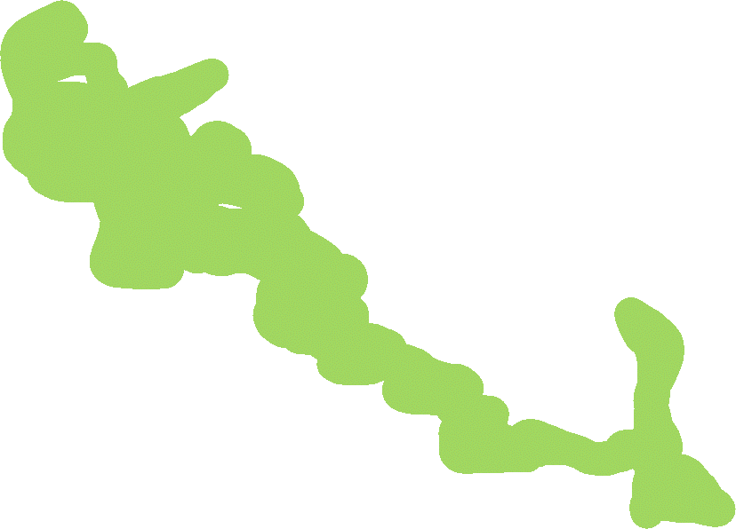

Location
Incident Location
Incident Location
Wetlands

Slide 5

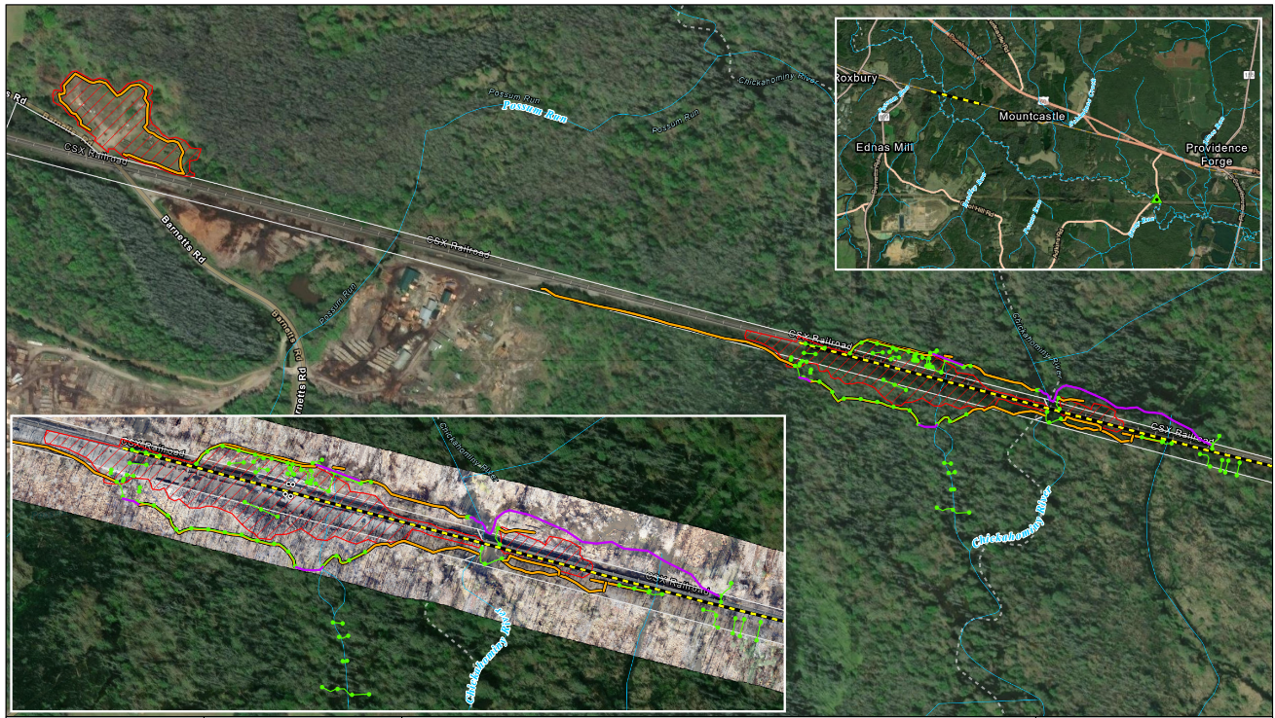

Incident Overview
At 15:38 on October 25, 2025, 53 cars and 2 locomotives on Train C13522, which consisted of 220 cars and 4 locomotives in total, derailed
44 cars lost contents totaling 4,230 tons of coal
Locomotives were holding approximately 6,900 gallons of diesel
  2,980 gallons of diesel presumed lost

Slide 6

Primary Incident Challenges
Derailment length: approximately ¾ mile
Derailment occurred in wetlands of the Chickahominy River watershed
Access
Four bridges affected
Sediment and petroleum control and containment in waterways

Slide 7
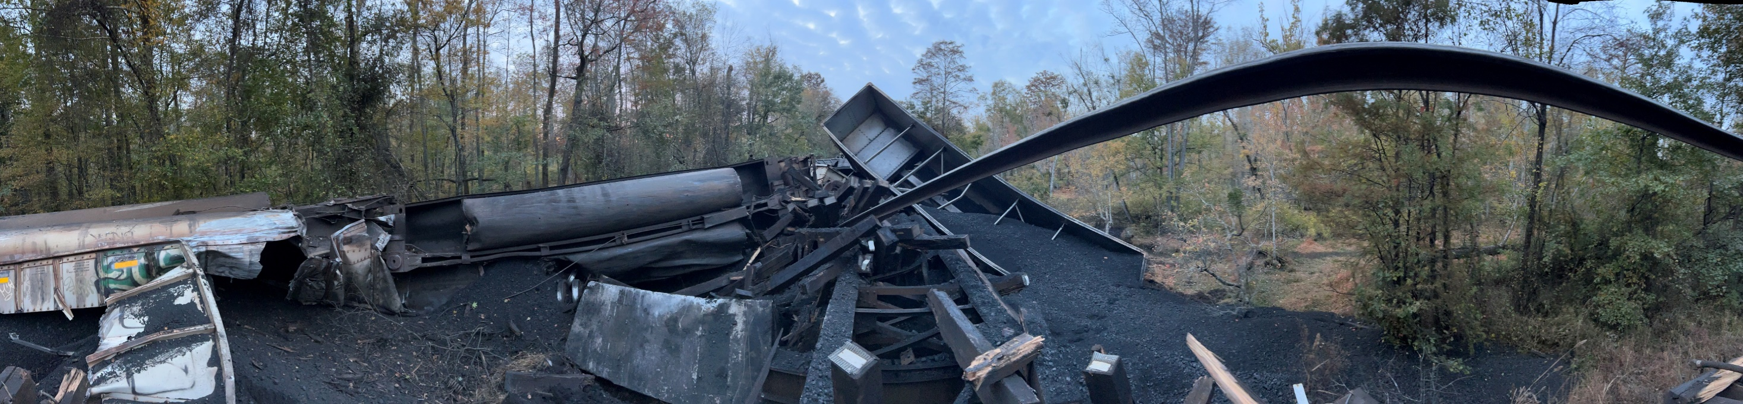

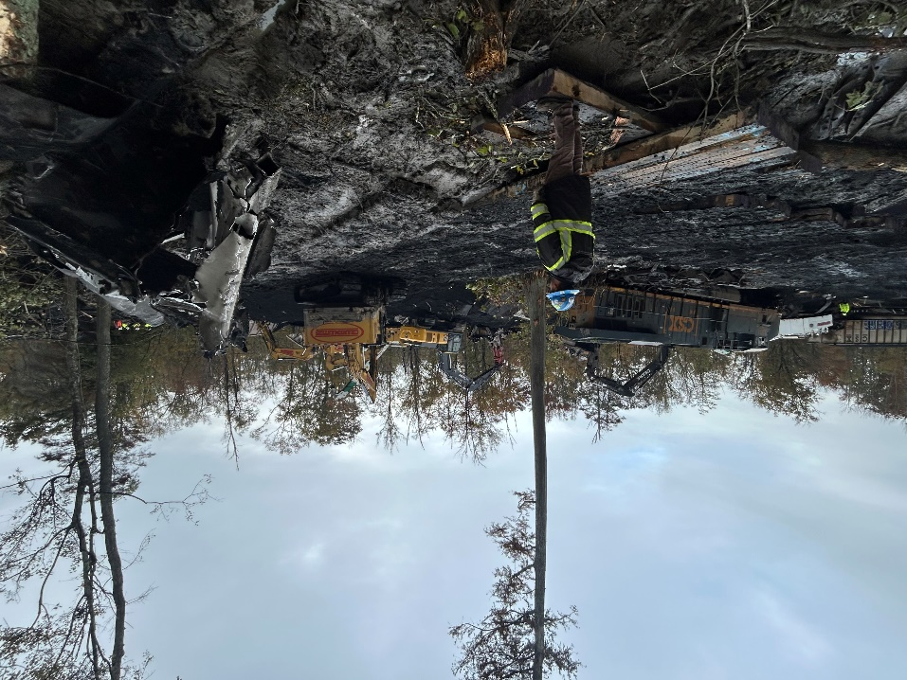
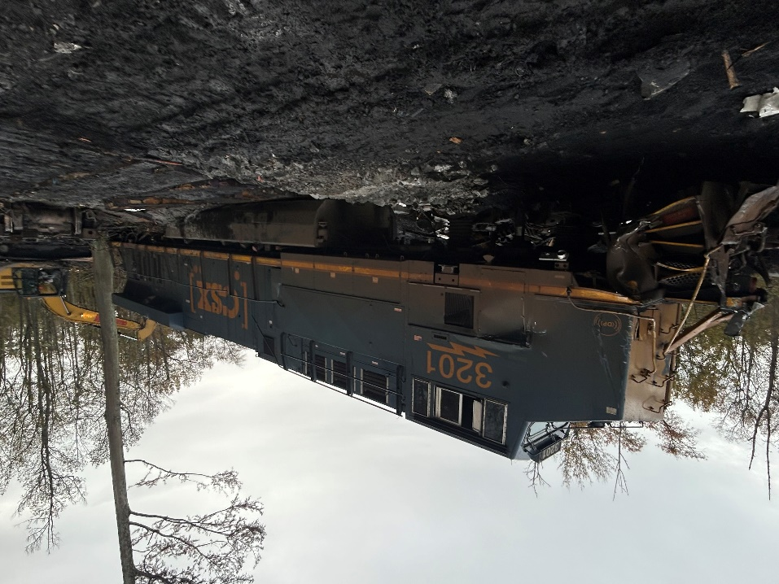
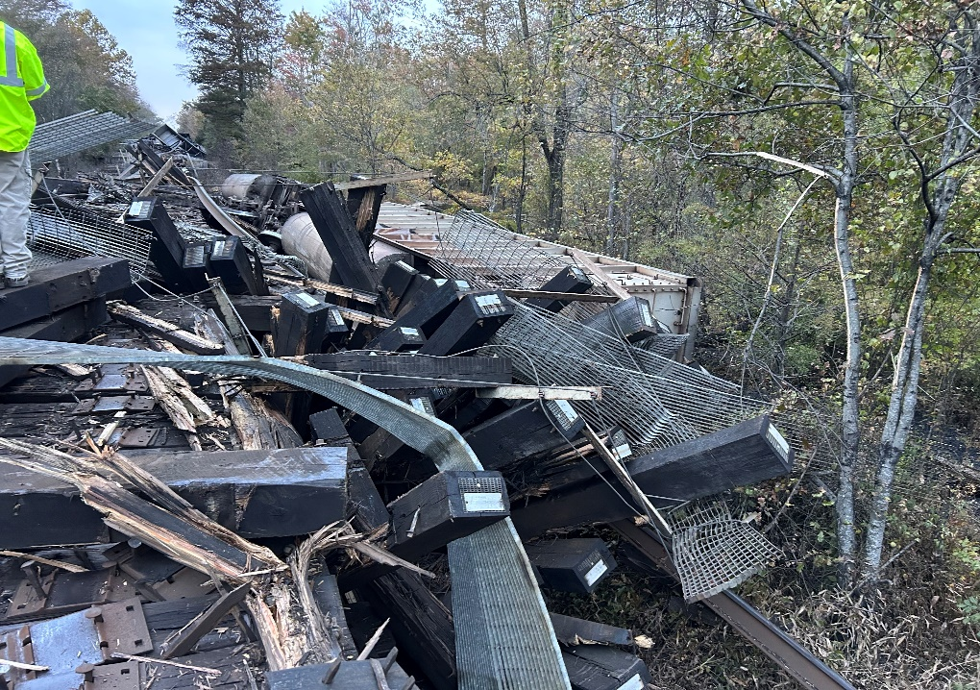
Incident Photographs – October 25-26, 2025
November 15, 2025
Survey of new access road to assess impacts to delineated wetlands
October 26, 2025
Wrecking crew equipment in wetlands prior to swamp mat installation

Slide 8
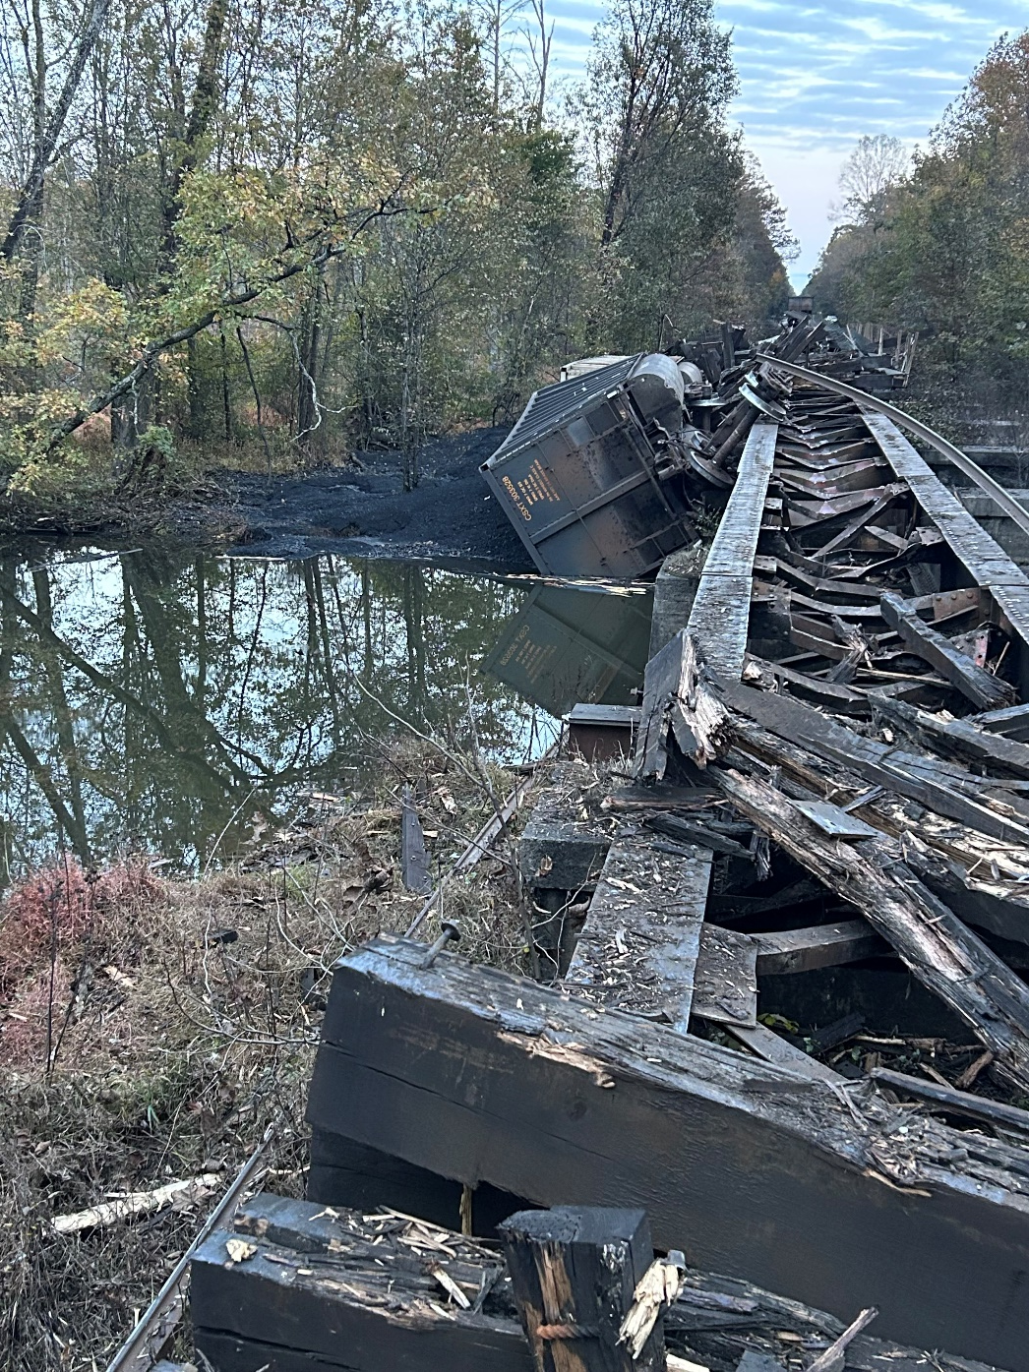
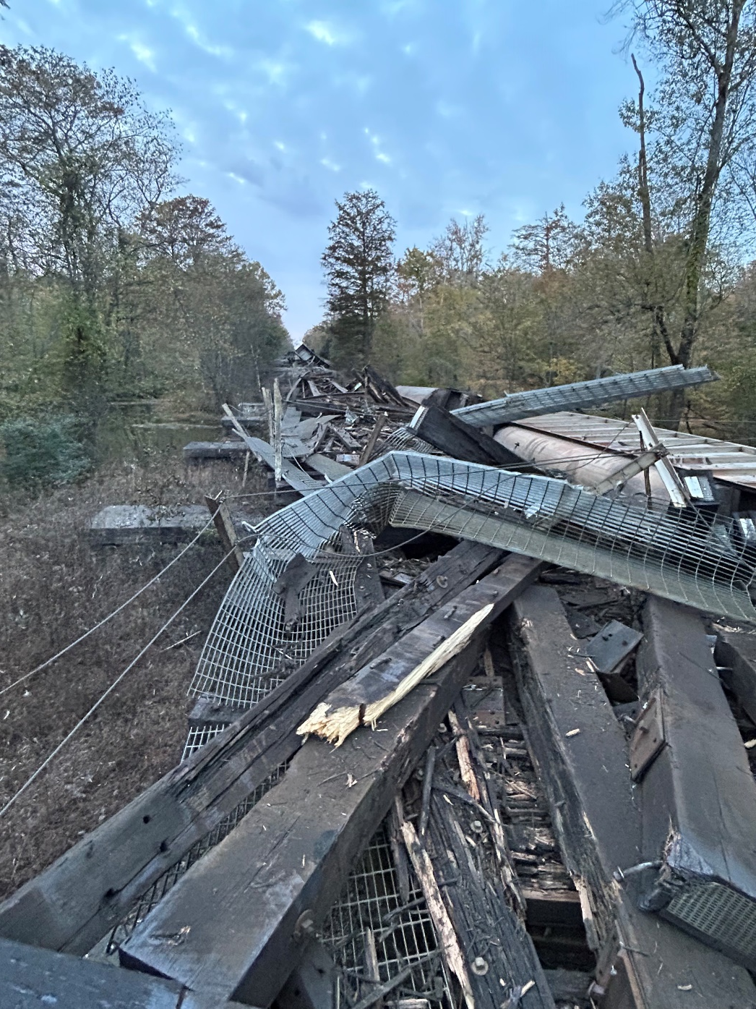
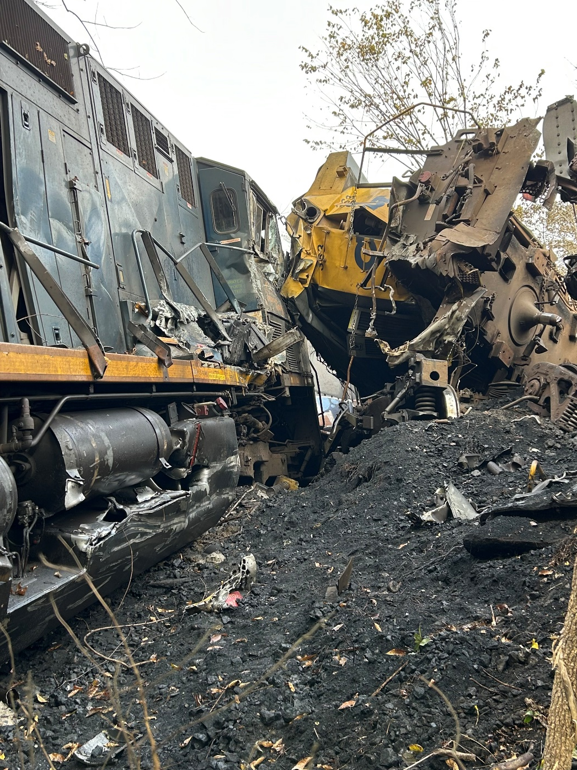
Incident Photographs – October 25-26, 2025
November 15, 2025
Survey of new access road to assess impacts to delineated wetlands
October 26, 2025
Wrecking crew equipment in wetlands prior to swamp mat installation

Slide 9
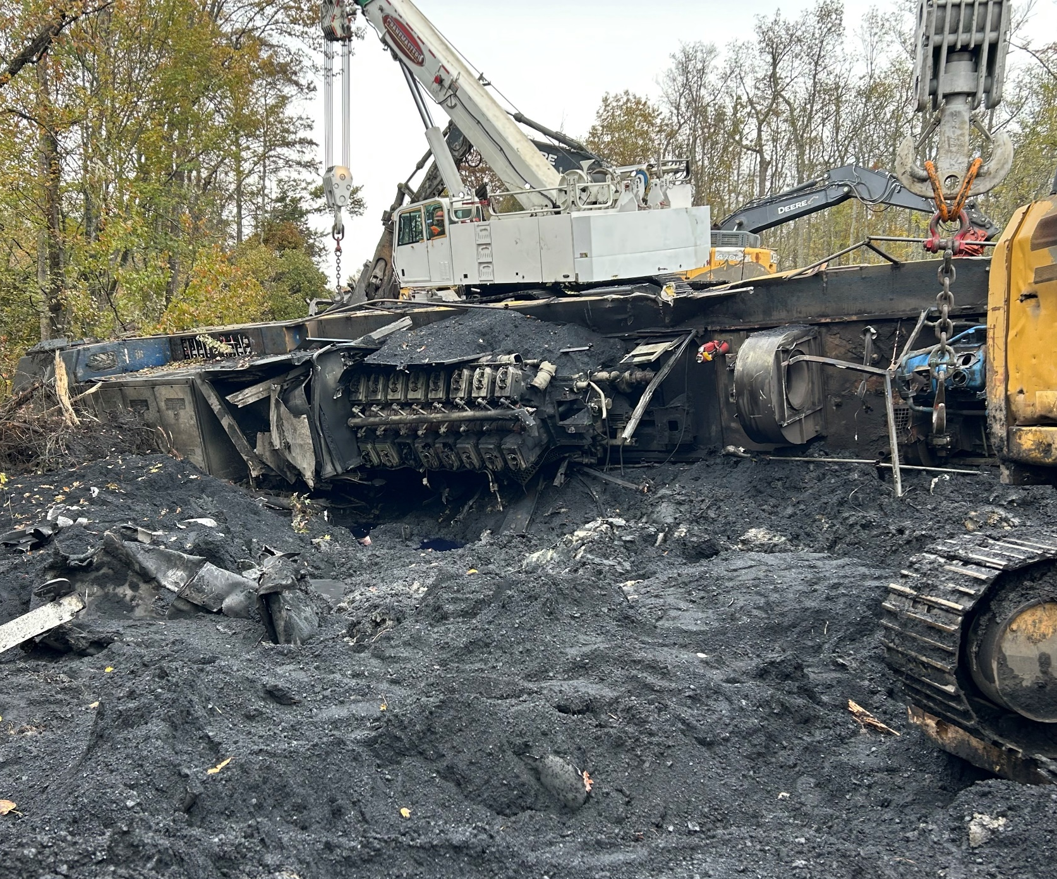
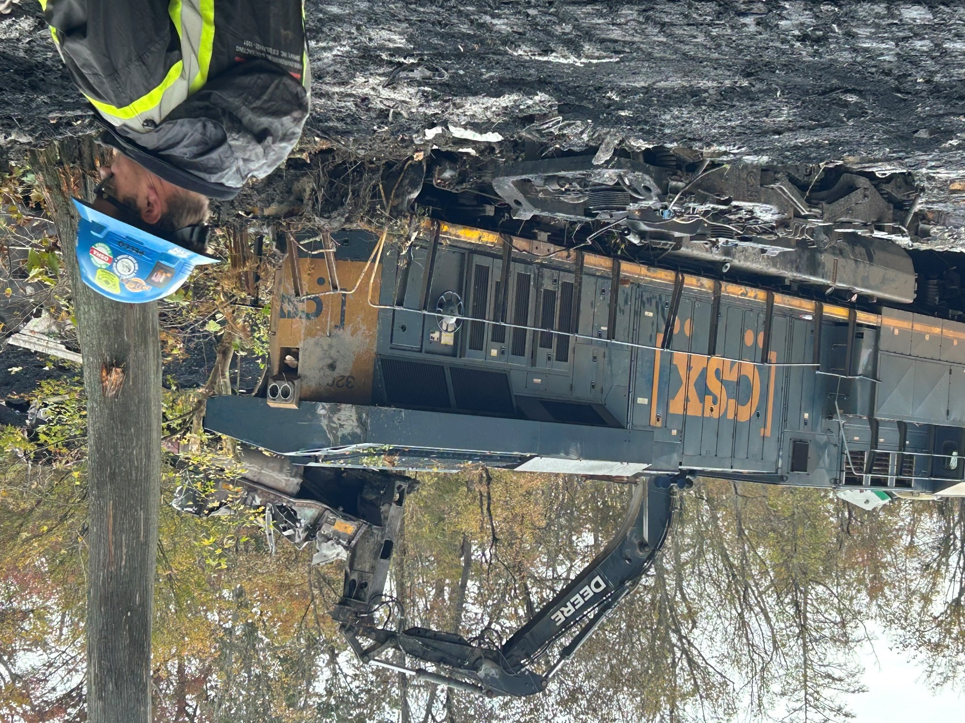

Incident Photographs – October 25-26, 2025
October 26, 2025
Wrecking crew equipment in wetlands prior to swamp mat installation

Slide 10
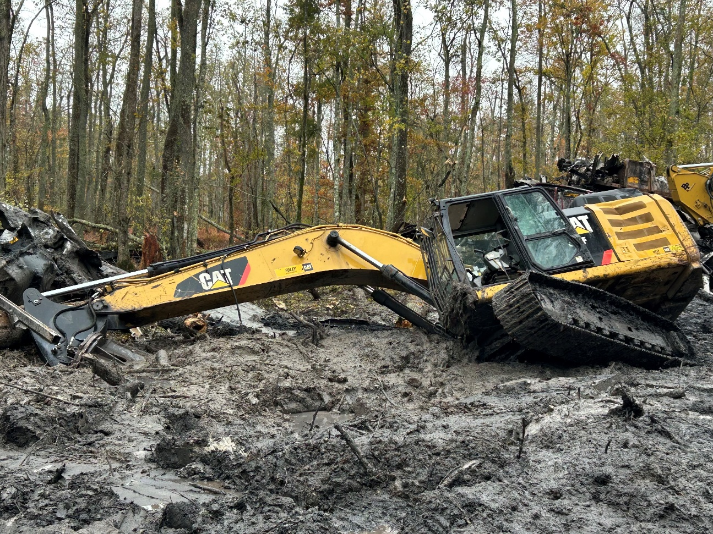
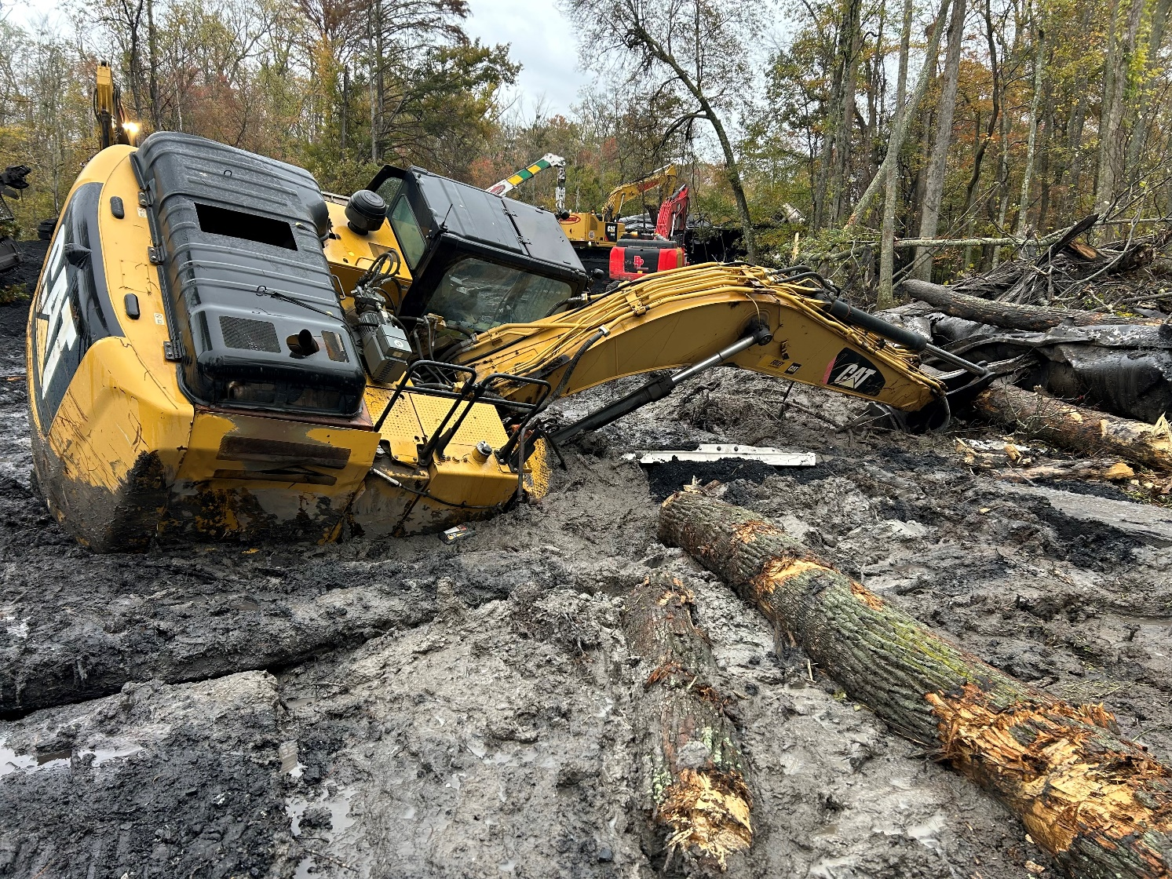
Primary Incident Challenges - Access
November 15, 2025
Survey of new access road to assess impacts to delineated wetlands
October 26, 2025
Wrecking crew equipment in wetlands prior to swamp mat installation

Slide 11
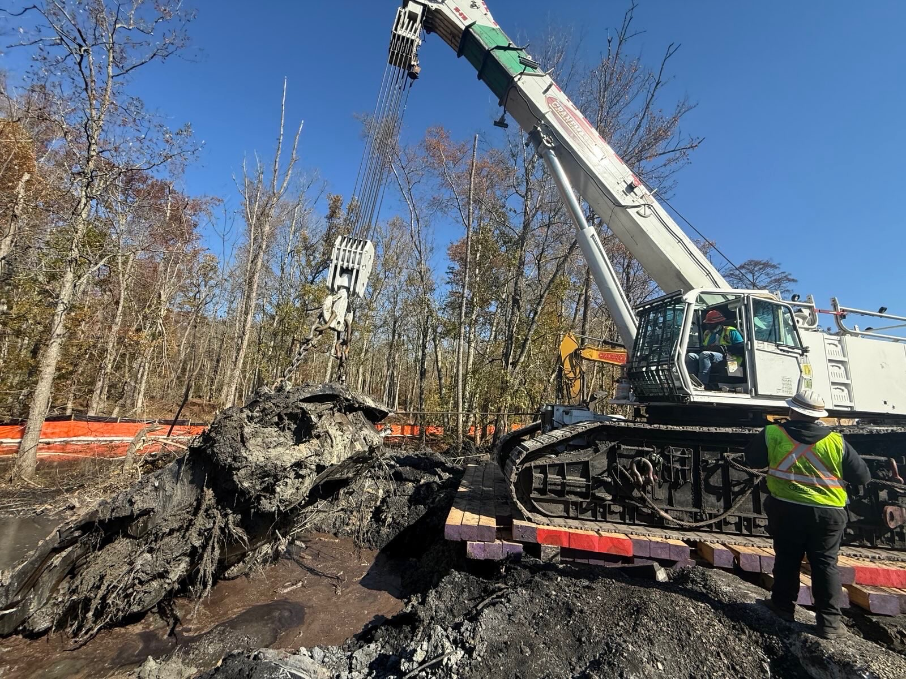
Primary Incident Challenges - Access
October 28, 2025
Debris removal and multi-tier swamp mat installation
October 26, 2025
Wrecking crew equipment in wetlands prior to swamp mat installation

Slide 12
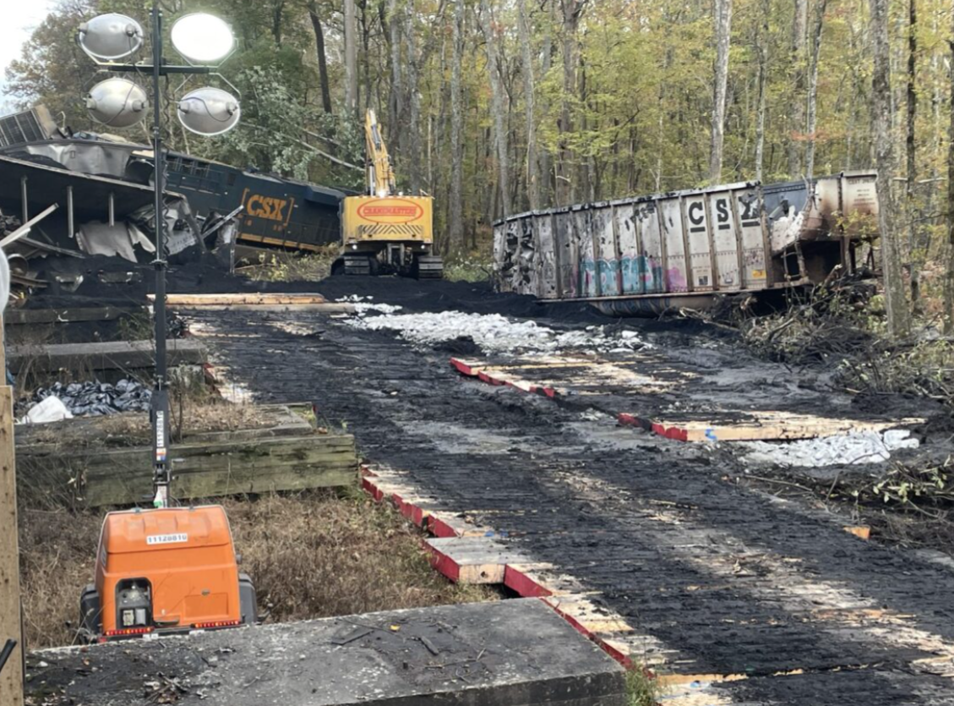
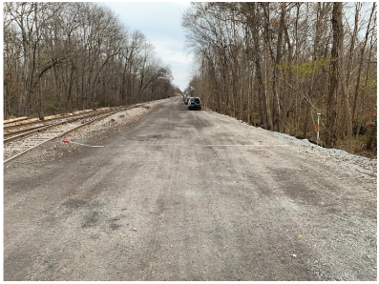
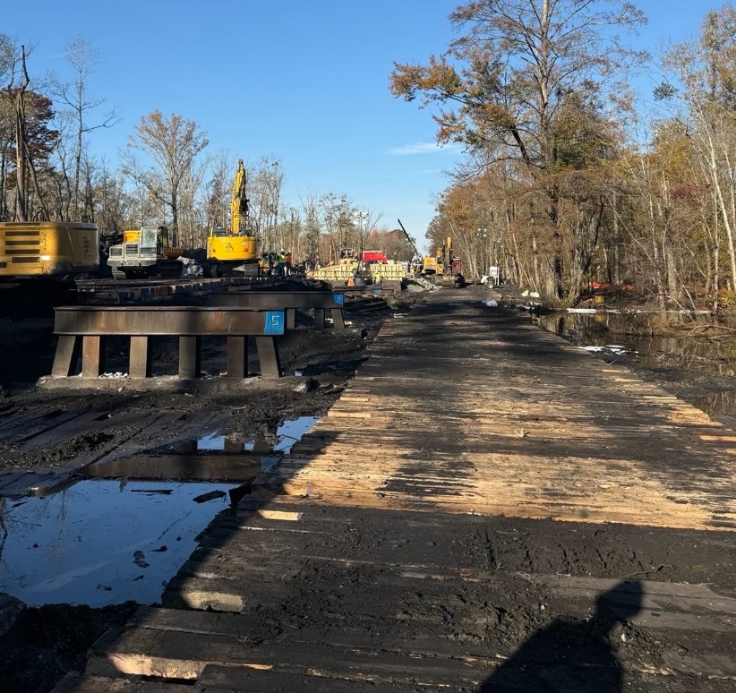
Primary Incident Challenges - Access
November 15, 2025
Survey of new access road to assess impacts to delineated wetlands
October 26, 2025
Installation of swamp mats to form base of new access road

Slide 13
Pre-Incident Aerial Imagery

Slide 14
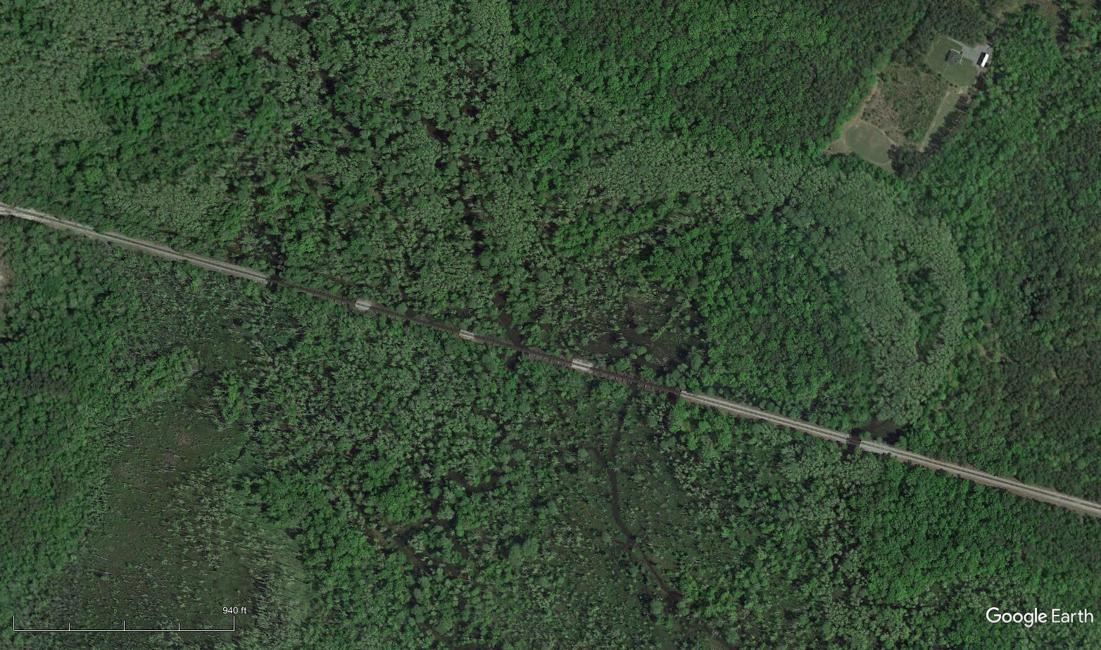
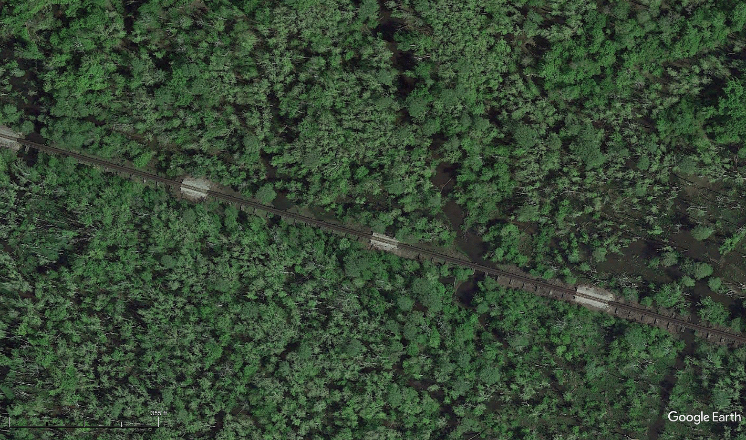

Pre-Incident Satellite Image – April 26, 2021
Bridge 2
Bridge 4
Bridge 3
Bridge 1
Scale

Slide 15
Post-Incident Drone Imagery

Slide 16
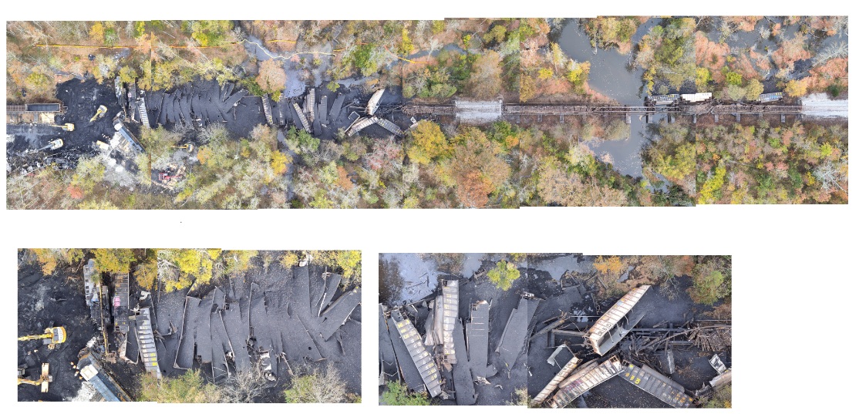
Car Layout
250 feet

Slide 17
ICS Organization

Slide 18











Unified Command
Incident Commander
Joe Taylor
Charles City County Fire and EMS Department
James Johnson
New Kent Fire and Rescue
Jason Bishop
Rick Opett
VDEM
Robert Paxton
Todd Cannon
Regulatory Liaisons
VA DEQ
U.S. EPA
Laura Casillas
Maggie Ferry
Dane Kormos
VDOT
Rusty Bevan
New Kent County Sheriff
C. Thomas
TSA
Joseph Lopez
FRA
USACE

Slide 19













Organizational Chart
Incident Commander Joe Taylor
Safety
CSX Operations Chief
MOCC
Planning Section
Environmental Response
Hazmat Branch
Bridge Branch
Mechanical Branch
Site Control
Loadout Yard Group
Affected Property Division
Engineering
    13 Contractors onsite
    268 Personnel
      max on 10/28/25

Slide 20
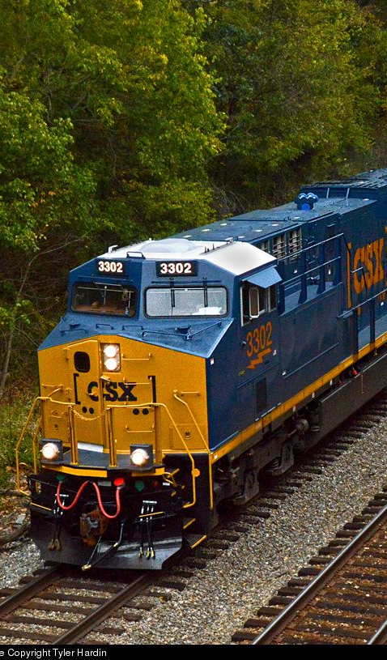


CSX Organizational Chart
Incident Commander
Joe Taylor
CSX Safety
Ryan Prewitt
Matt Williamson
Carrie Martin
CSX Bridge
Ed Sparks
CSX Mechanical
Paul Johnson
CSX Hazmat Operations
Rob James
Dave Scoons
CSX Hazmat Branch
Blaise MacDonald
Loadout Yard Group
James Courtney
Site Control Group
Mark Castin
Scott Karcher
Excavation Group
Ryan Godsey
CSX Engineering
Rex Carter

Slide 21
Incident Objectives

Slide 22

Incident objectives
ICS 202
Ensure life safety of all personnel at and around the incident
Stabilize and secure the incident area
Perform collection, containment, and recovery operations on the ground and in the water
Establish communication procedures to include contingency planning for changing conditions
Maintain positive communication and transparency with partners, contractors, regulatory agencies, interested parties, and stakeholders

Slide 23
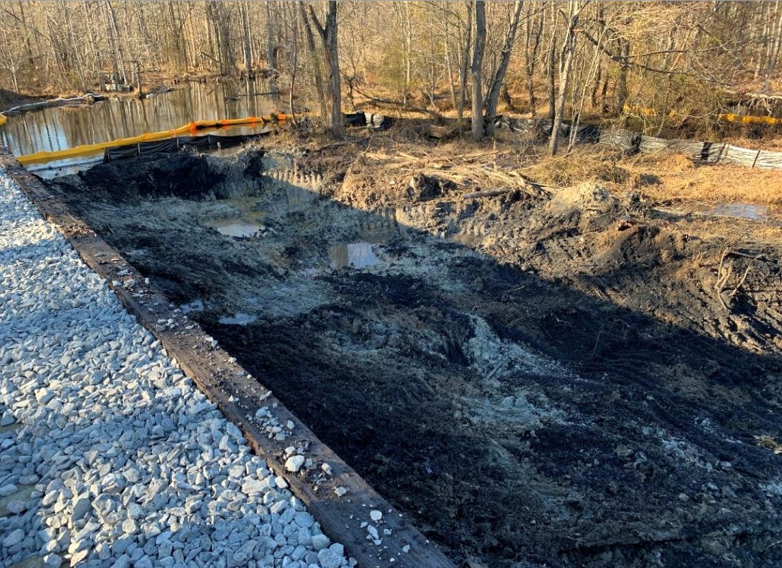

Incident objectives
ICS 204 – Hazardous Materials
Receive and stage lading and waste from incident location
Consolidate and process material at loadout yard for disposal
Profile waste streams
Oversee transport of waste off-site to disposal facilities under waste manifests
Transport spilled lading under bills-of-lading
Coordinate supporting tasks for risk management team
Apply site controls including containment and removal of product and inspection and repairs to silt fencing and turbidity curtains
Track resources, including manpower and equipment, via ICS 218
Monitoring and sampling of waterways
Limit impact to neighboring properties and sensitive receptors
Work with consulting to confirm and document limits of excavations
November 18, 2025
Coal recovery, northeast side at Chickahominy River

Slide 24
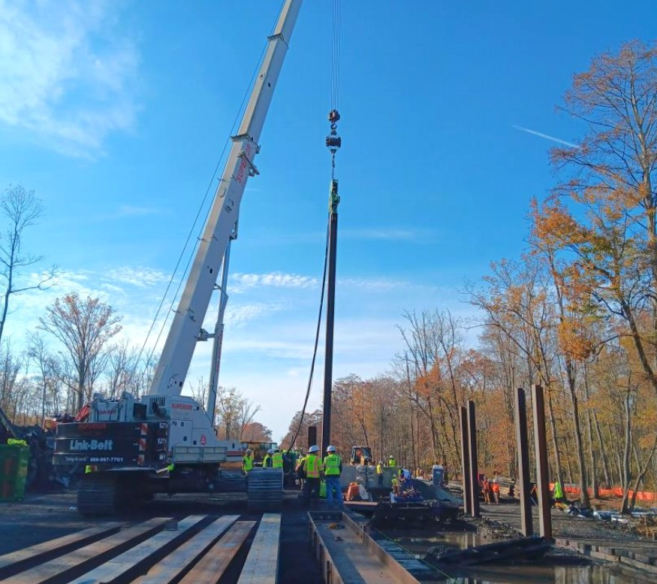
Incident objectives
ICS 204 - Bridge
Design, evaluate, repair, and reconstruct four bridges
Order, receive, and process all materials necessary for bridge repairs
Demobilize CSX and Contractor assets dedicated to bridge repair
November 3, 2025
Bridge 3 support installation activities

Slide 25
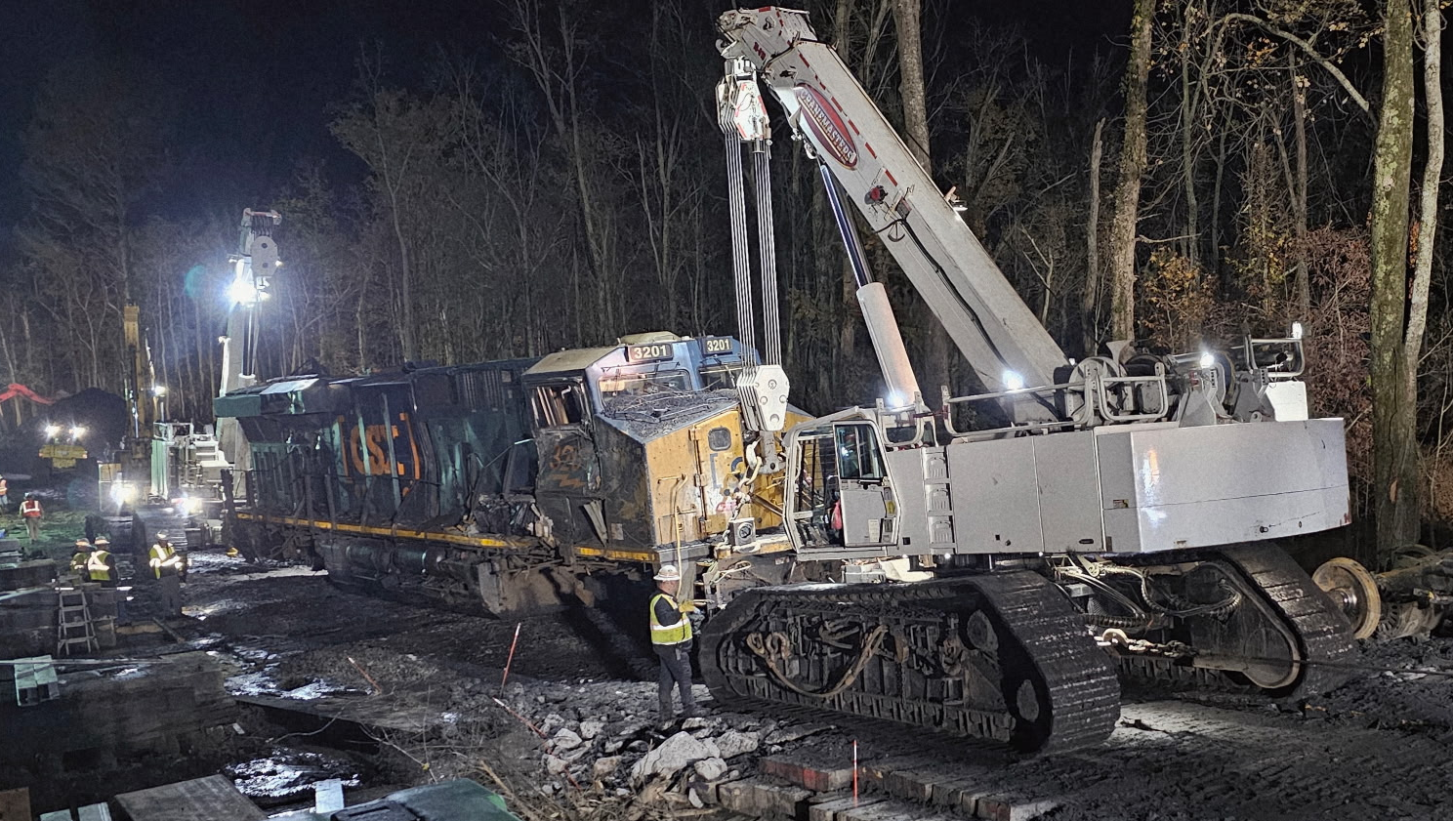
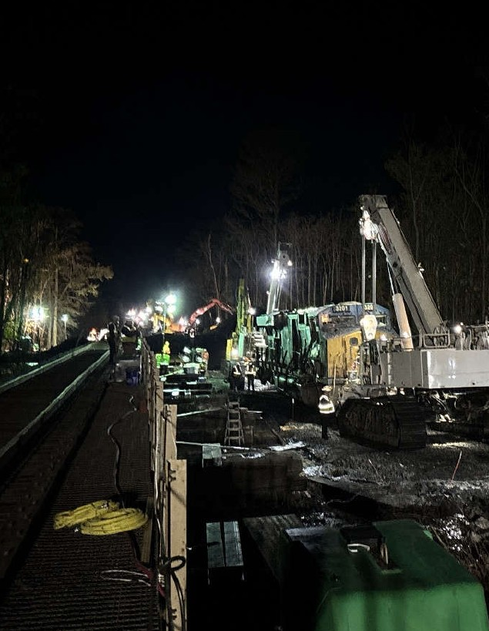

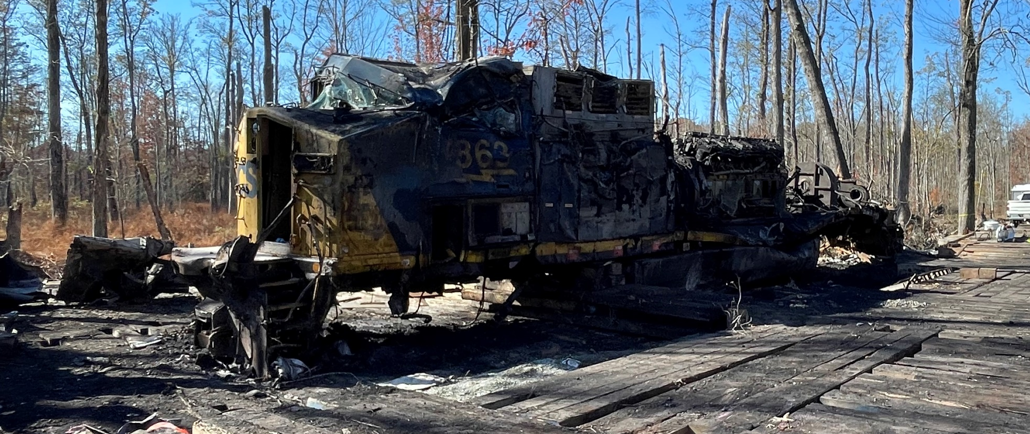

Incident objectives
ICS 204 - Mechanical
Management of locomotives including re-railing and scrapping
October 30, 2025
Uprighting and re-railing of Locomotive 3201
October 30, 2025
Scrapping operations for Locomotive 363

Slide 26
Timeline

Slide 27
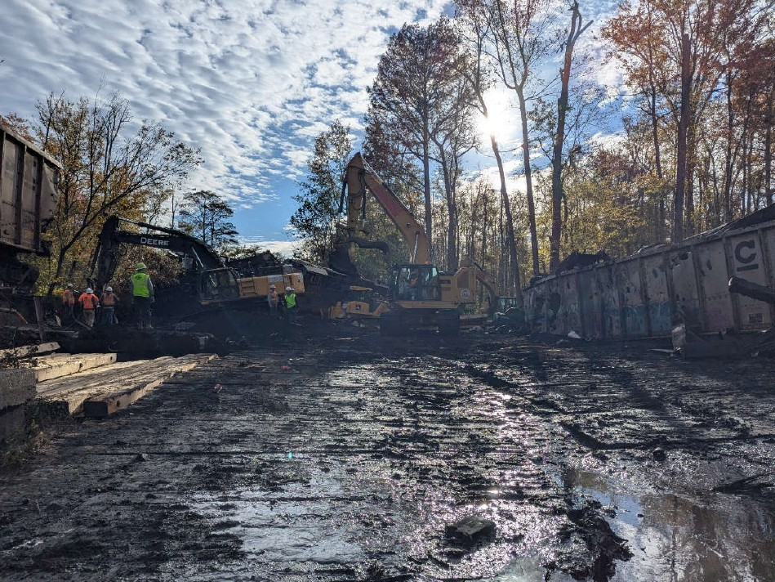

Timeline – Week 1
Incident Summary
53 cars and 2 locomotives derailed
44 cars lost contents totaling 4,230 tons of coal
Locomotives were holding approx. 7,600 gallons of diesel
October 25, 2025
Contractor Mobilizations
October 26, 2025
October 27, 2025
October 28, 2025
October 29, 2025
CSX MOCC Mobilization
Wrecking crews begin construction of access with timber mats
Containment booms and silt fencing emplaced
Water quality monitoring commenced
October 30, 2025
October 31, 2025
October 27, 2025 Wrecking Crew
3 of 4 traction motors removed and staged
In total, 4,700 ft of silt fence, 400 ft boom, and 1,050 ft of turbidity curtain installed and maintained
Access roads improved and widened
Continue with diesel recovery efforts
800 feet of access road completed
12 cars scrapped
Wetlands survey began
400 ft turbidity curtain and 2,000 ft silt fence installed
Coal and scrap metal staging continued
300 ft boom installed east of Chickahominy River
Two samples collected for DRO
41 cars staged for scrapping
2,600 ft silt fence and 700 feet turbidity curtain installed, in total
Tree survey completed
3 water quality samples collected
New staging area constructed and coal/metal transferred to prepare for bridge repair
Locomotive 3201 re-railed and removed
200 ft turbidity curtain and 800 ft silt fence installed
3,800 gallons diesel recovered (Locomotive 3201)

Slide 28
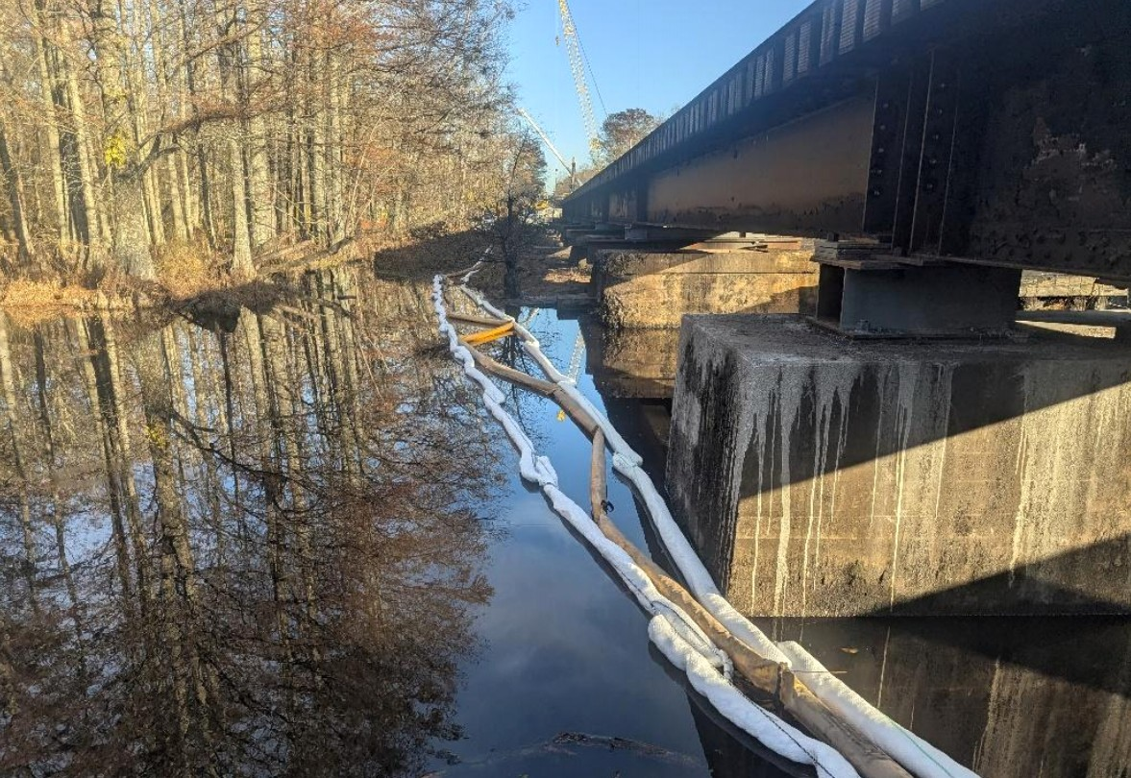

Timeline – Week 2
continued
November 1, 2025
November 2, 2025
November 3, 2025
November 4, 2025
November 5, 2025
November 6, 2025
November 7, 2025
November 5, 2025
Site controls on north side of new Bridge 4
In total, 5,800 ft of silt fence, 500 ft boom, and 1,150 ft of turbidity curtain installed and maintained
New staging area completed
Fourth traction motor recovered
Additional 100 ft containment boom, 800 ft silt fence, and 200 ft absorbent boom installed, mostly at Bridge 1
In total, 7,300 ft of silt fence, 800 ft of boom, and 1,550 ft of turbidity curtain installed and maintained
Bridge construction
Aerator deployed to increase dissolved oxygen on north side near Bridge 3
Preparation for bridge rebuild
Coal and scrap metal staging
Three cars from northeast zone recovered and staged
Bridge construction complete
Installation of new track panels
Train traffic resumed
Scrapping and coal staging
Bridge construction complete
Installation of new track panels
Train traffic resumed
Scrapping and coal staging
Preparation for coal recovery operations
Additional 650 ft absorbent boom installed, mostly at Bridge 1
Bridge construction
Continued monitoring and adjustments of booms and turbidity curtains
Diesel recovery with vacuum truck and sorbents
Scrapping and coal staging

Slide 29
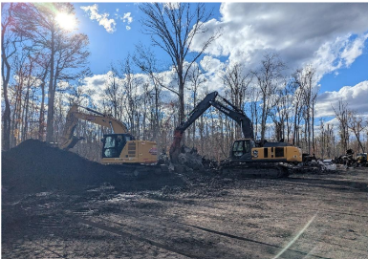
Timeline – Week 3
continued
November 8, 2025
November 9, 2025
November 10, 2025
November 11, 2025
November 12, 2025
November 13, 2025
November 14, 2025
November 10, 2025
Excavator and shear excavator staging coal and scrap metal
Preparation for coal removal operations
Surface water monitoring
Inspection and hardening of site controls
Coal removal operations began
Manual recovery of diesel
Surface water monitoring
Inspection and hardening of site controls
Installation of sorbent booms at rail tie staging
Continuation of operations from previous day
Coal Removal and Waste Plan developed
Containment and Inspection Plan submitted
Continuation of coal and scrap metal recovery operations
Site control monitoring and hardening
Ongoing surface water monitoring
Preparation for coal removal operations
Ongoing surface water monitoring
Inspection and hardening of site controls
Continuation of operations from previous day
LiDAR survey conducted
PID readings collected during product recovery
Continuation of operations from previous day

Slide 30
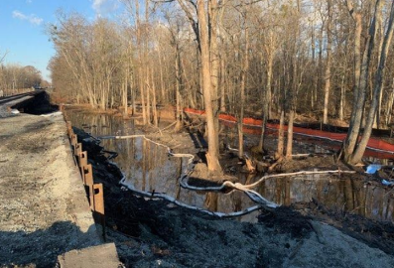
Timeline – Week 4
continued
November 15, 2025
November 16, 2025
November 17, 2025
November 18, 2025
November 19, 2025
November 20, 2025
November 21, 2025
November 16, 2025
Progress photo of Area 4 (northeast), which required high-rail equipment to recover coal
Ongoing coordination with USACE and VDEQ Water Quality Group
Submitted impacted wildlife to USFWS
Wetlands delineation submitted to VDEQ
Ongoing recovery of coal, scrap metal, and diesel-impacted material
Ongoing surface water monitoring and inspection of site controls
VDEQ conducted stream biological survey
Developed draft Corrective Action Plan
Continuation of operations from previous day
Submitted draft Corrective Action Plan
Ongoing recovery of coal, scrap metal, and diesel-impacted material
Ongoing surface water monitoring and inspection of site controls
Coal removal at Area 4 with high-rail trucks
Ongoing recovery of coal, scrap metal, and diesel-impacted material
Ongoing surface water monitoring and inspection of site controls
Final coal load removed from incident
Preparation for demobilization and transfer of command to remediation
Continuation of operations from previous day

Slide 31

Timeline – Demobilization
continued
November 22, 2025
MOCC demobilized
CSX internal responsibility transferred from Hazmat to Remediation
Equipment demobilization
Restoration of MOCC parking areas
Inspection and hardening of containment booms and silt fencing for holiday week
Most contractor crews demobilized

Slide 32
Work Progression

Slide 33
Bridge Repair and Replacement

Slide 34
Bridge Repair and replacement
Highlights
Four bridges constructed over wetlands required replacement and/or repair
Access challenges required installation of 1,066 swamp mats and construction of a new access road
Bridges were completed, new track panels were laid, and train traffic resumed on Day 12
Bridges were xxx-type construction
Repair hightlight
Replacement highlight
Bridge 4
Bridge 3
Bridge 2
Bridge 1

Slide 35
Containment and Recovery Methods

Slide 36
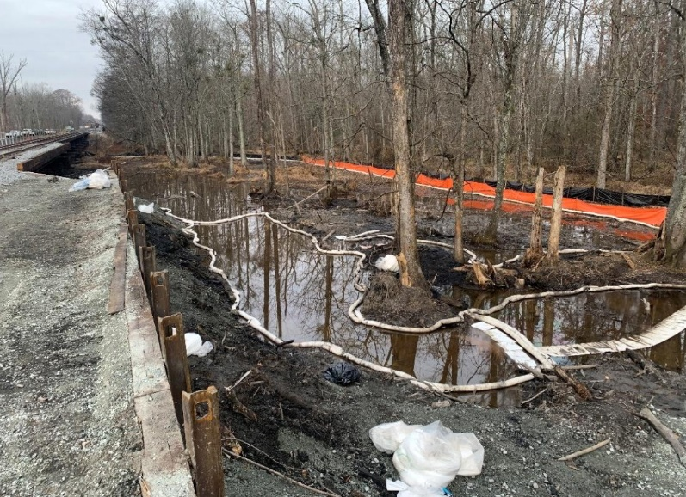
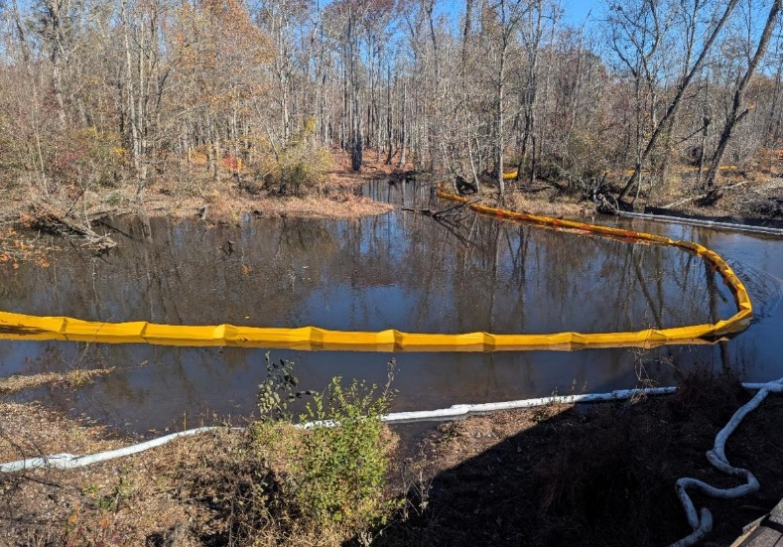

Containment
Silt Fencing
Booms
Turbidity Curtains
Intercept and contain sediment from disturbed ground to prevent it from leaving site
Hard boom:
Containment measure utilized in areas with concentrated flow where silt fence is unsuitable
Absorbent Boom: Containment and recovery measure used to attract and hold petroleum while repelling water
Temporary floating barrier designed to contain suspended particles in waterways

Slide 37
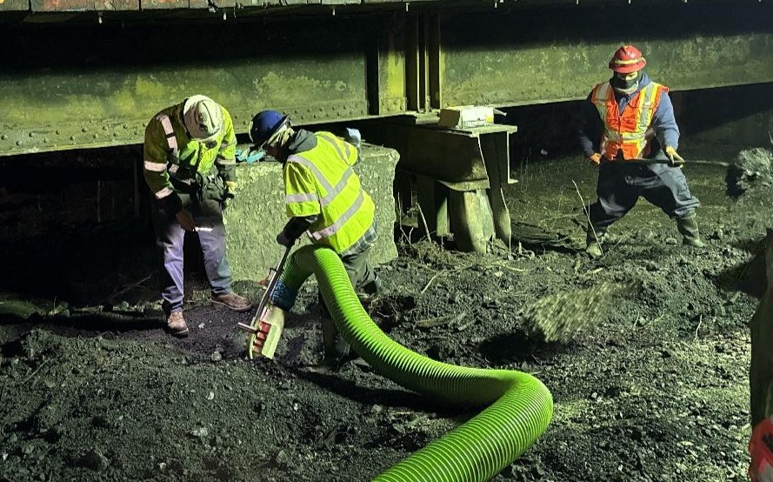
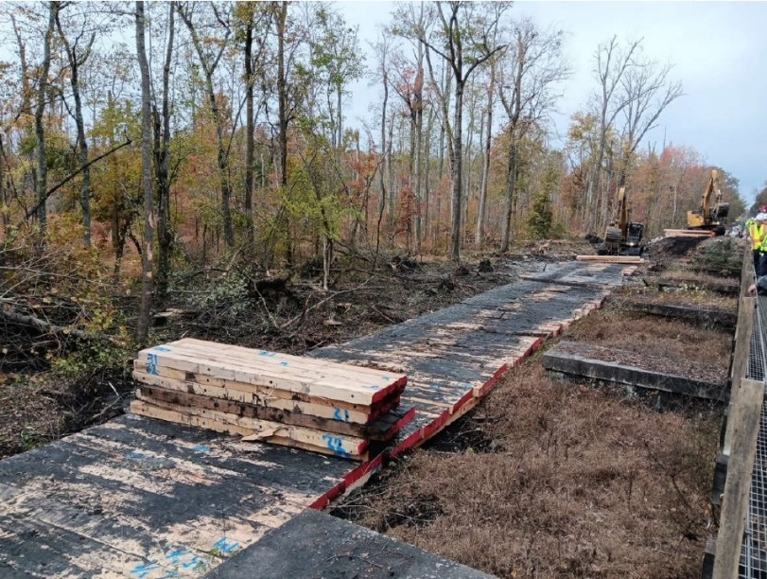
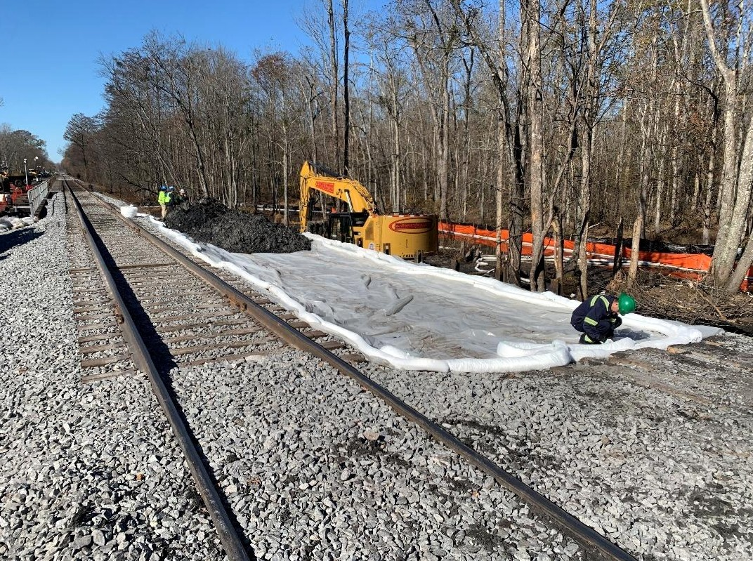
Recovery
Coal lading was excavated with heavy equipment following installation of timber mats and new access roadway
Vacuum Truck
Excavation
Diesel and coal were removed via vacuum truck

Slide 38
Waste Stream Management

Slide 39
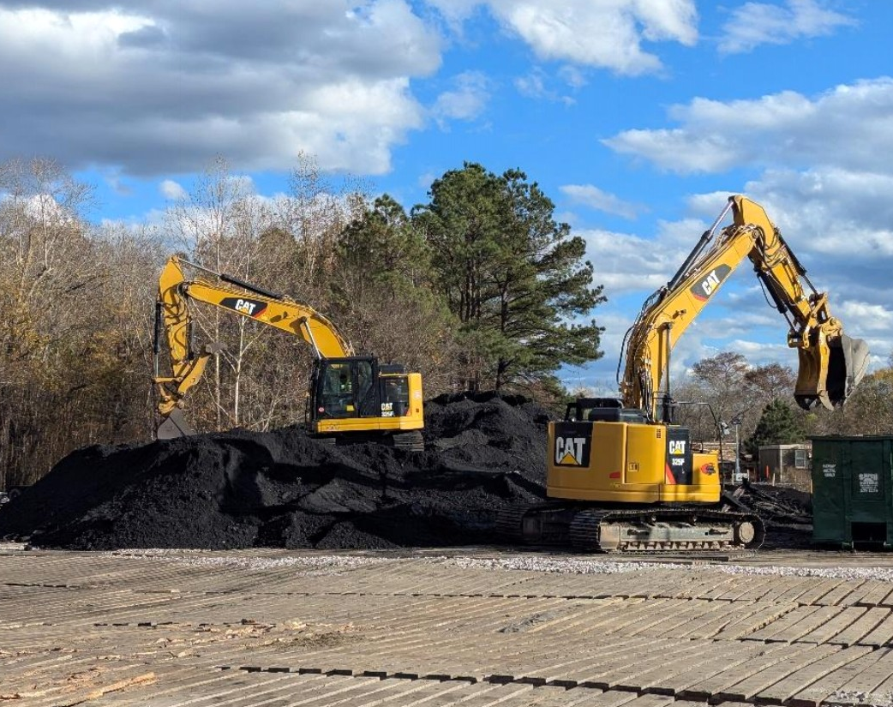
Waste Streams
Waste Streams
Coal for beneficial reuse
Diesel and water mixture
Diesel-impacted solids
Deceased aquatic and terrestrial animals
Scrap metal
Diesel-impacted absorbents
Vegetation and wood
General trash (non-impacted)

Slide 40

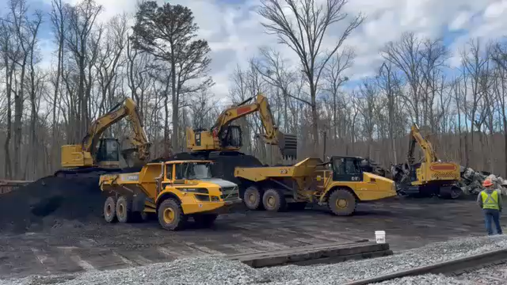
Waste Tracking
November 11, 2025
Staging and load out of coal, metal, and debris

Slide 41
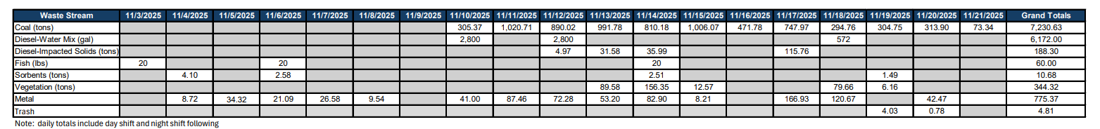
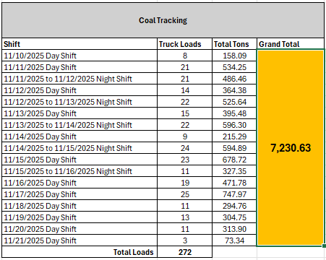
Waste Tracking
November 14, 2025
Staging and containment of diesel-impacted material
Coal lading spilled: 4,230 tons
Coal and adjacent sediment recovered: 7,230.63 tons
272 Total Loads of Coal Transported

Slide 42
Surface Water Monitoring

Slide 43
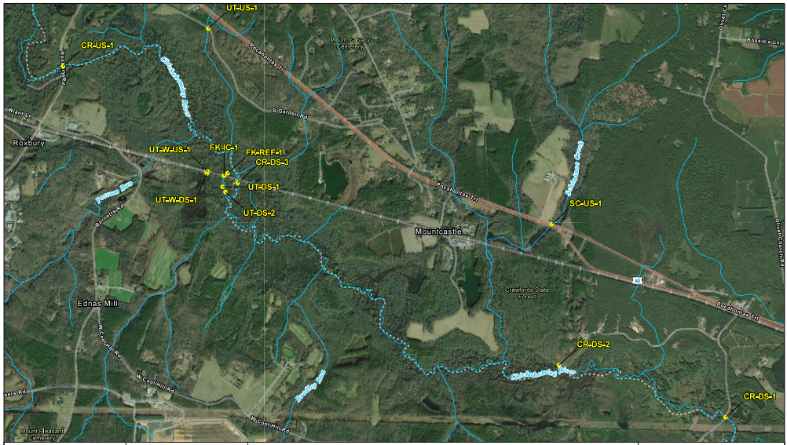

Monitoring Locations
Chickahominy River Watershed
Five upstream locations
Seven downstream locations
Incident Location

Slide 44
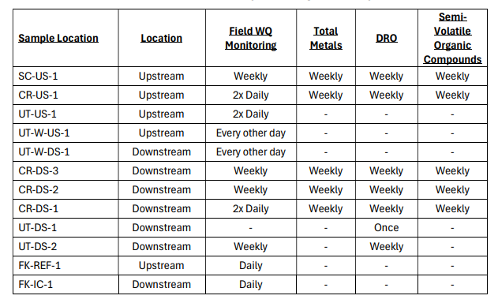
Monitoring Frequency
Surface Water Monitoring Plan
November 7, 2025

Slide 45
Surface Water Monitoring Data Collection
Water Quality Monitoring
Analytical Laboratory Data
DAILY
Temperature
Dissolved Oxygen
Specific Conductivity
pH
Turbidity
WEEKLY
Diesel-Range Organics (DRO by Method 8015D)
Total Recoverable Metals (Method 200.8)
Semi-volatile Organic Compounds (SVOCs by Method 8270)

Slide 46

Surface Water Analytical Data Highlights
November 12, 2025
DRO was not detected at any sampling location
Arsenic detected between laboratory detection limit and method reporting limit in two samples with a maximum concentration of 0.99 J micrograms per liter (ug/L)
Lead and chromium detected between laboratory detection limit and method reporting limit in one downstream sample at concentrations of 0.64 J ug/L and 3.0 J ug/L, respectively
Three SVOCs detected in one downstream sample

Slide 47
ICS Recordkeeping

Slide 48
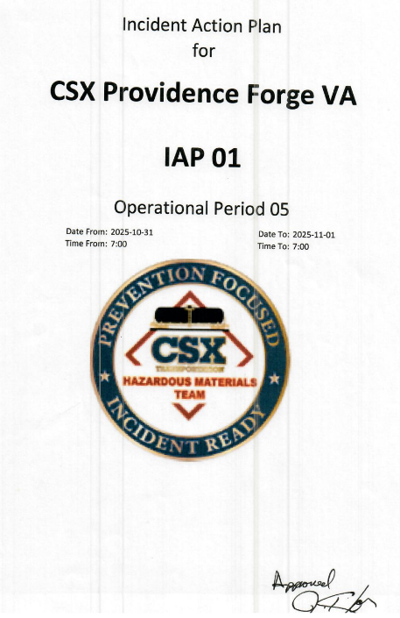
ICS Recordkeeping
Incident Action Plans (IAPs)
ICS Resource Tracking
Structured document that outlines the objectives, strategies, procedures, and organization for daily incident activities
22 IAPs prepared for Operational Periods 5 through 27
Signed by Incident Commander and stored in hardcopy and electronically
Daily contractor headcounts for day and night shifts including off-site office support staff
Contractor equipment mobilization dates, authorizations, and demobilization dates
Non-consumable supplies
Visitor Log

Slide 49
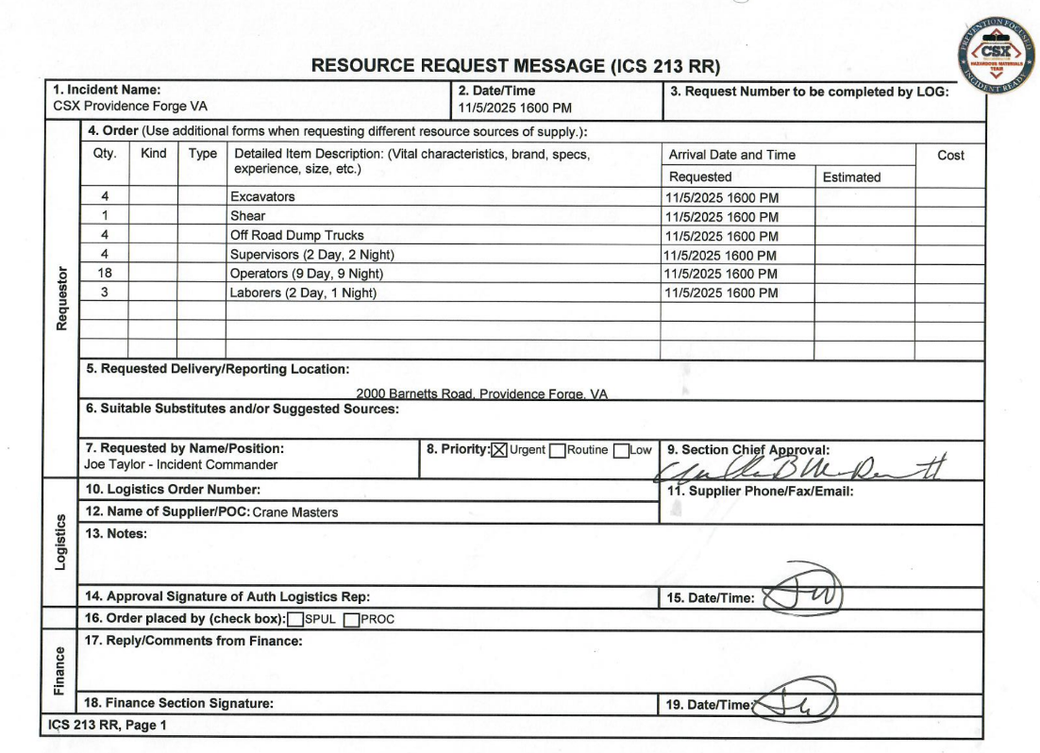
ICS 213: Resource Requests
Resource
Arrival Date
Quantity
Requestor
Priority
Authorization
Authorization
Authorization

Slide 50
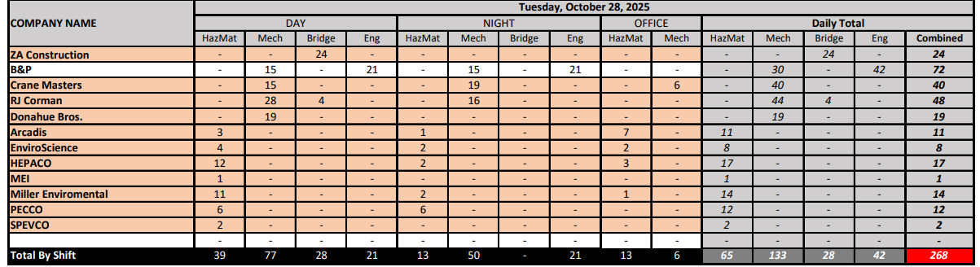

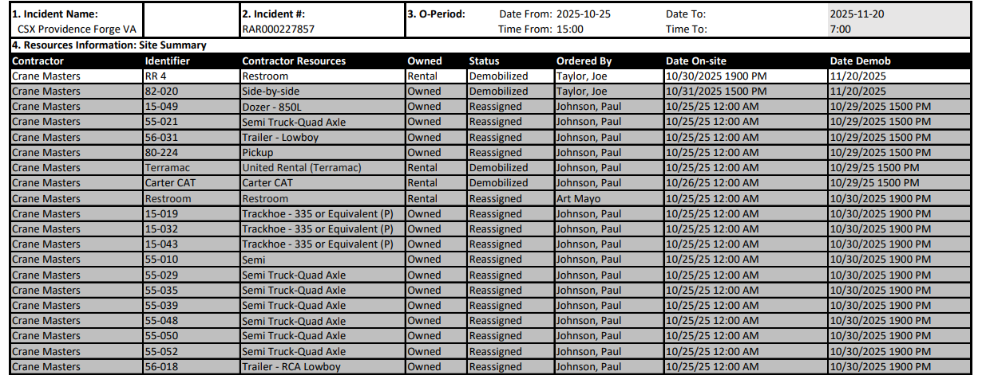

ICS 218: Resource Inventory
Daily Headcount
Equipment

Slide 51
Stakeholders

Slide 52
Summary

Slide 53
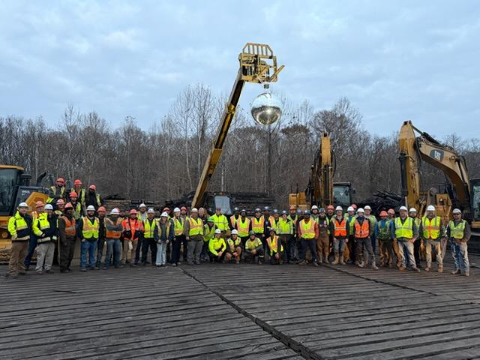
Summary
Incident Day Count: 29
Well-organized ICS command structure
Exceptional leadership by CSX Hazmat
Clear and consistent communication
Safety first
Effective planning, tracking, and resource allocations
Successful collaboration with partners, regulators, and stakeholders
Smooth transition for transfer of command
Thirteen contractors and approximately 300 individuals worked as one team

Slide 55
Joseph L. Taylor
Director Hazardous Materials
500 water street, j-275
Jacksonville, fl 32202
757-710-4650 phone joe_taylor@csx.com
1-800-232-0144 csx public safety coordination center

