Slide 1
Providence Forge Train Derailment
October 25, 2025
Elizabeth “Beth” Lohman, Manager
Office of Pollution Response & Emergency Preparedness
Virginia Department of Environmental Quality

Slide 2
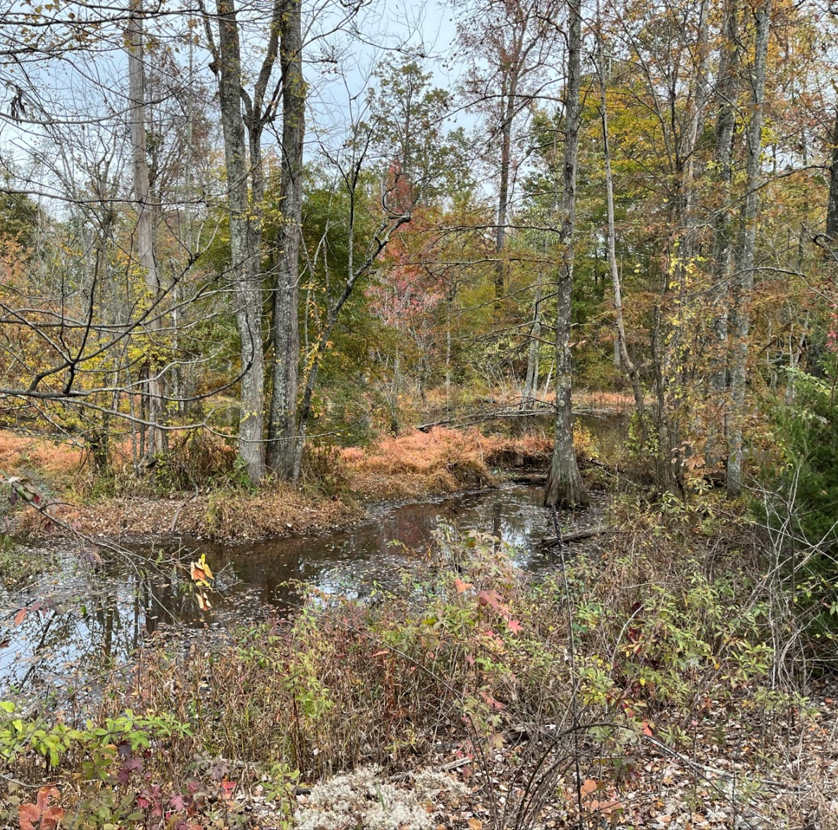
Chickahominy River
The lower Chickahominy watershed is recognized for harboring some of the most biologically diverse and ecologically significant areas in the Coastal Zone of Virginia. (DCR)
Significant natural communities that are rare, high-quality, or ecologically important groupings of plants, animals, and their environment (not found elsewhere).
Cypress is one of the keystone species in this area (e.g., flood control, shade, spawning grounds around roots)

Slide 3
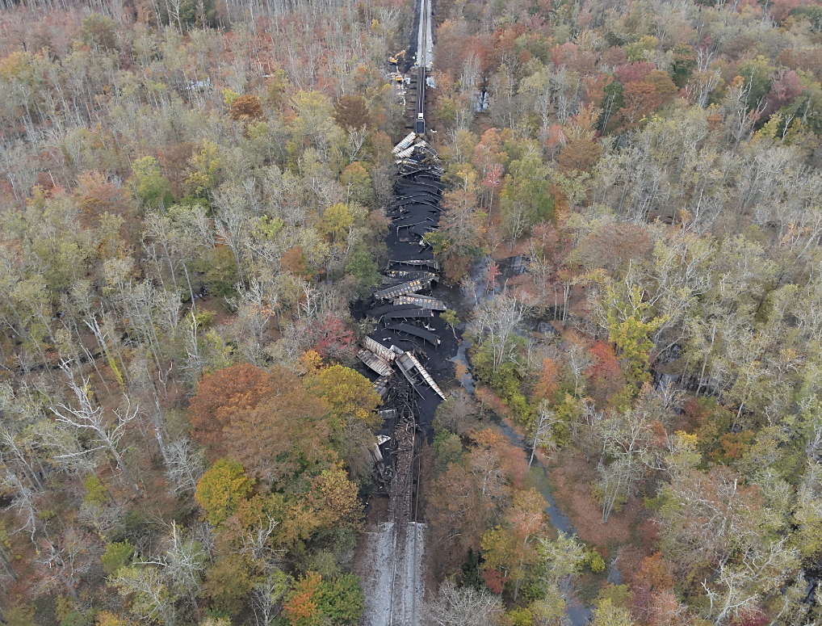
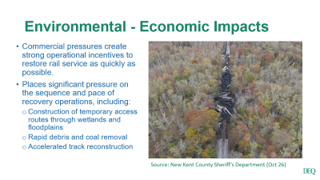
Environmental - Economic Impacts
Commercial pressures create strong operational incentives to restore rail service as quickly as possible.
Places significant pressure on the sequence and pace of recovery operations, including:
  Construction of temporary access routes through wetlands and floodplains
  Rapid debris and coal removal
  Accelerated track reconstruction
Source: New Kent County Sheriff’s Department (Oct 26)

Slide 4
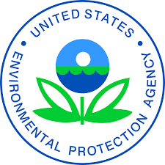

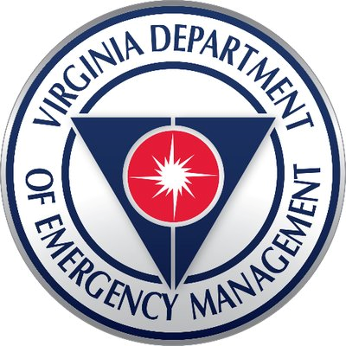
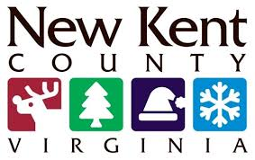
Unified Command
(Environmental)
Natural & Cultural Resource Trustees
Public Utility Operators
Private Land- Owners
Non-Governmental Organizations
(early)

Slide 5
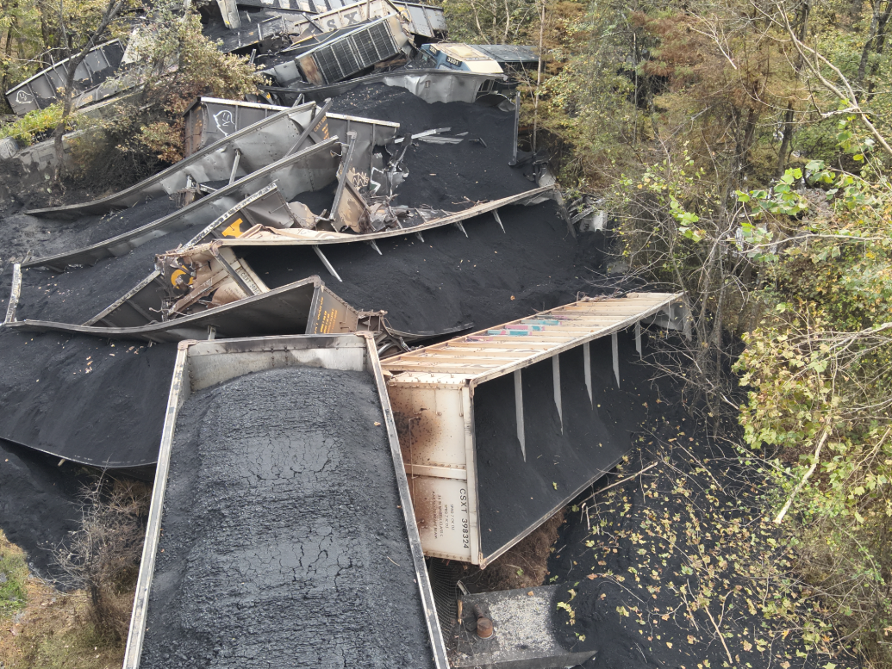
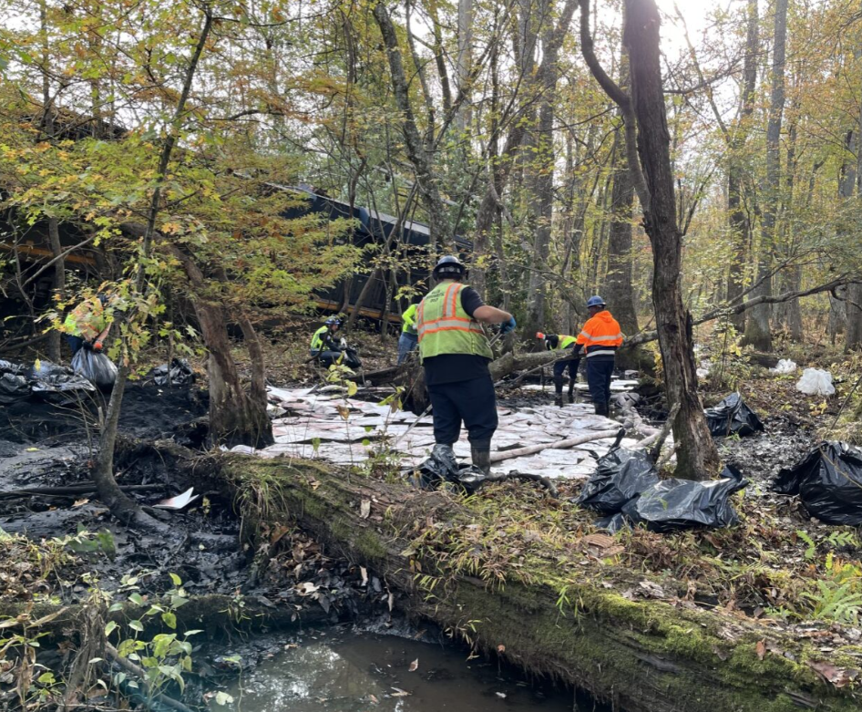
Environmental Decision-Making
Daily Tempo: October 25 – November 20
Morning
EPA/DEQ Site Inspection
Noon
CSX SitRep (previous 24 hours)
DEQ SitRep (different tempo for land-owners, NGOs)
Afternoon
Federal-State Partners Call
UC Call

Slide 6
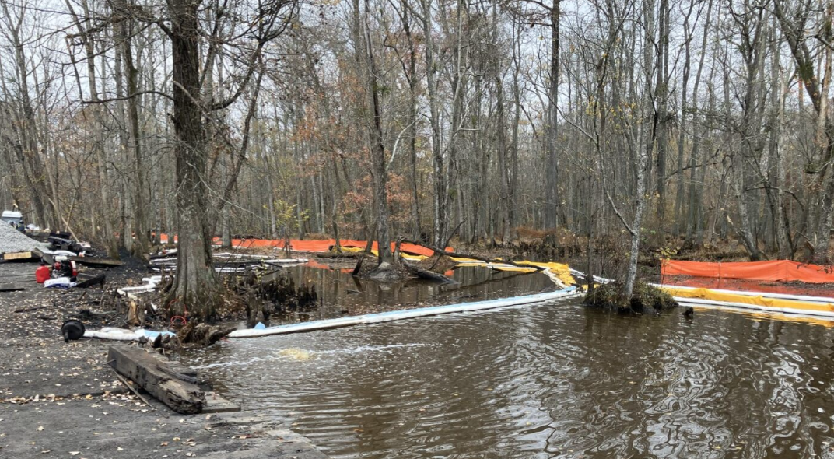
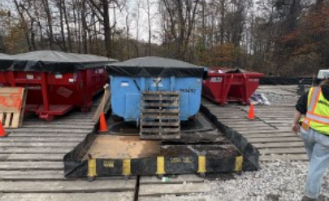
Plans
Specific Plans
  Protective Measures & Maintenance
  Sampling & Analysis
  Waste Removal and Management
  Corrective Action (Restoration) Plan (still under review, not final)
Trustees and public utility operator provided technical feedback to UC
Final versions of the plans were signed off by the UC members

Slide 7
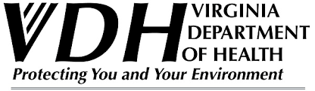

Public Utility
Source water area for public water utility
Initially concerned about:
  Monitoring locations (pH, DO, conductivity, turbidity)
  Sampling locations
  Parameters (DRO, SVOCs, and metals)

Slide 8
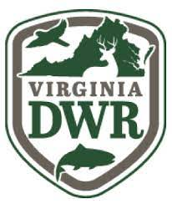



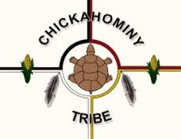
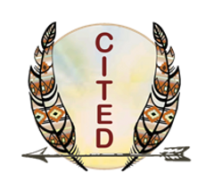

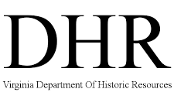
Trustees

Slide 9
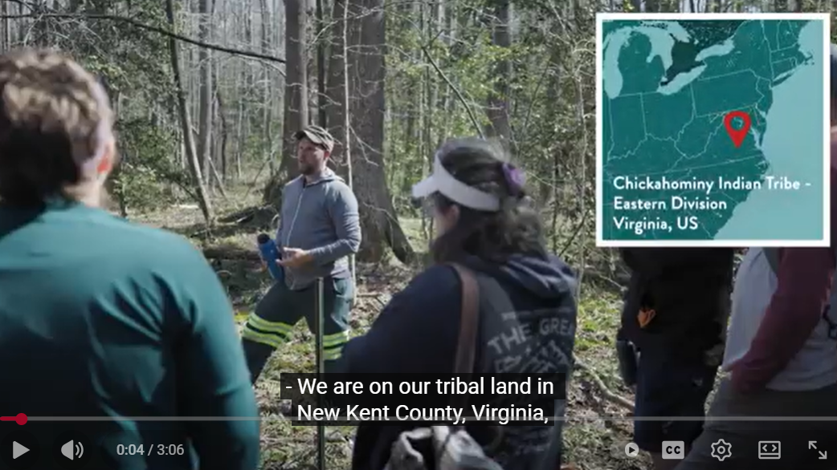
Tribal Interests
Chickahominy Tribe and Eastern Chickahominy are federally recognized
Historical connection & identity (farming, hunting, spiritual)
Environmental stewardship and preservation
Cultural sites and artifacts
Feedback on various plans
National Historic Preservation Act (Section 106 consultation)
Image Source: Land Needs Guardians. Chickahominy Tribe -- Eastern Division's Food Forest: Restoring Food Systems and Cultural Knowledge. August 2025.

Slide 10
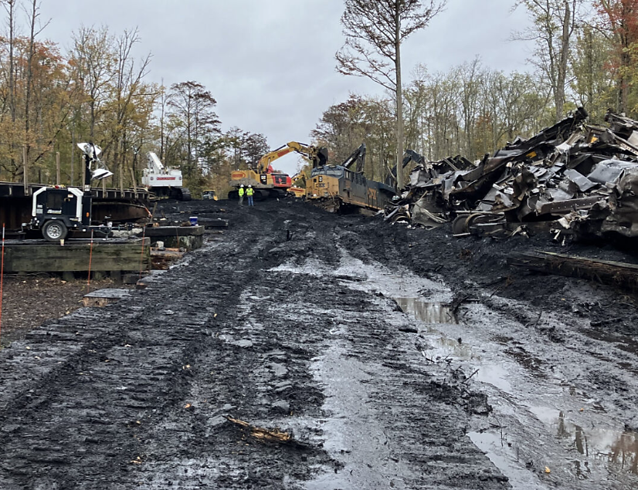
Land-Owner and NGO Interests
Restoration of property/ wetland ecosystem
Downstream impacts to Lower Chickahominy and James River
Provided “executive-level” briefings to LO/NGOs
Met in-person or spoke by phone regularly

Slide 11
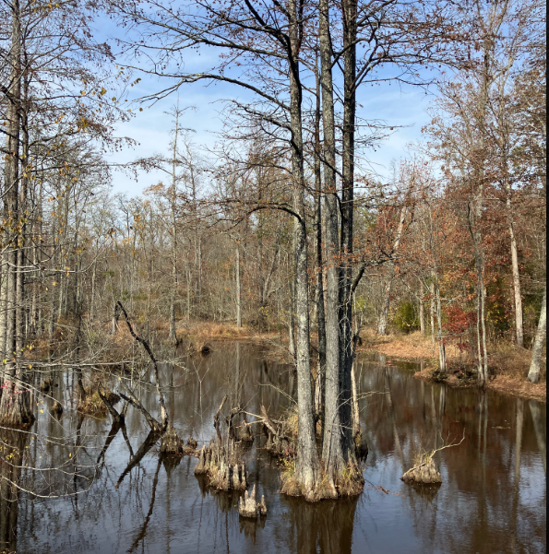
Cooperative Response
Access to work zones for inspection
Responsive to requests for field adjustments and plan changes
Open and continuous communications between CSX (and its contractors), DEQ, and EPA
Impacts limited to less than five acres
No downstream impacts to critical infrastructure
Restoration work will continue under DEQ’s Virginia Water Protection (VWP) Program and USACE

