Slide 1
May 2024

Slide 2
USCG Delaware Bay, FOSC Report – May 2024
F/V SUSAN ROSE initially grounded on 17 Nov at Point Pleasant, NJ. Vessel sank during salvage operations. Administrative Order still in effect. Salvage delayed due to Baltimore response. Approx. 100 gal of oil and marine batteries aboard.
Delaware City Refinery discharge from their secondary containment area into the Delaware River. Fourth offense in 12 months.
F/V SUSAN ROSE: Prior to salvage operations, removal of all oil was requested. Ensure that OSRO understands that all oil products and HAZMAT are to be removed before salvage.
Harbor Fire/Oil Response Exercise, Atlantic City, NJ 30th April 2024.
Spill of National Significance Engagement 9 May 2024.
Two Unannounced Exercises at Cape May – Lewes Ferry on 13th Dec 2024 & Paulsboro Refinery, Paulsboro, NJ on 28th of Mar 2024.
SDB Area Contingency Plan 5-year review currently underway for CG National Review Panel in Aug 2024.
LCDR Kevin Higgins, Incident Management Division (IMD) Chief departing in June.
LT Samantha Watson oncoming IMD Chief.
LT Mariclair Mims Deputy IMD.

Slide 3
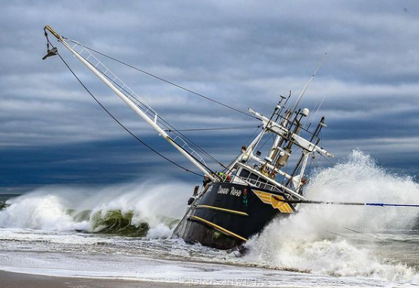
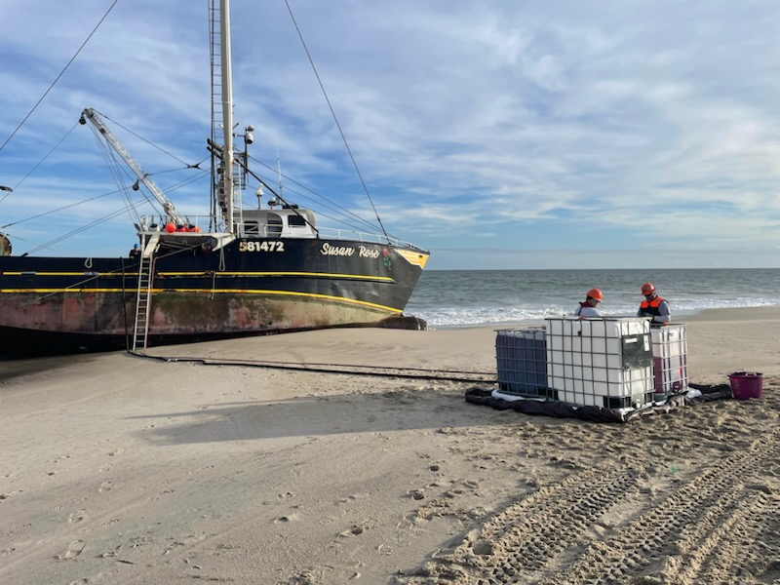
USCG Delaware Bay, FOSC Report – May 2024
F/V SUSAN ROSE oil removal operations.

Slide 4
USCG Maryland-NCR, FOSC Report – May 2024
Vessel Fire in Anchorage Marina, Baltimore – 31 Jan
  Approximately 200 gal of diesel into Patapsco River
  Great coordination between Owner, Baltimore PD, Baltimore FD, MDE, MNRP, USCG, and Tow Boat
Francis Scott Key Bridge collapse, M/V DALI grounding
  ~1.5 mil gal of mixed oil threat potential
  14 HAZMAT containers, bow thruster, and 80 oil drums crushed/damaged resulting in discharge with 3,250 ft of containment boom around vessel
Best Practices
  UAS used to monitor M/V DALI sheen and effectiveness of containment boom with live video feed to ICP
  Utilized emergency ESA consultation for Key Bridge Response, received Best Management Practices for response actions
Challenge
  Coast Guard UAS experiencing numerous equipment failures outside of warranty window
18 January: GIUE 01/04 completed at Kinder Morgan Liquid Terminal
21 March: NCR Water Supply TTX
23-25 April: 03 Mbrs-SCAT Training hosted by D5 DRAT and NOAA
30 April: GIUE 02/04 completed at Sunoco Andrews
02 May: 02 Mbrs attended Norfolk Southern Train 101
25 June: Sector Change of Command
  New FOSC - CAPT Patrick Burkett

Slide 5
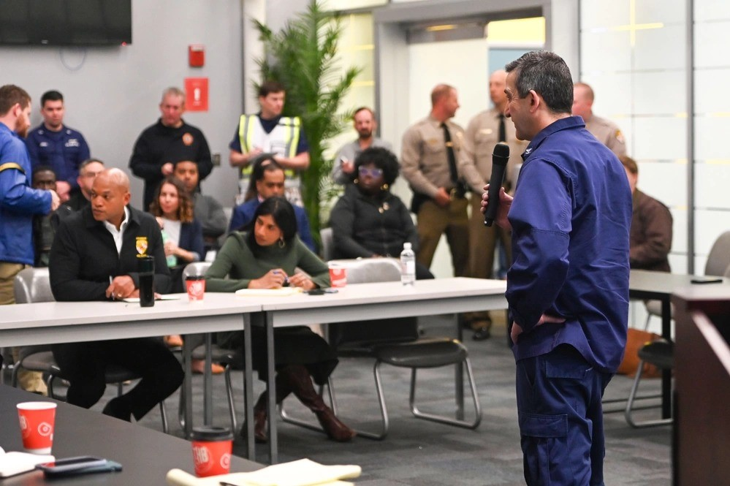
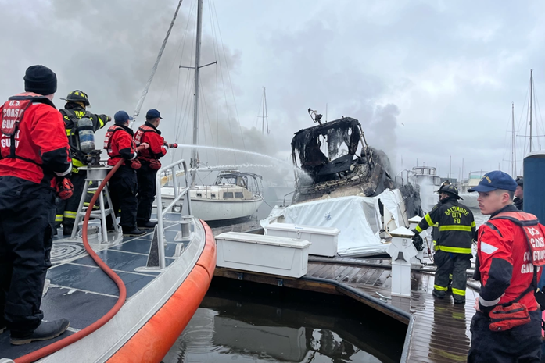
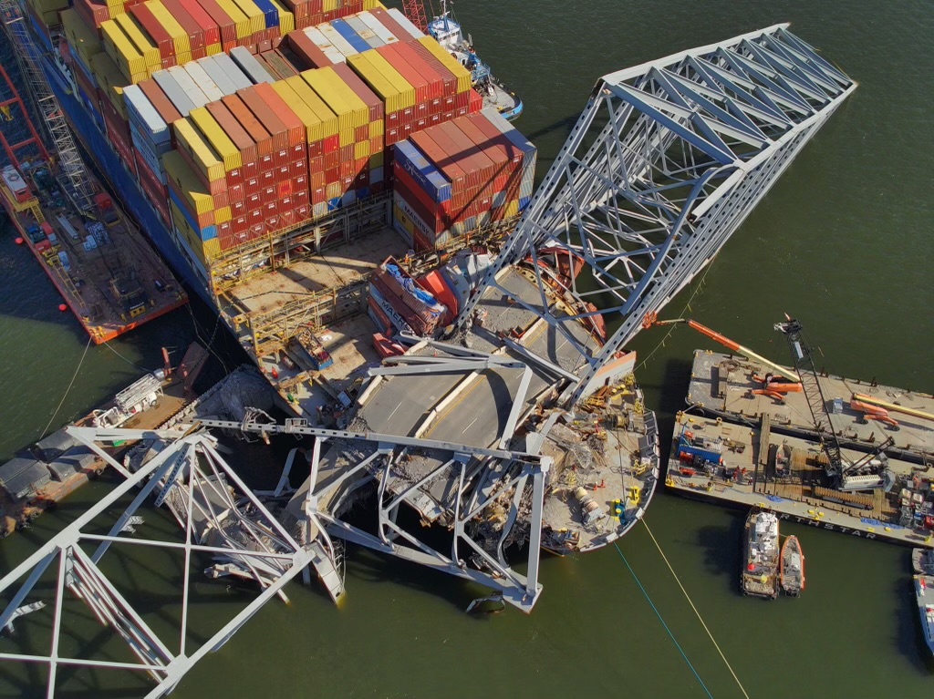
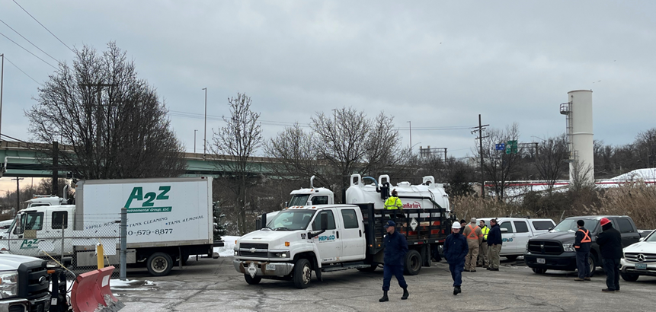
USCG Maryland-NCR, FOSC Report – May 2024

Slide 6
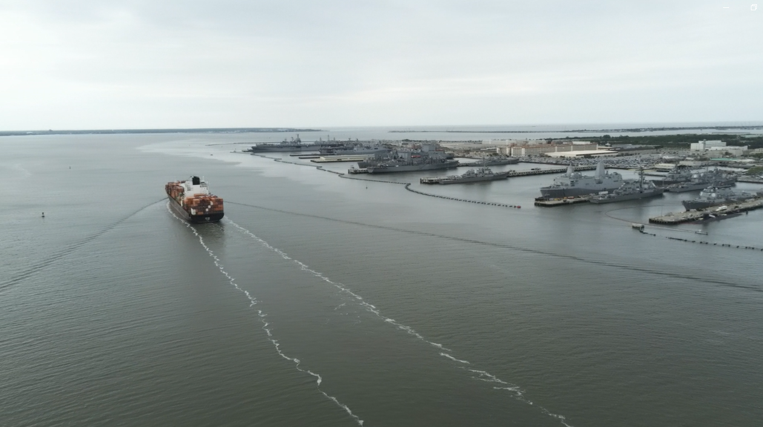
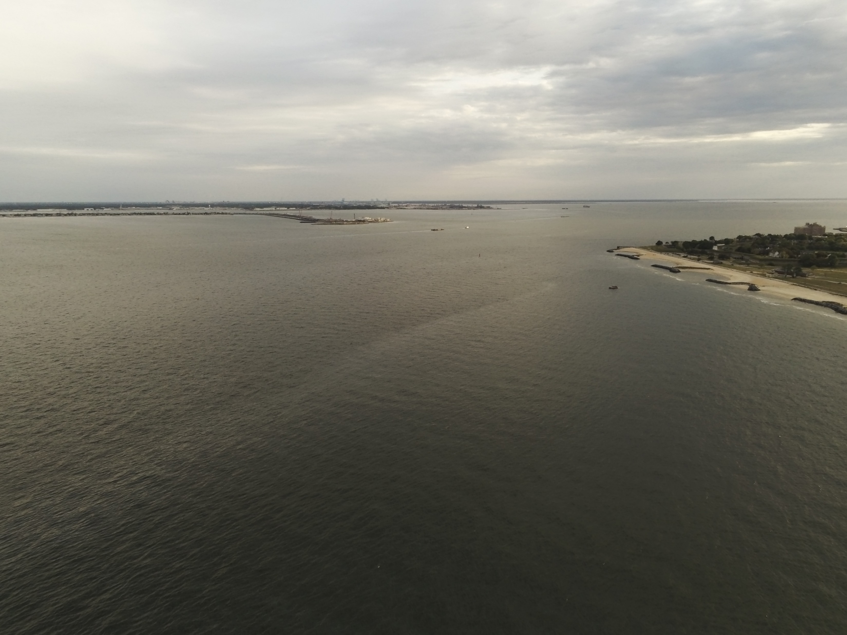
USCG Virginia, FOSC Report – May 2024
The National Strike Force Coordination Center (NSFCC) and Atlantic Strike Team (AST) provided a capabilities brief and static display for Area Committee familiarization.
Coastal Virginia Offshore Wind – on-water construction begins May 2024.
  Oil Spill Response Plan Review
Use of UAS in spill response (see pictures)
27APR / 29APR: Oily Water Waste (OWW) Spills at Naval Station Norfolk
Sector VA responded to NAVSTA Norfolk for two incidents of OWW discharge from the installed pier system.
Each incident involved an estimated 5,000-10,000 gallons of OWW.
The 27APR incident impacted the Elizabeth River (7.5 NM sheen from a breach at the end of the pier).
Sector VA worked with NAVSTA Norfolk to effect cleanups.
USCG involved field resources: RB-M, MH-60, UAS Drone Team, and Pollution Response Team.
15 DEC: PREP Notification Exercise
19-21 FEB: ICS DIVS Course
13 MAR: General Dynamics/ NASSCO Navy Full Scale Exercise
18-21 MAR: Virginia Emergency Management Symposium
21 MAR: GIUE
25-29 MAR: Oil Spill Control Course
31 MAR: PREP Notification Exercise
17 APR: VDEM Federal Partners Day
22-25 APR: Shoreline Cleanup Assessment Techniques Course
27 JUN: Sector Virginia Change of Command: Captain Peggy Britton will assume command of Sector Virginia.
New Deputy Sector Commander: Captain Aaron Demo.
08 JUL: New Chief of Response, CDR Holly Deal reporting.
Notes:
Photos 1 & 2 – Images taken from Sector Virginia UAS Drone team. Image 1 is of Southern end of Naval Station Norfolk looking North. Image 2 is of Fort Monroe looking South.

Slide 7
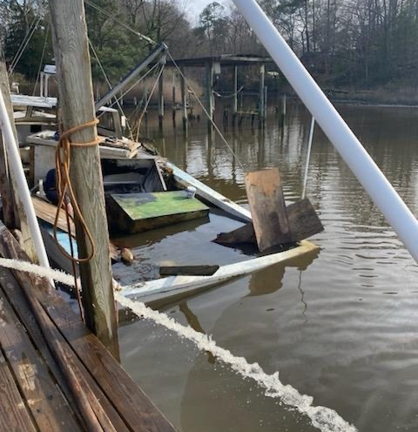
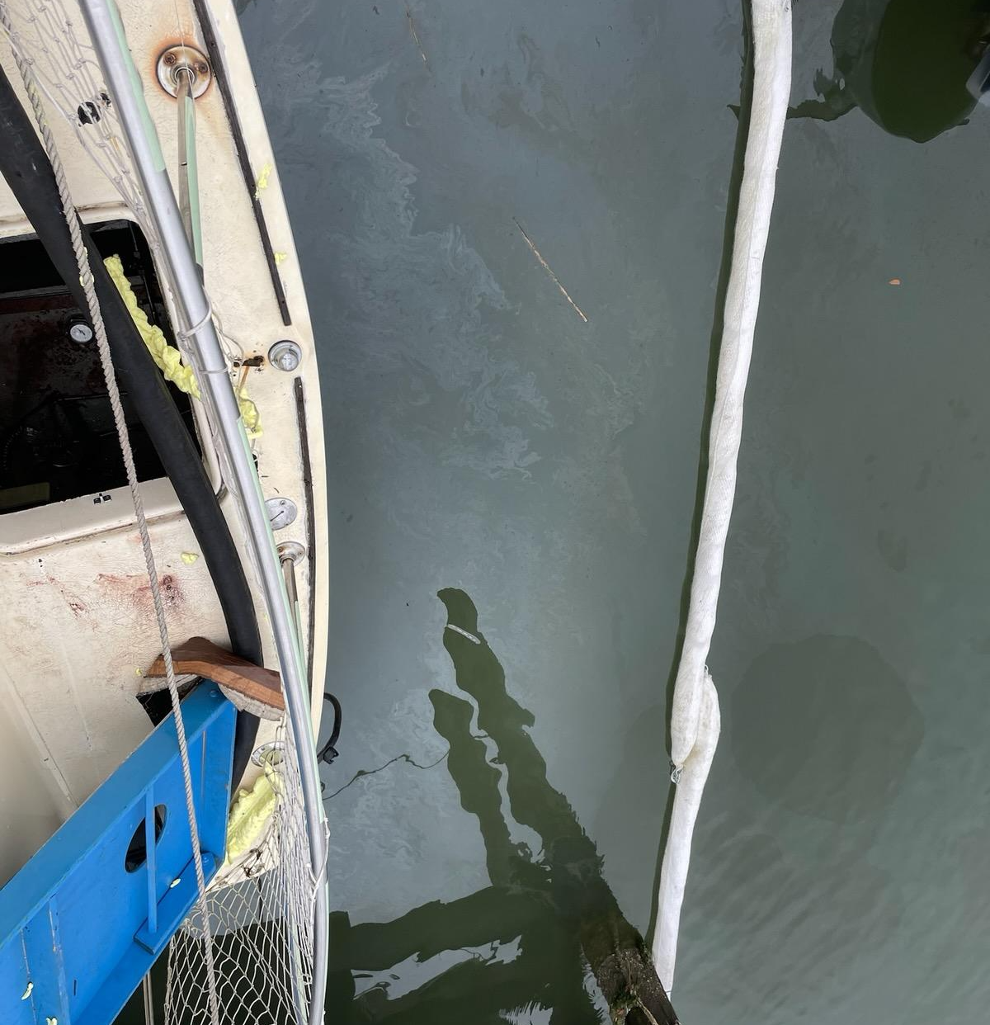
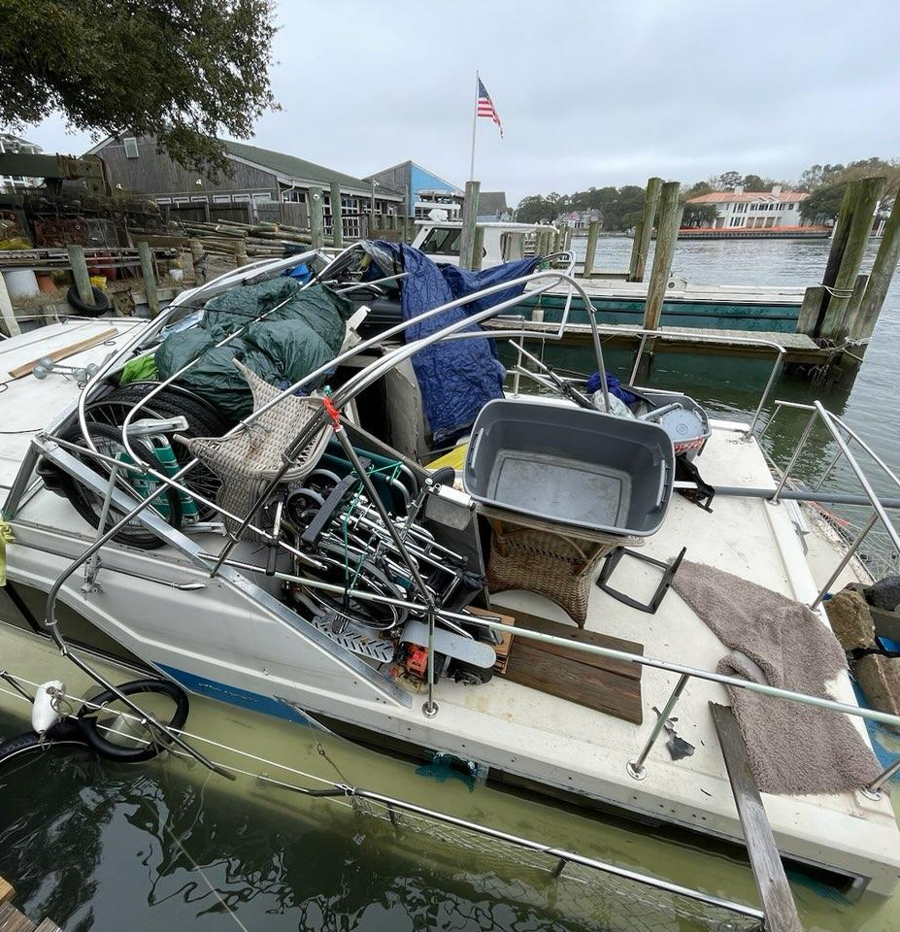
USCG Virginia, FOSC Report – May 2024
Notes:
Photo 1 – Image of a 28ft crab boat that sunk due to a compromised hull. Approximately 15 gallons of diesel discharged. Owner was able to reclaim the vessel utilizing dewatering pumps.
Photos 2 & 3 – Images of recent federalized project in March 2024 involving a sunken 36ft chris craft actively discharging pollution and the owner was non-responsive. Federalized project removed 75 gallons of gasoline prior to causing further impact to the Lynnhaven River.

Slide 8
USCG Eastern Great Lakes FOSC Report – May 2024
Wellesley Island Home Heating Oil Discharge - January 28
  Wellesley Island, NY; private residence; no. 2 fuel oil discharged thru drainage ditch into Saint Lawrence River
  Max potential: 275 gallons || Actual discharged: 25 gallons
  Deployed UAS for aerial observation
M/V CUYAHOGA Fire - March 15
  Vessel caught on fire during maintenance period at Port of Ashtabula, OH
  Max potential: 135 metric tons of fuel onboard || 430,000 gallons of contaminated firefighting water onboard || Actual discharged: 0 gallons
N/A
National Workshop for developing GRS
COE 12050 Sector EGL Maritime Disruption 2024 (will have an element of oil spill response/prevention)
  July 15-16 Fort Drum, NY
COE 12051 Sector EGL GRS Validation Drill (likely in conjunction with above MTS Exercise)
COE 12049 WNY ACP Drill (another verification drill)
  September 12-13
MSU Thousand Islands commissioned on 23 April (Fort Drum, NY) [Formerly MSD Thousand Islands]
New AOR boundary for MSU Thousand Islands February 24
Notes:
Wellesley Island NRC #1390177
M/V CUYAHOGA NRC #1393976

Slide 9
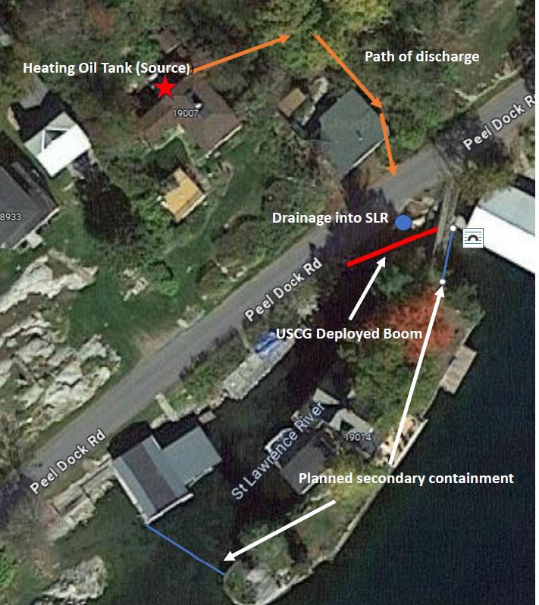
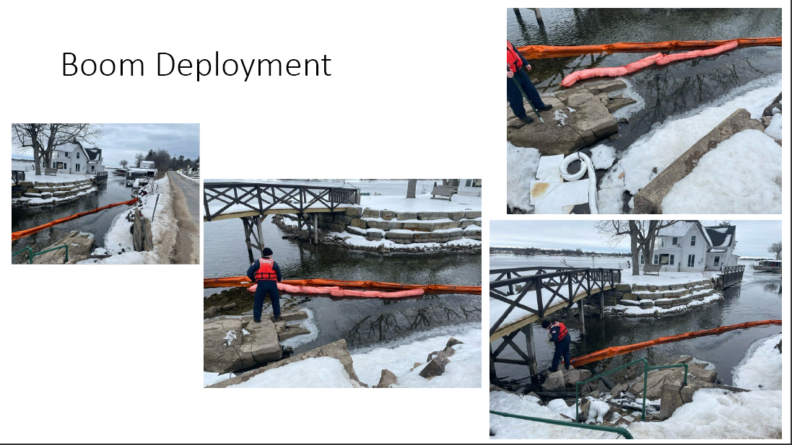
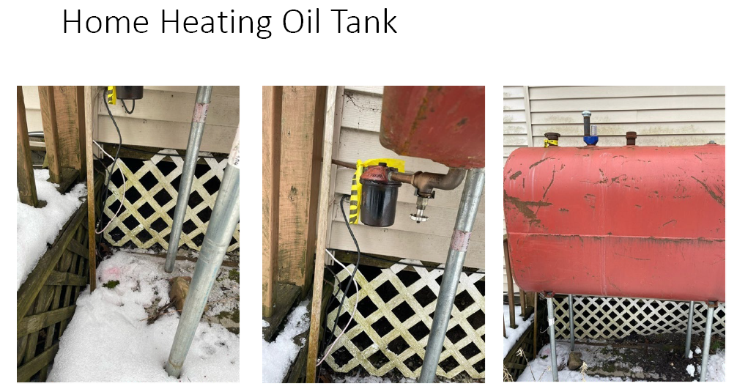
USCG Eastern Great Lakes FOSC Report – May 2024

Slide 10
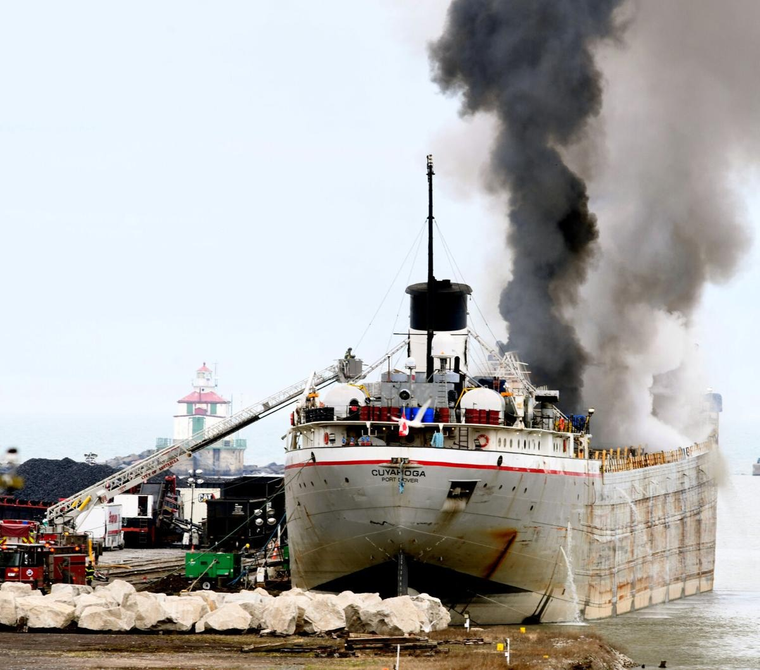
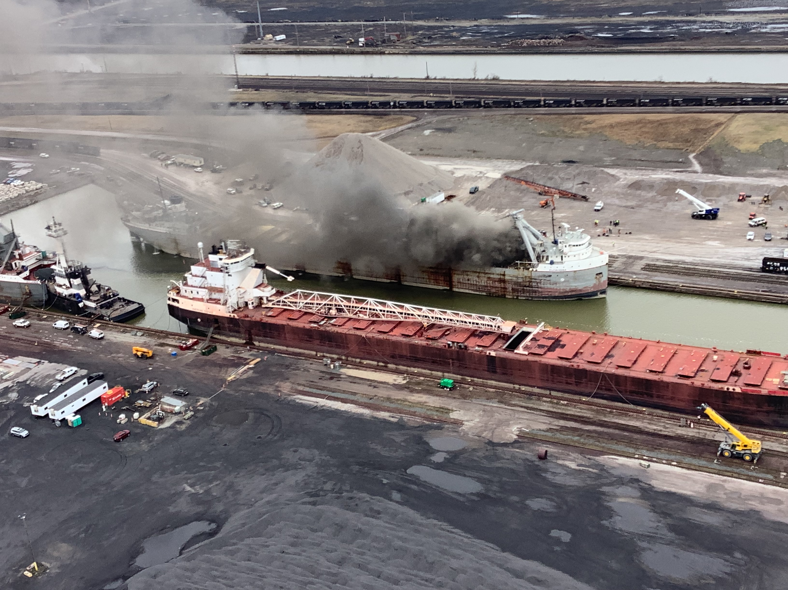
USCG Eastern Great Lakes FOSC Report – May 2024

Slide 11
USCG North Carolina, FOSC Report – May 2024
Period of Report: December 1, 2023-April 18, 2024
NRC REPORTS – 91 (43 Wilm, 36 FM, 12 NH)
LETTERS OF WARNING – 7 (3 Wilm, 3 FM, 1 NH)
FEDERALIZED CASES – 7 (4 Wilm, 1 FM, 2 NH)
NOTICE OF VIOLATION – 4 (2 Wilm, 1 FM, 1 NH)
CRIMINAL CASES – 0
Coordination with USCG Civil Engineering Unit Cleveland, US Army Corps of Engineers, and National Park Service along with State and Local partners on Buxton, NC, shoreline contamination from former Navy and Coast Guard facility.
ESF-10 TTX – Leland, NC – May 22nd
NSTR

Slide 12
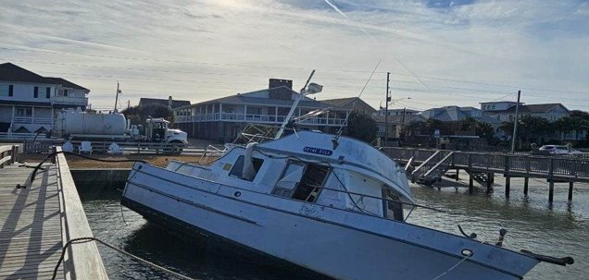
USCG North Carolina, FOSC Report – May 2024

Slide 13
USCG MSU Pittsburgh, FOSC Report – May 2024
26 March 2024 – M/V Catlettsburg – Reported discharge of oil (<5 gal) into Ohio River; oil came from vessel’s engine exhaust stacks.
Investigation prompted Inspection Activity resulting in 04 deficiencies, including a “Prior to Movement” deficiency due to engine oil leaking into and blowing out of the exhaust stacks.
12 April 2024 – Barge Breakaway – 26 Barges broke free from their moorings during a high-water event from Campbell Transportation Company’s fleeting area located on the Ohio River. No barges contained hazardous cargo - extent of the breakaway caused damage to neighboring marinas. Barges lodged themselves against Emsworth & Dashields L/D, and one barge sank in the Dashields pool at MM 7.5 of the Ohio River. CTC and River Salvage utilized ICS and local resources to recover barges that caused a navigation hazard, in a timely manner and mitigated impact to vessel traffic. At this time the only barge remaining unrecovered is on Dashields L/D. OGAs involved included ACOE’s Diving Supervisor for oversight & approval of all dive plans. CG MSU Pittsburgh reviewed/approved salvage plans & maintained oversight; WWM ensured safety of all vessel traffic.
BP – Utilizing multiple personnel from varying specialties prompts decisive action, presents a uniform expectation of mariners and their Companies, effectively resolving and ultimately preventing discharges of oil into the Western Rivers.
Feb. 13th - Three Rivers Pollution Response Council (TRPRC) Meeting – 50 member companies providing mutual aid for response to pollution incidents
Mar. 1st – Hosted MSU Pittsburgh’s 2nd Annual Industry Day at Allegheny Co. EOC
ICS – various training for multiple members, including MTSL3, DIVS and OSC3
GIUEs – 1 executed since last RRT meeting; satisfactory completion
April 26th - MSU held Change of Command Ceremony and retirement of CDR Eric Velez; Executive Officer CDR Justin Jolley relieved CDR Velez as Commanding Officer.
Personnel departing: Incoming Personnel:
New XO: LCDR M. Zanella
PDH - LT S. Dolan LT G. Amores
IMD Chief – MSTC K. Schneider MSTC J. Belcher
FOSC-R – MST1 R. Gowing MST1 O. Blackledge

Slide 14
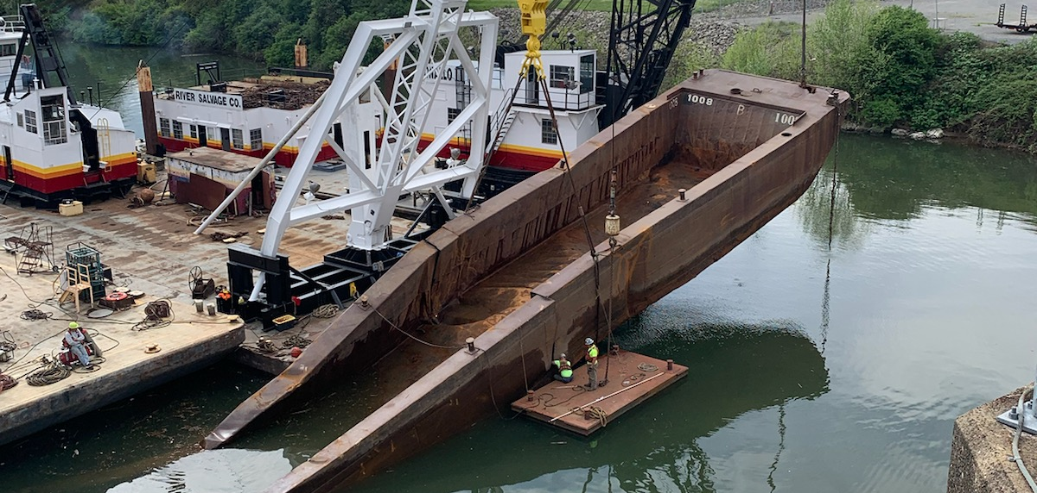
USCG MSU Pittsburgh, FOSC Report – May 2024

Slide 15
USCG Marine Safety Unit Huntington – May 2024
On February 10th the inspected towing vessel (ITV) TOM FRAZIER allided with a submerged concrete boat ramp pier at mile marker 355.1 of the Ohio River (near Portsmouth, OH) and vessel began taking on water. The crew abandoned ship and the vessel remained hard around on the concrete pier when response actions began. The vessel discharged approximately 10 gallons of lube oil from the bilge. The engine room was pumped out after divers sealed an open vent fan hatch. Approximately 72,000 gallons of fuel was lightered from the vessel, and it was towed to a shipyard.
Excellent response from port partners (local fire / police departments, EPA) including evacuation of crew from ITV
The responsible party (RP) hesitated to contact the oil spill removal organization (OSRO) for the initial response because the vessel was not actively polluting. After discussing the issue with Marine Safety Unit (MSU) Huntington, the RP had their OSRO on scene the next day.
The salvor listed in the vessel response plan was not the salvor used by the RP, causing confusion and additional tasking to determine why this occurred.
West Virginia American Waters exercise (Nov. 2023)
Sector Ohio Valley led an ICS exercise at Marine Safety Unit (MSU) Huntington (Dec. 2023)
MSU Huntington personnel attended an ICS exercise at Sector Ohio Valley (Jan. 2024)
The entire Ohio Valley region had high-water in early / mid-April, leading due an uptick in marine casualties and local training in our Waterways Action Plan.
Our Commanding Officer, Commander (CDR) William Albright, will be relieved by CDR Christopher Weiser this June.
Due to staffing shortages throughout the Coast Guard, all personnel stationed at our boathouse, Detached Duty Huntington, have been reassigned to other areas along with the small response boats.

Slide 16
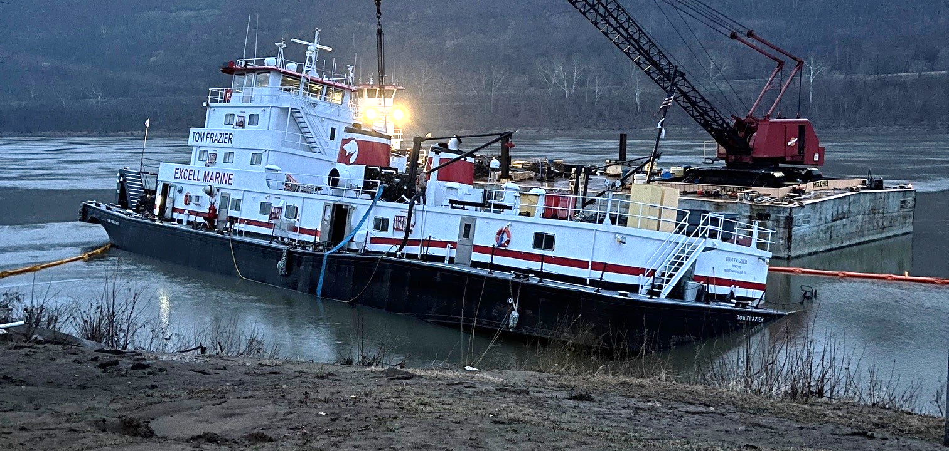
USCG Marine Safety Unit Huntington – May 2024

Slide 17
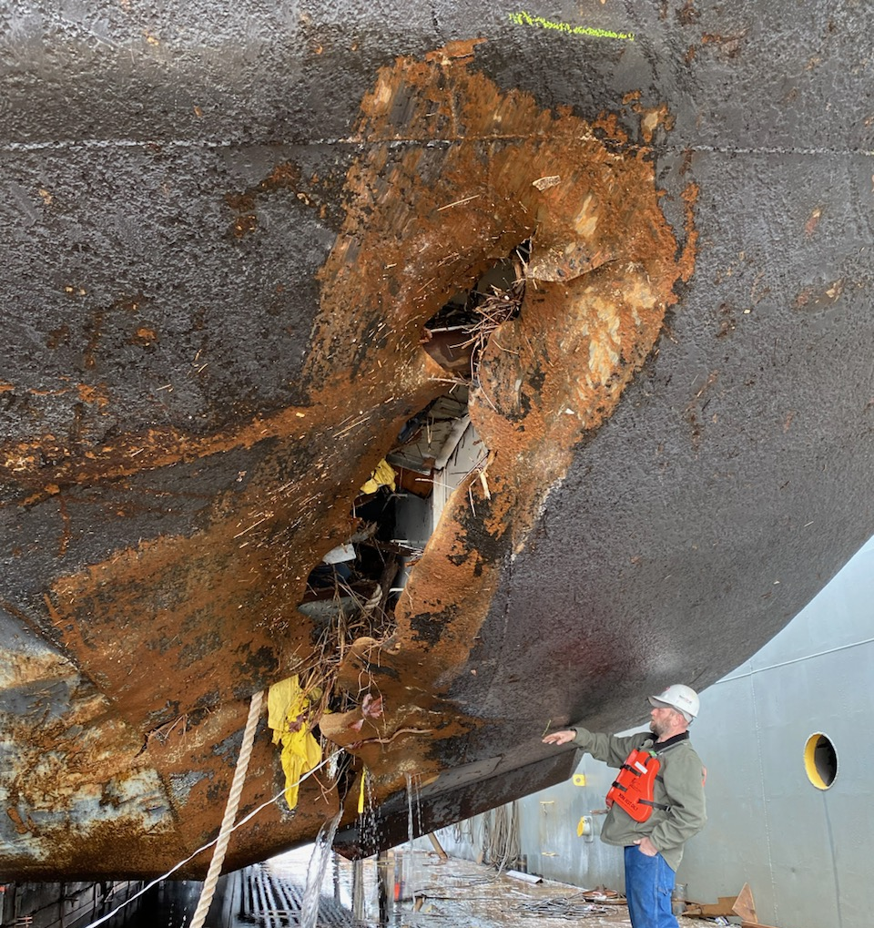
USCG Marine Safety Unit Huntington – May 2024
Pictured: ITV TOM FRAZIER starboard void
An initial damage assessment discovered that the forward void and engine room was flooded and there was no damage to fuel tanks. The engine room flooded because of progressive flooding through the open vent fan hatch. The OSRO pumped out the engine room after the vent fan hatch was closed by a dive team.

Slide 18
USCG North Carolina, FOSC Report – May 2024
Period of Report: December 1, 2023-April 18, 2024
NRC REPORTS – 91 (43 Wilm, 36 FM, 12 NH)
LETTERS OF WARNING – 7 (3 Wilm, 3 FM, 1 NH)
FEDERALIZED CASES – 7 (4 Wilm, 1 FM, 2 NH)
NOTICE OF VIOLATION – 4 (2 Wilm, 1 FM, 1 NH)
CRIMINAL CASES – 0
Coordination with USCG Civil Engineering Unit Cleveland, US Army Corps of Engineers, and National Park Service along with State and Local partners on Buxton, NC, shoreline contamination from former Navy and Coast Guard facility
ESF-10 TTX – Leland, NC – May 22nd
NSTR

Slide 19
USCG North Carolina, FOSC Report – May 2024

