Slide 1
May 2024

Slide 2
PA, SOSC Report – May 2024
Home Heating Oil release in Sullivan County
Norfolk Southern Derailment into Lehigh River in Northampton County
N/A
Peach Bottom Hostile Action Drill – Nuclear Rad Response – April 16
ESF 10 – Workshop / tabletop – November 29
Brian Feist – PEMA Tech Hazards Director

Slide 3
Virginia, SOSC Report – May 2024
Gasoline Discharge – Colonial Pipeline
  Remington, Fauquier County
Westover Dairy Milk Discharge
  City of Lynchburg
Red Mulch Dye Spill
  City of Norfolk
Jet Fuel Tanker Spill – Fort Belvoir
  Fairfax, VA
Gasoline Release from UST
  South Hill, VA
Virginia Partners in Response Conference and Workshop
  Kingsmill Resort Williamsburg, VA
  May 21-22, 2024
John Giese
  Transitioned to Director
New Office of Pollution Response and Emergency Preparedness Manager will be incoming

Slide 4
Virginia (DEM), SOSC Report – May 2024
22 MAR 2024 Mecklenburg County
Gasoline leak from a 20,000 gallon underground storage tank migrated into nearby businesses, residential dwellings and sewer system.
Evacuations: 35 businesses, 10 single-family dwellings, 1 apartment complex
Requested EPA assistance due to on-going hazardous conditions
Agencies: DEM, DEQ, VSP, USEPA, Town of South Hill
Challenge: working with RP (representative) who is not on-site.
Lessons learned: communication means the right message reaching the right person or people.
6-7 MAY 2024
Completed state VESTEx functional exercise involving topical weather with inland impacts
21-22 MAY 2024
Partners in Response (Colonial Pipeline)
17-20 SEPT 2024
Virginia Hazardous Materials Conference
Nothing to report.

Slide 5
West Virginia, SOSC Report – May 2024
Water Base adhesive Non TOX / impacted WV, and VA waters. No fish kill. Coordinated with VA DEQ
4 Mercury cleanups throughout WV. All sites cleaned up to EPA standards
Fire Fighting Foam Incident, Under investigation
2-Substantial Crude oil spills
Buckhannon Petroleum Contamination, FOSC Coordination Weekly meetings Kevin Clark
CSX Train Derailment, near miss
Nitro WV, MDI tanker valve resulted in 5K gallons on ground
Environmental Remediation company capabilities. Getting better but still a challenge.
Thank you to Geoff Donahue with MDE, his quick reaction and willingness to respond to a WV train derailment and provide the initial size-up. This is great example of how the RRT system works.
No Report
RCRA
Beaver Valley Nuclear Power Plant Readiness Exercise

Slide 6
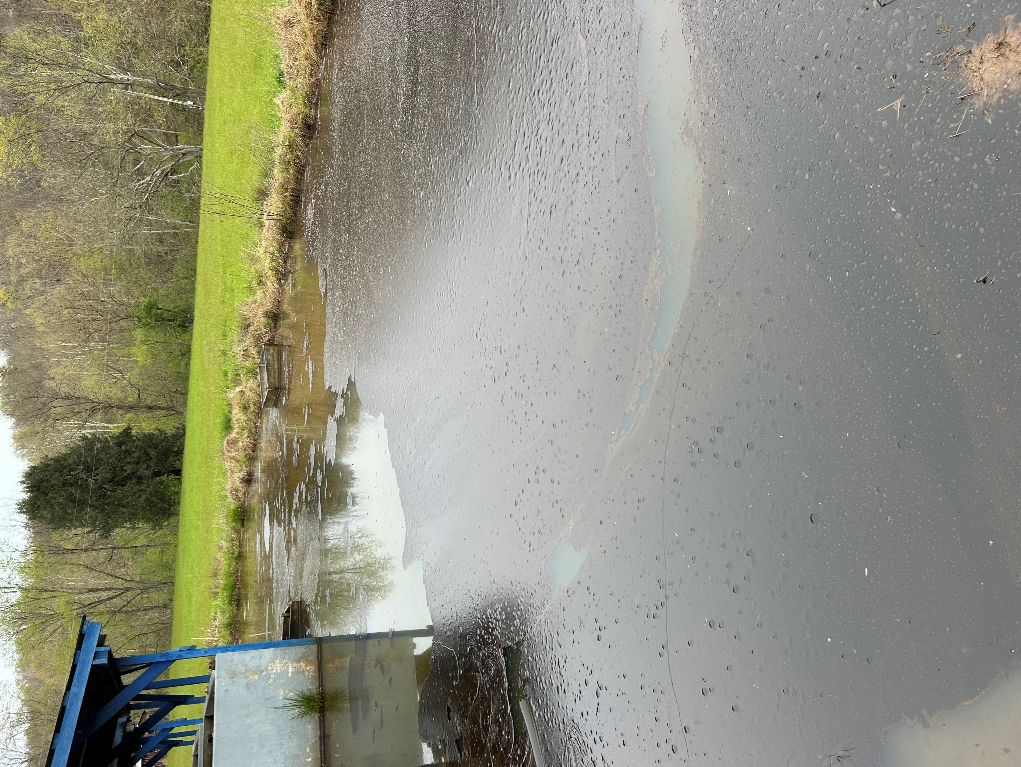
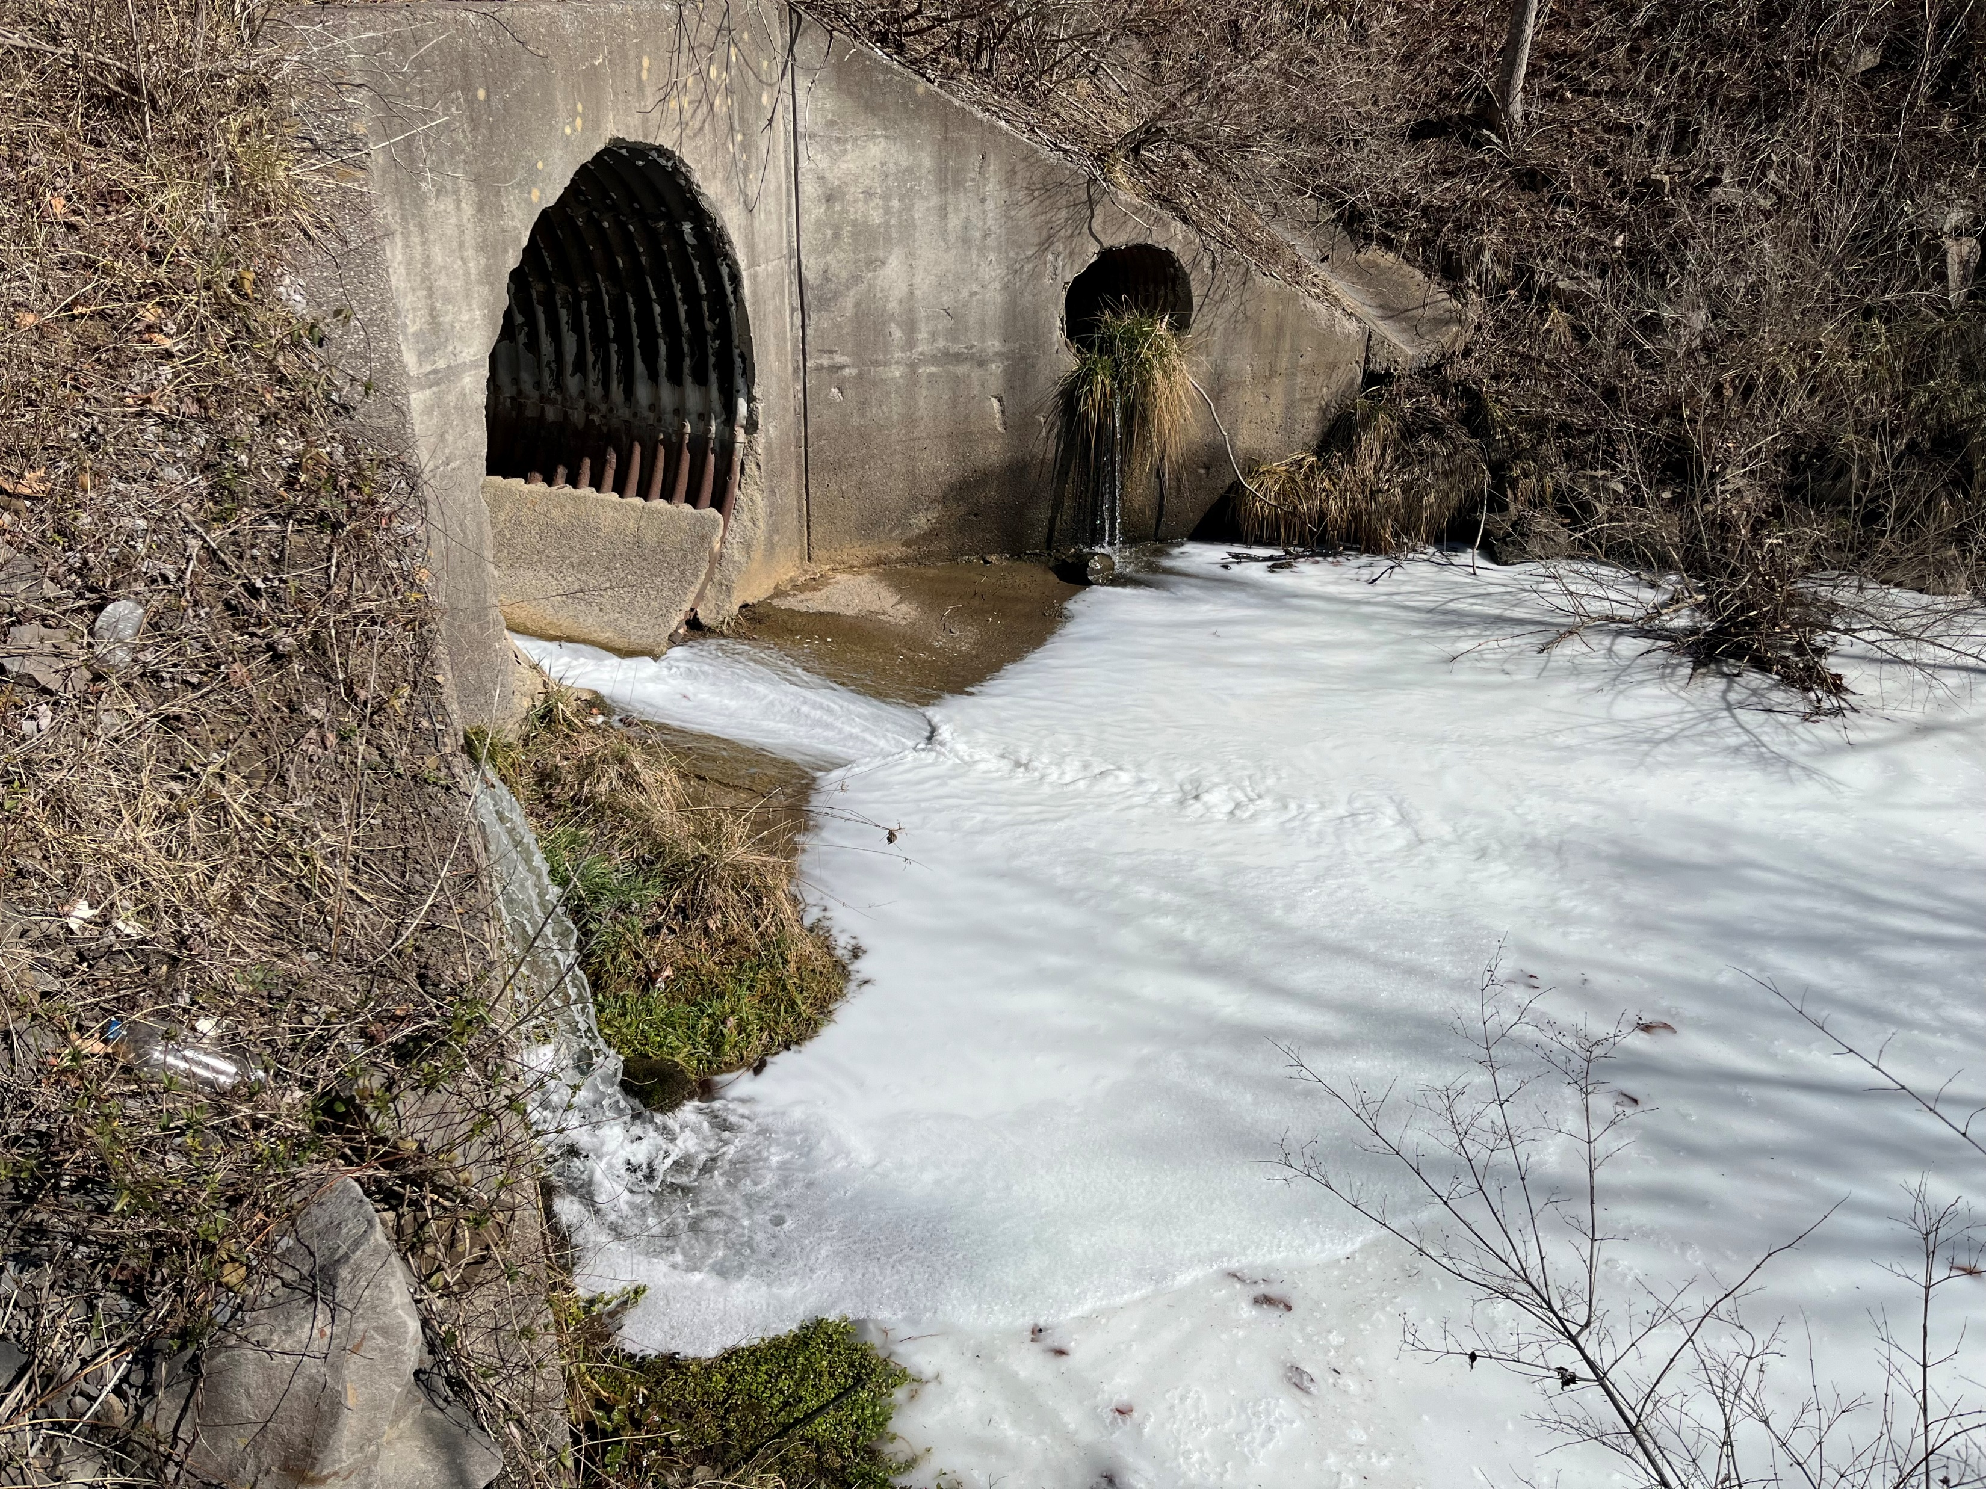
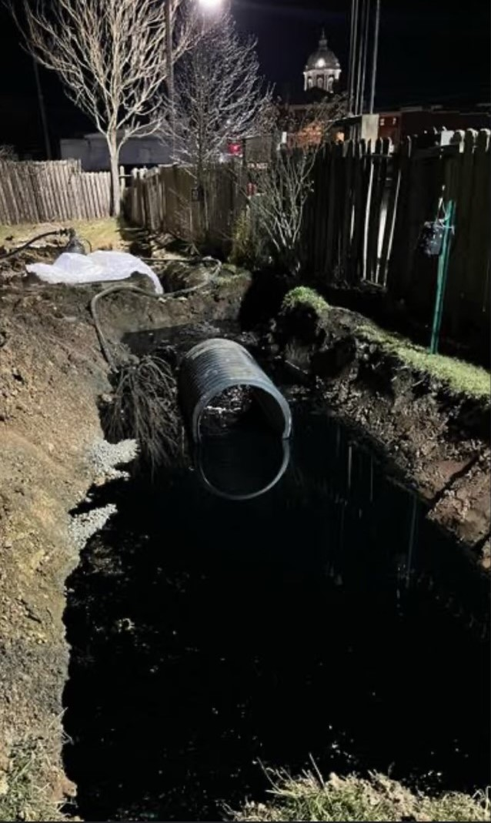
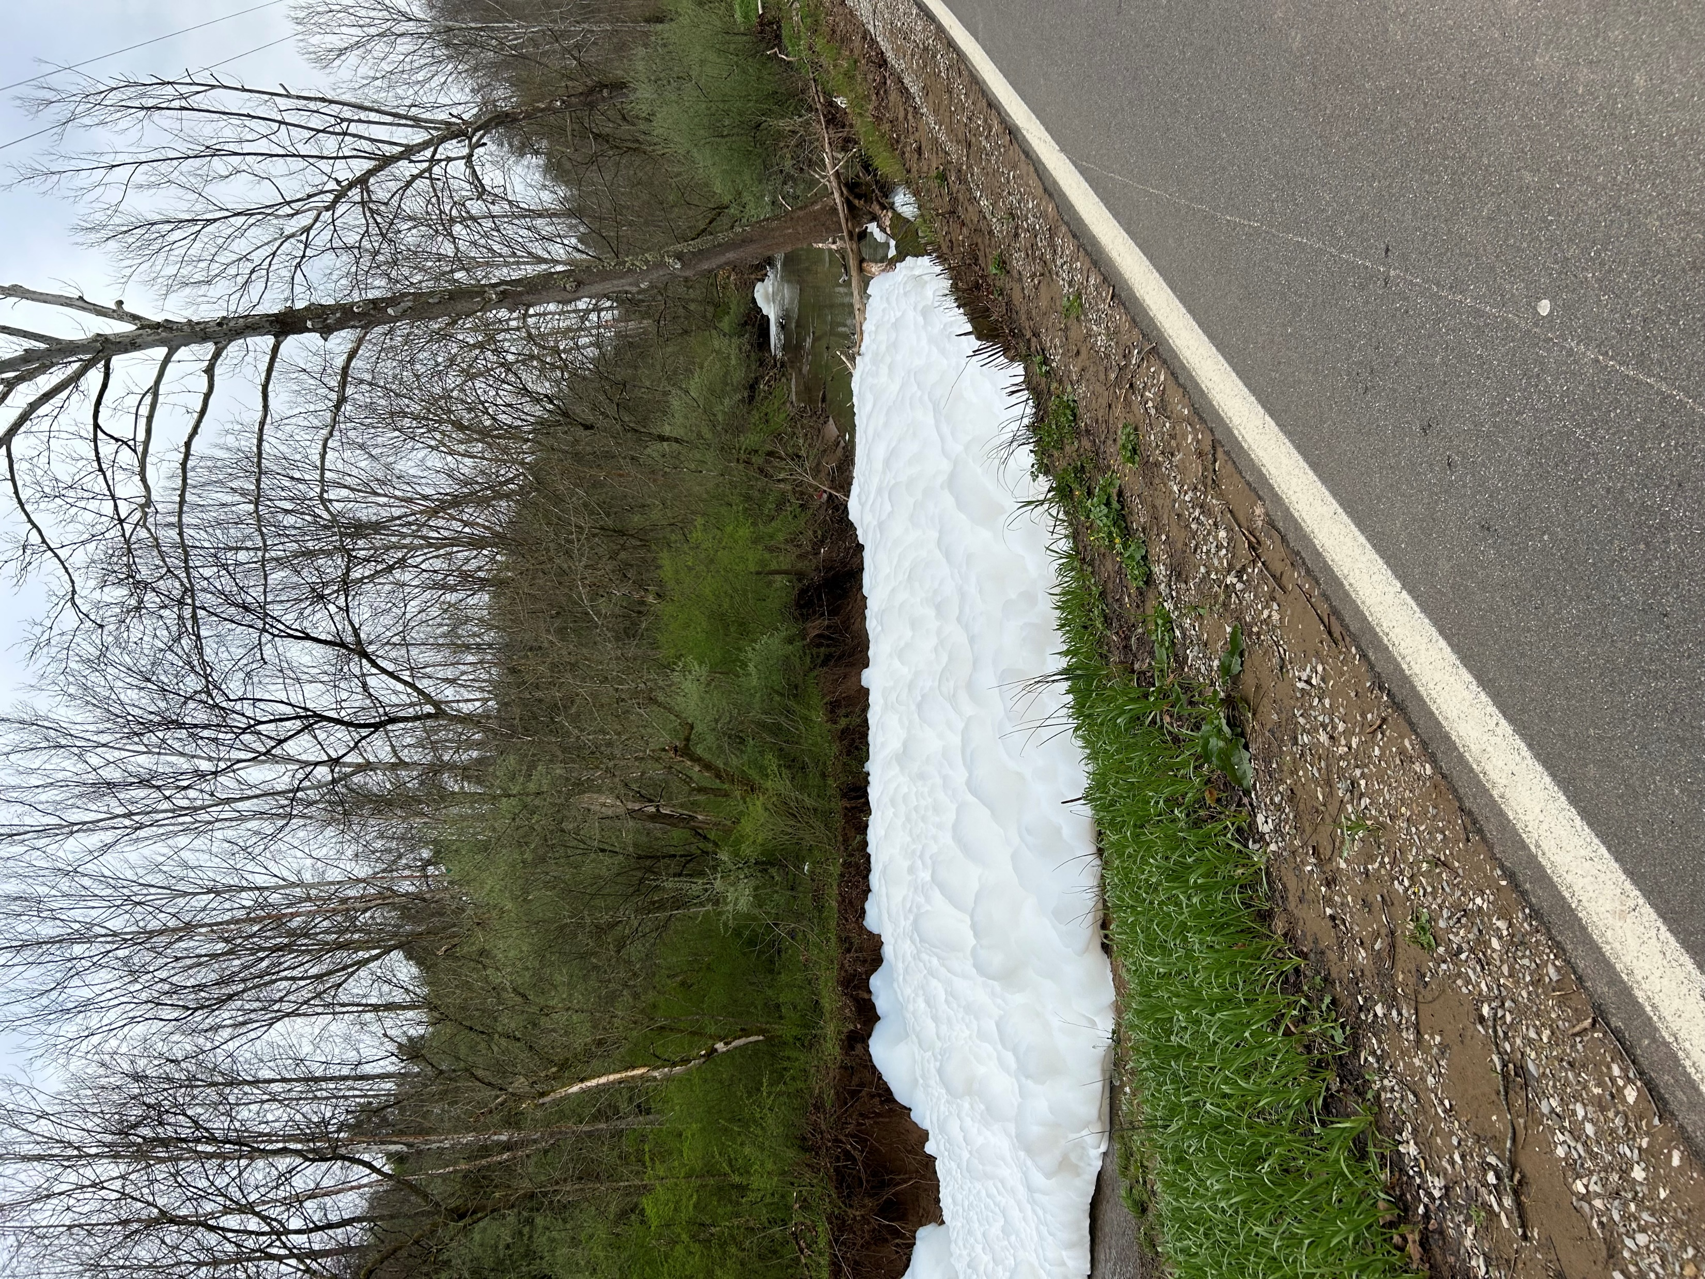
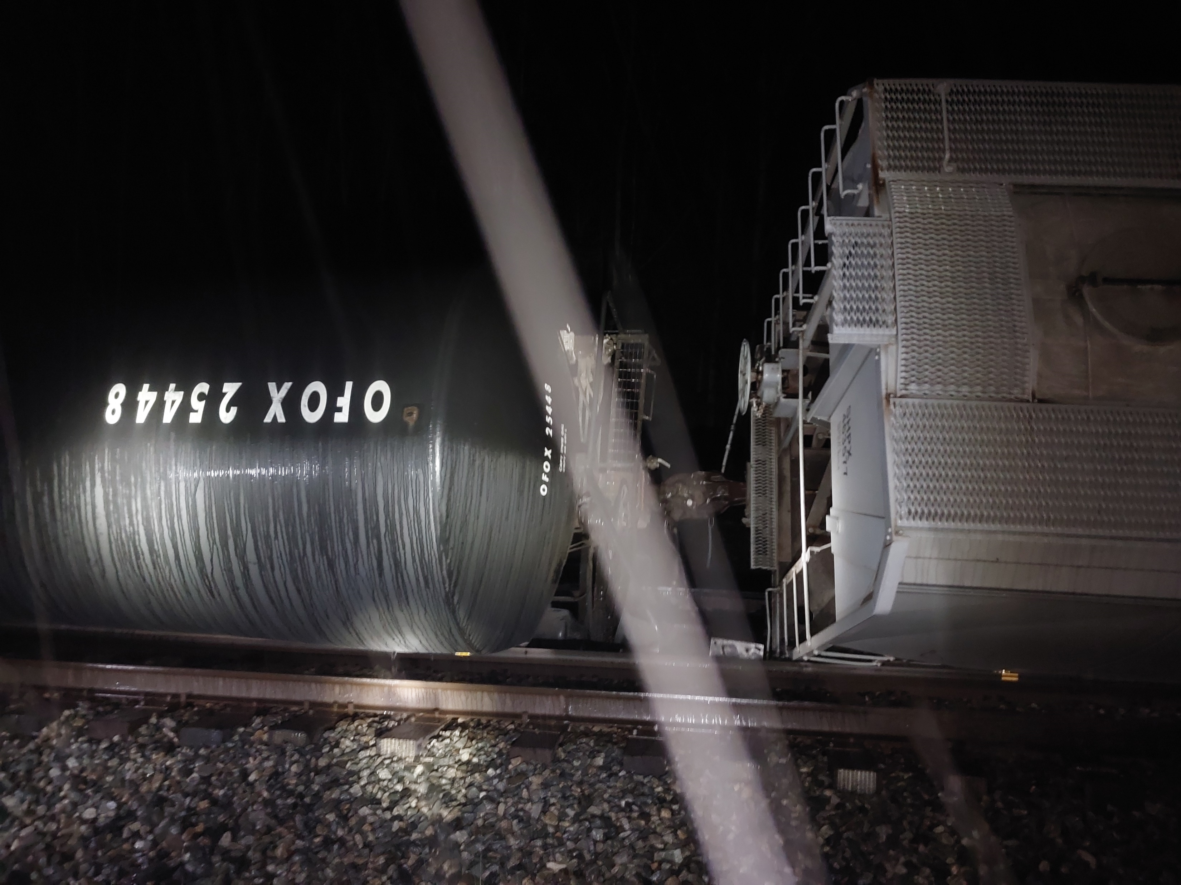
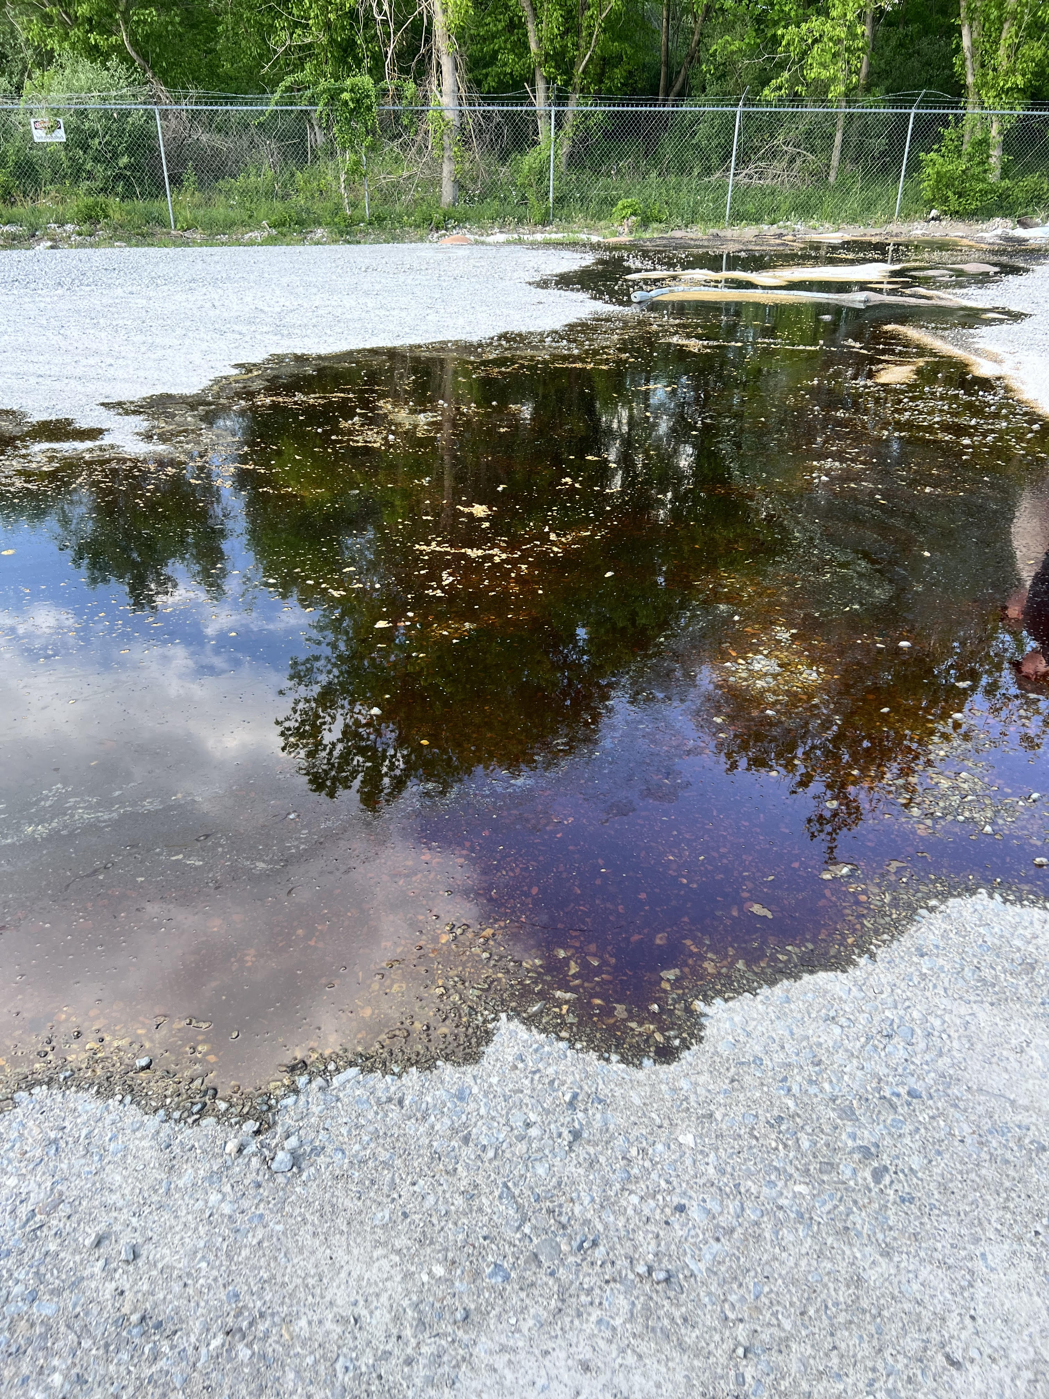
West Virginia, SOSC Report – May 2024

