Slide 1

SECTOR SAN DIEGO
October 2024 – January 2025
CAPT Patrick Dill, CO/FOSC
Deputy Commander
CDR Ellen Motoi
Chief of Prevention
CDR Jamie Koppi
Chief of Response
CDR Gregory Waugh
Chief of Emergency Management Force Readiness
LCDR Rebecca Brooks
Chief of Incident Management Division
LT Gerald Carr

Slide 2


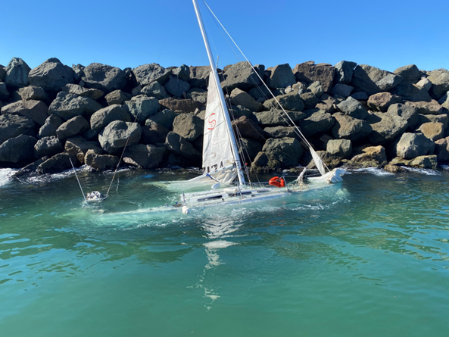
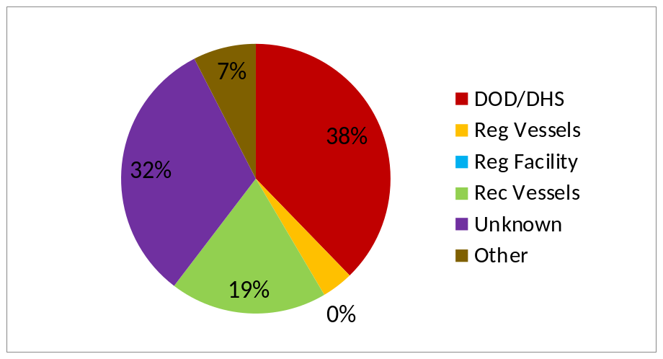
Incident Management Division
Brief: IMD
OCT 2024 – JAN 2025 Overview
Cases: 53
Enforcement Activities: 09
Federalized cases: 01
OSLTF Case Cost: $34,000
Spill Source Totals
DOD/DHS – 20 reported
Regulated Vessels – 2 reported
Regulated Facilities – None reported
Recreational Vessels – 10 reported
Unknown (mystery sheens) – 17 reported
Other (vehicles, etc.) – 4 reported

Slide 3
Area Committee: 2025 Schedule
Brief: EMFR
Area Committee Meetings
13 May 2025
  Virtual & In-Person at Sector San Diego
18 November 2025
  Virtual & In-Person at Sector San Diego
Abandoned & Derelict Vessel Subcommittee Meetings
10 March 2025
  Virtual
12 May 2025
  Virtual

Slide 4
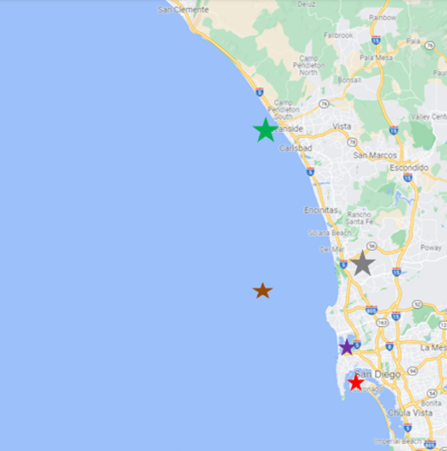
Area Committee: Subcommittee
Brief: EMFR
San Diego Area Subcommittee: Addressing Abandoned and Derelict Vessels (ADV)
The San Diego Coastal Zone Area Committee has identified the pressing issue of Abandoned and Derelict Vessels (ADV) within our Area of Responsibility. An inter-agency group has been formed to address this challenge.
Key Areas of Focus:
Vessels in Anchorages (e.g., Zuniga): Abandoned vessels left at anchor present unique challenges for removal and enforcement.
Vessels in Marinas: While similar to those in anchorages, marina-bound vessels pose different logistical and regulatory challenges.
Notes:
First Meeting Objectives:
Align stakeholders and ensure full representation from relevant agencies and organizations.
Provide an overview of the issue from the U.S. Coast Guard’s perspective.
Open discussion to refine and modify the “problem statement.”
Draft and finalize the group’s charter to guide future efforts.

Slide 5
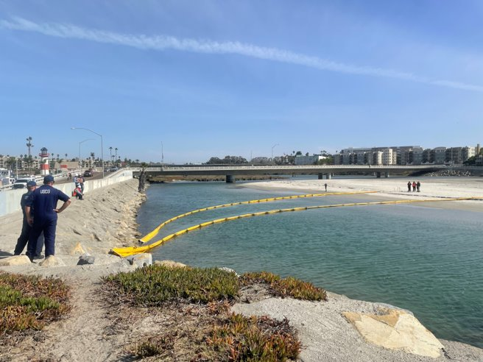
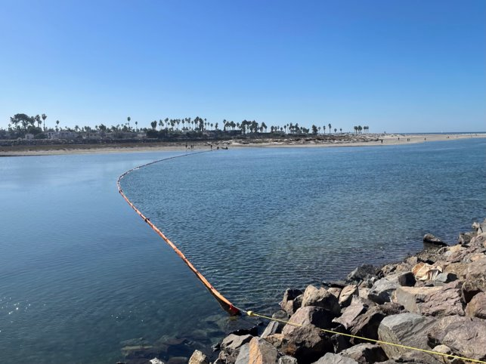
Area Contingency Plan: Updates
Brief: EMFR
Sensitive Site Boom Deployment Drills
6-253.2 Buena Vista Lagoon:
  Deployment postponed until 2025.
6-250.1 San Luis Rey River:
  Deployment successfully completed by NRC ES on November 6, 2024.
  Key lessons learned:
    Recommended revision: Update the site diagram to reflect the two-tiered harbor boom setup as deployed.
6-304.2 Mission Bay Entrance:
  Deployment successfully completed by MSRC on November 20, 2024.
  No changes recommended to this strategy.

Slide 6
Questions?

