Slide 1
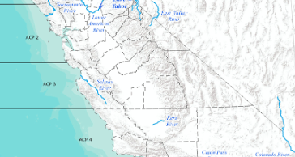

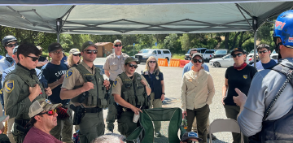
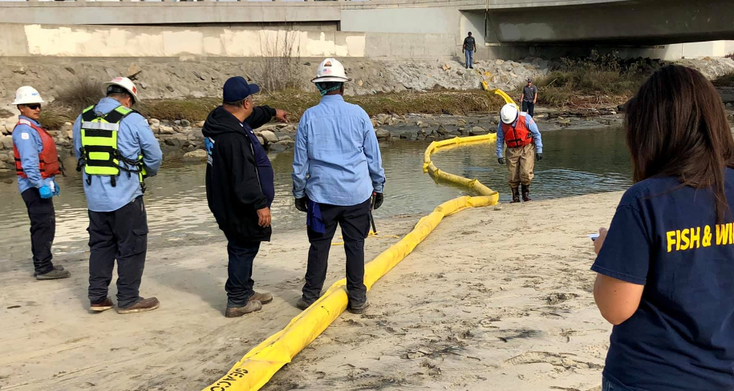
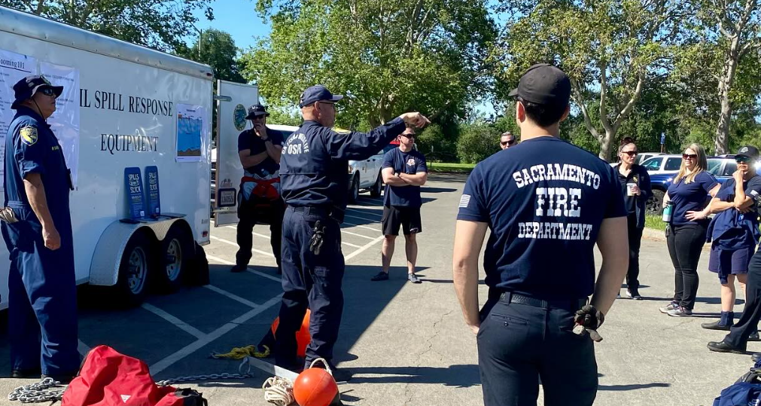
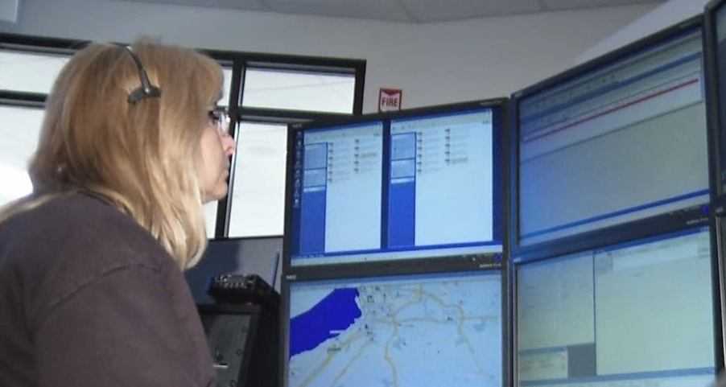
Environmental Response Branch
Day-to-Day Operations
Readiness, Response, and Outreach
Contingency Plans
Response & Planning Committees
Training, Testing, Maintenance
Drills & Exercises
Outreach Training
Dispatch

Slide 2
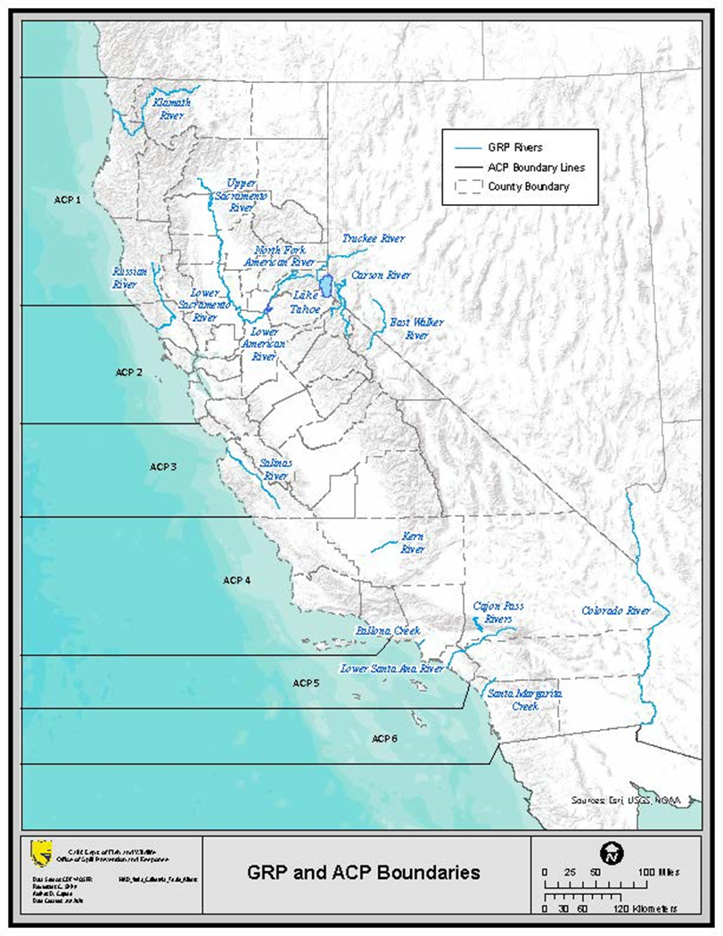
OSPR ERB – Leads
6 ACPs:
ACP 1 (North Coast) – Jeff Dayton
ACP 2 (SF Bay/Delta) -Mike Schommer
ACP 3 (Central Coast) - Lindsey Saum
ACP 4 (North LA/LB) - Jennifer Gold
ACP 5 (South LA/LB) - Sonia Torres
ACP 6 (San Diego) - David Lyons
17 ACTIVE GRPs:
Klamath, Upper Sacramento, Truckee*, Lake Tahoe*,Carson* Russian, North Fork American, Lower Sacramento, Lower American, East Walker*, Salinas, Kern, Cajon Pass, Colorado*, Ballona Creek, Lower Santa Ana, Santa Margarita.
*Interstate GRPs

Slide 3
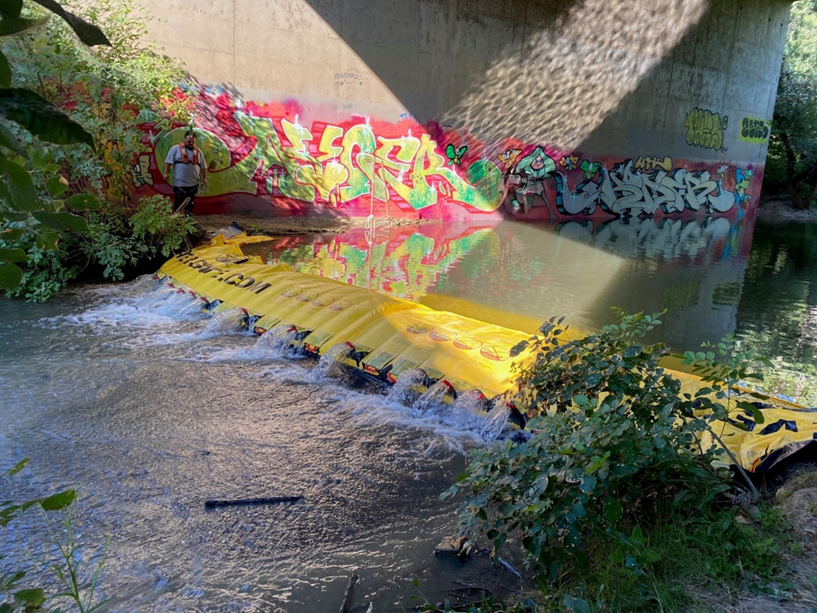
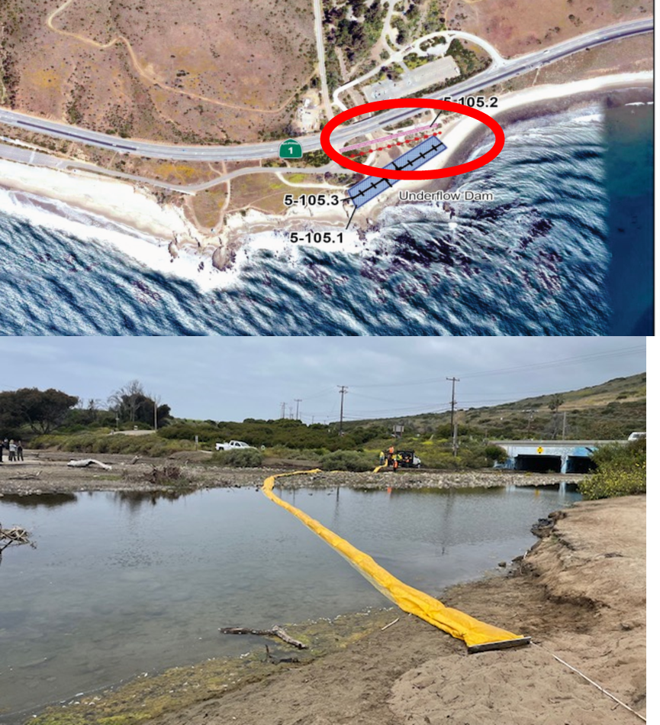
Sensitive Site Strategy Evaluation Program (SSSEP)
(Started 2003 in ACP 2)
SSSEP at Arroyo Sequit (May 2024)
WaterGate (underflow dam) deployment with MSRC, regional trustees and OSPR on Putah Creek, Davis (July 2024).

Slide 4
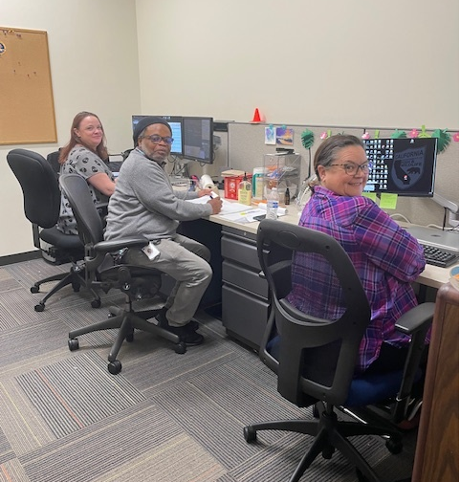
OSPR Spill Desk
Spill Notifications to OSPR FRTs
  During Business Hours
  Phone Notifications/Follow-up Text/Email
  Backup Cal-OES Email Notifications
OSPR Incident Tracking Database (ITDB)
  Notification Tracking
  FRT Response Log Input (QA/QC)
  FRT Training on Data Entry
2024 DOF Audit Requests
  Requests for OSPR Spill Data – Last four FYs
Training in Environmental Unit Support Specialist (EUSS)
  Internal Training/Exercise (September 2023, April 2024)
  Industry Exercise (October 2023)
OSPR Spill Desk Staff

Slide 5

Questions and Thank You!
Contact Information
Kathleen.Jennings@wildlife.ca.gov
(707) 372-0103

