Slide 1
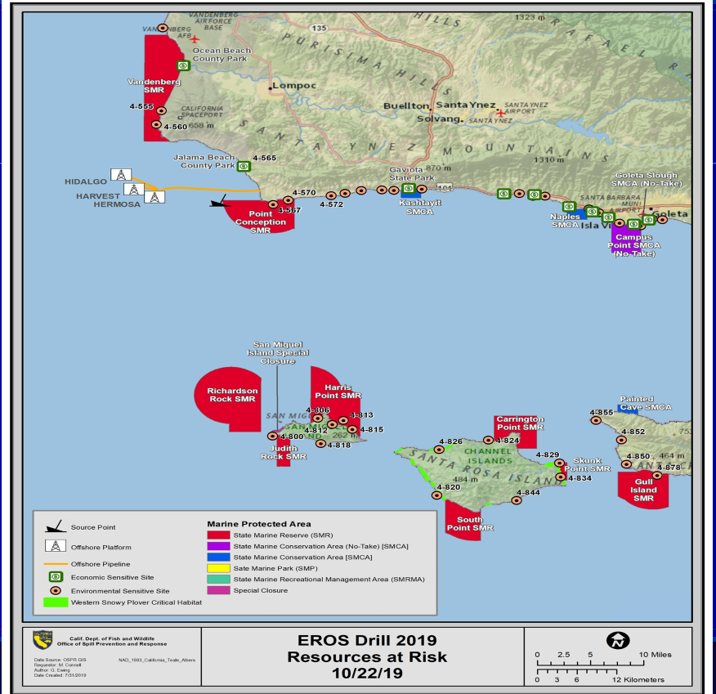
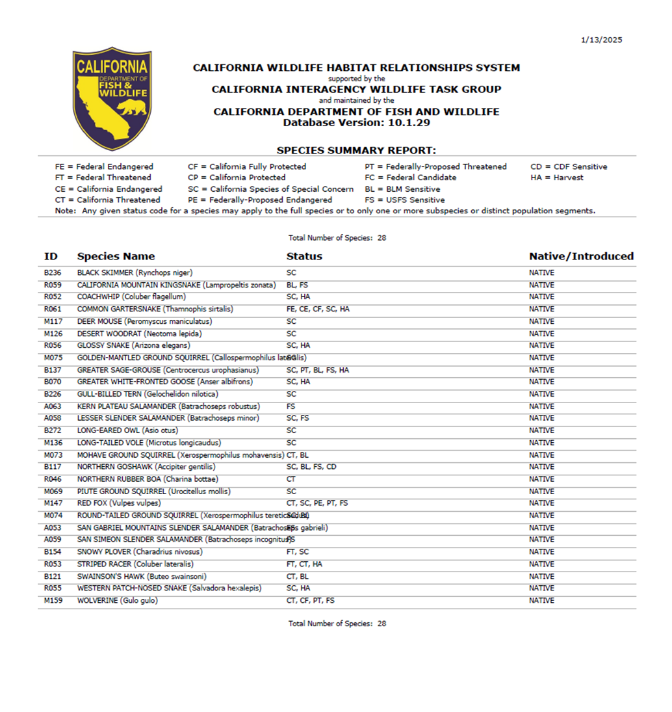
RAR Technical Specialist

Slide 2
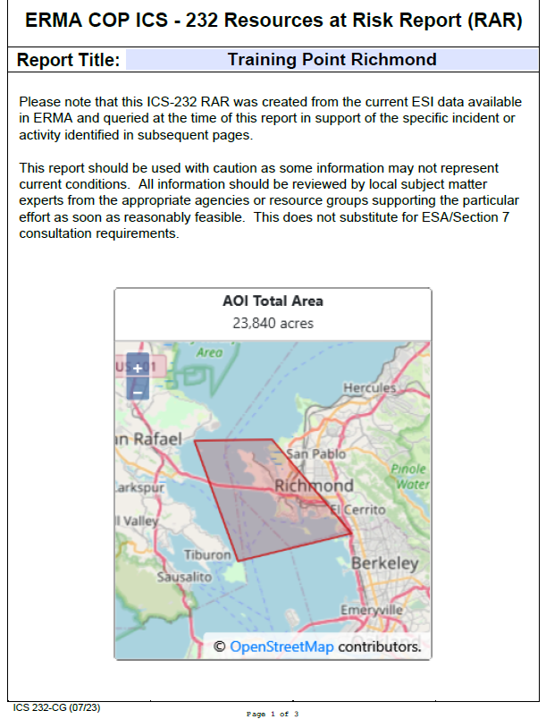
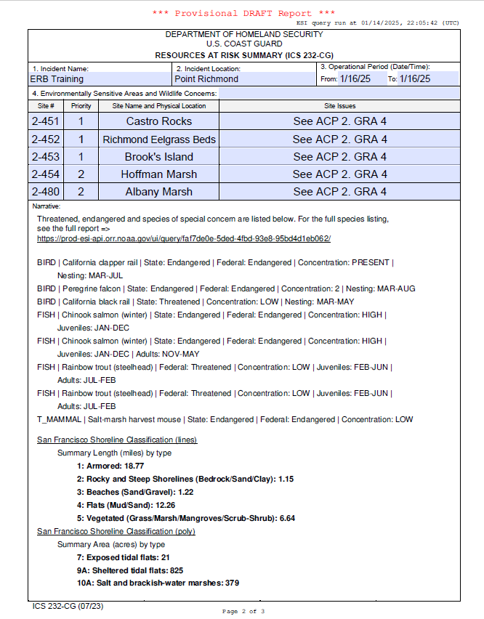
RAR Technical Specialist

Slide 3

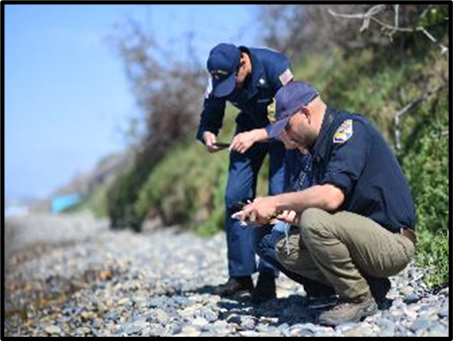
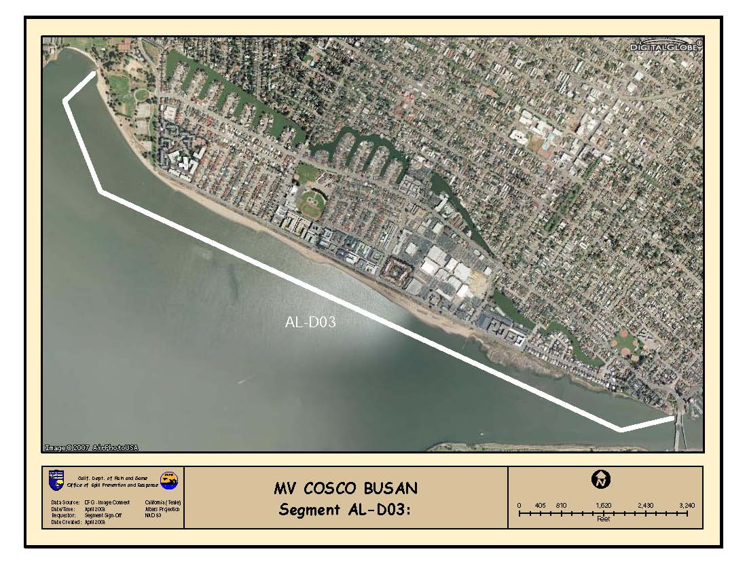
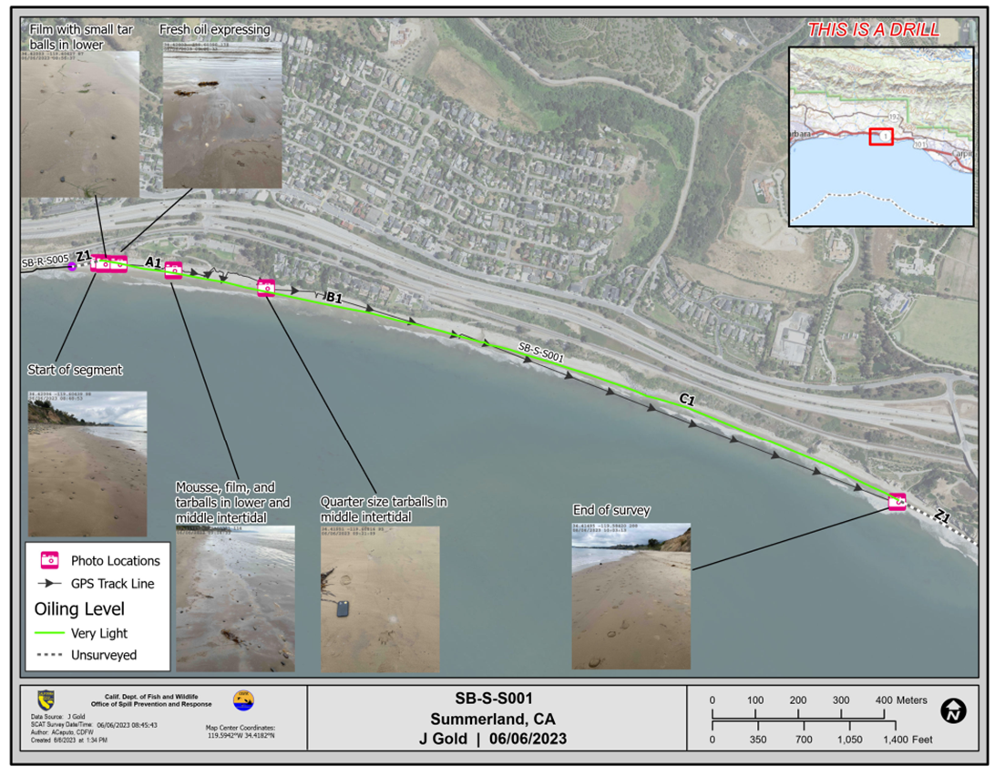
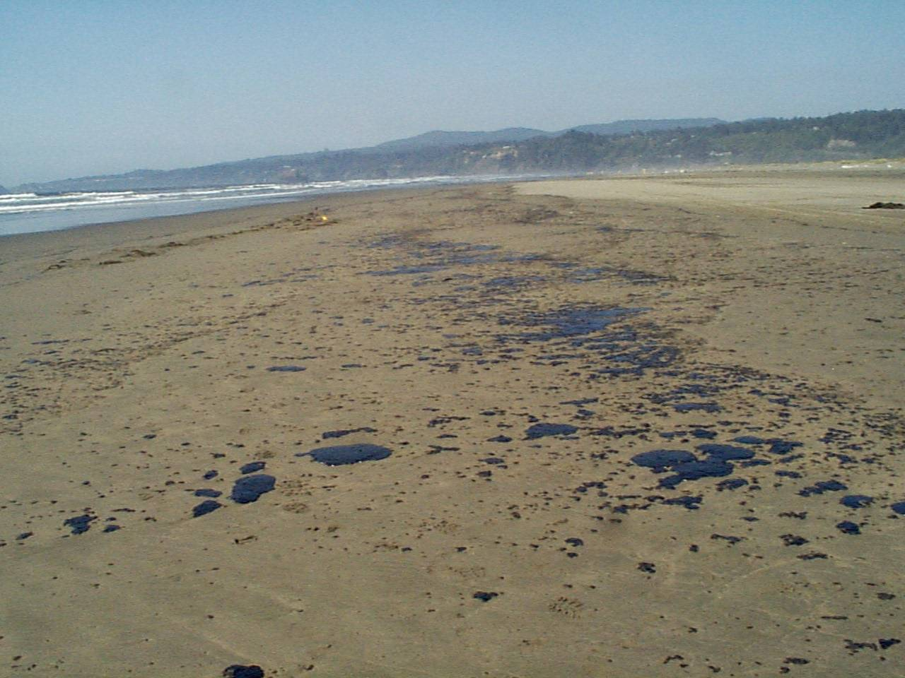
Shoreline Cleanup & Assessment Technique (SCAT)
7
OSPR In-house SCATalogue App,Pre-Identified ODs/Segments
Assess Shoreline Oiling & Make Cleanup Recommendations
Three Member SCAT Team (USCG, OSPR, RP Rep)
Visual Observations of Oiling, Data Used to Generate Maps
Qualitative Cleanup Endpoints, Gross Oil Removal
Rapid Time Frame, Stay Ahead of Operations

Slide 4
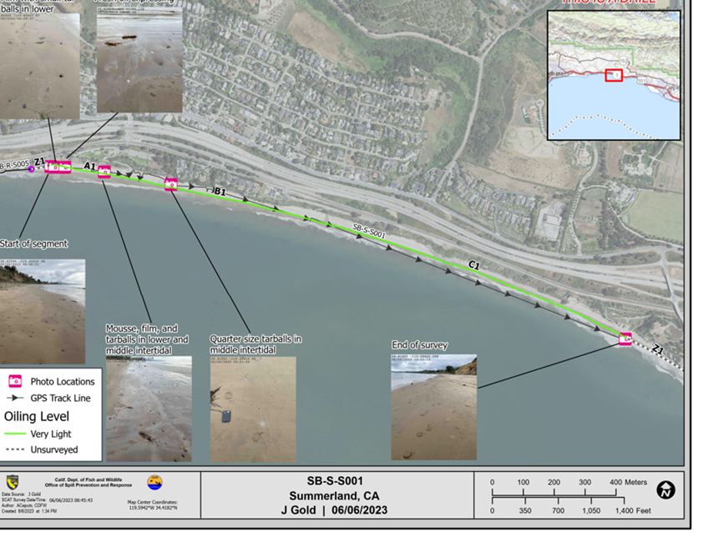
Collaboration with Other OSPR Programs
OSPR Geographic Information Systems (Nita Barve)
OSPR Tribal Liaison (Cindy Murphy)
OSPR Fisheries Closure Coordinator (Noah Ben-Aderet)
OSPR Applied Response Technology (Annie Nelson)

