Slide 1


The Navigable Waters Protection Rule:
Definition of
“Waters of the United States”
Regional response team 9 virtual meeting
15 July 2020
Joe morgan, r9 wetlands section, morgan.joseph@epa.gov

Slide 2
Today’s Presentation
  Background on the “waters of the United States” (WOTUS) rulemakings
  Overview of the final Navigable Waters Protection Rule: Definition of “Waters of the United States”
  Key changes from the 2019 Rule (i.e., pre-2015 Rule practice)
  Implementation of the final rule
  Next steps
Notes:
For today’s presentation, we will provide background on waters of the United States, take a close look at the elements of the final rule – what waters are in and what are out and some definitions of terms – and highlight some differences compared to the 2019 Rule (which is how the agencies implemented the definition of “waters of the United States” prior to the 2015 WOTUS Rule); and then highlight how we will implement the final rule and some next steps.
I also want to note that the pre-publication version of the final rule and preamble, fact sheets, and the supporting analyses for the final rule can be found on the EPA’s website. The preamble in particular provides an extensive discussion of the rationale for the final rule and includes important information on how the agencies will implement it.

Slide 3
Background: “Waters of the United States” and the Clean Water Act
  “Waters of the United States” is a threshold term in the Clean Water Act and establishes the scope of federal jurisdiction under the Act.
  The Clean Water Act applies to “navigable waters,” defined in the Act itself as “waters of the United States.”
  The Clean Water Act does not further define “waters of the United States.”
  The EPA and the Department of the Army (Army) have defined it by regulation since the 1970s.
Notes:
To provide some context, “Waters of the United States” (WOTUS) is a threshold term in the Clean Water Act and establishes the scope of federal jurisdiction under the Act.
It applies to the many programs under the Act, including water quality standards, TMDLs, oil spill, national pollutant discharge elimination system permits, and dredged and fill permits.
Because the Clean Water Act does not further define WOTUS, the EPA and the Army have defined it in regulation since the 1970s, and the definition has been subject to litigation over the years.

Slide 4
Background: Rulemaking Process
  Step 1 – 2019 Rule: Repealed the 2015 Rule and recodified prior regulations (86/88 regs with post-SWANCC and Rapanos guidance).
      Effective date was December 23, 2019.
  Step 2 – Navigable Waters Protection Rule (NWPR): Revises the definition of WOTUS, replaces the 2019 Rule.
      The final rule was published on 21 April 2020 and became effective on 22 June.
Notes:
The EPA and the Army have responded to Executive Order 13778, which directed the agencies to rescind or replace the 2015 Rule, in a two step rulemaking process to provide regulatory certainty.
The first step, completed in the fall of 2019, was to repeal the 2015 Rule defining WOTUS and recodify the regulations in place before 2015, implemented consistent with guidance and caselaw. That rule, which we refer to as the 2019 Rule or Step 1, became effective nationwide on December 23, 2019.
On June 22nd, 2020, the agencies began implementing the final Navigable Waters Protection Rule: Definition of “Waters of the United States.” This revised definition, which is the second step of our rulemaking process, establishes the scope of federal regulatory authority under the Clean Water Act.

Slide 5
Key Overall Changes under NWPR
  Key changes from the 2019 Rule:
      Four categories of jurisdictional waters and twelve categories of excluded waters/features.
      No standalone interstate waters category.
      No case-specific significant nexus analysis.
      Key changes for:
          Tributaries
          Adjacent wetlands
          Ditches
          Lakes, Ponds and Impoundments
Notes:
The agencies have streamlined and clarified those waters that are waters of the United States and those that are not through the 4 categories of jurisdictional waters and 12 categories of excluded waters and features. Many of the exclusions that the agencies have codified now were highlighted in the preambles of the agencies’ 1980s regulations and, where that was the case, these waters are generally not found to be jurisdictional under the 2019 Rule. Specifying these exclusions in regulation rather than in preamble provides greater predictability and consistency.
In the final rule, the agencies have combined into one category the territorial seas and traditional navigable waters.
The final rule does not contain a standalone category of interstate waters – waters crossing state boundaries must meet the conditions of one of the four categories of jurisdictional waters to be waters of the US
Unlike the 2019 Rule as implemented, this final rule does not require the agencies to conduct a significant nexus analysis to determine the jurisdiction of certain waters and wetlands – rather we will assess waters based on the conditions described in the four categories
Finally, the agencies have created a new category of standing waterbodies by combining the historic category of impoundments with lakes and ponds as they function similarly on the landscape.

Slide 6
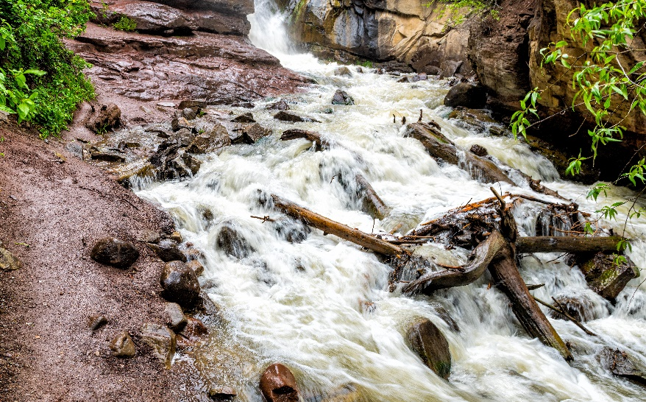
(a)(2) Tributaries:
Key changes from the 2019 Rule:
  No significant nexus test.
  All ephemeral streams are non-jurisdictional, whereas some may be found jurisdictional under 2019 Rule.
The final rule does not change existing regulations for establishing the lateral limits of federal jurisdiction for tributaries i.e., Ordinary High Water Mark (OHWM).
Tributaries include those perennial or intermittent streams that flow in response to snowpack melt, like Hayes Creek in Colorado that contributes surface flow to the Crystal River.
Notes:
I’m skipping (a)(1) Traditional Navigable Waters and Territorial Seas, because this category has not changed.
In order to be considered a tributary and jurisdictional under the CWA, rivers and streams must first be intermittent or perennial in a typical year; they also must contribute surface water flow to a downstream TNW/territorial sea in a typical year. They can flow through other categories of jurisdictional waters before reaching the TNW/territorial sea.
As I mentioned before, the final rule does not require a significant nexus analysis to determine jurisdiction which is different from how we are implementing the 2019 Rule. This analysis, as called for under Justice Kennedy's opinion in the Rapanos Supreme Court case, required the agencies to prove that the water or wetland in question has significant physical, chemical and biological effects on other covered waters more readily understood as "navigable."
Ephemeral streams are not jurisdictional under the final navigable waters protection rule, a contrast to the 2019 Rule and pre-2015 Rule practice where some ephemeral streams have been found jurisdictional following a significant nexus analysis.
Finally, the agencies have long used the ordinary high water mark to establish the lateral limits of a tributary, and the Corps’ longstanding regulatory definition is retained and codified in EPA’s regulations. However, it is not in the definition of tributary, unlike the 2015 Rule.

Slide 7
Key Definitions in the Final Rule
Perennial:
  The term perennial means surface water flowing continuously year-round.
Intermittent:
  The term intermittent means surface water flowing continuously during certain times of the year and more than in direct response to precipitation (e.g., seasonally when the groundwater table is elevated or when snowpack melts).
Ephemeral:
  The term ephemeral means surface water flowing or pooling only in direct response to precipitation (e.g., rain or snow fall).
Snowpack:
  The term snowpack means layers of snow that accumulate over extended periods of time in certain geographic regions or at high elevation (e.g., in northern climes or mountainous regions).
Notes:
The final rule contains 16 definitions of key terms used. Several of these are particularly relevant to understanding the definition of tributary.
To provide clarity, the agencies have defined “perennial” to mean surface water flowing continuously year-round; “intermittent” to mean surface water flowing continuously during certain times of the year and more than in direct response to precipitation (e.g., seasonally when the groundwater table is elevated or when snowpack melts); “ephemeral” to mean surface water flowing or pooling only in direct response to precipitation (e.g., rain or snow fall)
The use of the term “in direct response to precipitation” in the definition of “intermittent” and “ephemeral” in the final rule is intended to distinguish between surface flow solely caused by individual precipitation events (including multiple, individual back-to-back storms), and continuous flow resulting, for example, from weeks- or months-long accumulation of precipitation in the form of snowpack that melts slowly over time or an elevated groundwater table that provides baseflow to the channel bed.
The agencies are also clarifying the difference between snowpack melt and snowfall to distinguish between intermittent and ephemeral waters – snowpack means layers of snow that accumulate over extended periods of time in certain geographic regions or at high elevation (e.g., in northern climes or mountainous regions).
To clarify, the final rule does not mandate groundwater input as part of the definition of “perennial” or “intermittent” – which the agencies determined would too narrowly limit CWA jurisdiction over waters that provide sufficient surface water flow to traditional navigable waters in a typical year. For example, perennial or intermittent flow in certain mountain streams, may result primarily from melting snowpack, not from groundwater contributions to the channel. Similarly, effluent-dependent streams may meet the definition of “tributary” as long as they are perennial or intermittent and contribute surface water flow to a traditional navigable water or territorial sea in a typical year.

Slide 8
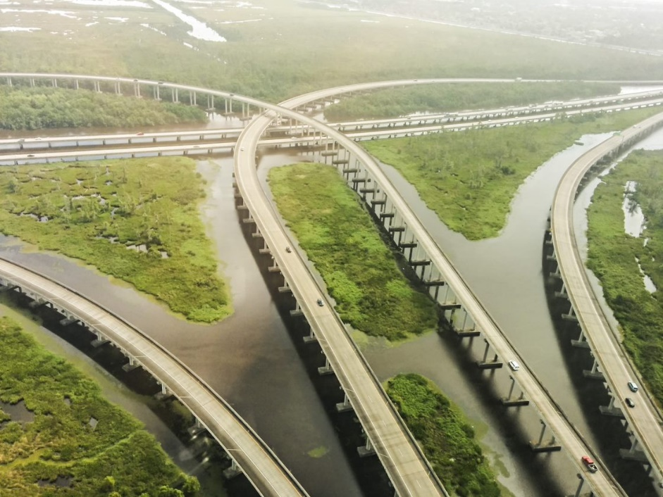
(a)(4) Adjacent wetlands:
The final rule does not change the agencies’ longstanding definition of “wetlands.”
Key changes from the 2019 Rule:
  Revises longstanding definition of “adjacent.”
  Wetlands physically separated from an (a)(1) - (a)(3) water by an artificial berm, dike, or similar artificial feature must have a direct hydrologic surface connection to the jurisdictional water in a typical year to be considered adjacent.
  No wetlands are evaluated by a significant nexus test.
Adjacent wetlands include wetlands with manmade structures that allow for a direct hydrologic surface connection to an (a)(1-(3) water in a typical year, like these wetlands in the Mississippi river Delta region of Louisiana.
Notes:
It’s important to note that the agencies have not modified their longstanding definition of wetlands, so before determining if a wetland meets one of the conditions of adjacency under the final rule, it must first meet the regulatory definition of a “wetland” – in other words, it has the appropriate hydrology, vegetation and soils.
The agencies have changed their tests for determining whether a wetland is adjacent compared to the 2019 Rule. As noted earlier, the final rule does not require a significant nexus analysis to determine adjacency of a wetland. The agencies also will no longer use the longstanding interpretation of “neighboring, bordering or contiguous” but rather a wetland must meet one of the four conditions in the final rule’s definition and not be excluded under paragraph (b) of the final rule.
Another key difference from the 2019 rule is that wetlands physically separated from a jurisdictional water by an artificial feature where there is no direct hydrologic surface connection, are not adjacent wetlands. Under the 2019 Rule, wetlands may be found adjacent based on a subsurface connection.

Slide 9
Ditches
The term ditch means a constructed or excavated channel used to convey water.
Ditches are jurisdictional where they are:
    TNWs, including those subject to the ebb and flow of the tide (i.e., are (a)(1) waters);
    Either constructed in or relocate a tributary, or are constructed in an adjacent wetland, and satisfy the flow conditions of the tributary definition (i.e., are (a)(2) waters); or
    Constructed in an adjacent wetland and develop wetland characteristics (i.e., are (a)(4) waters).
Ditches are excluded from WOTUS except where they meet the conditions of paragraph (a)(1) or (a)(2) waters (i.e., they are a TNW, or a tributary) or where they were constructed in an adjacent wetland and develop wetland characteristics.
Key changes from the 2019 Rule:
    Codifies that ditches constructed in upland (other than TNWs and rerouted tributaries), certain ditches constructed in wetlands, and ditches with ephemeral flow are not jurisdictional.
Notes:
After considering public comments, the agencies are not finalizing a separate category of jurisdictional ditches. Rather ditches are jurisdictional where they (read slide).
For ditches constructed in an adjacent wetland, the agencies note that if a ditch then continues on through upland to flow into a jurisdictional water, that upland portion will still be jurisdictional so long as it has either intermittent or perennial surface water flow in a typical year. A key point is that the wetland has to meet the definition of adjacent wetland.
- All other ditches are excluded. This is also articulated in paragraph (b) of the final rule.
The final rule provides greater clarity over the treatment of ditches compared to the 2019 Rule by codifying which ditches are and are not jurisdictional.
Overall, we expect fewer ditches will be jurisdictional compared to the 2019 Rule.
As always, the burden of proof is on the agencies to determine if a ditch meets the conditions of the final rule to be jurisdictional.

Slide 10
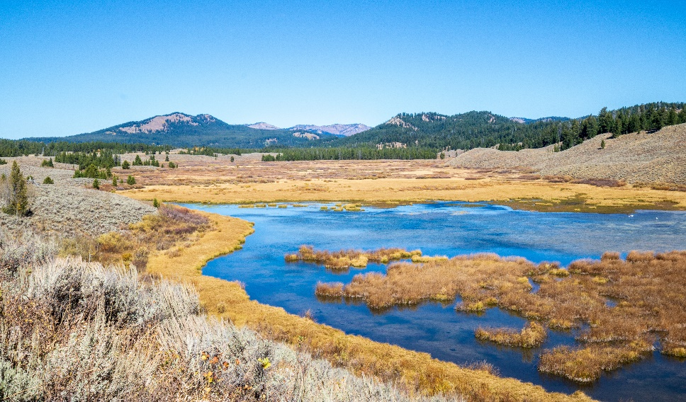
(a)(3) Lakes and ponds, and impoundments of jurisdictional waters:
Key changes from the 2019 Rule:
  Expanded previous impoundments category to include lakes and ponds.
  Flooding: Clarifies that other kinds of surface hydrologic connections can also render lakes, pond, and impoundments jurisdictional (e.g., inundation by flooding from an (a)(1)-(3) water).
  Typical Year: Impoundments of jurisdictional waters are non-jurisdictional if they do not contribute surface water flow to a downstream TNW or territorial sea in a typical year.
Lakes, ponds, and impoundments of jurisdictional waters include open bodies of surface water that contribute surface flow to a traditional navigable water, like Christian Pond in Wyoming.
Notes:
The agencies are continuing to treat certain lakes and ponds as part of the tributary network; however, we are providing greater clarity about the types of surface water connections that can establish jurisdiction – whether it is flooding by inundation from a jurisdictional water or artificial connections to jurisdictional waters like pumping or reservoir releases that contribute surface water flow to a downstream TNW in a typical year.
With the exception of impoundments that are TNWs themselves, while both the final rule and the 2019 rule require jurisdictional impoundments to first be impounding other jurisdictional waters (such as damming a perennial river), the final rule also requires that for an impoundment to be jurisdictional, it has to contribute surface water flow to a TNW or territorial sea in a typical year. Where an impoundment does not have such a surface connection in a typical year, it won’t be jurisdictional unless it is inundated by flooding of a jurisdictional water.

Slide 11
Waters/Features Excluded from Final WOTUS Definition [33 CFR 328.3(b)]
  Waters not listed as WOTUS
  Groundwater
  Ephemeral features
  Diffuse stormwater run-off
  Ditches not identified as WOTUS
  Prior converted cropland (PCC)
  Artificially irrigated areas
  Artificial lakes and ponds
  Water-filled depressions incidental to mining or construction activity
  Stormwater control features
  Groundwater recharge, water reuse, and wastewater recycling structures
  Waste treatment systems
Notes:
To complement the 4 categories of waters of the United States, the agencies are also codifying 12 exclusions from the definition and regulation under the Clean Water Act; many of these waters and features are longstanding exclusions from the definition.
§328.3 Definitions. (a) is Jurisdictional waters and (b) lists these exclusions as non-jurisdictional waters.
The agencies attempted to balance a list of excluded features that are familiar, like waste treatment systems, with not wanting to include an exhaustive list that could create confusion if a feature is mistakenly not listed.
Diffuse stormwater run-off and directional sheet flow over upland;

Slide 12
Next Steps
  NWPR is being implemented nationwide, except for in the State of Colorado.
  New tools are being developed and will be publicly available for download on the EPA’s website in the near future:
          Antecedent Precipitation Tool (APT)
          Regionally-specific SDAMs will be released over time
  EPA & Army are working with DOI to use existing datasets to develop maps of jurisdictional waters
  Implementation guidance and memoranda
Notes:
As of June 22nd, the NWPR is being implemented nationwide, except for in Colorado where it is enjoined.
As noted earlier, the agencies have developed an Antecedent Precipitation Tool (APT) that may be used to inform determinations of whether surface flows or surface water connections occur in a typical year.
Regionally-specific SDAMs will be released over time, as they are developed. SDAMs are rapid assessments to rapidly evaluate whether a stream meets the intermittent flow requirements under the NWPR. A SDAM has been developed for the Arid Southwest ecoregion, and a draft version will be ready for release this summer. Another for Western Mountains is currently in development. Additional tools that would facilitate implementation may be developed in the future.
The EPA and the Army have been engaging with the Department of Interior to discuss using existing geospatial datasets to map the nation’s aquatic resources, including both waters of the United States and non-jurisdictional waters. To align the agencies’ waters of the United States mapping interests with DOI’s established aquatic resource mapping efforts, including the National Hydrography Dataset (NHD) and National Wetlands Inventory (NWI), the EPA and the Army have engaged the U.S. Geological Survey (USGS) and the U.S. Fish and Wildlife Service (FWS) to establish a technical working group to develop strategies that can address their CWA mapping needs.
EPA and the Army are developing several joint memoranda to help facilitate implementation of the final rule. These memos are currently undergoing E.O. 12866 interagency review or have recently cleared interagency review. The agencies will consider the interagency comments they receive before finalizing the memoranda and will post the final memos to their websites.

Slide 13
For Further Information
Visit https://www.epa.gov/nwpr for more information about the final rule, including the pre-publication copy, supporting analyses, and fact sheets.
View the public webcast at - https://www.youtube.com/watch?v=dt_OoxYU0-M&feature=youtu.be
Additional questions may be directed to the EPA at: CWAwotus@epa.gov or to the Corps at: USACE_CWA_Rule@usace.army.mil.
Notes:
You can find out more about the rule at epa.gov/nwpr. You can see a 45-minute webinar that goes into more detail on the categories of waters and exclusions at the YouTube link in the slide. I’ll take a few questions now, but feel free to contact me with any more, or to the EPA and Corps emails in the slide here.

