Slide 1
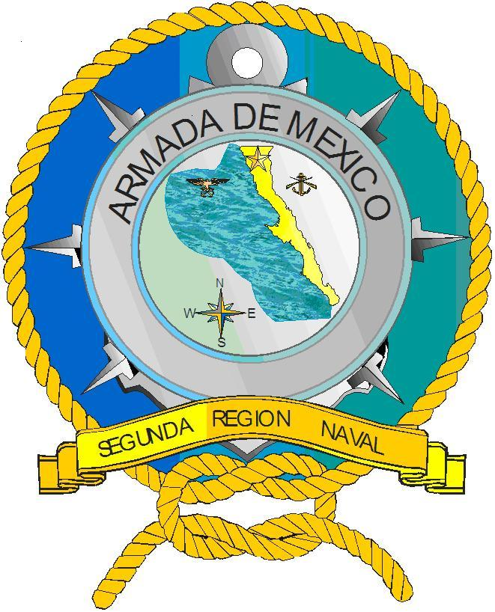
Segunda Región Naval
MEXUSPAC
OIL SPILL SEMINAR
11 AUGUST 2021

Slide 2




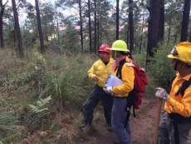
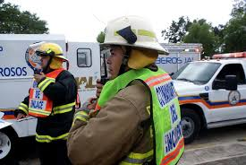
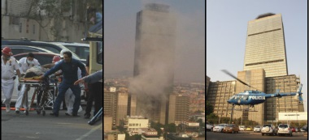



Mexico, Military Camp no. 1, a large scale use of the ICS is executed in the 4th. International Congress of Health Officials
The ICS was implemented in building B, of the PEMEX administrative complex due to an emergency
First use of ICS in Mexico applied to emergency management by the private sector.
In Mexico, the state of Jalisco applies the ICS in the metropolitan area of ​​Guadalajara
ICS is used in the Pan American Games in Guadalajara
The PROY-NOM-010-SEGOB-2016 released, establishing guidelines for pre-incident application the ICS
ICS
Guidelines
2002
1997
2003
80’s
2003
2011
2013
2016
2012
2021
1989
2016
2018
In Mexico, the PNIF uses the ICS during the Q. Roo forest fires.
In the US, USAID / OFDA agencies promote ICS in some Latin American countries
SEMAR implements ICS on the Northern border
PEMEX general implementation of ICS within their emergency response plans
ICS implemented at CESNAV as a credential
ICS is applied throughout all levels of government
Tomada de Ing. Arturo Arevalo G.

Slide 3

SECRETARIA DE MARINA
ARMADA DE MÉXICO

Slide 4
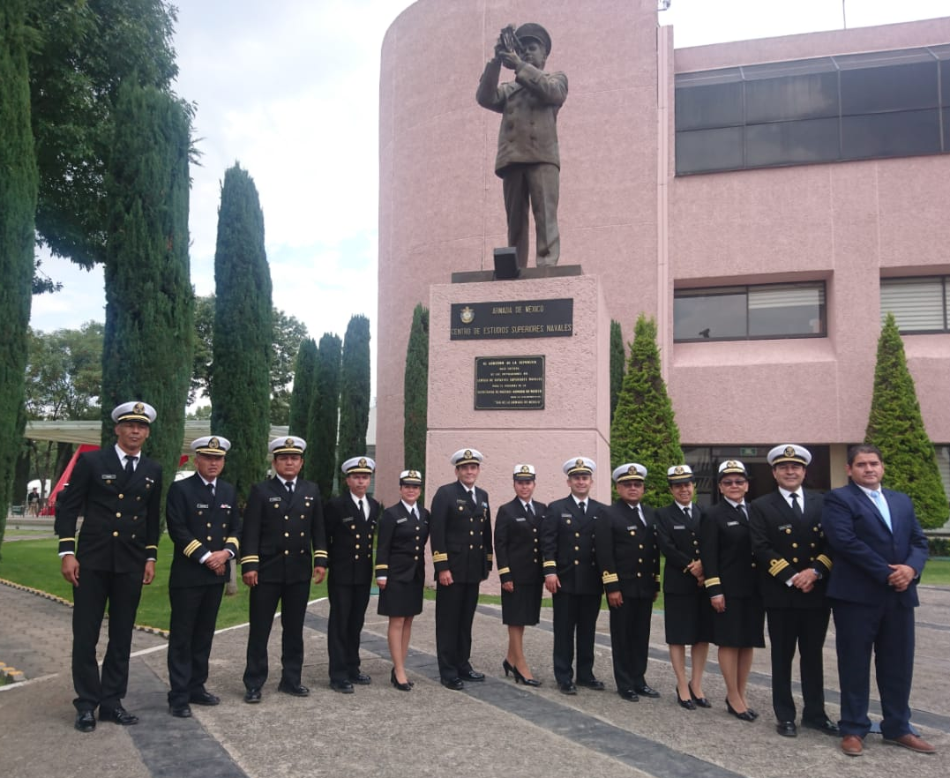
TUTORS
Cap. Frag. SMAM. Ocean. Norma Angélica Hernández Ramírez
Cap. Corb. SMAM. L. Biol. Wilma V. Díaz González
Tte. Nav. SMAM. L. Ocean. Bruno Matteotti Sánchez
Tte. Nav. SMAM. L. Biól. Mariano Ramón Pool Estrella
Tte. Nav. SMAM. L. Biól. Ariosto Lechuga Medina
Tte. Frag. SIA. IQ. Teresa A. Guadarrama Mendoza
Tte. Frag. SMAM. L. Biol José Andrés Ulloa Núñez
Tte. Frag. SIA. I. Quím. Luis Vidal Rodríguez Nava
Tte. Frag. SMAM. L. Biol. Ana Mariela Gutiérrez Martínez
Tte. Frag. SMAM. L. Biol. Iván Sujail Velázquez Pérez
Tte. Corb. SMAM. L. Biol. María Teresa Coronado Ramírez
Lic. Armando De la Huerta Navarro

Slide 5
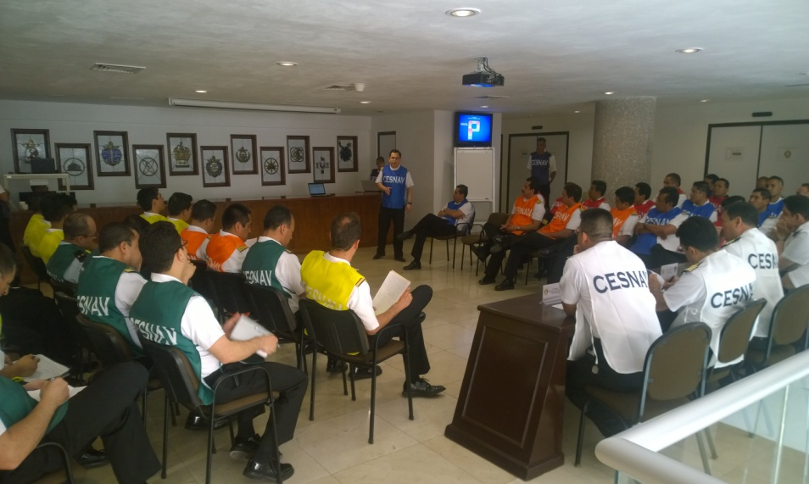
OBJECTIVES OF THE DIPLOMA IN INCIDENT COMMAND SYSTEM:
Provide them with a functional tool for the administration and organization of any type of emergency, incident or event of great magnitude that requires the coordinated intervention of two or more departments or agencies at any level of government.
Standardize response procedures in an organized manner in the event of any type of emergency.
Experience the flexibility of the ICS through hypothetical scenarios.
Implement the inter-institutional and interdisciplinary exchange of information between the different levels of Federal, State, local government, Academia, Industry and the civilian community.

Slide 6
ACTIVITIES
DAY ONE
15 JUNE 2021
HORA | ACTIVIDAD | LUGAR
09:00-11:00 | OBJECTIVES AND RULES OF THE EXERCISE, INTEGRATION OF THE SECTIONS, DESCRIPTION OF THE ACTIVITIES OF THE 3 DAYS. | CONFERENCE ROOM
11:00-11:30 | INCIDENT INFORMATION MEETING | CONFERENCE ROOM
11:30-12:00 | INITIAL MEETING OF THE UNIFIED COMMAND
12:00-12:30 | OBJECTIVES MEETING
13:00-14:30 | LUNCH
14:30-15:00 | RESUME ACTIVITIES | CONFERENCE ROOM
15:00-16:00 | INFORMATION MEETING SECTION CHIEFS | SALA ZOOM PRINCIPAL
16:00-17:00 | HOTWASH | CONFERENCE ROOM
REUNION DE TACTICAS
PREPARACION PARA LA REUNION DE PLANEACION
REUNION DE PLANEACION
PREPARACION PARA LA REUNION DE TACTICAS
PREPARACION Y APROBACION DEL P.A.I.
15:00-16:00
REUNION INFORMATIVA JEFES SECCION
REUNION INFORMATIVA DE OPERACIONES
12:00-12:30
REUNION DE OBJETIVOS M.U/C.I./J-OPS.
INICIA NUEVO CICLO OPERACIONAL SE ANALIZAN PLANES Y EVALUAN PROGRESOS
09:30-10:00
REUNION INICIAL DEL MANDO UNIFICADO
11:30-12:00
REUNION INFORMATIVA DEL INCIDENTE
S.M.I. 201
11:00-11:30
RESPUESTA INICIAL Y VALORACION
NOTIFICACION
INCIDENTE
Red: By the tutors
Green: Independently
Blue: By the students
Per ICS Manual 2014.

Slide 7
ACTIVITIES
DAY 2
16 JUNE 2021
HORA | ACTIVIDAD | LUGAR
09:00-09:30 | FEEDBACK | CONFERENCE ROOM
09:30-10:30 | PREPARATION FOR TACTICS MEETING | CUBICLES
10:30-11:30 | TACTICS MEETING | CONFERENCE ROOM
11:30-12:30 | PREPARATION FOR PLANNING MEETING | CUBICLES
12:30-13:00 | PLANNING MEETING | CONFERENCE ROOM
13:00-14:30 | LUNCH
14:30-15:00 | RESUME ACTIVITIES | CONFERENCE ROOM
15:00-16:30 | PREPARATION AND APPROVAL OF INCIDENT ACTION PLAN (IAP) | CUBICLES
16:30-17:00 | FEEDBACK | CONFERENCE ROOM
11:30-12:30
12:30-13:00
10:30-11:30
REUNION DE TACTICAS
PREPARACION PARA LA REUNION DE PLANEACION
REUNION DE PLANEACION
09:30-10:30
PREPARACION PARA LA REUNION DE TACTICAS
PREPARACION Y APROBACION DEL P.A.I.
15:00-16:30
REUNION INFORMATIVA JEFES SECCION
REUNION INFORMATIVA DE OPERACIONES
REUNION DE OBJETIVOS M.U/C.I./J-OPS.
INICIA NUEVO CICLO OPERACIONAL SE ANALIZAN PLANES Y EVALUAN PROGRESOS
09:30-10:00
REUNION INICIAL DEL MANDO UNIFICADO
REUNION INFORMATIVA DEL INCIDENTE
S.M.I. 201
Source: ICS Manual 2014
RESPUESTA INICIAL Y VALORACION
NOTIFICACION
INCIDENTE
Red: By the tutors
Green: Independently
Blue: By the students

Slide 8
ACTIVITIES
DAY 3
17 JUNE 2021
REUNION DE TACTICAS
PREPARACION PARA LA REUNION DE PLANEACION
REUNION DE PLANEACION
HORA | ACTIVIDAD | LUGAR
09:00-09:30 | FEEDBACK | CONFERENCE ROOM
09:30-10:30 | INFORMATION MEETING ON OPERATIONS | CONFERENCE ROOM
10:30-13:00 | NEW OPERATIONAL CYCLE BEGINS WATCH TURNOVER
13:00-14:30 | LUNCH
14:30-17:00 | EXERCISE CONCLUDES | CONFERENCE ROOM
PREPARACION PARA LA REUNION DE TACTICAS
PREPARACION Y APROBACION DEL P.A.I.
REUNION INFORMATIVA JEFES SECCION
REUNION INFORMATIVA DE OPERACIONES
09:30-10:30
REUNION DE OBJETIVOS M.U/C.I./J-OPS.
INICIA NUEVO CICLO OPERACIONAL SE ANALIZAN PLANES Y EVALUAN PROGRESOS
10:30-13:00
09:30-10:00
REUNION INICIAL DEL MANDO UNIFICADO
REUNION INFORMATIVA DEL INCIDENTE
S.M.I. 201
RESPUESTA INICIAL Y VALORACION
Red: By the tutors
Green: Independently
Blue: By the students
NOTIFICACION
INCIDENTE
Source: ICS Manual 2014.

Slide 9
SITUATION
"EFFECTS CAUSED BY HURRICANE KARL"

Slide 10
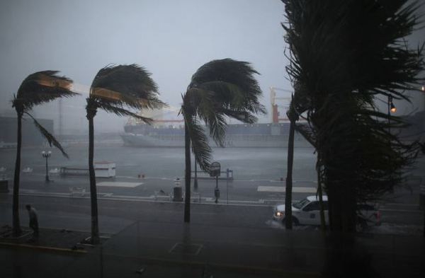
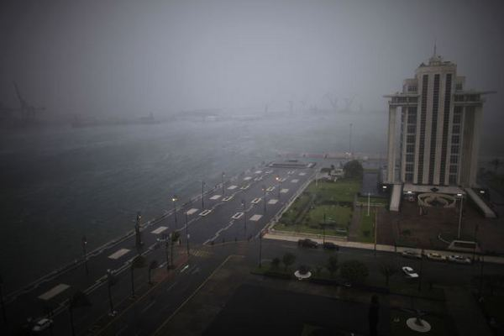
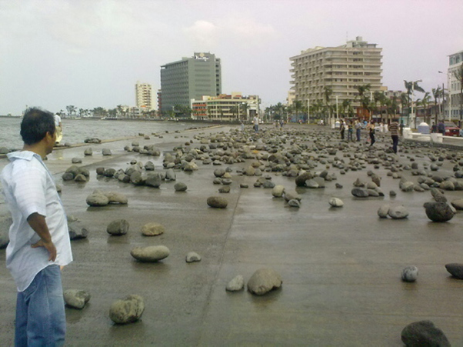
STAGE: "EFFECTS CAUSED BY KARL"
June 15, 2021, 0900. Hurricane Karl makes landfall, category 3, 15 KM north of the Port of Veracruz, with sustained winds of 195 KM per hour and gusts of up to 250 KM per hour

Slide 11
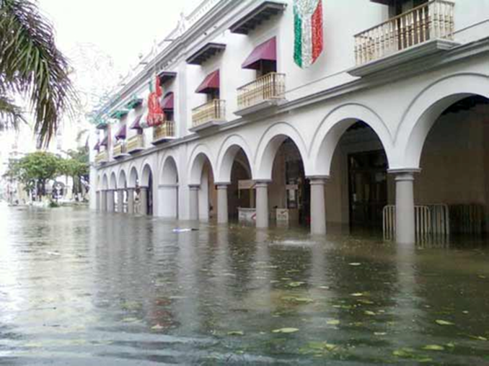
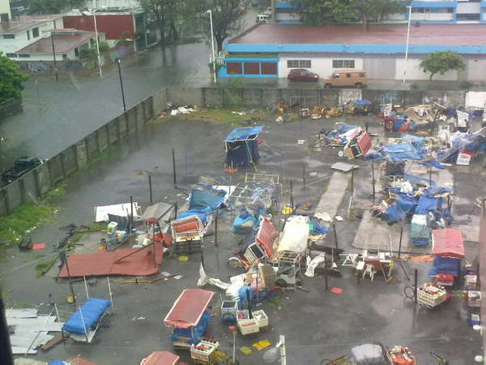

Slide 12
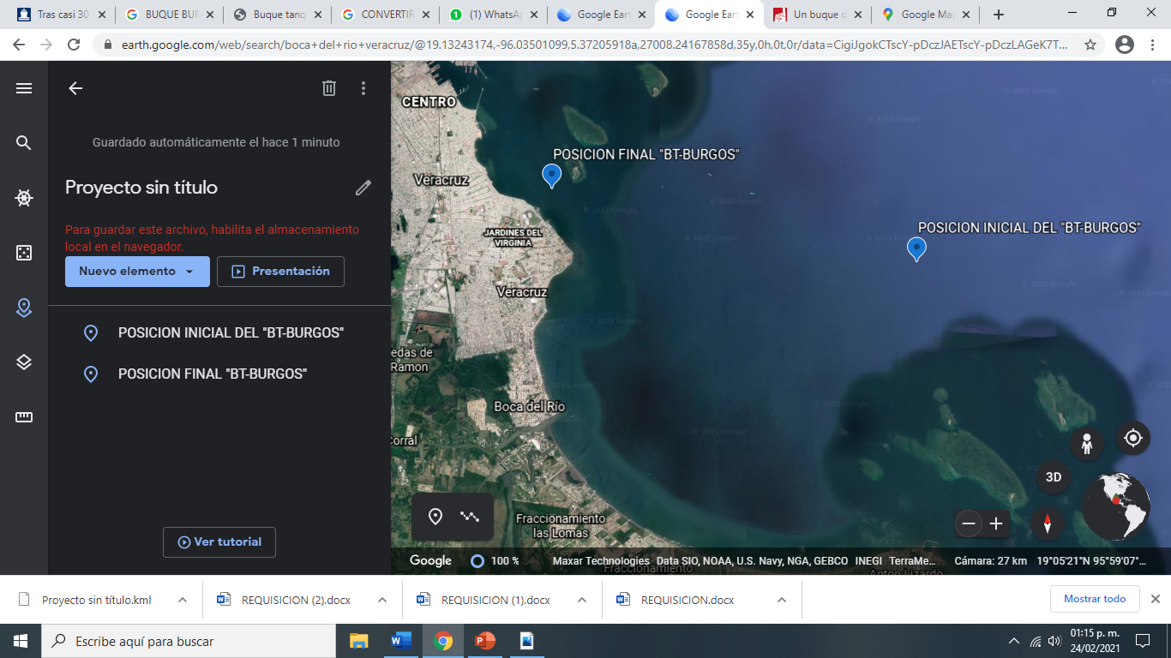
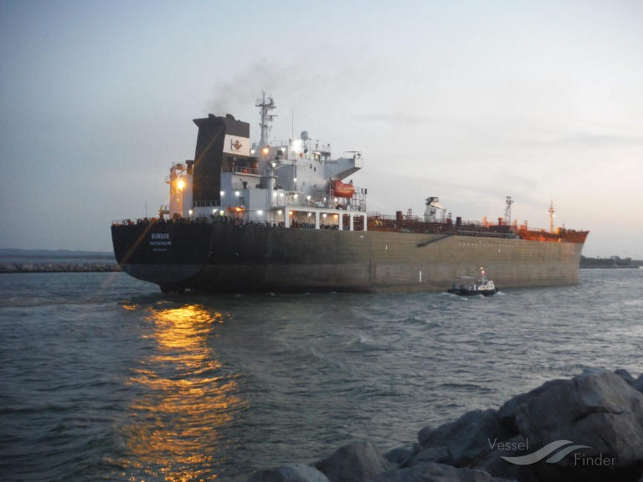
Escenario del Incidente del Buque Tanque “BURGOS”
At the same time, this meteorological phenomenon caused damage to the T/V BURGOS with 31 crew members, from the Pajaritos Lagoon Maritime Terminal in Coatzacoalcos, with 81K barrels of diesel, 71K barrels of Magna gasoline.
Vessel loses engine propulsion while underway approx. 7 NM from Boca del Río Veracruz, its anchoring system not working and being dragged by the wind and waves toward the beach between the breakwater of the Hotel Punta Azul and the Isla de Sacrificios.

Slide 13
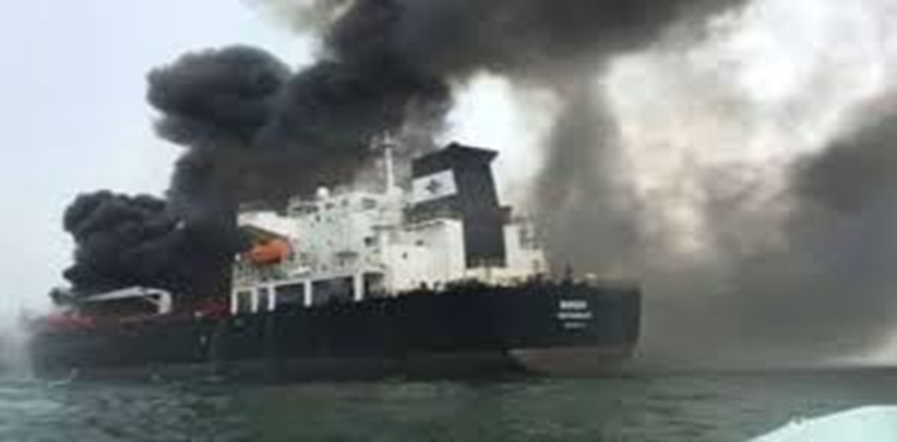


Slide 14
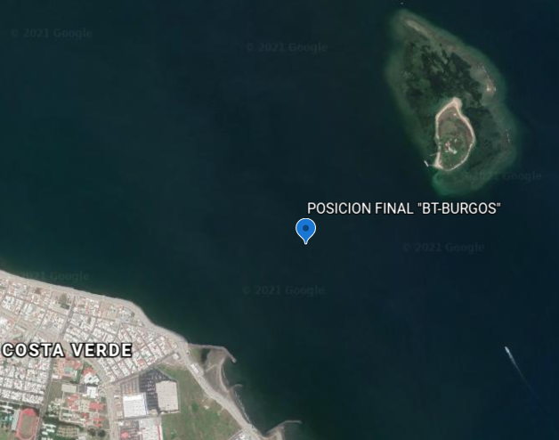
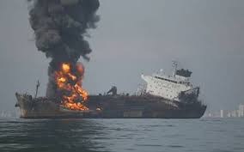
“ISLA DE SACRIFICIOS” OF THE VERACRUZANO REEF SYSTEM NATIONAL MARINE PARK
0.39 MN
0.38 MN
BOCA DEL RIO VERACRUZ BEACHES

Slide 15
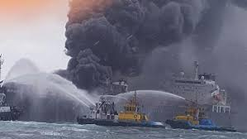

Slide 16
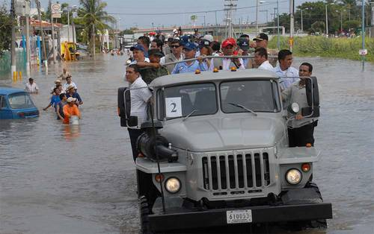
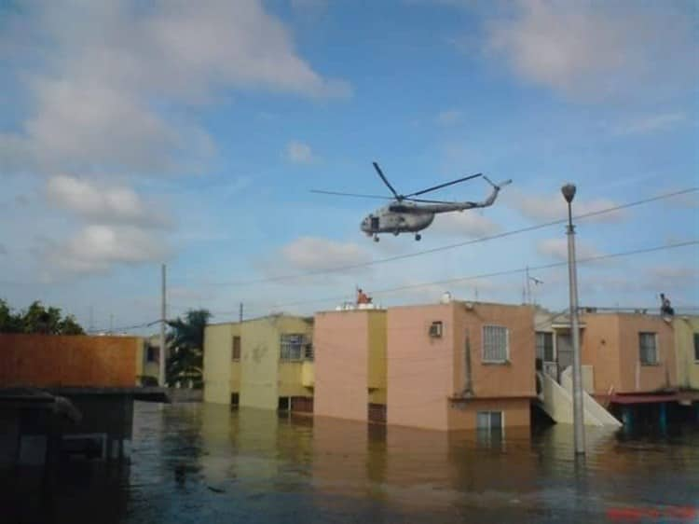
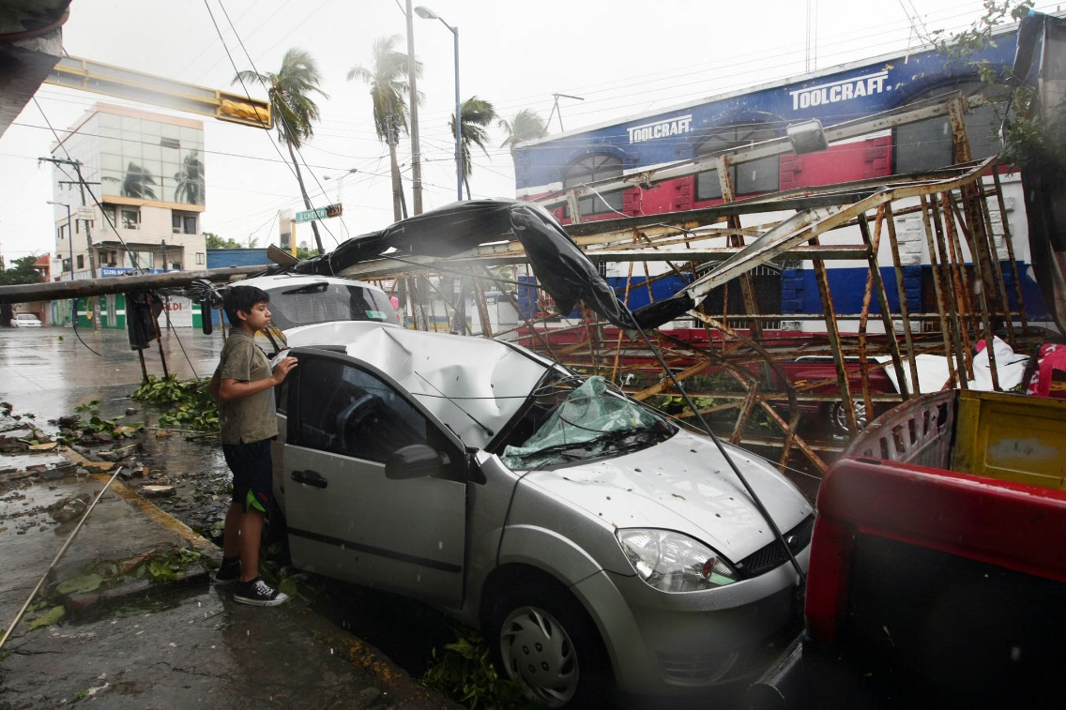
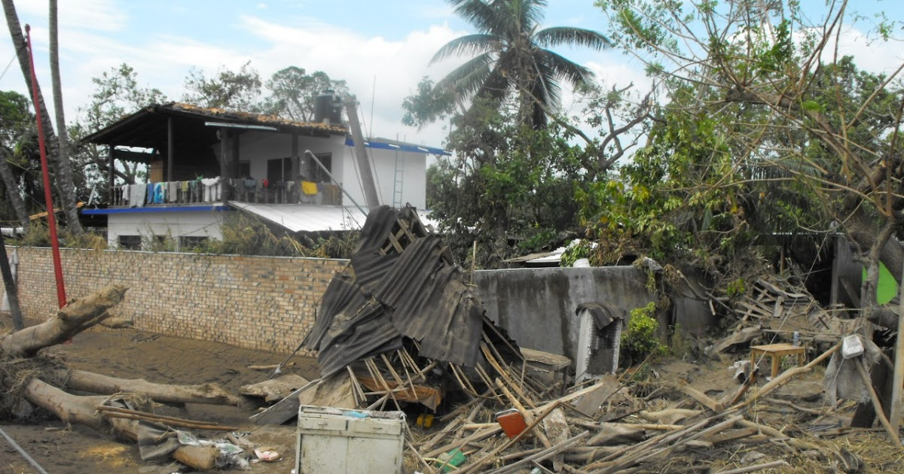
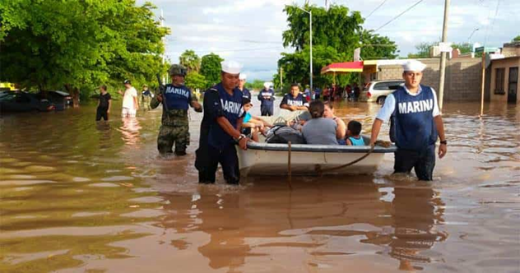
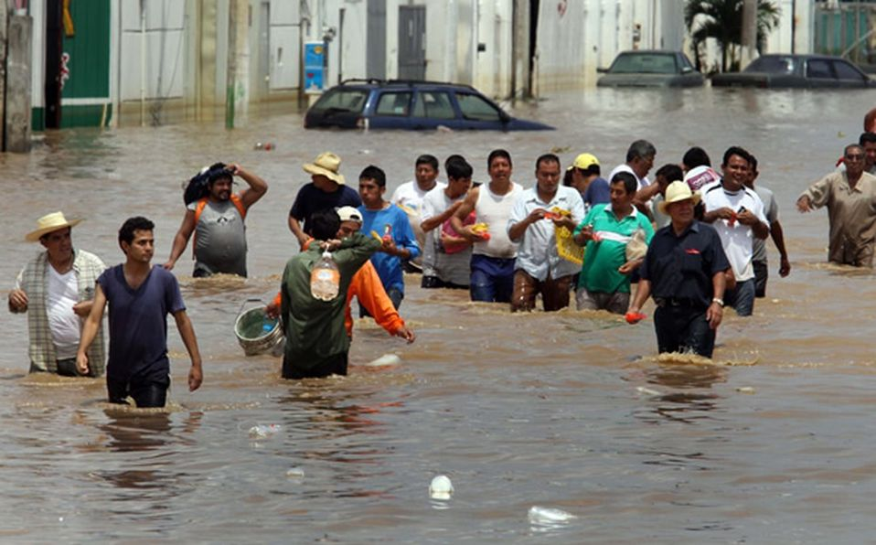
16 June
Supervision of the area where the hurricane impacted and rivers overflowed.

Slide 17

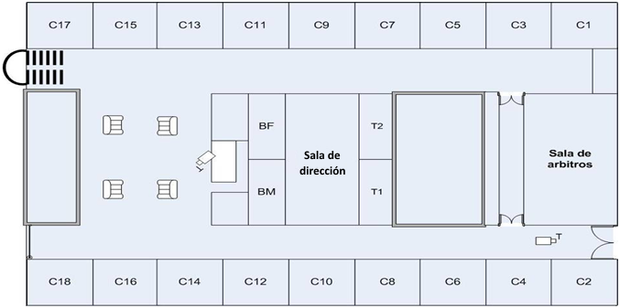


  POSITION DISTRIBUTION AND GENERAL INFORMATION
C1
C-13
C-11
C-9
C-7
C-5
C-3
C-1
5
C
C1
OBSERVERS
FIN/ADMIN SECTION
LOGISTICS SECTION
PRESS VIP
Impresora
LOG/ADM
UNIFIED
COMMAND
(UC)
CONFERENCE ROOM CON EL MU
CONF
ROOM
OPS/PLANNING
PLANNING SECTION
OPERATIONS SECTION
COACHES
C-14
C-12
C-10
C-8
C-6
C-4
C-2
C12
30

Slide 18

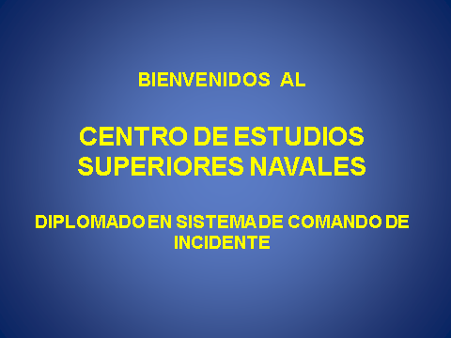
COMUNICACIONES INTERNAS
REMOTE MESSAGING NETWORK THROUGH
WALL-RECESSED TELEVISION SCREENS

Slide 19
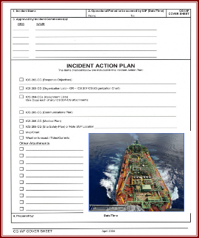
DELIVERABLES
Prepare presentations, videos, graphics for scheduled meetings per operational period before the Unified Command.
Incident Action Plan (IAP).

Slide 20

Thank you
for your attention!

