Slide 1

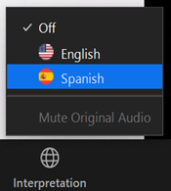
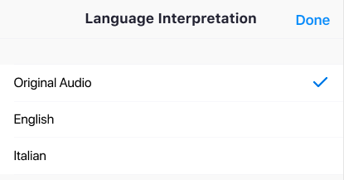
Interpretation | Interpretación
Computers
In your meeting/webinar controls (bottom bar), click Interpretation.
Click “English”
Computadoras
En los controles de la reunión (barra inferior), haga click en “Interpretation” o Interpretación
Seleccione “Spanish” (español)
Cell Phones, Tablets
In your meeting controls, tap ... More.
Tap Language Interpretation. Tap English
Celular, tableta (móvil)
En los controles de la reunión, haga click en … “More” (Más)
Seleccione “Language Interpretation” / Seleccione Spanish
Notes:
Today we are offering interpretation services in English and Spanish. I will speak in English first.
Hoy ofrecemos servicios de interpretación en inglés y español. Hablo primero en inglés.
English:
In green you will see how to access interpretation on a computer and orange a cellphone or tablet.
For the computer in the controls click “interpretation“ or the globe and select your language.
For the cellphones or tablet click the three dots or more and select your language.
Spanish:
En verde verás cómo acceder a la interpretación en un ordenador y en anaranjada en un móvil o tableta.
Para el ordenador en los controles haga clic en "interpretación" y seleccione su idioma.
Para los móviles o tabletas haga clic en los tres puntos o más y seleccione su idioma

Slide 2





Zoom Meeting Best Practices
Buenas Prácticas para Sesiones en Zoom
Use “raise hand” or chat feature to indicate you would like to comment/speak
Utilice la función de “levantar la mano” o la ventana de chat para indicar que
desea hablar/comentar
Turn off microphone when you are not talking
Apague su micrófono cuando no esté hablando
My name is…
Yo soy..
OPTIONAL
OPCIONAL
    Mute Original Audio if you would not like to hear the (Spanish) original audio while it is being interpreted into English
    Seleccione "Mute Original Audio” para no escuchar de fondo el idioma original
Notes:
Automatically muted
KEY MESSAGE (EMILY):
Throughout the session, please put comments in the chat or raise your hand.
If possible, please save questions for after the speaker presents.
Remember to say your name and what ngo, university or agency you’re with to help everyone know who you’re.
Please mute when not talking.
Reminder, for interpretation you need to be on ZOOM not the phone. If you don’t want to hear the original audio because it is too distracting, please hit “mute original audio”

Slide 3


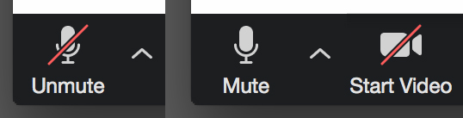
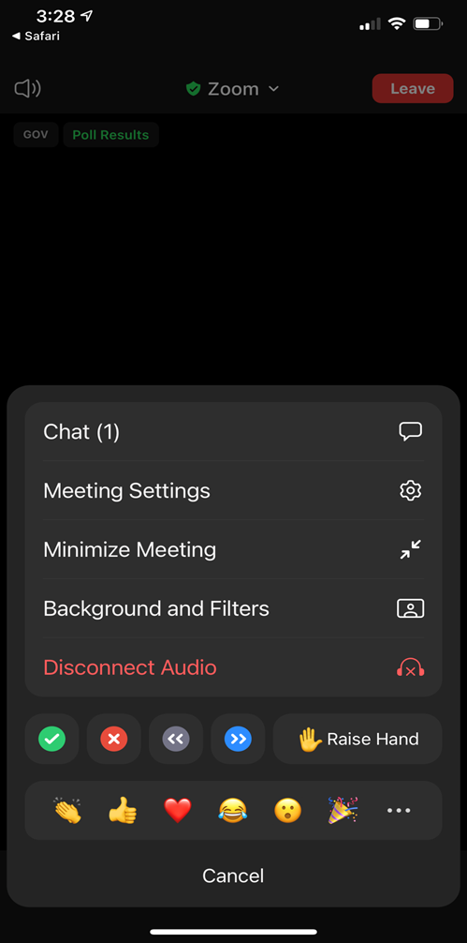
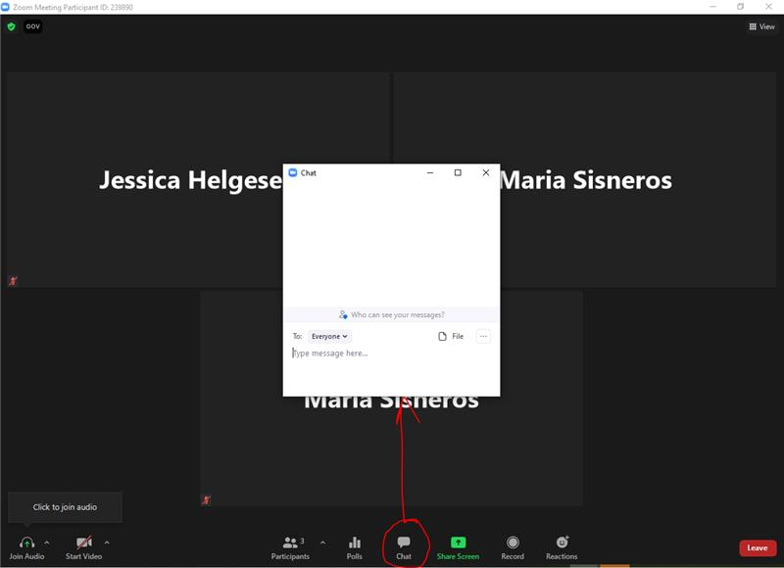


Questions | Preguntas
Visit toolbar to unmute
Use la barra de herramientas para activar el micrófono
Cellphone | Movil
Computer | Computadora
Chat
Mensaje
Chat
Mensaje
Raise hand
Levantar la mano
Raise hand
Levantar la mano
Notes:
If you have question that you want to share verbally, please raise your hand and we will call on you to unmute. You click the microphone symbol in the toolbar to unmute.
If you are on a cellphone you click the three dots and click chat to write a comment. In his same space you can raise your hand if you’d like to speak.
If you are on a computer, go to the toolbar, hit the chat button to add your comments/questions and if you want to speak, go to “reactions” to raise your hand.

